Slide 1


Writing Bid or Purchasing Specifications
The Key Element to Successful Purchasing
1 hour Professional Standards Training
Notes:
This presentation will provide you with important elements to consider when drafting specifications. This presentation credits 1 hours towards the professional standards requirement.

Slide 2

What is a Specification (or spec)?
A specification (or spec) is a description of the product or service a user seeks to procure
AND
A description of what a bidder/ vendor must offer to be considered for an award
Notes:
What is a specification?
A specification ( or Spec) is a description of the product or service a user seeks to procure and a description of what a bidder must offer to be considered for an award. It contains standards relating to the quality, appearance and delivery of the product: conditions under which it is to be grown or produced, packed, stored and transported; explicit descriptions regarding its size, weight, color and nutrient content; details of the inspection process; and specific packing and labeling requirements.

Slide 3

Why have Specifications?
Quality and cost control standards
Avoid misunderstandings between suppliers, buyers, users and other district officials
In the absence of the buyer/ purchasing agent, they allow someone else to fill in
They are essential when you need to set down all relevant aspects of something you want to purchase, to submit a list of these aspects to two or more suppliers, and ask these suppliers to indicate (bid) the price they will charge for the specific product or service.
Helps the vendor understand exactly what you want so a competitive price can be quoted
They are required for the Child Nutrition Program
Notes:
Specs have several basic purposes and advantages, the primary ones being that:
They serve as quality control standards and as cost control standards (in these respects, specs are important aspects of an operation’s overall control system)
They help avoid misunderstandings between suppliers, buyers/ purchasing agents, users and other district officials by detailing exactly what is being requested.
In a buyer’s absence, they allow someone else to fill in temporarily (because they will know exactly what to expect from the purchased item)
They are essential when a district wants to set down all relevant aspect of something it wants to purchase, to submit a list of these aspects to two or more suppliers, and to ask these suppliers to indicate (bid) the price they will charge for the specific product or service.
They help vendors understand exactly what you want to purchase so a competitive price can be quoted. (Comparing apples to apples, so to speak)
They are REQUIRED for the Child Nutrition Program
In short, specs are sounding boards for your ideas through which you detail every relevant consideration.

Slide 4

What is the goal of having and using product Specs?
The goal when creating product specifications is to be:
Specific enough for vendors to provide exactly the product needed by the sponsor
Not so specific as to limit the number of vendors that can provide the specified product
Notes:
The goal when creating product specifications is to be:
Specific enough for a vendor to provide exactly the product needed by the sponsor, but not so specific as to limit the number of vendors that can provide the specified product.
Clear, concise specifications describe the required characteristics of the goods and/or services. If a known brand name or product is used as the quality standard, regulations require the specifications in the bid document to say brand name or equivalent. For example, you want to purchase chicken nuggets and really want a particular nugget by Tyson. In the specifications, you are not allowed to name Tyson specifically, without saying Tyson or equivalent.

Slide 5

What influences the types of information included on the spec?
1) Time and money available
2) Production systems/ equipment available
3) Storage facilities
4) Employee skill levels
5) Menu requirements
6) Budgetary limitations
7) Service style
Notes:
Several factors must be assessed before determining what information to include on a specification.
Time and money available- How much detail do you want to have listed for products? Do you have time to research all of your options? Knowing what’s available can save you money in the long run, as you’ll be able to get the product that best fits your needs.
Production systems/ equipment- what kind of equipment do you have available to you? If you only have reheating equipment, you will not want to purchase a cook from raw product.
Storage facilities- if your freezer space is limited, a buyer may have to purchase larger amounts of fresh vegetables, for example. A specification will carry this reminder.
Employee skill level- generally, the lower the skill level, the more buyers tend to rely on portion controlled and other convenience foods
Menu requirements- For example, chicken nuggets on the menu forces a buyer to include the words “chicken nuggets” on the specification.
Budgetary limitations- School meal budgets are very tight. This fact may force a buyer to include cost limits for some or all food specifications.
Service style- cafeteria style service needs food items that have a relatively long hot- holding life since the food many remain on a steam table for a while. This type of information might be included on the specs, especially the specs for prepared food entrees.

Slide 6

Writing Bid Specifications
What Are The First Two Documents You Need To Have Before You Begin To Write Bid Specifications?
1. CYCLE MENUS
2. STANDARDIZED RECIPES
Notes:
The reasons you need cycle menus and standardized recipes are by having a rotating menu and using the same recipe every time, you will know exactly which products you will need to order and how frequently. This will make the spec writing process go more quickly because you can use the same food items in more than one recipe.

Slide 7

Writing Bid Specifications- The Details
What is the Definition of the item to be purchased?
What are Specification Characteristics of the item to be purchased?
How to Develop Bid Specifications?
Notes:
We will be addressing the following topics:
- What is the definition of the item to be purchased? It’s not as simple as saying “apples”
- What are the specific characteristics of the time to be purchased? Are they red apples?
- How do we develop bid specifications based on what we need?

Slide 8

Specifications Definition
The Physical Descriptions of Products Material, and/or Process
Words to describe:
Color
Size
Packaging for the Product
Numbers or Letters to Describe:
Grade
Weight
Quantity
Notes:
Writing an adequate product specification is not as easy as writing 8 oz. milk carton. We will discuss this in detail in the next slides

Slide 9
Product Specification Information
Name of Product
Description of the Product
Case Pack and Weight
Minimum and Maximum Size and Pieces
Main Ingredient(s)
Other Product Ingredients
Prohibited Ingredients
Nutritional Standards
Unit on Which Award is Made
Quality Indicators
Meal Pattern Requirements/Child Nutrition (CN) Label
Notes:
This slide lists the information that should be part of each items bid spec. We will discuss in detail in coming slides

Slide 10
Product Specification Information- Name of the Product
Name of the Product
WG Breaded Chicken Nuggets
Milk, Fluid, Unflavored
Apples, Red Delicious
WG Breaded Cod
Beans, Green
Cups, Foam
Notes:
The product name would seem self-explanatory, however there are hundreds of different chicken nuggets, which is not necessarily the same as a chicken fritter. Make sure you know what you are asking for.

Slide 11

Product Specification Information- Description of the Product
Description of the Product
Clearly Identify the product listed
  Type
  Cut, shape
  Portion size
  Precooked weight
  Frozen, fresh or Dry
Notes:
In the case of chicken nuggets, what type of chicken nuggets are they? Are they spicy, southern, breaded, battered? Do you want a particular shape, such as dinosaur or star shaped nuggets? How big is the portion size? Are they pre-cooked and just need to re-heated or are they raw? Do they come to you frozen?

Slide 12
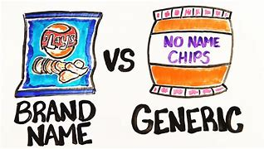
Product Specification Information- Description of the Product Continued
A vendor will need a complete description of the product you are looking to purchase.
If specifying brand, SFA must allow equivalent
When specifying a brand you must include:
  Manufacturer’s name
  Manufacturer’s name for product (e.g. rounds, triangles, etc.)
  Manufacturer’s code number
  Manufacturer’s pack size
Notes:
If a brand name is specified, then you must allow an equal product to be substituted, to ensure maximum free and open competition. For example, if a fish product from a specific company is listed, the type of fish would need to be identified (e.g., tilapia), the cut of fish (e.g., filet), and the portion size, the precooked weight, and whether it is frozen, etc.
If you are specifying a brand, in addition to the above information you should also include:
Manufacturer’s name
Manufacturer’s name for the product (e.g. rounds, triangles, etc.),
Manufacturer’s code number
Manufacturer’s pack size
This will allow all vendors to compare “apples to apples” with the product they may sell.

Slide 13
Product Specification Information- Product Packaging
Describes How the Items is Packaged:
6/#10 Cans
4/5# Loaves or Not to Exceed 25#
Individually Wrapped
48, 72, 96 to the Case
Cases Can’t Exceed 30 Pounds
Notes:
When writing specifications, case pack and weight are important to remember.
How should the item be packaged and how big are the cases? As an example, this can be as simple as specifying 6/#10 cans per case, or 4/5# loaves, or case not to exceed 25#.

Slide 14
Product Specification Information- Product Sizes
Minimum?
Maximum?
Example:
  Minimum serving 3.9 ounces
  Maximum serving 4.1 ounces
  6 nuggets per 5-ounce portion
Notes:
Describe the minimum and maximum size of the product you would be willing to accept
What is the minimum size of the product? What is the maximum size of the product?
Some examples may include:
Each serving must weigh a minimum of 3.9 ounces and cannot exceed 4.1 ounces
6 nuggets per 5- ounce portion

Slide 15
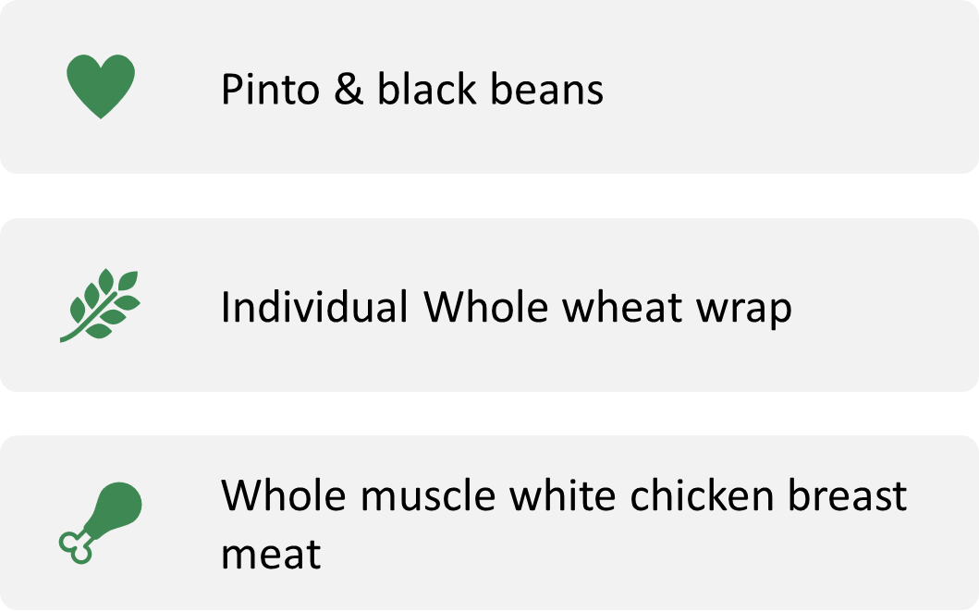
Product Specification Information- Main Ingredients
Specify the Main Ingredients Desired
Notes:
What are the main ingredients for the product you’re looking to purchase? Products may have a lot of ingredients, but everything always has a primary ingredient and often times that ingredient has a quality indicator.
Some possible examples may include:
Pinto beans
Black beans
Whole muscle white chicken breast meat
Natural proportion chicken meat
A quality indicator example could be whole muscle white chicken meat versus natural proportion chicken meat (50/50 white and dark meat blend).

Slide 16
Product Specification Information- Other Product Ingredients
Other Product Ingredients
Describes What other ingredients can be included:
◦ Whole-grain Pasta
◦ Whole-wheat Flour
◦ Spices
◦ Emulsifiers
◦ Soy Proteins
◦ Vegetable Purees
◦ Thickening Agents
Notes:
Describe what other ingredients are included in the product. Some possible examples could include: whole-grain pasta, whole-wheat flour, spices, emulsifiers, vegetable purees, and thickening agents.
If you don’t specifically list something, then you should not expect it to be in the product ingredient. However, if you are too specific, there may not be a product to meet the specifications you have written.

Slide 17

Product Specification Information- Prohibited Ingredients
Prohibited Ingredients
What ingredients are prohibited?
Examples:
  Food additives
  Artificial colors and flavors
  Hydrogenated fat
  Monosodium glutamate (MSG)
  Assorted allergens
  Soy
  Egg
  Peanuts
Notes:
What ingredients are prohibited?
When creating a specification, indicate what ingredients are prohibited in the product (e.g., food additives, artificial colors and flavors, hydrogenated fat, Monosodium glutamate (MSG), assorted allergens, soy, egg, and peanuts, product cannot contain pork, fish by-products, soy derivatives, or food coloring) are a few examples.
If there is ever a question about the ingredients of an item, always refer to an official ingredient label.

Slide 18
Product Specification Information- Nutritional Standards
What are the nutritional standards for the product?
Examples
Pinto beans and black beans combined must provide a 1.5 oz. equivalent for the Meat/Meat Alternate requirement for CNP
Whole grain-rich tortilla must provide a 1.5 oz. equivalent for the Grains component for CNP.
Notes:
The nutrition standards are the minimum or maximum nutrient or ingredient requirements or limitations.
Some possible examples could include:
Pinto beans and Black beans combined must provide a 1.5- ounce equivalent for the Meat/Meat Alternate requirement of the CNP
Whole grain-rich tortilla must provide a 1.5- ounce equivalent for the Grains component for CNP.
Regardless of what you specify, products must meet CN meal pattern requirements to be claimed for meal reimbursement.

Slide 19
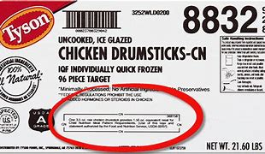
Product Specification Information- Crediting Documentation
Meal Pattern Requirements/Child Nutrition (CN) Label and Product Formulation Statements
Does the product contain certain meal components?
Does the product have a CN label and/or a product formulation statement?
Notes:
Specify when you need documentations that proves the product meets CN meal pattern requirements, including a CN label and product formulation statement.

Slide 20
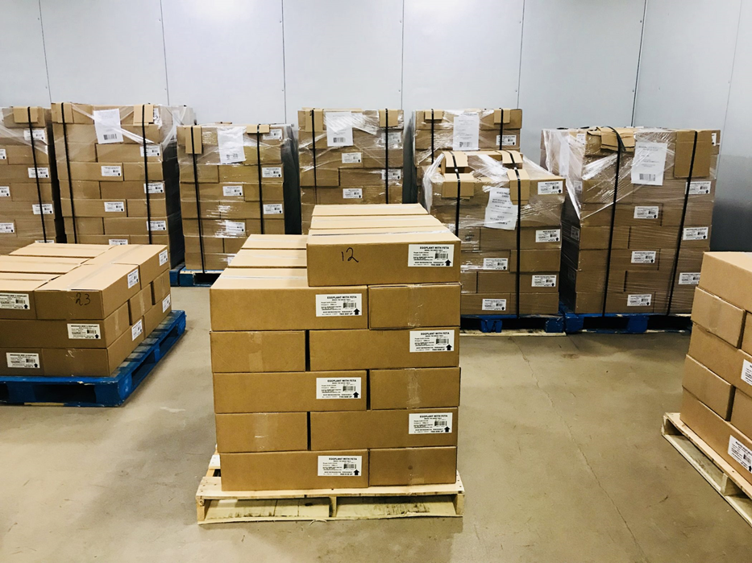
Product Specification Information-Awards are based on ?
Unit on Which the Award is Made
How will you determine which company is offering the best price for an acceptable product?
Examples are:
Price by the case
Price by the serving size
Price per pound
Notes:
How will the SFA/ buyer/ purchasing agent determine which company is offering the best price for an acceptable product? How will the unit price be determined for an acceptable product?
Some possible examples could include:
Price by the case
Price by the serving size
Price per pound

Slide 21

Product Specification Information- Quality Indicators
Quality Indicators
Fruits and Vegetables
Grade A or U.S. Fancy = First Quality Private Label
Grade B or U.S. Choice = Second Quality Private Label
Veg- Grade B or U.S. Extra Standard = Second Quality Private Label
Grade C or U.S. Standard = Third Quality Private Label
Notes:
Quality Indicators
What are some quality indicators for a particular product?
Some food items are very basic and are either defined by their single-ingredient, such as iodized salt, or by their standard of identity, such as yogurt.
Standards of Identity (SOI) for foods are federal requirements that define what a food product is, its name, and the ingredients that must or may be used in the manufacture of that food. SOI’s protect consumers by ensuring labels accurately describe the products contained within the package. For example, an imitation spread cannot be called mayonnaise, and a non-dairy frozen dessert cannot be called ice cream.
Grade standards are USDA quality standards and are based on measurable attributes that describe the value and utility of the products. U.S. Grade Standards provide a uniform language for describing the quality and condition for meat, poultry, fresh fruits and vegetables, and processed fruits and vegetables. While safety inspections are mandatory, the federal government does not require that all food products are graded. Know your grade. Produce is graded based on the amount of imperfections that is allowed. It is up to you to determine what you are willing to except. If you order bananas for example, there are varying stages of ripeness. In stage 1-3 you will be receiving a fairly green banana. If it is in stage 3-6 it will be green tipped and a 7+ will be ripe. It’s important you let your vendor know how you want to receive your product.
Many food processors participate in grading voluntarily because their customers list grade requirements in their specifications. Grade standards, such as USDA Prime and USDA Choice, are based on the product’s taste, texture, and appearance

Slide 22
Product Specification Information- Quality Indicators, Continued
Quality Indicators, continued
Due to the diversity in the nature of produce products, specific standards have been established for individual products.
Including grade standards on the solicitation document specification ensures the quality of produce purchased will meet the needs of your nutrition program.
Notes:
Quality Indicators continued
Due to the diversity in the nature of produce products, specific standards have been established for individual products. For example, the U.S. Standard for fresh apples is identified as U.S. Extra Fancy, U.S. Fancy, U.S. No. 1, U.S. Utility, or Combination grade. For fresh tomatoes off the vine, the U. S. Standard is U.S. No. 1 or U.S. No. 2.
Including grade standards on the solicitation document specification ensures the quality of produce purchased will meet the needs of your nutrition program. Some possible descriptions may include: Grade A, Prime, Choice, or Fancy. Additional examples include private label or manufacturer’s brands are subject to internal quality screening.

Slide 23
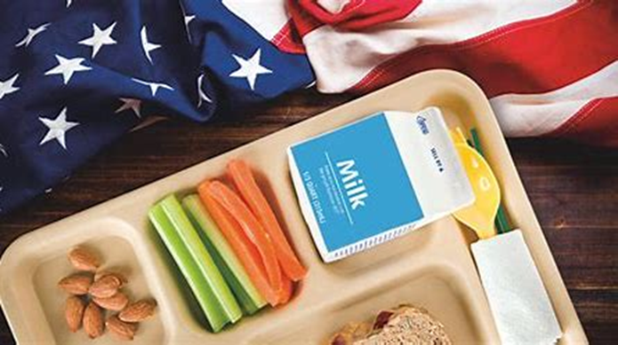
Product Specification Information- Buy American
Buy American
The Buy American Provision is a very important provision in the National School Lunch and Breakfast Programs (NSLP/SBP). This provision does not apply to Child and Adult Care Food Program (CACFP) sponsors who are not school food authorities operating the NSLP/SBP.
This provision requires that a school food authority purchase, to the maximum extent practicable, domestic commodities or products. The term “domestic commodity or product” means an agricultural commodity that is produced in the United States or a food product that is processed in the United States substantially using agricultural commodities that are produced in the United States
Notes:
When writing your specifications, you will need to include that the agricultural products and commodities you are interested in procuring are domestically grown and/ or processed in the United States.

Slide 24
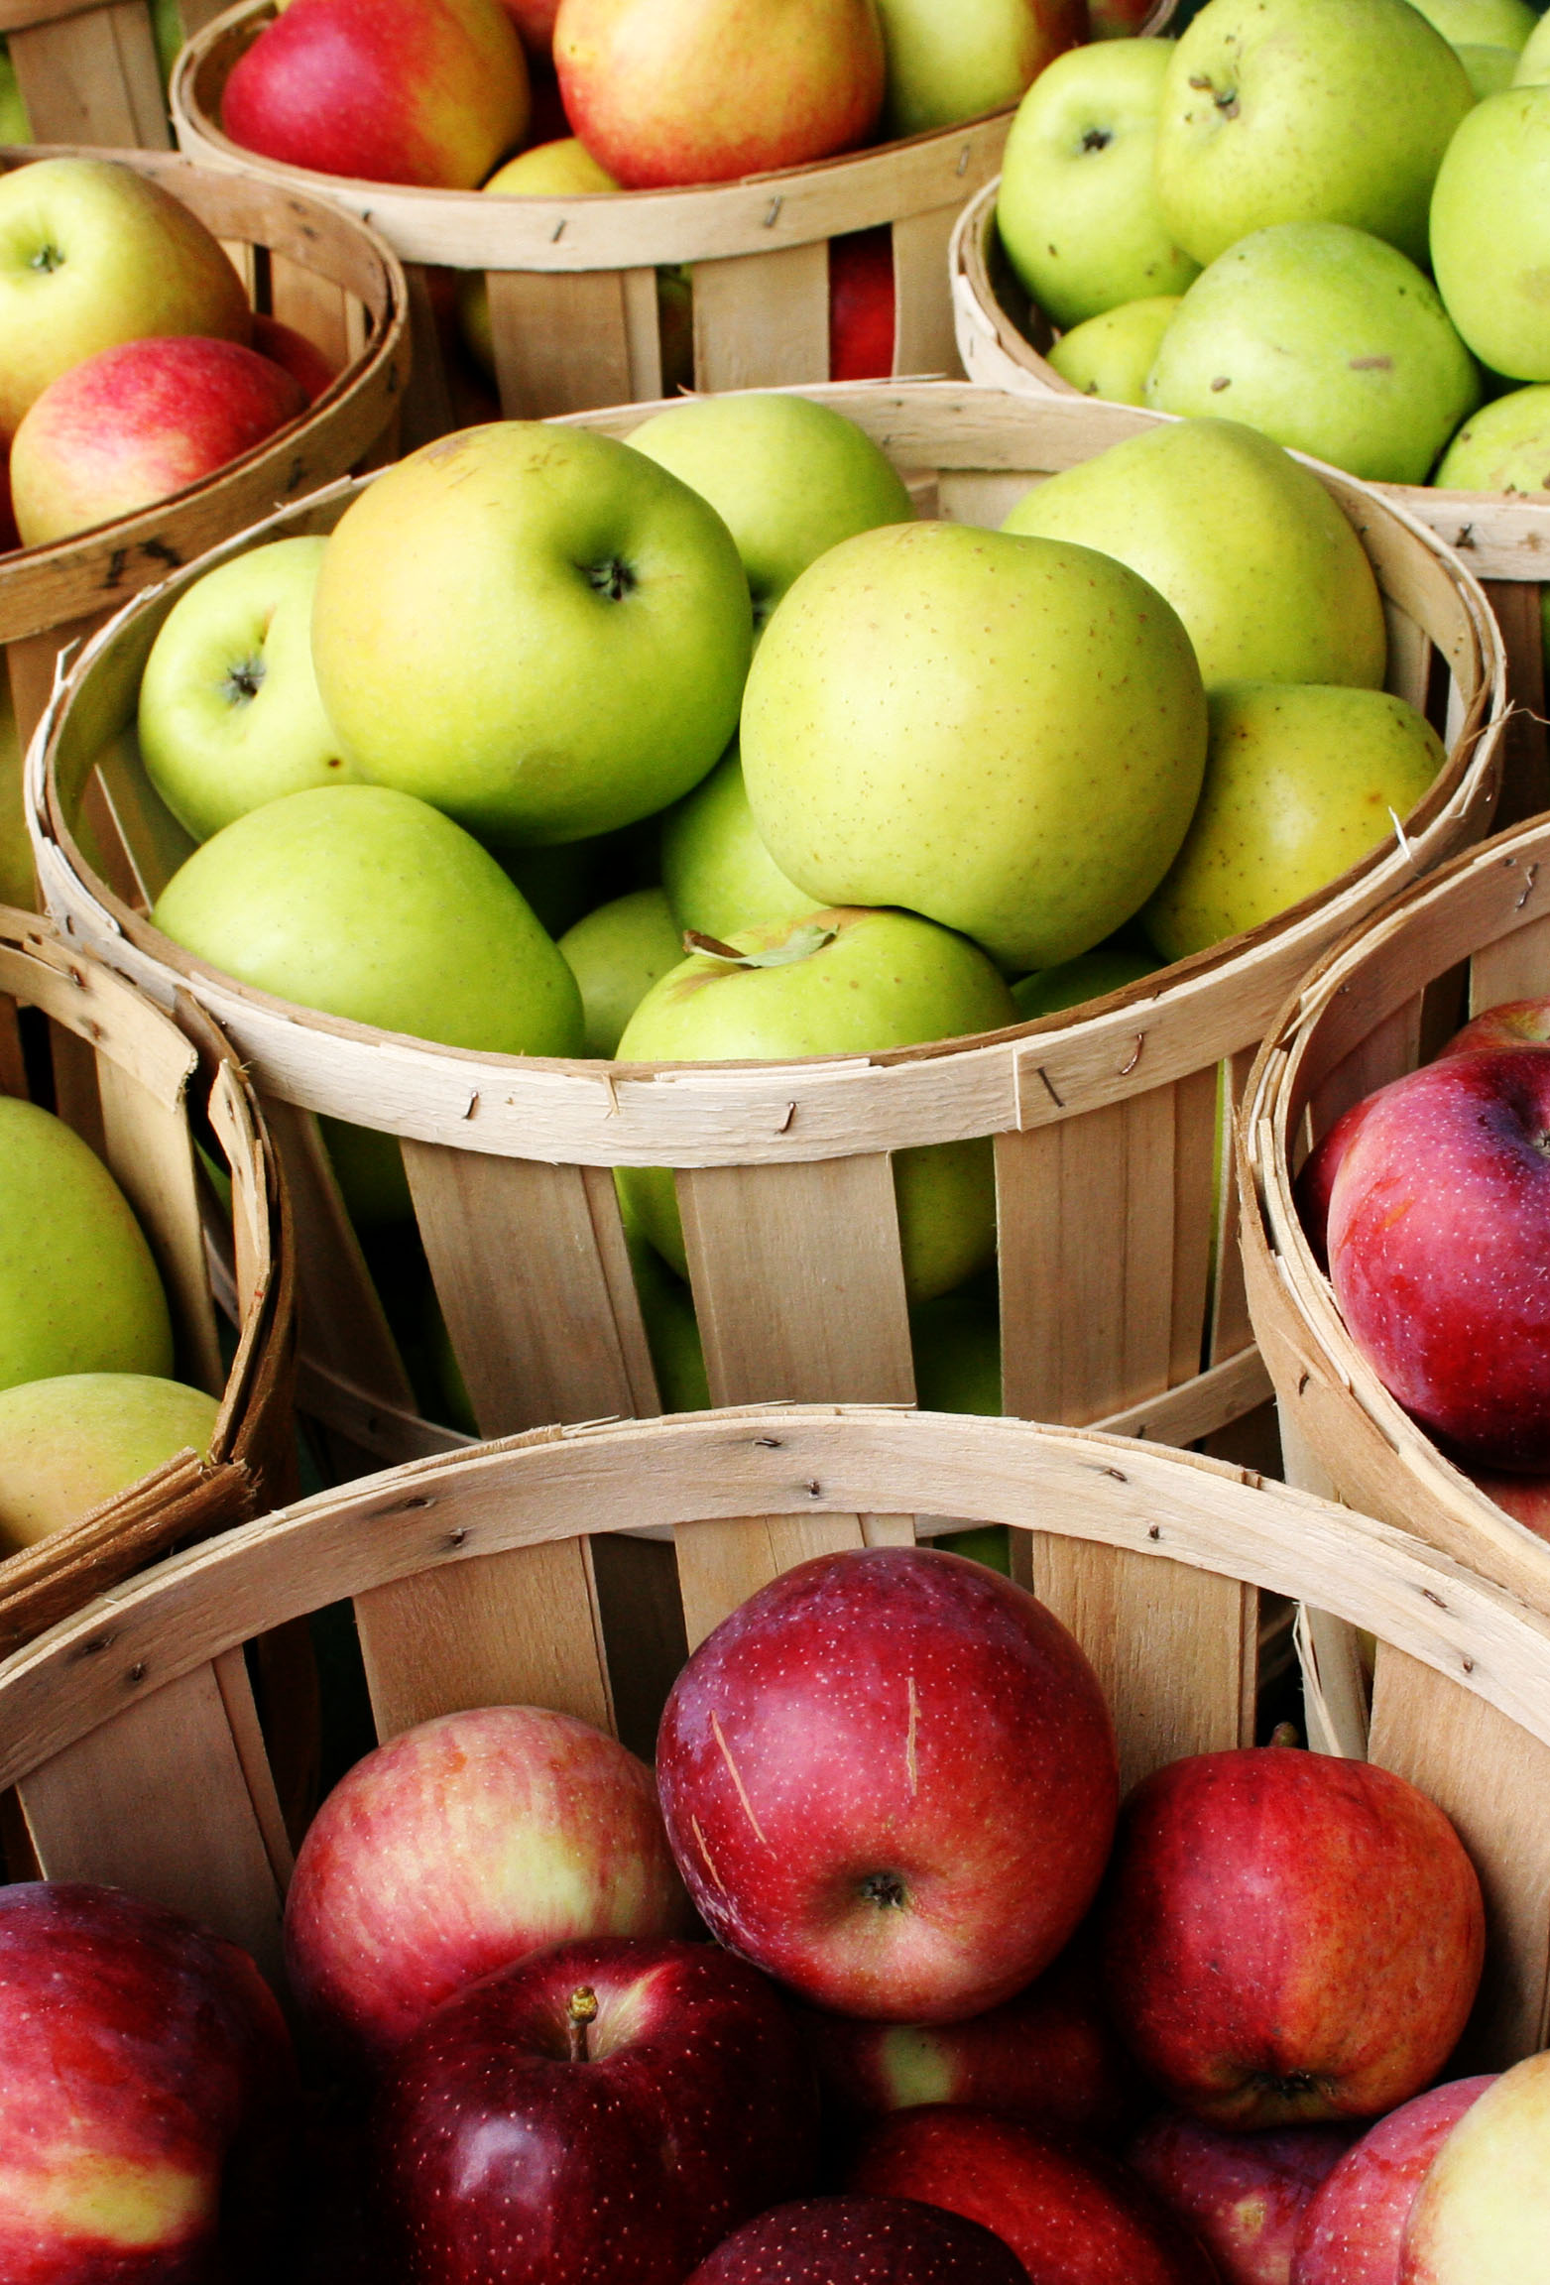
Example of a Specification for Apples
1. What do you want to purchase
  Red Delicious Apples
2. What are your requirements
  Domestic, U.S. fancy
3. What is the pack size you would like
  125- 138 count to a case
4. How many do you think you will purchase during the year
  1000 cases
5. Other specifications- these are things you would put in your Request for Proposal:
Must be produced in the US
Prefer locally grown when possible. (Locally grown is determined by each district)
Produce deliveries will be needed Tuesdays and Thursdays between 6:30am and 10:00am.
Notes:
This is a sample spec. Start by stating what it is you would like to purchase. Note I didn’t just say apples but stated Red Delicious, as this is the type I purchase most often. I made sure to state I wanted U.S. Fancy apples. I stated I want a box with 125- 138 apples to a case rather than giving a poundage. Finally, you want to let the vendors know how many cases you expect to use. Your current vendor should be able to give you a usage form or you can use your own records to see how many cases you purchased in the previous year. Remember to pad your cases based on what you think you will use to complete the school year. The specifications on #5 are things you would put in your Request for Proposal, not on each item. The buy American clause is true for all produce available in the US. If you have a preference for locally grown, make sure you put that in your Request for Proposal.

Slide 25
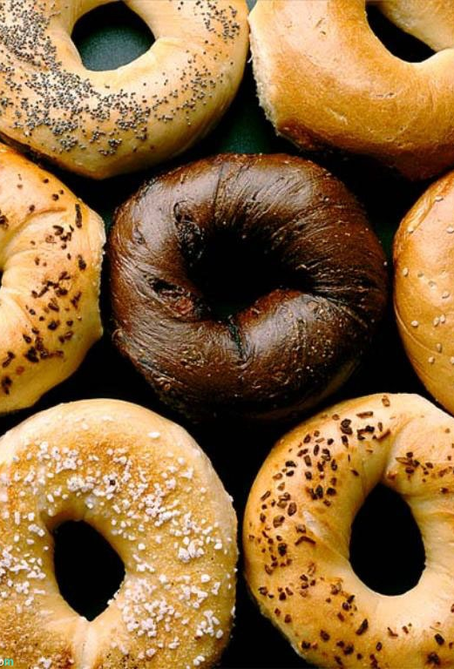
Example of a Specification for Bagels
1. What do you want to purchase
  2 oz Bagel
2. What are your requirements
  Whole Grain
  Individually Wrapped or Bulk
  Plain or Flavored
3. What is the pack size you would like
  72 per case
4. How many do you think you will purchase during the year
  350 cases
5. Do you have an example of a brand you have used?
  Lender’s (Pinnacle Food Group) 00074
6. You must allow the vendor to choose an alternative. This allows all companies that meet this specification an equal opportunity to put in price for consideration.
  An equivalent that meets the above specifications will be considered
Notes:
On this slide, you’ll see an example of a spec for non- produce. I want to purchase 2 oz. bagels. I know it has to be Whole Grain but do I want individually Wrapped or Bulk pack? How about Plain or flavored? If you want both cinnamon and plain bagels, then they need to be listed separately. In this example, I have given a suggestion of a Lender’s Bagel. I know that this product is bulk and has 72 - 2 oz. bagels in a case. I would state that under my pack size. If the vendor wants to quote a different product, they will need to do the math. In my case I want 350 cases of 72 count to a case. This would equal 25,200 bagels. It is up to the Vendor to determine the number of cases you will need if they quote you a 100 count case. Be sure to include the Buy American Provision!

Slide 26
Product Specification Information for Non-Food Items
Specifications apply to non-food items such as:
  Office Supplies
  Kitchen Equipment
  Janitorial Supplies
  Security
  Marketing Materials
  Phone plans
Notes:
Remember that specifications do not only apply to food!

Slide 27
Developing Specifications Process
Develop a cycle menu
Create standardized recipes
Evaluate customer quality and acceptance of current items
Research the market on new items
Request a description of the product from the manufacturer
Taste test with your customers
Write the bid specifications
Notes:
The process for developing specifications involves:
Developing a cycle menu
Create standardized recipes
Evaluate customer quality and acceptance of current items (do you customers like the products you are currently using?)
Research the market for ne items (are there better, more cost effective items out there?)
Request a description of the product from the manufacturer
Taste test with your customers (there’s no point in buying something your customers don’t want or like)
Finally, write your bid specification.

Slide 28
Results of a Good Specification
Supports fair and equitable treatment of vendors
SFA acquires what they need
Time spent is minimized
Best price or value
Customer satisfaction
Notes:
If specifications have been written correctly it will result in fair and equitable treatment of vendors, the agency's received what they need, time spent doing procurement is minimized throughout the process, the SFA received the best price or value and customer satisfaction is thriving.

Slide 29
Resources:
Click for More Information
School Nutrition Produce Specifications
USDA Specifications: US Grade Standards
USDA Product Specifications & Requirements
https://theicn.org/resources/943/january.../processing-usda-foods-at-the-sfa-level.pdf

Slide 30
Questions?
Contact your CN representative with any questions
New York State Education Department
Child Nutrition Program Administration
(518) 473- 8781
CN@nysed.gov
Notes:
Thank you. This concludes Writing Specifications .
Remember to record completion of this training for Annual Professional Standards Training requirements.
If you have any additional questions, please do not hesitate to contact us.

