Slide 1


Residential Child Care Institutions (RCCI) & Jails
Notes:
This training is geared for Residential Child Care Institutions (RCCI’s) and Jails that are participating in the National School Lunch Program and/or School Breakfast Program.

Slide 2
Professional Standards for State and Local Nutrition Program Personnel Final Rule
Required to track the number of training hours earned each year and maintain documentation of the trainings attended
SED prototype tracking Excel document
Notes:
Professional Standards became effective on July 1, 2015 and requires all school food service personnel to complete annual continuing education and training requirements.
This webinar will contribute up to 1.5 training hours towards the training requirements.
You are required to track the number of training hours you earn each year and maintain documentation of the trainings that you have attended.

Slide 3
Certification
Residents qualify for free meals
  Record eligibility using free and reduced-price application or an eligibility documentation sheet
    Eligibility documentation sheet must include the student’s name, DOB, personal income, date of admission and date of release
Day Students
  Students who do not reside at the RCCI
  Eligibility can be determined by direct certification or household application
    RCCI may request copy of free and reduced price meal application from regular school, if available
Notes:
Residents are students who reside on site. These students qualify for free meals. Certification documentation may be free and reduced-price meal application or an eligibility documentation sheet. An eligibility documentation sheet must include the student’s name, date of birth, personal income, date of admission and date of release.
Day students are defined as children who attend, but do not reside at the RCCI.
Eligibility may be determined by direct certification or a free and reduced application. A student can be eligible for free meals through direct certification using the Direct Matching process, using the Eligibility letter method, or when deemed categorically eligible.
When eligibility is determined by free and reduced applications, day students must be considered a part of the household in which they reside. Also, in some cases, day students may already be enrolled at a regular school and have an approved application on file there. If this is so, the RCCI may request a copy of the application. However, the RCCI is ultimately responsible for the validity of that application’s determination.
If you have day students attending your site, you are expected to review the policy booklet and eligibility webinar on the Child Nutrition Knowledge Center website.

Slide 4
Benefit Issuance Document
Master list of all eligible free and reduced-price students
  Indicate how the student was deemed eligible
    Direct Certification
    Categorical Eligible
    Free and Reduced Price Application
    Eligibility Documentation Sheet
      Resident’s discharge date and time
Point of Sale systems – keep a hard copy of the master list at the registers
Notes:
A benefit issuance document is the link in the accountability system between the eligibility determination and the benefit delivery.
The benefit issuance document is an up-to-date master list of all eligible free and reduced-price students.
It will indicate how the student was deemed eligible, including direct certification, categorical eligible, free and reduced-price application, and the eligibility documentation sheet.
The resident’s discharge date and time should be entered as it occurs. If the site has a Point of Sale system, a hard copy of the master list should be kept at the register in case the system fails.

Slide 5
Income Verification
Income verification
  Required for day students only
    Refer to Verification Booklet and applicable webinars
Completion of Verification Collection Report (attachment G) is required annually, even if income verification was not required
  The report must be submitted to the State Agency by December 15th
Notes:
RCCIs and jails are not required to complete verification for the residents.
However, income verification is required for day students. SFAs are expected to review the verification booklet and applicable webinars for further instruction.
Regardless if income verification was conducted, the Verification Collection Report (attachment G) is required to be completed annually by November 15th. This report must be submitted to SED by December 15th.

Slide 6
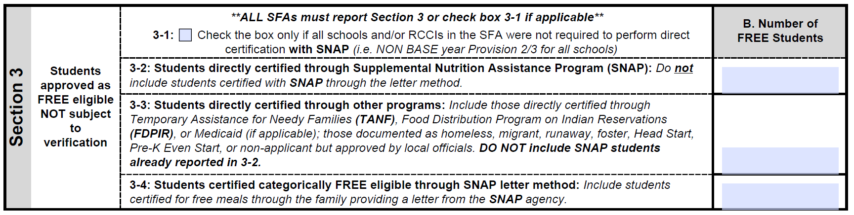
For SFAs with No Day Students
Section 1 will prefill once the October claim is submitted using the last operating day in October.
Section 3-1
  Check the box indicating that you were not required to perform direct certification
Notes:
The Verification Collection Report is completed using data from the last operating day of October.
Section 1 will prefill after the October claim is submitted.
SFAs that have only residents and no day students will need to check the 3-1 box that indicates that the RCCI was not required to perform direct certification.

Slide 7
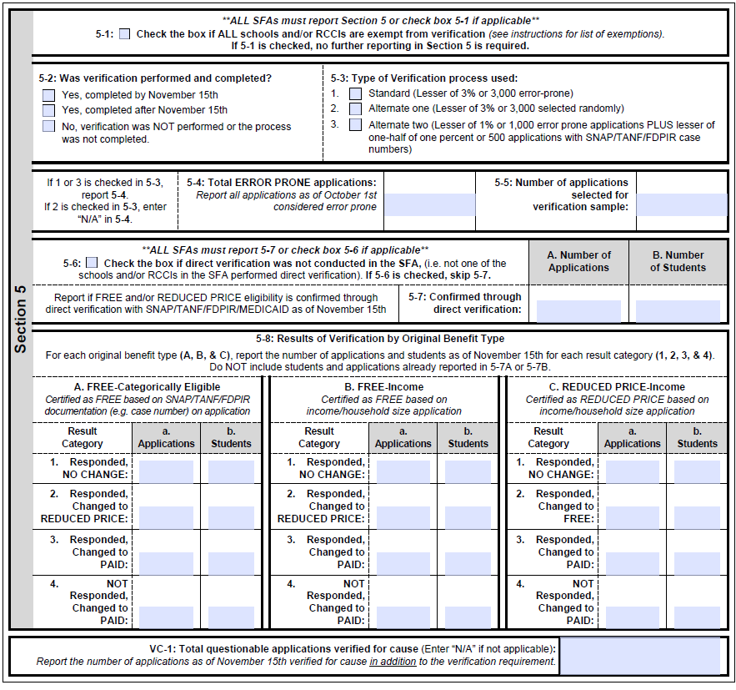
For SFAs with No Day Students
Section 5-1
  Check the box indicating that you are exempt from verification
Completed by November 15th
Submitted to SED by December 15th
Notes:
Section 5-1 must also be checked. This indicates that you are exempt from verification.
Click update at the bottom of the page to submit. This must be done annually by November 15th and submitted by December 15th.
The Income Verification Collection Report must be submitted by DECEMBER 15th to the Child Nutrition Office.

Slide 8
Meal Counting & Claiming
SFAs must establish a reliable system for counting, recording and claiming meals
Meal counts should be based on reimbursement category
Collection Methods
  Rosters
  Computerized Systems (Point of Sale Registers)
  Tic sheets
    For sites with only free eligibles
Notes:
Before an institution can claim meals for reimbursement, staff must ensure that the actual number of meals served to students have been accurately counted and recorded. Therefore, it is essential that SFAs establish a reliable system for observing and documenting meal counts.
There are several methods of collecting meal counts that may be utilized, including rosters, computerized systems or point of sale registers, or tic sheets.
Tic sheets are generally used to tally meal counts and only apply to schools where all students receive free meals, such as RCCIs without day students.

Slide 9
Meal Counting & Claiming
Rosters
Apply a uniform code for eligibility status
  A for Free, B for Reduced, C for Paid
  NOT F, R and P
List all eligibility categories on one roster
Rosters should be updated as changes occur
  Upon admission or discharge
Check off student name on roster at the point of service (POS)
  After service, check marks are tallied, by category, to calculate the daily meal count
Computerized System
Electronically records the number of meals served to students
  Uses a programmed coding system
  Ensures anonymity of students
Ensure back-up plan exists if systems were to go down
  Printed Coded Rosters
Notes:
Rosters are often used to count meals at the point of service or POS.
The eligibility status of students should always be coded to prevent overt identification. For example, A for free eligibles, B for reduced and C for paid. All eligibility categories should be included on one roster and rosters should be updated as changes occur. Students who were discharged should be removed from the roster and newly enrolled students added upon admission.
Staff should check off the student’s name on the roster at the POS when the student receives a reimbursable meal. Following the meal service, staff should total all check marks by category to calculate the daily meal count.
A number of SFAs rely on computerized software systems to count and record reimbursable meals at the POS. The computerized system electronically records the number of meals served to students using a programmed coding system to ensure anonymity of the students. Although very reliable, schools must maintain a backup system in case the computerized system is down. Printed coded rosters should always be kept at each POS in case this happens.

Slide 10
Point of Service
Location and time that a student receives a reimbursable meal
All the required meal components in the minimum required quantities must be on a student’s tray before the meal can be counted as reimbursable
It is essential that staff is trained to identify the components of a reimbursable meal
  Offer Versus Serve
Point of Service count must be taken for all methods of meal service
Notes:
The point of service or POS refers to the location and time that a student receives a reimbursable meal – usually at the end of the serving line where the meal count is recorded by category.
In order to claim a meal for reimbursement, the meal must contain all the required components in the minimum required quantities. Staff must be trained to identify the components of a reimbursable meal, especially in schools that utilize Offer Versus Serve. Staff training on Offer Versus Serve should occur, at a minimum, once a year or as often as necessary and when new staff is hired. This applies to cashiers and all staff that record meals on rosters.
RCCIs may utilize different types of meal service in addition to the traditional cafeteria lines. Other types of service include: family style meals in cottages as well as grab and go meals in the classroom. It is essential that meals are counted after a student receives a reimbursable meal. Under Family-Style Service, meals are counted after all components are offered and served to students. When teachers/aides take meals to classrooms, staff cannot record the meal when the food is picked up from the line or kitchen. Rather, the count should be taken when the student is served. Staff should then bring the marked rosters to food service staff to consolidate the classroom meals with cafeteria counts.

Slide 11

Method of Meal Service & Accountability
Method | Meal Count Taken
Tray Line | After all required components are offered and served
Family Style | After Required components are served
Buffet | After all required components are offered and served
Bag/Grab & Go Meals | When students receive their meals
Accountability
  POS
  Reimbursable meal identification
  Proper counts by category
  One meal per child per meal service
Notes:
There are many methods of meal service that SFAs may utilize, however the most common are tray line, buffet style, and family style.
For tray line, meal counts should be recorded after all the required components are offered and served to a student and the student has all required items on his/her tray. For buffet style, meal counts should be taken after all the required components are offered and served.
Family style is common in RCCIs especially in cottages where students live and consume the majority of their meals. Meal counts should be recorded by staff once all the required components are offered and served to students.
A good accountability system produces an accurate claim for reimbursement. In order to maintain a reliable accountability system, RCCIs must:
Establish fixed points of service to ensure that all items that are part of the reimbursable meal are provided prior to the point of service. Establishing fixed points will enable cashiers/staff to observe and document correct meal counts. Claim only one breakfast and/or lunch per day per child. If a student selects a second meal or less than the minimum required components, that selection cannot be claimed for reimbursement. Ensure that cashiers/meal counters are counting eligible children by their appropriate eligibility category in RCCIs with day students.
For RCCIs with day students:
We suggest that you notify families upon admission where and how to pay for meals. If a meal is charged, it must be counted on the day it is served; not when it is paid for. Likewise, pre-paid meals are not recorded until the meal is in the student’s possession.

Slide 12
Edit Checks
Ensure that the meal counting and claiming system works properly
Ensure the daily meal count does not exceed the number of eligible students
SFAs are required to conduct edit checks of daily meal claims for all Recipient Agencies (RA)
Verify meal count is accurate and compare the daily meal counts at each RA
Notes:
Regulations require that all RCCIs and Jails perform monthly edit checks of claims for each Recipient Agency or RA under an SFA’s jurisdiction prior to submitting the monthly claim for reimbursement.
Daily and monthly edit checks ensure that the daily meal count does not exceed the number of eligible students. The edit check enables the SFA to verify that the meal count is accurate and ensures that the meal counting and claiming system works properly. The SFA is required to verify the meal count is accurate by comparing the daily meal counts for each building to the daily attendance before submitting a claim.

Slide 13
Consolidation of Buildings/RAs
NYSED will restructure RCCIs with multiple RAs that share the same address
  They will be combined into one RA for claiming purposes only
  Each consolidated RA will represent a separate POS
Consolidation will:
  Simplify the administrative review process
  Reduce administrative paperwork
  NOT affect meal service
Notes:
Some RCCIs have a number of RAs, many of which share the same physical address or are located within close proximity to each other. NYSED will restructure RCCIs with multiple RAs that share the same address or campus, or RAs that are located within close proximity to each other. These RAs will be combined into one RA for claiming purposes only.
Meals will continue to be served at these RAs but instead of claiming them separately, they will be considered points of service. Consolidation is beneficial because it will simplify the administrative review process and reduce administrative paperwork. Instead of having to submit claims for multiple RAs, consolidation will allow certain RCCIs to submit one claim for reimbursement. As noted, consolidation will not affect meal service.

Slide 14
Meal Pattern and Nutritional Quality
Notes:
The next topic we will be covering is Meal Pattern and Nutritional Quality, which includes Meal Components and Quantities, Offer versus Serve, Dietary Specification and Nutrient Analysis.

Slide 15
Meal Components
Breakfast Meal Components
Lunch Meal Components
  Fruits/Vegetables
  Grains/Meat and Meat Alternates
  Fluid Milk
  Fruits
  Vegetables
    Dark green
    Red/Orange
    Beans/Legumes
    Starchy
    Other
  Grains
  Meat/Meat Alternates (M/MA)
  Fluid Milk
Notes:
There are three meal components for breakfast and five meal components for lunch.
For breakfast, the three meal components are: fruits and vegetables, grains and meat/meat alternates, and fluid milk.
For lunch, the five meal components are: fruits, vegetables (including the five vegetable subgroups listed on the slide), grains, meat/meat alternates, and fluid milk.

Slide 16
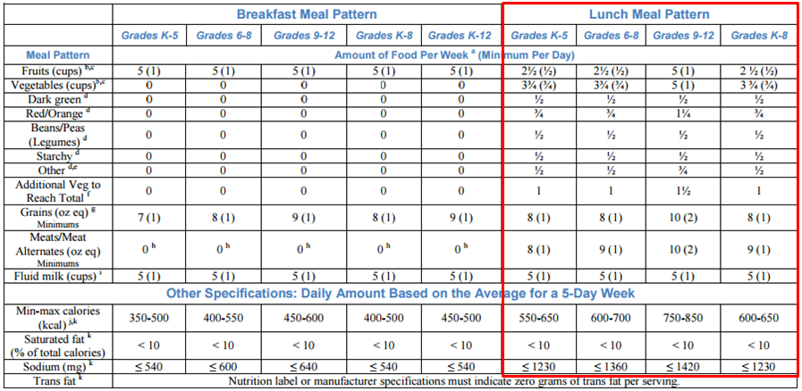
Meal Pattern
Notes:
This is the meal pattern chart which is included in the resource download. We will now break down each requirement in greater detail.

Slide 17
Seven Day School Week Meal
Component Adjustment for Lunch
Lunch | Grades K-5 Weekly (daily) | Grades 6-8 Weekly (daily) | Grades 9-12 Weekly (daily) | Grades K-8 Weekly (daily)
Fruits (cups) | 3.5 (0.5) | 3.5 (0.5) | 7 (1) | 3.5 (0.5)
Vegetables (cups) | 5.25 (0.75) | 5.25 (0.75) | 7 (1) | 5.25 (0.75)
Dark Green | 0.5 | 0.5 | 0.5 | 0.5
Red/Orange | 0.75 | 0.75 | 1.25 | 0.75
Beans/Peas (Legumes) | 0.5 | 0.5 | 0.5 | 0.5
Starchy | 0.5 | 0.5 | 0.5 | 0.5
Other | 0.5 | 0.5 | 0.75 | 0.5
Additional | 2.5 | 2.5 | 3.5 | 2.5
Grains (oz eq) | 11 (1) | 11 (1) | 14 (2) | 11 (1)
Meats/Meat Alternate (oz. eq.) | 11 (1) | 12.5 (1) | 14 (2) | 12.5 (1)
Fluid Milk (cups) | 7 (1) | 7 (1) | 7 (1) | 7 (1)
Notes:
Meal component adjustments are available on the Child Nutrition Knowledge Center for 3, 4, 6 and 7 day schedules.
The minimum requirements range given the number of days of service in a given week.
Since most RCCIs and Jails serve every day of the week, this is an example of a 7 day school week meal component adjustment chart for lunch.
The fat, calorie and sodium limits are daily averages, so those are the same regardless of the number of days of service. Please note that the requirements are the same for all days of service.

Slide 18
Seven Day School Meal Component Adjustment for Breakfast
Breakfast | Grades K-5 Weekly (daily) | Grades 6-8 Weekly (daily) | Grades 9-12 Weekly (daily) | Grades K-8 Weekly (daily) | Grades K-12 Weekly (daily)
Fruits (cups) | 7 (1) | 7 (1) | 7 (1) | 7 (1) | 7 (1)
Grains (oz eq) | 10 (1) | 11 (1) | 12.5 (1) | 11 (1) | 12.5 (1)
Fluid Milk (cups) | 7 (1) | 7 (1) | 7 (1) | 7 (1) | 7 (1)
Notes:
Here is the 7 day school week meal component adjustment chart for breakfast.

Slide 19

Offer Versus Serve (OVS)
at Breakfast
OVS is optional for all age/grade groups
Schools must offer all three required components in at least the minimum required amounts
Schools must offer at least 4 food items from the three required components
Students must select at least 3 food items, with one of the food items being at least ½ cup of fruit and/or vegetable
Notes:
Offer Versus Serve is optional at breakfast for all age/grade groups.
If you are going to participate in Offer Versus Serve, you must offer at least 4 food items from the three required breakfast components. Students must then select 3 of the items, with one being a ½ cup of fruit and/or vegetable.

Slide 20

OVS at Lunch
OVS is only required for students in the 9-12 age/grade group, it is optional for all other age/grade groups
Schools must offer all five required components in at least the minimum required amounts
Students must take 3 components, one being ½ cup of fruit and/or vegetable
If a student chooses ½ cup of fruit or vegetable, the other two components selected must be in the minimum required quantities to be considered reimbursable
  K-5 age/grade group selects ½ cup carrots and 2 oz. eq. M/MA hamburger on 1.5 oz. eq. grain whole wheat bun
    √ Reimbursable!
  9-12 age/grade group selects ½ cup carrots and 2 oz. eq. M/MA hamburger on 1.5 oz. eq. grain whole wheat bun
    X Not Reimbursable!
Notes:
Offer Versus Serve is required for the 9-12 age/grade group and is optional for all other age/grade groups at lunch.
If you are going to participate in OVS, you must offer all 5 lunch components in at least the minimum required amounts for each age/grade group. Students must then select 3 of the components, with one being a ½ cup of fruit and/or vegetable.
If a student chooses ½ cup of fruit and/or vegetable, the other two components selected must be in the minimum required quantities to be considered reimbursable
For example:
A student in the K-5 age/grade group selects ½ cup carrots and a 2 oz. eq. hamburger on a 1.5 oz. eq. whole wheat bun. This would be considered reimbursable.
If a student in the 9-12 age/grade group selects the same meal, it would not be considered reimbursable. The minimum grain requirement for 9-12 age/grade group is 2 oz. eq.

Slide 21

Meal Service Styles
Generally accepted meal service styles.
Tray line
Pre-set table setting
Pre-plating
Family Style
Notes:
Tray line - children go through the line and receive all required meal components by the time they reach the end of the line. This style works well in the SFSP because: EASY TO GET AN ACCURATE MEAL COUNT AT POS-the point at which a child receives a complete meal; The serving line is ready to go @ your approved meal service time
Pre set-table setting - all components on a plate at each place setting at the start of your approved meal svc. For this style to work,
sponsors would have to know ahead of time how many kids were expected & how many would be at each table . You would take your meal count when the child is seated at a complete meal.
Pre plating means the required components are on plates which are then served to the children. Children sit down at the approved meal service time and plates are immediately served to them. You would take the meal count once a complete meal is in front of the child.
Family Style can be used to help young children learn good eating habits. Family style means you are having the children eat like they would at home. Enough food is placed on the table for all children to have the required portion size of each component; some amount of each component is on each child’s plate. When full portion is not initially served to the child, a supervising adult actively encourages the child to take the full portion. Appropriate serving utensils should be used to portion described prior to services.
Offer vs Serve in the National School Lunch and School Breakfast Programs requires each student to select at least ½ cup of a fruit and/or vegetable. Therefore the adult supervisor must ensure that each student selects at least a ½ cup of fruit and/or vegetable during the course of a family style meal service.
The supervising adult must also be present to ensure that the full planned serving of each food component or food items is available to students throughout the entire meal service.
SFAs that use family style meal service, often pre-plate the required ½ c fruit and/or vegetable to help ensure a reimbursable meal is chosen.

Slide 22
Age/Grade Waiver
Memorandum SP38-2012 extends age/grade group flexibility of the lunch meal pattern to RCCIs and Jails
With State approval, the SFA can offer the meal pattern of the highest age/grade group in attendance to all students
Notes:
On July 16, 2012, the Food and Nutrition Service issued memorandum SP 38-2012, which allows RCCIs and jails, with State agency approval, to serve the National School Lunch Program meal pattern of the highest age/grade group in attendance to all students.

Slide 23
Age/Grade Waiver
In order to utilize this flexibility, the RCCI or jail must meet all three of the following criteria:
  Be a juvenile detention or correctional facility
  Serve children in different age/grade groups;
  Have legitimate safety concerns, or State juvenile justice laws or regulations related to offering meal(s) with varying amounts of food within the same meal period
Notes:
In order to utilize this flexibility, the RCCI or jail must meet all three of the following criteria: 1) be a juvenile detention or correctional facility; 2) serve children in different age/grade groups; and 3) have legitimate safety concerns, or State juvenile justice laws or regulations related to offering meals with varying amounts of food within the same meal period

Slide 24
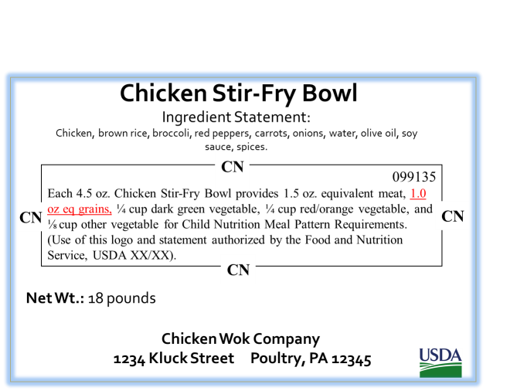
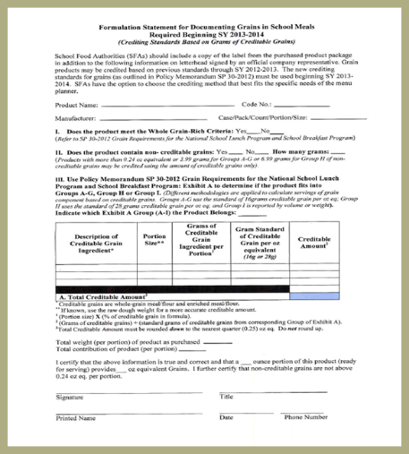
Meal Pattern Compliance Tools
SFAs need to retain records that show how planned meals contribute to the required meal pattern
  Child Nutrition (CN) Labels
    Exhibit A
  Product Formulation Statements
  Standardized Recipes
  Production Records
Notes:
In order for SFAs to show compliance regarding meal patterns, they must maintain records that show how each food served corresponds to the meal pattern requirements. These records include Child Nutrition or CN Labels, product formulation statements, standardized recipes and production records.
A CN label statement clearly identifies the contribution of a product toward the meal pattern requirements. A CN labeled product will always contain the following:
The CN logo, which is a distinct border;
The meal pattern contribution statement;
A unique 6-digit product identification number, which is assigned by FNS, appearing in the upper right hand corner of the CN logo;
The USDA/FNS authorization statement; and
The month and year of final FNS approval appearing at the end of the authorization statement.
The remaining required label features are the product name, inspection legend, ingredient statement, signature/address line, and net weight.
A Product Formulation Statement will provide specific information about how the product credits to meet the meal patterns. We strongly encourage SFAs when purchasing a processed product without a CN label, that they have a completed, signed and dated Product Formulation Statement from the manufacturer for accurate crediting purposes.

Slide 25
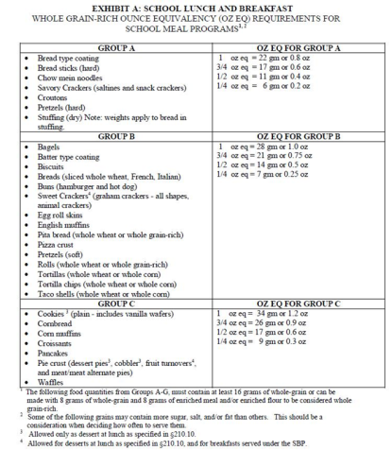
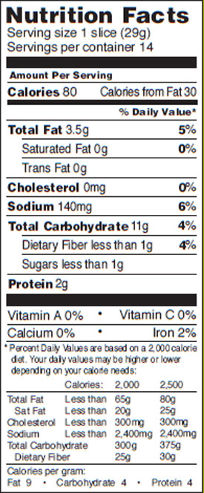
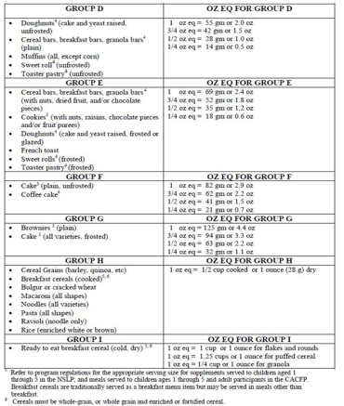
Exhibit A
Exhibit A can be used to credit grains.
Using Exhibit A (Example):
  Locate the correct category for the grain item on Exhibit A (B)
  Use the per serving weight of the product found on the nutrition fact label (29 g)
  Divide the weight of the product by the ounce equivalent column in Exhibit A (29/28 = 1.036)
  Always round down to the nearest quarter! (1 oz. eq.)
Notes:
Exhibit A can be used to determine the grain ounce equivalent per serving.
To use this chart, locate the correct category for the grain item.
For our example, bread is found in group B. Then look at the nutrition fact label and determine the weight of the product per serving.
In our example, one slice of bread weighs 29 grams. Next we divide the product weight by the number found in the ounce equivalent column of Exhibit A.
For our example, in group B, a 1 ounce equivalent weighs 28 grams, so we divide 29 by 28 and get 1.036. Always rounding down to the nearest quarter ounce equivalent, our product is a 1 ounce equivalent.

Slide 26
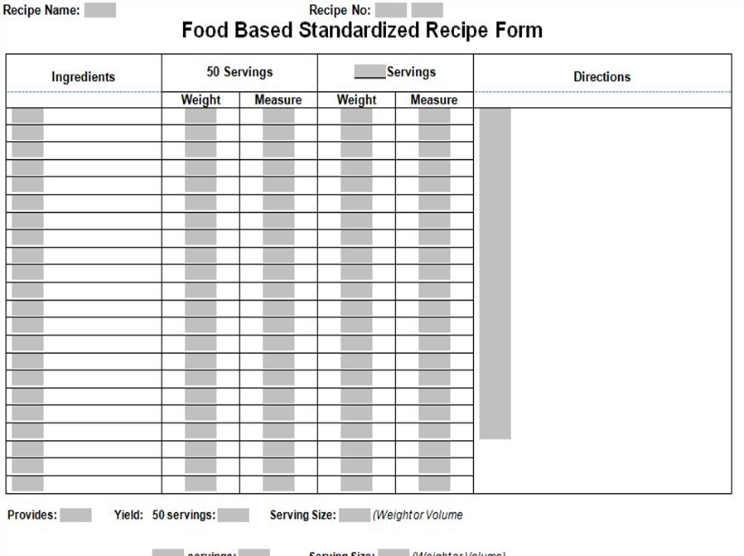
Standardized Recipes
Standardized Recipes includes:
  Recipe Name
  Ingredients
  Weights and/or Measures
  Directions
  Yield
Notes:
Standardized recipes are used to provide a consistent product each time. The standardized recipe form that is shown on the slide is available on the Child Nutrition Knowledge Center for you to use as a template. You may use your own template but all required elements must be included.
The following items must be included on standardized recipes.
Recipe Name/Number - List the recipe name. Numbering recipes is not required but may be helpful for organization and recording the standardized recipe on production records.
Ingredients - The ingredients are listed in the first column. Provide as much information as possible for each ingredient. Include form (such as fresh, frozen, or canned); packing medium (such as canned in juice or light syrup, frozen with added sugar, or plain); fat content (such as 20 percent fat ground beef or ground pork, no more than 30 percent fat); or brand (Tyson® Cooked Diced Chicken Meat, Pierre® Pork Sausage Patty). You should specify alternative ingredients when necessary.
Alternative ingredients are sometimes given for use in place of a similar ingredient in the recipe; for example, dehydrated onions instead of fresh onions.
Weights and/or Measures – This is the amount of the ingredients used in the recipe. For instance, 1 pint of milk or 2 cups chopped onions or 30 pounds of raw ground beef. Also, there is a standard set of columns for a yield of 50 servings. The second set of columns is for other yields. If you typically make 325 servings with this recipe, 325 would be entered in the blank and the quantities below would be adjusted to reflect that yield.
Directions - This column tells how to prepare the recipe. Where appropriate, times and temperatures are given for the type of food service equipment being used. The food safety process approach should also be included.
Yield- This gives the approximate total yield (or total number of servings) of the recipe. *The yield is often forgotten but very important for menu planning! With OVS, describe the full portion size you are planning, regardless of what you believe the students will take.

Slide 27
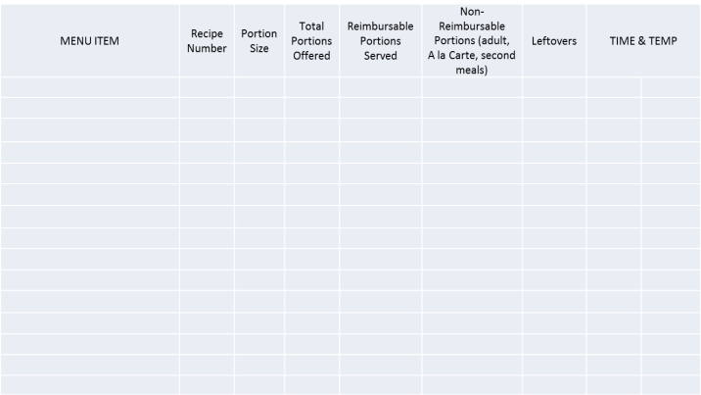
Production Records
Daily documentation of what was planned, prepared and served at your foodservice operation
  Required for Breakfast, Lunch and Snack programs
Necessary to support the claim
Must Contain:
Date
Age/Grade Group
School/Site Name
Menu Item
Recipe Number
Portion Size
Total Portions Offered
Reimbursable Portions Served
Non-Reimbursable Portions Served (adult meals, a la carte and second meals)
Leftovers
Notes:
Production records are the main documentation to demonstrate that each meal was in full compliance with the food based menu plan. They are required for breakfast, lunch and snack and are necessary to support the claim. Production records can also serve as a helpful tool to Food Service Directors as they can help manage costs by forecasting future meals, minimizing leftover food/waste, and predict student acceptability of meals.
Production records must contain:
the date;
the age/grade group;
the school or site name;
all planned menu items, which includes main entrées, alternate meals, fruit, vegetables, milk, condiments, and substitutions;
recipe number or product name or number;
portion size, which should be consistent with the meal pattern, meaning ounce equivalencies for grains and meats and cups for fruits and vegetables;
total number of portions prepared;
the number of reimbursable portions served;
the number of non-reimbursable portions served, which includes adult meals and second meals to students; and
the number of leftovers.
While it is optional to include time and temperature on production records, it is highly encouraged to ensure correct food safety measures are being followed.
Please note that if menus are planned for more than one age or grade group at the RCCI or Jail, the different portion sizes on the production records must be clearly distinguishable or separate.

Slide 28
Resource Management
Notes:
The next topic we will be discussing is Resource Management.

Slide 29
Nonprofit School Food
Service Account
Nonprogram Foods
Indirect Costs
Second Meals
Extra Items
Non-reimbursable Meals
Adult Meals
Must be allowable cost
Use approved rate from SED
http://www.fns.usda.gov/indirect-cost-guidance
Notes:
Any foods or beverages purchased using funds from the Nonprofit School Food Service Account that are not part of the claimed reimbursable meals must be compensated to the account by the general fund. This includes second meals, non-reimbursable meals and extra items selected by students. This also includes any meals served to non-program adults.
SFAs have the option to charge indirect costs to the nonprofit school food service account. This must be an allowable cost and the approved rate from SED must be used. For more information and guidance, we have provided a link to the USDA website.

Slide 30

Procurement
Importance
Free, Open Competition
Obtaining Best Possible Price
Notes:
Procurement is an important part of operating the Child Nutrition Programs, because federal dollars are being used to purchase goods and services, and all purchases made with federal dollars must be properly procured. SED began reviewing procurement records as part of the administrative review process during the 2016-2017 year.
It is important for you to understand and comply with local, state, and federal procurement guidelines to make sure the federal dollars are spent wisely.
“Procurement” refers to the purchasing of goods and services. Obtaining the more economical purchase should be considered in all purchases when using the nonprofit food service account.
There are three binding principles of good procurement. They should be thought about in every step of the procurement process from setting procurement policies to monitoring procurements.
Free and Open competition is required and is the basis for the overarching procurement regulations. Full and open competition means that everyone has an equal opportunity to compete for business. Procurement procedures may never unjustifiably restrict or eliminate competition.
Fairness and integrity encourages vendors to compete. Vendors don’t want to compete in a arena that isn’t fair and doesn’t have integrity. Remember – all vendors must be given the same bid information in order to level the playing field. The more players there are in the market the more competition exists driving costs lower and quality higher
Competition requires seeking responsive and responsible vendors - vendors who respond to a solicitation clearly indicating compliance without material deviation from the solicitation’s terms and conditions and who have the capability to perform successfully under the terms and conditions of the contract.

Slide 31
Procurement Plan
Required by regulations
Include in Plan
  Definitions
  Basic Organizational Concepts
  Specifications
  Buy American
  Minority/Women-Owned Businesses
  Conflict of Interest / Code of Conduct policy
Notes:
Regulations require all SFAs have procurement procedures in place. The procedures provide the specific roadmap for how the SFA is conducting procurement in compliance with regulations.
The procurement plan should clarify terms used in the policy which may need further explanation such as responsive and responsible bidder. It should include basic organizational concepts, such as which people in your organization are responsible for ordering and who approves purchases. Developing good specs ensures your procurement is competitive and not too restrictive, including using the Buy American provision and purchasing from minority or women-owned businesses.
A procurement plan would not be complete without a conflict of interest and code of conduct policy for everyone involved in the procurement process. It documents the steps to take if there is a conflict of interest and the consequences if there is a violation of the policy.
The policy should address areas such as:
Gratuities and kickbacks,
Miscellaneous fees, which are fees that aren’t attributable to the purchase, and
The process for violations of the procurement policy

Slide 32
Buy American
Requirements
  Purchase domestic commodities and products that are
    produced in the US, or
    processed using agricultural commodities produced in the US.
  Include in all solicitation and contract documents
Best Practices
  Country of origin on all products and invoices
  Specification in solicitations and contracts that only 100%domestically grown and processed products are approved for purchase
Notes:
The Buy American provision requires schools, or entities that are purchasing on a schools behalf, to purchase, to the maximum extent practicable, domestic commodities and products.
A domestic commodity or product means an agricultural commodity that is produced in the United States and/or a food product that is processed in the United States substantially using agricultural commodities that are produced in the United States.
“Substantial” means that over 51 percent of the final processed product consists of agricultural commodities that were grown domestically or in a territory of the United States.
Language about the Buy American provision should be included in all procurement documents. It is recommended that you require country of origin on all products and invoices submitted for payment and implement procedures for monitoring the country of origin at the time of delivery.
If SFAs have difficulty ensuring that food products meet this regulation, FNS encourages a specification to be included in solicitations and contracts that only 100% domestically grown and processed products are approved for purchase.

Slide 33
Buy American
Limited Exceptions
  Consider alternatives first
    Other domestic sources
    Domestic substitution
    Time of year/availability
  Exceptions: last resort
    Insufficient quantities
    Competitive bid shows cost significantly higher
    Keep documentation to justify
SED Monitoring
  Solicitation and contract documents
  Product labels
  Invoices/receipts
  Exception documentation
Notes:
There are limited exceptions to the Buy American provision which allow for the purchase of products not meeting the “domestic” standard in circumstances when use of a domestic products is truly not practicable.
However, before utilizing an exception, alternatives to purchasing non-domestic food products should be considered.
For example, SFAs should ask:
• Are there other domestic sources for this product?
• Is there a domestic product that could be easily substituted, if the non-domestic product is less expensive (e.g. substitute domestic pears for non-domestic apples)?
• Am I soliciting bids for this product at the best time of year? If I contracted earlier or later in the season, would prices and/or availability change?
Again, although exceptions to the Buy American provision exist, they are to be used as a last resort. These exceptions, as originally outlined in the 2012 guidance, are:
• The product is not produced or manufactured in the U.S. in sufficient and reasonable available quantities of a satisfactory quality; or
• Competitive bids reveal the costs of a U.S. product are significantly higher than the non-domestic product.
SFAs must keep documentation justifying the exception(s).
SED must ensure SFA compliance with the Buy American provision. SED will examine SFA’s solicitation and contract documents to determine if they contain the language for contractors to supply products in compliance with the Buy American provision.
SED will review the label on a variety of food products in storage facilities; and review a sample of supplier invoices/receipts to ensure the country of origin is the United States or its territories. If exceptions are identified, SED will look at documentation justifying the exception(s). If non-domestic products are identified and there is no documentation justifying the exception, SED must issue a finding and require corrective action.

Slide 34
Which Regulation Applies?
Non-public Schools and Charter Schools
Federal Procurement Thresholds
  Micro Purchase-$10,000
  Small Purchase- $250,000
Public Schools
  GML § 103 small purchase threshold $20,000
    Exceptions
      Emergency
      Sole Source
Notes:
In all procurements SFAs must use federal, state, or local bid thresholds to determine whether to use Formal or Informal procurement processes.
Nonpublic entities must use the current federal small purchase threshold of $150,000 unless a more restrictive threshold of $250,000 is set by their governing board.

Slide 35

Written Procurement Procedures
Determine procurement methods to be used
Identifies parties that will address issues raised
Written Standards of Conduct
Conflicts of interest
Prohibiting gratuities, favors
  May set standards for nominal value
Disciplinary actions
Notes:
Procurement is an important part of operating the USDA Child Nutrition Programs, because Federal dollars are used to purchase goods, products or services.
In large part, the procurement rules were put in place to correct discrepancies in the process such as nepotism, improper awards, kickbacks, incentives, and other improper practices when purchasing goods and services.
Obtaining the more economical purchase should be considered in all purchases when using the nonprofit food service account.
All SFAs are required to have written procurement procedures which reflect applicable Federal, State, local, laws. Please note that the Federal thresholds have been updated referred in the beginning of the powerpoint.
These procedures provide the specific roadmap for how procurements will be conducted and who within the SFA is ensuring compliance with regulations.
SFAs must also maintain written standards of conduct covering conflicts of interest and governing the actions of its employees engaged in the selection, award and administration of contracts. These may be part of your procurement procedures or can be a separate document.
No employee, officer, or agent may participate in the selection, award, or administration of a contract supported by a Federal award if he or she has a real or apparent conflict of interest which would be a financial or other interest or a personal benefit from a company considered for a contract.
SFAs cannot solicit or accept gratuities, favors, or anything of monetary value from contractors or parties to subcontracts. However, SFA may set standards for situations in which the financial interest is not substantial or the gift is an unsolicited item of nominal value.
The standards of conduct must provide for disciplinary actions to be applied for violations of such standards
(i

Slide 36

Maintain Procurement Records
Rationale for the method of procurement
Selection of contract type
Vendor selection or rejection
Basis for the contract price
Contract/agreement
Delivery receipts
Invoices
Accounting records
Notes:
SFAs must maintain records sufficient to detail the history of procurement. These records will include, but are not necessarily limited to the following: rationale for the method of procurement, selection of contract type, contractor selection or rejection, and the basis for the contract price as well as documentation to support the management of the contract, Contract performance management documentation (description of procedures used by the SFA to ensure contractors performed in accordance with the terms, conditions, and specifications of the contract)

Slide 37
SFA Procurement Review
Procurement Policy/Standards
Code of Conduct
Summary of Expenditures
In-depth review of selected procurements
Review of written procurement procedures
Notes:
SED will perform procurement reviews in conjunction with the Administrative Review process.
Your Child Nutrition Rep will contact the school regarding completing the procurement review worksheet.
You will also be asked to provide SED with your SFA’s procurement policy/standards and Code of Conduct as well as the SFA’s Summary of Expenditures from the previous year.
SED will review your written procurement procedures and practices to determine if they conform with federal regulations.
Make sure you have a written procurement policy and are following it and that you are documenting all procurements.

Slide 38
General Program Compliance
Notes:
The next topic area is the General Program Compliance, which includes Civil Rights, SFA On-site reviews, Local School Wellness Policies, Water Availability, Food Safety, Professional Standards, and Recording and Record Keeping.
While we will only provide a brief overview of each topic, additional information can be found on each topic on our Child Nutrition Knowledge Center website, and we will also take questions at the end of the presentation.

Slide 39
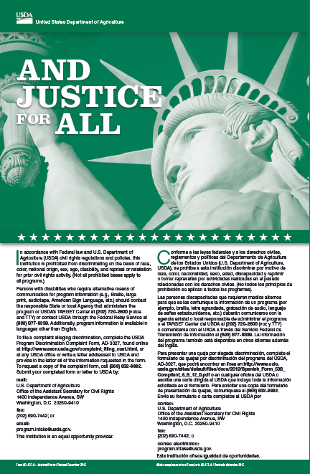
CIVIL RIGHTS
  “And Justice for All” poster
  Non-discrimination statement
  Civil Rights training requirement- PowerPoint presentation
    Limited English Proficiency (LEP)
  Civil Rights Compliance Report-Not required if data is collected through district for other purposes (BEDS)
Notes:
The “And Justice for All” posters are required to be posted in highly visible locations in all Child Nutrition Program service areas including cafeterias, classrooms and in the vicinity of or on reimbursable meal vending machines if they are placed in areas other than the cafeteria.
Posters are available from NYSED free of charge.
Non-discrimination statement must be on all material that references Child Nutrition Programs and must be the current statement. Refer to the policy booklet and the civil rights training for the most current statement.
Annual civil rights training is required by USDA and must be completed by all staff who work with program participants or applicants as well as those who supervise staff.
One section of the civil rights PowerPoint is Limited English Proficiency (LEP). Recipients of Federal financial assistance have a responsibility to take “reasonable steps” to ensure meaningful access to their programs and activities by persons with Limited English Proficiency (LEP). Please refer to the civil rights training PowerPoint on our website for more information on LEP.
Keep a record of the annual training and include a sign-in sheet, the date, location, and who provided the training.
The USDA has proposed the following timeline to update all Child Nutrition Program materials as follows:
1. Websites must be updated by November 20, 2015;
2. Documents, pamphlets, brochures, etc. using Nondiscrimination Statement language prior to 2013 must be updated by December 31, 2015;
3. Documents, pamphlets, brochures, etc. using 2013 Nondiscrimination Statement language should be updated when supplies are exhausted or by September 30, 2016; or
4. All new printing must use the 2015 Nondiscrimination Statement.

Slide 40
Non-Discrimination Statement
All program materials must contain the most recent USDA non-discrimination statement
  The font of the statement may be decreased in size, however spacing must remain the same
Statement must be on SFA’s food service webpages
SFAs are not required to include the USDA nondiscrimination statement on child nutrition menus or documents to other State agencies
Notes:
All informational materials and sources used by sponsors to inform the public about Child Nutrition Programs, must contain the most recent USDA nondiscrimination statement.
Additional program materials that must include the USDA non-discrimination statement are as follows:
Income Applications;
Consent Forms;
Notices of Rights and Disciplinary Actions;
Letters and notices to households;
SFA’s food service webpages; and
RFPs related to the program.
SFAs are not required to include the USDA nondiscrimination statement on child nutrition menus or documents to other State agencies.

Slide 41
Non-Discrimination Statement
In accordance with Federal civil rights law and U.S. Department of Agriculture (USDA) civil rights regulations and policies, the USDA, its Agencies, offices, and employees, and institutions participating in or administering USDA programs are prohibited from discriminating based on race, color, national origin, sex, disability, age, or reprisal or retaliation for prior civil rights activity in any program or activity conducted or funded by USDA.
Persons with disabilities who require alternative means of communication for program information (e.g. Braille, large print, audiotape, American Sign Language, etc.), should contact the Agency (State or local) where they applied for benefits. Individuals who are deaf, hard of hearing or have speech disabilities may contact USDA through the Federal Relay Service at (800) 877-8339. Additionally, program information may be made available in languages other than English.
To file a program complaint of discrimination, complete the USDA Program Discrimination Complaint Form, (AD-3027) found online at: http://www.ascr.usda.gov/complaint_filing_cust.html, and at any USDA office, or write a letter addressed to USDA and provide in the letter all of the information requested in the form. To request a copy of the complaint form, call (866) 632-9992. Submit your completed form or letter to USDA by:
(1) mail: U.S. Department of Agriculture
Office of the Assistant Secretary for Civil Rights
1400 Independence Avenue, SW
Washington, D.C. 20250-9410;
(2) fax: (202) 690-7442; or
(3) email: program.intake@usda.gov.
This institution is an equal opportunity provider.
Notes:
This is the current USDA non-discrimination statement. Again, this full statement must be used on all program materials.
SFAs should check USDA and/or the Child Nutrition Knowledge Center for updates to the non-discrimination statement throughout the school year.

Slide 42
SFA On-Site Monitoring
Must be completed prior to February 1st of each school year
A copy of the SFA’s On-Site Review forms
Written documentation of follow-up to SFA reviews
    For any findings that require follow-up, the SFA is required to conduct a second self review of the site within 45 days to confirm the corrective action taken resolved the problems
Written documentation to verify Corrective Action has occurred for any findings in the initial SFA review
Notes:
SFAs with more than one cottage/house must perform a minimum of one onsite review per building prior to February 1 of each school year to evaluate the school's procedures for counting and claiming meals for reimbursement.
Regulations also require that if there is a problem, for example, with the accuracy of the data, the source of the counts, incomplete meals, etc., the SFA
must ensure the school implements corrective action.
A second review of the site must be conducted within 45 days to determine that the corrective action taken resolved the problems.
SED recommends using the monitoring forms that are available on the Child Nutrition Knowledge Center website in the Forms tab under Annual Self Review.
SFAs must review breakfast at 50% of all sites within a two year period however, we recommend that SFAs conduct the on-site review for both breakfast and lunch at every building.

Slide 43
Local School Wellness Policy
Each SFA must establish a Local School Wellness Policy (LSWP)
    Made available for the public
    Reviewed and updated on a periodic basis by the LSWP committee
Policies must include:
    Goals for nutrition education, physical activity, nutrition promotion and other school-based activities to promote student wellness
    Nutrition guidelines for all foods available on the school campus
    A plan for measuring implementation
    Designation of one or more officials in charge of school compliance oversight
Notes:
The Healthy, Hunger-Free Kids Act of 2010 strengthened local school wellness policy requirements by adding provisions regarding content, public input, implementation, evaluation and transparency. The Local School Wellness Policy is evaluated during an administrative review. SED will ask for this documentation in the off-site assessment tool.
To be in compliance, SFA’s must maintain:
A copy of the Local Wellness Policy;
Documentation of the policy made public;
Documentation of review and update; and
A copy of the most recent assessment.
Each SFA should have a Local School Wellness Policy committee which should periodically assess your SFAs compliance with the policy to determine if you are making progress toward attaining goals or if changes or additions are necessary. This assessment should be made public as well. SFAs should make sure potential stakeholders are made aware of their ability to participate in the review, update and implementation of the local school wellness policy.
Wellness policies are required to include information on various topics such as:
Goals for nutrition education, physical activity, nutrition promotion and other school-based activities to promote student wellness;
Nutrition guidelines for all foods available on the school campus;
A plan for measuring implementation; and
Designation of one or more officials in charge of school compliance oversight .

Slide 44
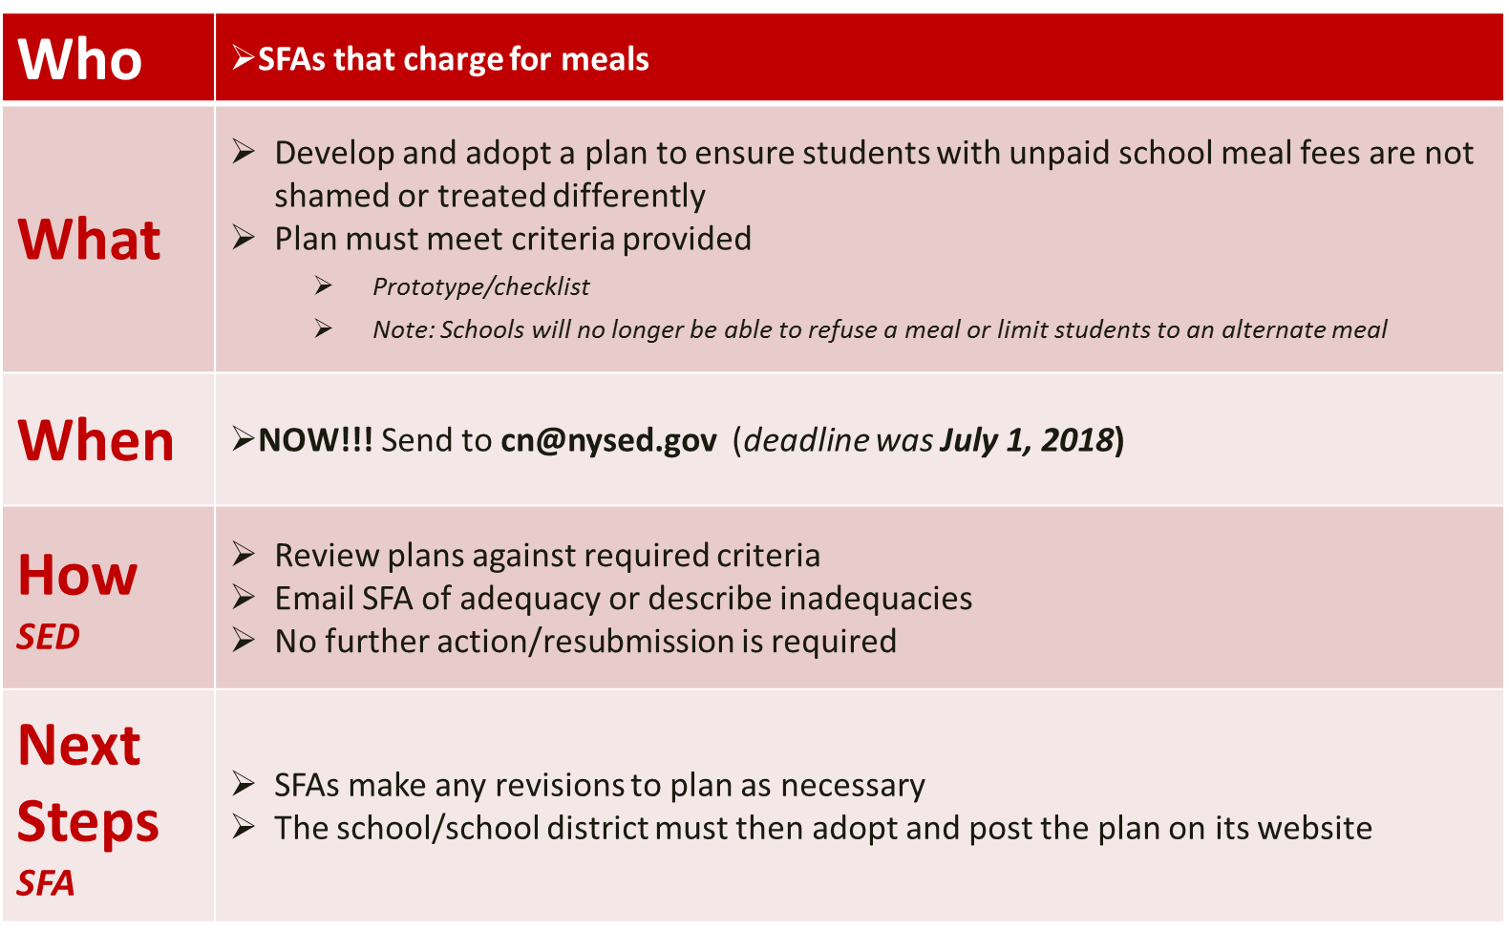
Anti Meal Shaming Policies
For Day Students Only
Notes:
If your facility or school is charging for meals, a policy must be created to ensure students with unpaid school meal fees are not shamed or treated differently.
School Food Authorities that charge for meals must develop a plan to ensure that a student whose parent or guardian has unpaid school meal fees is not shamed or treated differently than a student whose parent or guardian does not have unpaid school meal fees.
Again, this applies to all SFA that participate in National School Lunch Program and School Breakfast Program except schools offering meals at no charge such as schools participating in the Community Eligibility Provision, Provision 2, or zero pricing schools.
One of the biggest changes that we have seen SFAs have had to make, is that they can no longer limit reimbursable meal offerings to children with unpaid school meal fees.
The plan must address certain specific areas, and which we will outline in the next slides. A template policy has been developed for schools to use to ensure all required areas are addressed.
This plan was due to SED by July 1, 2018. Schools and facilities that are required to submit a plan but have not done so will be placed on reimbursement hold until a plan is received.
Plans can be emailed to the CN mailbox cn@nysed.gov.
SED will evaluate submitted plans to ensure they include the required elements. SED will notify SFAs in an email of any changes or additions that need to be made to the plan. Once the SFA has been notified, it can make any adjustment(s) to the policy as necessary.
The school district or facility must then adopt the policy and post the plan on its website.

Slide 45
Professional Standards
For State and Local Nutrition Program Personnel (Final Rule)
Effective July 1, 2015
SFAs are required to track the number of training hours earned each year and maintain documentation of the trainings attended
SFA must ensure compliance by maintaining:
    SED Tracking Tool
    USDA Tracking Tool
Notes:
USDA has established minimum professional standards requirements for school nutrition professionals who manage and operate the National School Lunch and School Breakfast Programs.
The standards, another key provision of the Healthy, Hunger-Free Kids Act of 2010 (HHFKA), aims to institute minimum education standards for new State and local school nutrition directors as well as annual training standards for all school nutrition professionals. These new standards will ensure school nutrition personnel have the knowledge, training and tools they need to plan, prepare, and purchase healthy products to create nutritious, safe, and enjoyable school meals.
Professional Standards for State and Local Nutrition Program Personnel Final Rule became effective July 1, 2015. The Final Rule requires all school food service personnel to complete annual continuing education/training requirements. The number of required training hours varies depending on the position and hours of the school food personnel.
As an SFA you are required to track the number of training hours you earn each year and maintain documentation of the trainings that you have attended. Our office has developed a simple excel document that you may use to do this. SFAs may use this excel document to track staff training hours and may add columns and other necessary information specific to your SFA. Our tool may be found within the Professional Standards training memo located on the Child Nutrition Knowledge Center. You may also use the USDA’s version or your own tracking tool.

Slide 46
Professional Standards
For Managers:
  At least 10 hours of annual continuing education/training
For Full Time staff (work >20 hours/week):
  At least 6 hours of annual continuing education/training
For Part-Time Staff (work <20 hours/week):
  Each year, at least 4 hours of annual continuing education/training, regardless of the number of part-time hours worked
Notes:
Managers are those individuals directly responsible for the management of the day-to-day operations of school food service for a particular school or schools. Effective during the 2018-2019 school year and going forward managers are required to behold at least 10 hours of continuing education/training.
School nutrition program staff includes all staff without managerial responsibilities who are involved in the day-to-day operations of the school food service for a participating school or schools. These staff members are classified as either full time (work >20 hours/week) or part time (those who work <20 hours/week). Those who work more than 20 hours per week are required to receive 6 hours of training per year while those who work less than 20 hours per week are only required to receive 4 hours of training.
Note: If a staff member is hired January 1 or later, they must only complete half of the above required training hours.
Required training for volunteers was not established in the Final Rule but allows for State Agencies to extend the trainings to these employees. SED is requiring that at a minimum, volunteers participate in the required Civil Rights training that is available on the Child Nutrition Knowledge Center. However, SED encourages all employees, including volunteers to participate in job-specific training.
If the SFA contracts with a FSMC, the SFA directors must ensure that the FSMC employees providing services for the school meal programs have the required annual training.

Slide 47
Professional Standards
For new directors hired after 7/1/15:
Standards are based on SFA enrollment
New directors must have at least 8 hours of food safety training within five years prior to their start date or within 30 calendar days after their start date
At least 12 hours of annual continuing education/training
Notes:
Minimum hiring standards are only for Food Service Directors hired after 7/1/2015.
SED also has the discretion to approve the employment of a candidate that meets the minimum education requirements but has less than 3 years experience in buildings with less than 500 students on a case by case basis.

Slide 48
Water
It is a responsibility of the SFA that children have access to free potable water during the lunch and breakfast meal services
Any SFA that does not make free water available or restricts access during the meal periods is out of compliance
While water must be made available to students, operators cannot promote or offer water or another beverage as an alternate selection to the fluid milk
Notes:
Water must be made available free of charge to all individuals who participate in the Child Nutrition program. Free water can be provided in a variety of ways including pitchers and cups on tables, a water fountain, or a faucet that allows students to fill their own bottles or cups with drinking water. Please note that the SFA is not required to serve bottled water. Potable tap water is adequate to fulfill this requirement.
Children must have access to water during the lunch and breakfast meal services. If a school is serving breakfast in an alternate location, such as in classrooms, free potable water is not required, although it is strongly encouraged. Water availability is also recommended for snack.
It is important to remember that free potable water is not in competition with milk and is not considered a beverage choice, because no beverage can compete with milk. Water availability is in addition to milk.

Slide 49
Food Safety
Hazard Analysis Critical Control Point (HACCP)
  Each site must have a written food safety plan for food preparation, service and storage facilities based on HACCP
Standard Operating Procedures (SOP)
  Temperature Logs & Recording
    Includes food, refrigerator, and freezer temperature logs
  Proper Food Storage
  Food Safety Inspections
    A letter requesting at least two food safety inspections each school year from the health department must be sent
    A copy of the most recent health inspection report must be posted in a location that is visible to the public
Notes:
During the admin review, SED will assess if proper food safety practices are followed at each RA selected for review.
Food safety compliance is assessed in the following areas:
Each site must have a written food safety plan for food preparation, service and storage facilities based on HACCP. The food safety plan should be a working document that has been modified to your site’s specific operations and reviewed by kitchen staff periodically or when changes to your operation occur.
Documentation requesting two annual food safety inspections from the health department, with the most recent inspection posted in a publicly visible location.
Proper recordkeeping, proper food storage and Temperature logs (include food, refrigerator and freezer temperature logs)

Slide 50
Reporting & Record Keeping
All reports must be accurate and submitted on time to NYSED
Maintain records for 3 years plus the current year
Notes:
SFA’s must maintain accurate records of all Child Nutrition Program operations and documentation supporting program operations and participation pursuant to the Single Permanent Agreement and CNP laws, regulation and policy. These records must be maintained for a period of 3 years plus the current school year and must be readily retrievable or immediately available upon request whether such request is due to an announced or unannounced review.
Submitting late reports may jeopardize funding.

Slide 51
Outreach
School Breakfast Program
Summer Food Service Program
Notes:
SFAs must inform eligible households of the availability of breakfast offered under the School Breakfast Program throughout the school year and meals offered through the Summer Food Service Program before the end of the school year.

Slide 52
Other Federal Programs
Afterschool Snack Program
Notes:
The final topic we will be covering is Other Federal Programs, in particular, the Afterschool Snack Program.

Slide 53
Afterschool Snack Program
Requirements
Record Keeping
Reimbursement – one snack per child per day up to 7 days
RCCIs that already have snack and dinner programs claimed under CACFP may continue to claim through that program or they may choose to claim for the snack program under the NSLP
Two self reviews must be conducted during the school year
  The first of which must be during the first four weeks of operation
Snack menus and daily production records
Daily attendance and/or intake logs
Applications for day students if less than 50% snack needy
“And Justice For All” poster must be displayed
Notes:
RCCIs and Jails can participate in the Afterschool Snack Program and can claim a reimbursement for one snack per child per day up to 7 days. SFAs that are already claiming snack through CACFP may continue to claim through that program or may choose to claim for the snack program under the National School Lunch Program.
To be in compliance, two self reviews must be conducted during the school year. The first must be during the first four weeks of operation. Snack daily production records are also required to be completed. Snack menus, production records, daily attendance and or intake logs must be maintained for 3 years plus the current year.
SFA's must conduct edit checks to ensure they are not claiming more snacks than the number of students in attendance. If an SFA is below the 50% eligible for a snack needy area, they must have applications on file and a coded document at the point of service to track reimbursable snacks.
If a school is above 50%, therefore claiming free snacks to all students, a tic sheet is acceptable at the Point Of Service, however they should also have a daily attendance record to ensure that the meal counts are reasonable.
RCCIs that already have snack and dinner programs claimed under CACFP may continue to claim through that program or they may choose to claim for the snack program under the NSLP, however they cannot claim under both CACFP and NSLP.
RCCIs may claim snack on the weekends as well.
Please note, the And Justice For All poster must be displayed in all areas of service.

Slide 54
After School Snack Components
A reimbursable snack must contain two different components from the following four components:
  Milk - 8 fluid oz.
  Meat/meat alternate - 1 oz. eq.
  Fruit/vegetable - 3/4 cup
  Grain - 1 oz. eq.
Juice may not be served when milk is the only other component
Notes:
A reimbursable snack shall contain two different components from the following:
Milk;
meat/meat alternate;
fruit/vegetable; and
bread/bread alternate.
Unlike NSLP though, schools are not required to offer two varieties of milk in the snack program. Juice may not be served when milk is the only other component. There is no Offer Vs Serve option, the child must be served two full components.
Please note there is an additional snack memo available on the Child Nutrition Knowledge Center which lists the correct portion sizes for each component.

Slide 55

Questions?
www.cn.nysed.gov
Child Nutrition Program Administration
CNTRAINING@nysed.gov
(518) 473-8781

