Slide 1
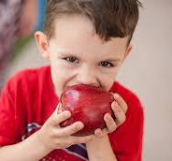
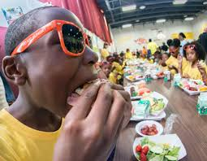

Promoting Your Summer Food Service Program

Slide 2

Some Hunger Statistics
Half of the public school children in this country are from low-income families
22 million of these kids rely on free or reduced price lunches
12 million of these kids rely on free or reduced price breakfast
Only 1 in 6 children who receive free or reduced price school lunches participate in a summer meal program
Low income families will spend almost $1,000 more each summer for groceries
For every 100 school lunch programs, there are only 87 breakfast sites and just 36 summer food programs

Slide 3

Ways to Promote Your Program

Slide 4


Social Media
Post information about your program on your social media sites
          Retweet information about Summer Meals from @USDANutrition
            Example Tweet: Individuals, schools, and communities can help connect eligible children to summer meals #SummerFoodRocks
            Post information on your Facebook page about your open site
            Include the text information so families can find a site closest to their location.
            Text “FOOD” (for English) or “COMIDA” (for Spanish) to 877-877
            Text “SummerMeals” to 97779

Slide 5
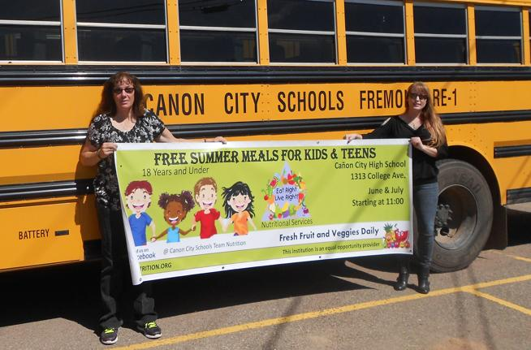
School Based Outreach
Provide schools with flyers to hang in common areas where both parents and students can see them
Offer materials to schools so they can provide them at parent teacher conferences or with third and fourth quarter report cards
Work with the PTA to get the word out to all the parents
Encourage schools to post information about your site on their Facebook page

Slide 6
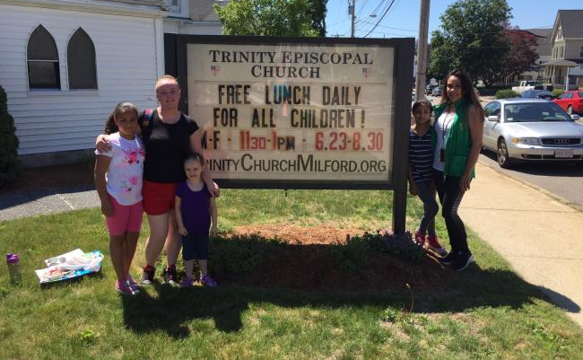
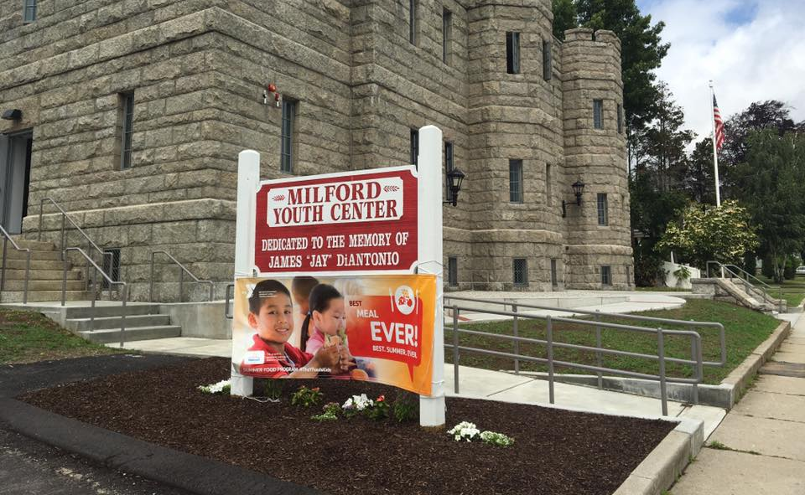
Faith Based Outreach
Provide faith leaders with flyers to post in their common areas where parents and children can see them
Ask faith leaders if they would consider including talking points about childhood hunger and the availability of summer meals
Work with the faith based organizations in your area to see if they would consider becoming a site
Encourage faith leaders to provide information about summer meals on their website and outdoor message board

Slide 7
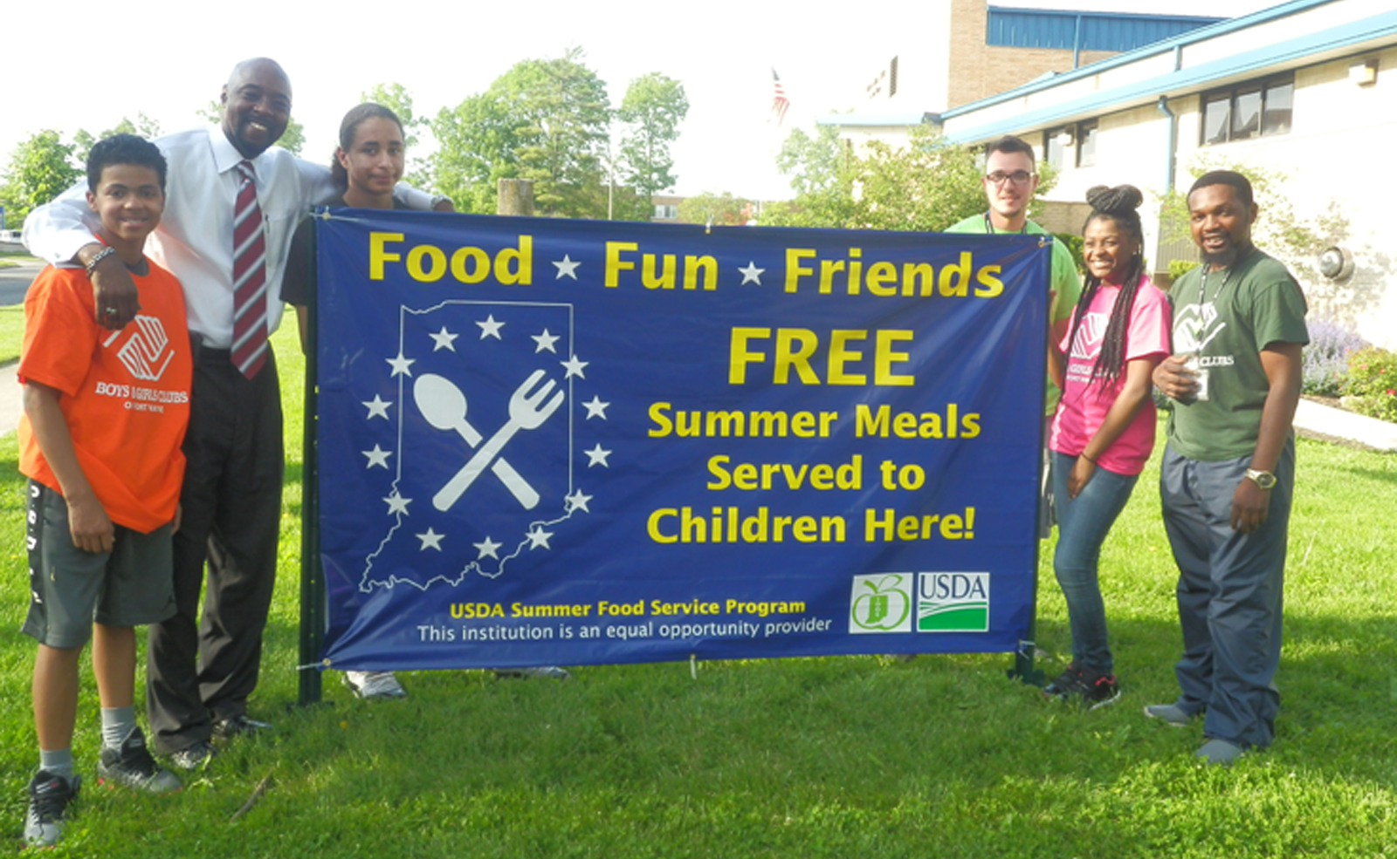
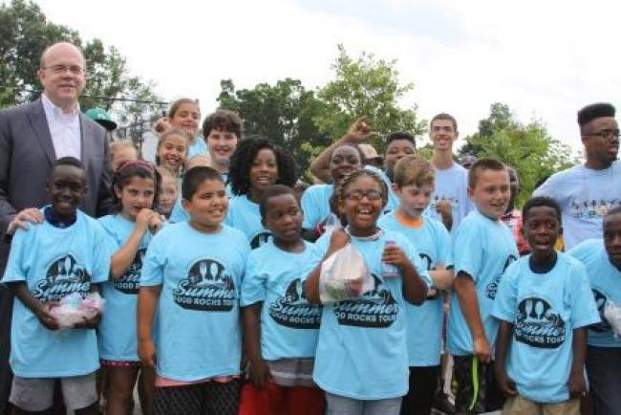
Community Outreach
Partner with community organizations that provide youth services such as Boys and Girls Clubs, YMCAs, and United Way
Advertise your program to your community early! Start before school is out and continue until your program ends
Partner with your local parks and recreation department. They could be a potential site or provide activities for your program
Participate in community events such as health fairs, library programs, and police and fire community meeting to get the word out about your program

Slide 8

Shared Strategies
Contact local utility companies to ask if you can include a flyer or handout in the mailed utility bills in your area.
Cross-promote with your local Department of Health & Human Services.
Create doorhanger flyers and leave them on doors in local neighborhoods.
Organize a raffle or prize drawing at your feeding site – provide raffle tickets to kids who bring other kids.

Slide 9

* FREE download from USDA
Hang flyers in your community:
Grocery Stores
Convenience Stores
Churches
Community Centers
WIC Offices
Doctor Offices
Libraries
Museums
Laundromats
Dollar Stores

Slide 10
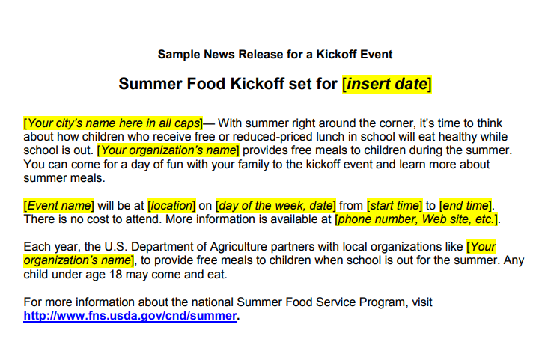

Alert The Media
Send a press release to local news outlets
Click HERE to View USDA’s Prototype Media Releases

Slide 11


Check out the free resources available for download from Share Our Strength’s website, including business cards, bookmarks, yard signs and postcards

Slide 12


Share the TEXT hotlines in your community
Text
“summermeals”
to
97779

Slide 13
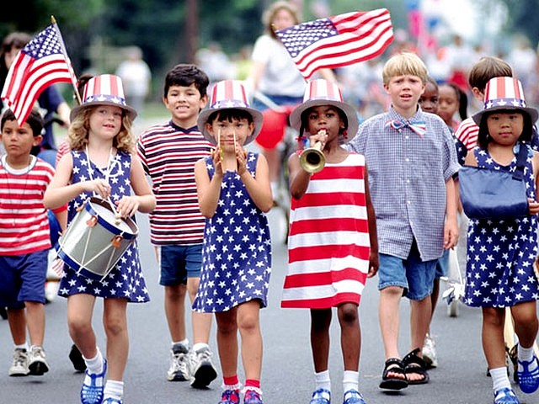
Consider organizing a “parade” in the neighborhood to involve kids and conduct outreach to other potential participants.
Have the kids make signs and a banner using craft supplies, teach them a song or a cheer and walk a short, safe route through the neighborhood.
Have print materials such as a calendar with menu and activities schedule to give to kids and parents.
Decorate nearby sidewalks with chalk art leading kids to the site.

Slide 14
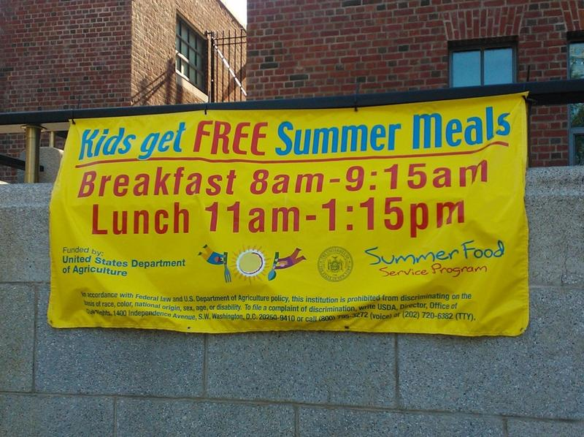
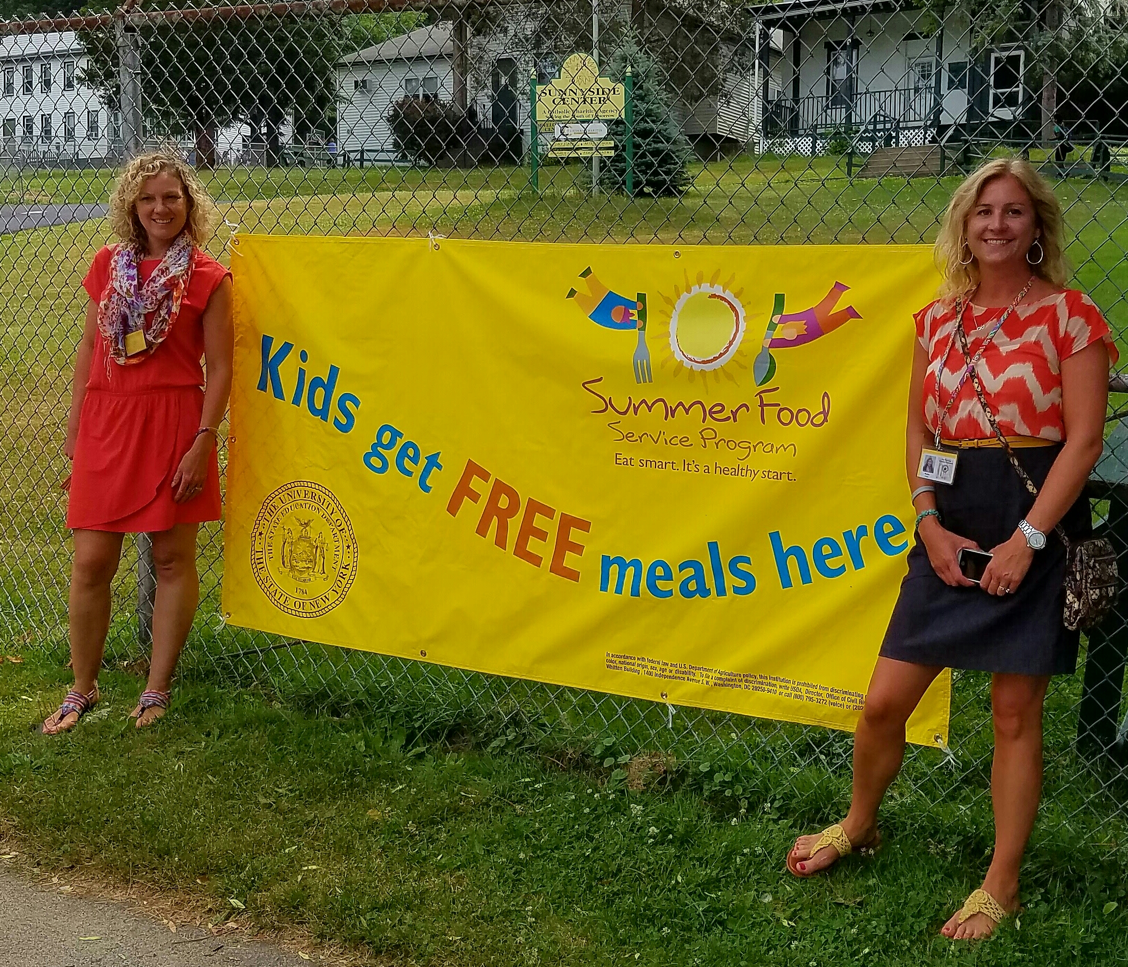
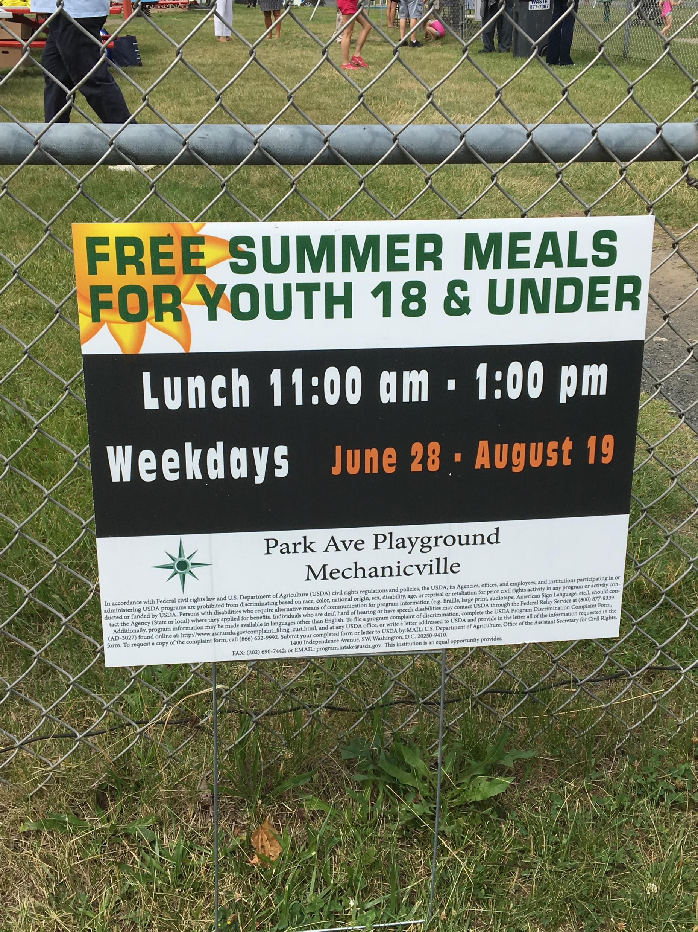
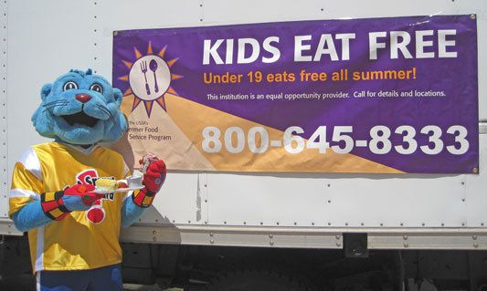
Remember…
Promotion of your Summer Food Service Program starts with YOU!

Slide 15
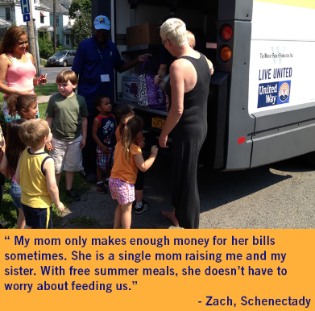
Many families struggle to feed their children nutritious meals each day. Thank you for the great work you do to ensure children in your community have access to nutritious, free meals in the summer!

