Slide 1
Production Records
New York State Department of Education
Child Nutrition Program Administration

Slide 2
Professional Standards for State and Local Nutrition Program Personnel Final Rule
This PowerPoint will contribute 1 Training Hour towards the Professional Standard training requirements
Required to track the number of training hours earned each year and maintain documentation of the trainings attended
SED prototype tracking excel document for School Food Service Directors is located on the CNKC
Notes:
The Final Rule requires all school food service personnel to complete annual continuing education/training requirements. The number of required training hours varies depending on the position of the school food personnel.
This webinar will contribute 1 Training Hour towards the professional standards training requirements.
You are required to track the number of training hours you earn each year and maintain documentation of the trainings you have attended.
Our office has developed an excel document called “ SED Training Tracker Tool” that you may use to track staff training hours. The excel training document is posted on the Child Nutrition Knowledge Center.

Slide 3
Production Records
Required by Regulation for Breakfast, Lunch & Snack
Provides a daily written history of the food planned, prepared and served
Documents compliance with meal pattern requirements
Completed daily for all buildings
Reflects age/grade groups, even if they are in one building
Example: High School is grades 6-12, production records must separate information for grades 6-8 and 9-12 to show different menu plans
Notes:
A production record provides a daily written history of the food planned, prepared and served in your establishment.
A production record serves as a communication tool for all staff.
A production record documents compliance with meal pattern requirements.
Production records must be completed daily for every building in your SFA and must reflect distinct age/grade groups, even if they are served in one building.
For example, if the high school is grades 6-12, there needs to be separate production records for each age/grade group since there is different meal pattern requirements.
Daily production records are required by regulation for Breakfast, Lunch & After School Snack.

Slide 4
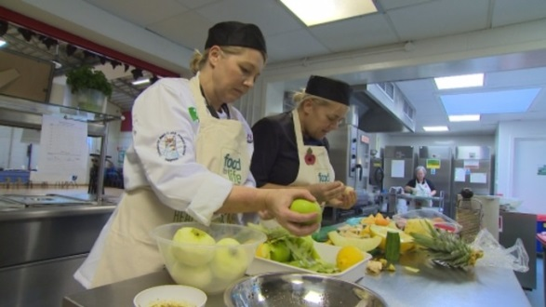
Advantages of Production Records
An excellent planning & forecasting tool that will help the food service manager to have a successful food service operation
Provides a written history that can be used to evaluate customer preference & improve menu planning
Minimizes overproduction and food waste
Improves participation
Provides a daily written history of the food planned, prepared & served
Can add comments to document changes
Notes:
SFAs should encourage staff not to think of production records as something “I must do” but rather an important tool in their daily process of providing meals.
We understand all of the challenges with the meal pattern but accurate and complete production records are essential.
Production records are an excellent planning and forecasting tool that will help with a successful food service operation.
Production records provide a daily written history of the food planned, prepared, and served.

Slide 5
Production Record Word Template
Notes:
This is the “Simple Production Record” template for Microsoft Word which can be located on the Child Nutrition Knowledge Center.
SFAs are not required to use this template but if they decide to use their own production record, all required elements must be on it.
5

Slide 6
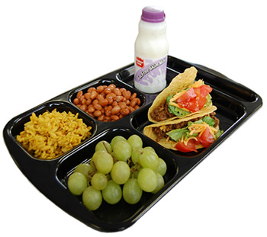
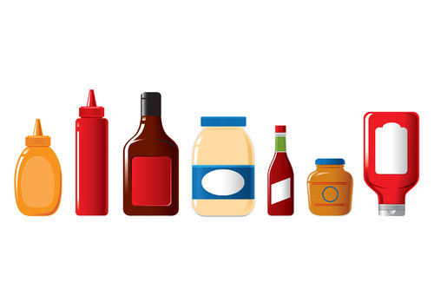
Required Elements
Menu Items
Includes ALL offered food components
Includes ALL daily menu options
(Salad meal, deli meal, PBJ sandwich)
Includes condiments & toppings
Notes:
These are the elements to a properly completed production record.
The production record must include all food items offered on the reimbursable menu. This includes ALL offered components, menued items and daily alternates. Condiment and topping usage must be documented as well, as they add to the overall calorie and sodium content of the total meal.

Slide 7
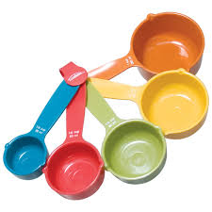
Required Elements
Portion Size
Amount of the item that is available to each student
Must be listed for ALL menu items
½ cup carrots vs. 4 oz. carrots
Total Portions Offered
Amount of each item expected to be served
Notes:
Portion size is the amount of the item that is available to each student. Portion sizes must be documented and differentiated on the production record as there are specific portion requirements for each group served.
When portioning out the menu items make sure you are using volume measurements unless you are weighing each menu item. For example, it should read “½ cup carrots” versus “4 oz. carrots.” This is essential as the total caloric value of portions can differ greatly between volume and weight. Consistency between the standardized recipe and the production record help to prevent breakdowns in service (such as not preparing enough food) and predictable yields result in less over-production.
The number of portions offered is the amount of each item expected to be served. For example the cook forecasted that 100 students usually select the hamburgers in the past, so when preparing the hamburgers today the cook will plan on offering 115 hamburgers to ensure there is enough hamburgers for the demand.

Slide 8
Required Elements
Reimbursable Portions Served
Number of portions of each food item that is actually served in a reimbursable meal
A la carte/non reimbursable portions served
Adult meals, second meals, snacks
Leftovers
Helps with forecasting
Prevents overproduction
Notes:
The number of reimbursable portions served must be recorded on production records. Reimbursable portions served are the number of portions of each food item that is actually served for a reimbursable meal. The reimbursable portion column must be completed for each menu item. This includes the main entrée, vegetables, fruit, milk, and condiments.
The number of a la carte and non reimbursable portions served must be recorded and differentiated from the reimbursable meals column. This information is important when calculating the SFA’s non-program food costs.
This column includes adult meals, second student meals, snacks, and extra menu items that are not included in the reimbursable meal.
The number of leftover portions must be recorded before anything is discarded. Tracking leftovers helps prevent overproduction for future meals. This information is also important if leftovers are utilized the next day. Salad bar leftovers may be estimated.

Slide 9
Required Elements
Date
Recipe Number (optional)
Notes:
The date is required on the production record. The day of the week is also very helpful but this is optional.
If standardized recipe numbers exist, they should be listed on the production record as it serves as a reference between the production record and specific information contained in the standardized recipe.

Slide 10
Condiments & Toppings
Condiments & Toppings must be included as they contribute to nutrient specifications
P.C. Packets/Pre-portioning
Track the number served as part of the reimbursable meal
Self-Serve
Track the total amount of the item used & determine how many students consume based on the average portion size
Notes:
Condiments and toppings must be included and documented on the production record as they contribute to nutrient specifications. SFAs have several options for documenting condiments. The condiment may be included as part of the standardized recipe for a menu item, such as including ketchup and mustard in the cheeseburger recipe. The condiments may be listed individually on the production record for portion control packaging. A condiment recipe is generally used when the meal site utilizes a standard, self-serve condiment bar. When using P.C. packets or pre-portioning, the number served as part of the reimbursable meal must be tracked and documented.
When students are using self-serve condiments, the staff should track the total amount of the item used and determine how many students consume the condiment or topping based on the average portion size.

Slide 11
Comments and Notes Section
Way to communicate any changes in meal counts
Factors affecting meal counts
Class trips, weather, illness
Helpful for forecasting
Communication tool
Notes:
The comments and notes section of the production record is a great place where the SFA can communicate any changes in meal service. For example, maybe the meal counts are higher or lower than normal.
Sometimes factors such as class trips, weather, or illness; and comments made by students provide valuable written history for the future. These factors can help to spot trends, evaluate what works best with your students, and help you decide what to change. Recording this information is helpful when you refer back to already completed production records for future forecasting.
Production records serve as a communication tool, so they should be kept in a place that staff may have access. Production records should be a working document which all staff uses daily.

Slide 12
Substitutions
Vegetable sub-groups
Ensures appropriate substitutions
Substitute within the same vegetable subgroup
Example: Romaine Salad replaced with broccoli
Notes:
All menu items served to students must be included on the production record, even if it is a last minute change.
The menu must offer five different vegetable subgroups of vegetables that count toward the daily and weekly vegetable requirements. It is important to know which vegetables are in each vegetable subgroup when making substitutions to the menu.
For example, if a raw Leafy Green romaine salad is on the menu, but romaine lettuce is not available, the salad should be substituted with another vegetable from the dark green vegetable subgroup, such as broccoli. Substitutions must also be documented in the notes and comments section of the production record to support the claim for reimbursement.
SFAs should always have a backup vegetable for emergencies.
The vegetable subgroup chart can be found under Nutrition Standards in the National School Lunch and Breakfast programs in the Food Based Menu Planning tab on the Child Nutrition Knowledge Center website.

Slide 13
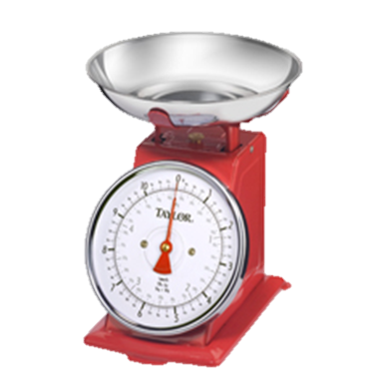
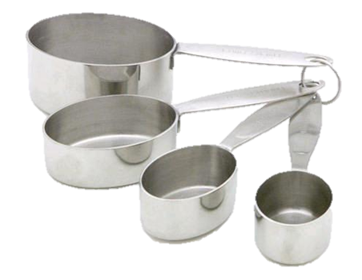
Weight vs. Volume
Cheese, grated
Weight: 2 oz. = 212 calories
Volume: ¼ cup = 84 calories
French Fries, potato puffs
Weight: 4 oz. = 252 calories
Volume: ½ cup = 142 calories
Notes:
Weight versus volume is one of the most significant problems we find with production records.
As you can see weight verses volume will change the number of calories. This will impact the nutrient analysis if you give us inaccurate data.
If you have a scale and are weighing items that are being served, feel free to use weight.
It is best to measure food as indicated in the food based menu plan.

Slide 14
Complete Before Meal Service
Notes:
This production records shows the elements that should be completed before food service
The elements that should be filled out are: school or service location, the date, the type of meal service; breakfast, lunch or snack; the age/grade group being served; the name of the menu (or food) item; including condiments recipe number (if applicable), portion size, total portions offered and time and temp.

Slide 15
Complete After Meal Service
Notes:
This production records shows the elements that should be completed after food service.
These elements are: reimbursable portions served, non-reimbursable portions (adult, a la carte, second meals) and leftovers. You should also record the number of reimbursable meal total at the top of the production record.

Slide 16
Example of Properly Completed Production Record
Notes:
This production record is legible and easy to obtain important production information from.
If your site has multiple serving times it is recommended that you take the temperature of your hot and cold items before each service.
Items stored in coolers with temperatures already recorded on the separate freezer and cooler temperature log, do not need to be re temped and recorded on the production record.

Slide 17
Example of Poorly Completed Production Record
Notes:
This production record is poorly completed. It is illegible. Be sure your production records are legible, often we cannot read them and therefore cannot confirm that program requirements are being met. This production record is sloppy, illegible and difficult to interpret usable information. It is also incomplete. The age/grade groups are not specified, quantities planned are inconsistent and incorrect, there should be continuity between the production record and the standardized recipe, number of reimbursable and a la carte meals served is not completed and the date is incomplete.

Slide 18
Common Errors
Missing/ Incomplete production records
Not separating age/grade groups
Portion sizes
Listing “vegetable”
Incorrect vegetable subgroup substitutions
Weight vs volume
Notes:
This is a list of the common errors founds on Administrative Reviews.
Missing productions records: SFAs are not filling them out for each meal service. Production records are required for breakfast, lunch, and after school snack.
Incomplete production records have been found to be missing food items, not adding condiments and milk variety to the production records, serving size is not listed, not listing daily alternative meals and not completed after the meal service.
Age/ grade groups need to be separated on productions records because there are specific portion requirements for each group served.
Portion size is the amount of the item that is available to each student and it must be listed for ALL items. For example, if serving chicken nuggets, write 5 nuggets versus 1 pan. This ensures that the meal pattern is being met for each age/grade groups.
When a production records just list “vegetable” this does not show what vegetable subgroup is being served during the meal service.
When making a vegetable subgroup substitutions make sure the vegetable being substituted falls under the same group. For example if carrots is listed on the menu you could switch to sweet potatoes.
When completing production records weight verses volume will change the number of calories.

Slide 19
Record Keeping
Production records must be retained for 3 years plus the current year.
Notes:
Be sure to keep all Child Nutrition related documents, including production records for 3 years plus the current year.

Slide 20
Helpful Resources
Food Buying Guide
Food Buying Guide Calculator
http://teamnutrition.usda.gov/Resources/foodbuyingguide.html
USDA Standardized Recipes
http://teamnutrition.usda.gov/Resources/usda_recipes.html
Recipes for Healthy Kids Cookbooks
www.teamnutrition.usda.gov
New York Child Nutrition
www.cn.nysed.gov
Notes:
Be sure to check out the resources.

Slide 21
Child Nutrition Program Administration
Child Nutrition Program Administration
89 Washington Avenue, Room 375 EBA Albany, NY 12234
(518) 473-8781
cntraining@nysed.gov
www.cn.nysed.gov
Notes:
Please contact your Child Nutrition Program representative if you have any questions.

