Slide 1

Production Records
1 hour Professional Standards Training
Notes:
This PowerPoint will contribute 1 hour towards Professional Standards training requirements. This training reviews Production Records in the Child Nutrition Programs.
A production record provides a daily written history of the food planned, prepared and served in your establishment. Production records document compliance with meal pattern requirements.

Slide 2
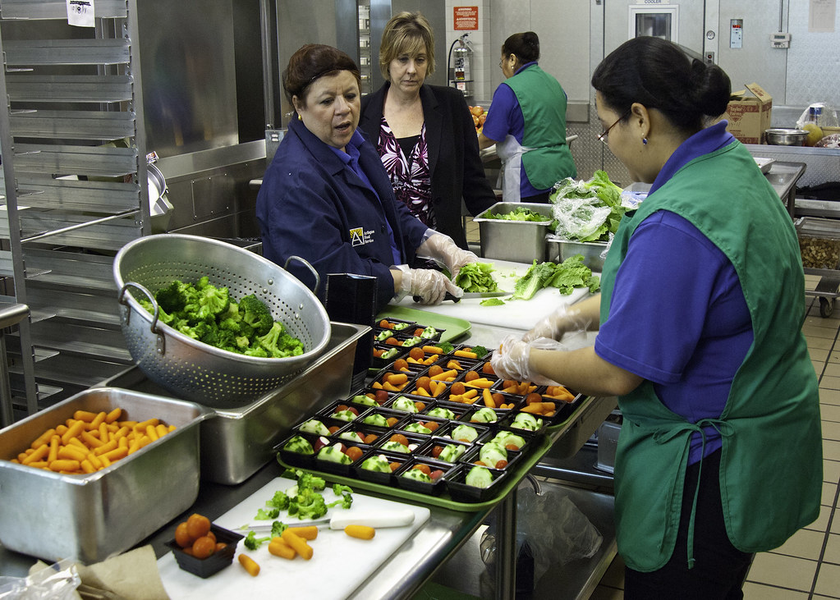
Your Production Records
Provides a daily written history of the food planned, prepared and served
Documents compliance with meal pattern requirements
Completed daily for all buildings
Reflect distinct age/grade groups, even if they are in one building
Example
  High School is grades 6-12, production records must separate information for grades 6-8 and 9-12 to show different menu plans
Required by Regulation for Breakfast, Lunch & Snack
Notes:
Production Records must be completed daily for every building in your SFA and must reflect distinct age/grade groups, even if all students are served in one building. For example, if the high school is grades 6-12, production records must identify the distinct information for grades 6-8 and 9-12 since they are different menu plans.
Daily production records are required by regulation for Breakfast, Lunch & After School Snack.

Slide 3

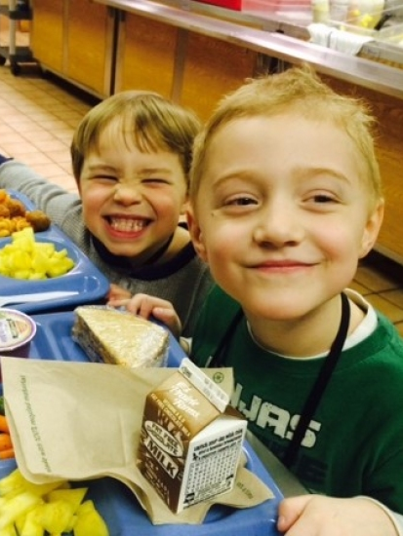
Advantages of Production Records
An excellent planning & forecasting tool that will help the food service manager to have a successful food service operation
Provides a written history that can be used to evaluate customer preference & improve menu planning
  Minimizes overproduction and food waste
  Improves participation
Provides a daily written history of the food planned, prepared & served
Can add comments to document changes
Notes:
SFAs should encourage staff not to think of production records as something “I must do” but rather an important tool in their daily process of providing meals.
We understand all of the challenges with the meal pattern but accurate and complete production records are essential.
Production records are an excellent planning and forecasting tool that will help with a successful food service operation.
They provide a written history that can be used to evaluate customer preference and improve menu planning. Staff are able to determine what entrees students prefer and which entrees don’t sell well.
Production records allow staff to determine how much of each food item is typically used. Being aware of the quantity of food that is usually consumed helps minimize overproduction and food waste. This will help cut down on program costs which helps maintain a financially successful program.
Production records provide a daily written history of the food planned, prepared, and served.

Slide 4
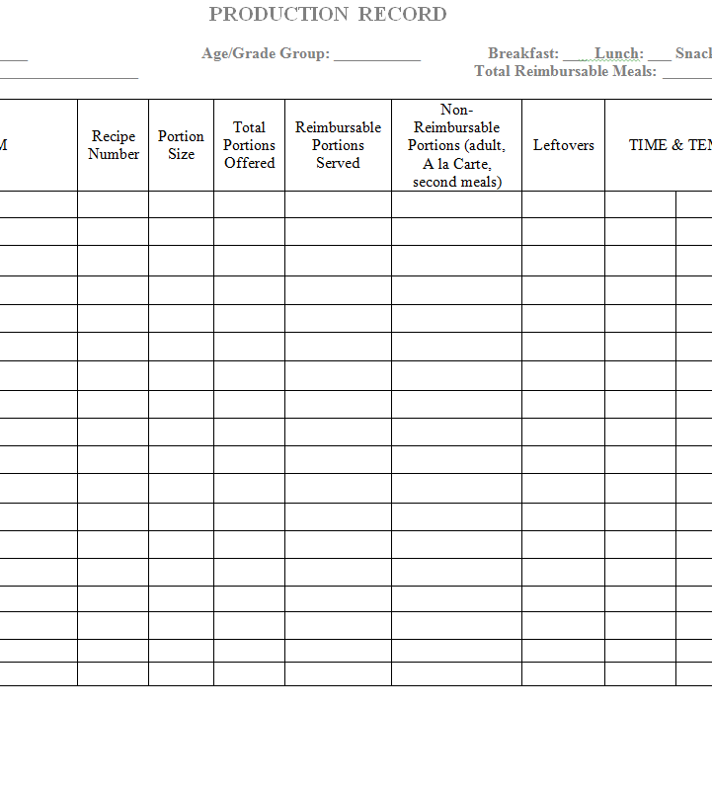
Production Record Word Template
Notes:
This is the “Simple Production Record” template for Microsoft Word. You will find this attached to this Learning Module and can also be located on the Child Nutrition Knowledge Center. Refer to the Simple Production Record provided in the attachments to this Module.
There is also a more detailed production record template available in Microsoft Excel on the Child Nutrition Knowledge Center.
This separates the menu items in different categories: meat/meat alternate, fruit, vegetable, grains, milk, condiments/other.
SFAs are not required to use this template but if they decide to use their own production record, all required elements must be on it.
4

Slide 5

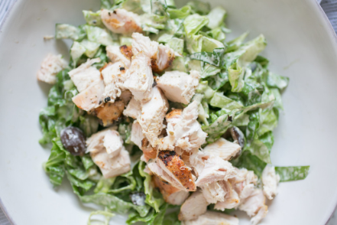
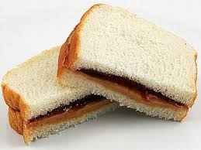
Required Elements: Food Items
All food items on the reimbursable menu
  Includes ALL offered components
    Meat/Meat alternate, Grain, Fruit, Vegetables, Milk
  *Missing a component may result in fiscal sanctions
  Includes ALL daily menu options
    Ex. Salad meal, deli meal, PBJ sandwich
  Includes condiments & toppings
Notes:
These are the required elements for a properly completed production record.
The production record must include all food items offered on the reimbursable menu. This includes ALL offered components, menu items and daily alternate meals.
All 5 components must be on production record: Meat/meat alternate, grain, fruit, vegetables, milk
If ALL components are not included on the production record fiscal sanctions may be assessed.
For example, Milk is often left off the production record. If a SFA cannot prove to a state reviewer that at least two different types of milk were offered for a given period. They may have to take back reimbursement for all meals which milk is not on the production record. This is why COMPLETE production records are so important.
Production records must also include ALL daily menu options. This includes any daily alternate meals, such as, a salad meal, deli meal, salad bar option, or sandwich option.
Once again, if an SFA can not substantiate that these options were offered reimbursement may be withheld.
A recipe number may be beneficial here because you won’t have to write on a production record every separate ingredient, as long as all ingredients are listed in the recipe that may be served with the menu item. You can simply indicate “chef salad” and a recipe number and indicate everything that is in the salad on the recipe card. This insures you won’t forget an ingredient during the rush of the day and there will be no chance of money being withheld.
Production records must also include ALL condiments and toppings offered that day. These are important for the nutrient analysis.
Condiment and topping usage must also be documented as well, as they contribute to the overall calorie and sodium content of the total meal.

Slide 6



Required Elements: Quantity Prepared
Quantity Prepared for each food item
  Instead of “1#10 can” prepared, use “20 - ½ c” portions
  Important for proper entrée forecasting
    avoids over/under production
    Distinguish between student likes/dislikes
Notes:
The quantity prepared of each food item must also be listed on production records.
It is best to be specific when recording prepared quantities. Instead of documenting that one #10 can of canned vegetables were opened, it is a best practice to relate the quantity prepared with the actual portion served, for example, twenty ½ cup portions.
This is important for forecasting to avoid overproduction or underproduction.
For example: After reviewing your production records you may determine that on a general basis 10% of the student population chooses peanut butter and jelly. You could then forecast exactly how many peanut butter and jelly sandwiches you would need to make on a daily basis to avoid overproduction or underproduction
Indicating the quantity prepared can also help determine students likes and dislikes for entrees or if something was wrong with an entrée.
For example: You decide to change your pasta sauce, you know from production records that about 70% of the population typically chooses spaghetti and meatballs when it is offered but today 40% of the population chose the entrée. You would then know that switching to the previous pasta sauce would be beneficial.

Slide 7
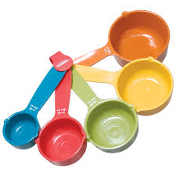
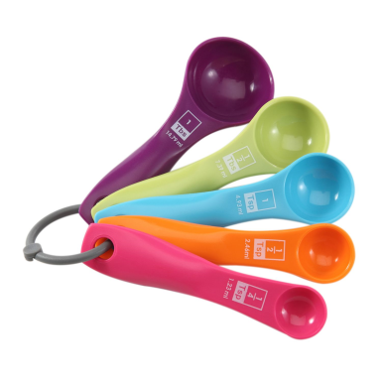

Required Elements: Portion Size
    Portion Size
      Amount of the item that is available to each student
      Must be listed for ALL menu items
        Be sure to use volume measurements
          ½ cup carrots vs. 4 oz. carrots
Total Portions Offered
  Amount of each item expected to be served
Notes:
Portion size is the amount of the item that is available to each student. Portion sizes must be documented and differentiated on the production record as there are specific portion requirements for each age group served.
When portioning out the menu items make sure you are using volume measurements unless you are weighing each menu item. For example, it should read “½ cup carrots” versus “4 oz. carrots.” This is essential as the total caloric value of portions can differ greatly between volume and weight. Consistency between the standardized recipe and the production record help to prevent breakdowns in service (such as not preparing enough food) and predictable yields result in less over-production.
The number of portions offered is the amount of each item expected to be served. For example, the cook forecasted that 100 students usually select the hamburgers in the past, so when preparing the hamburgers today, the cook will plan on offering 115 hamburgers to ensure there is enough hamburgers for the demand.

Slide 8

Portion Size
Weight vs. Volume
Best practice to follow the Food Based menu plan
  Cups for fruit and vegetables, ounces for grains and M/MA
French Fries or Potato Puffs
  Weight: 4 oz. = 252 calories
  Volume: ½ cup = 142 calories
Peaches, canned
  Weight: 6 oz. = 92 calories
  Volume: ¾ cup = 102 calories
Cheese, grated:
  Weight: 2 oz. = 212 calories
  Volume: ¼ cup = 84 calories
Production records must accurately reflect your meal service.
Notes:
Documenting the portion size correctly is one of the most significant problems we find with production records.
When measuring food, it is a best practice to use volume measurements unless you are weighing items. This means using cups for fruits and vegetables and ounces equivalents for grains and meat/meat alternates. In this example, two ounces does not necessarily equal ¼ cup, and two ounces does not necessarily equal a 2 oz. equivalent.
Documenting the measurement incorrectly will also impact the nutrient analysis. In this example, if measuring French fries by weight, 4 oz. is 252 calories and by volume, ½ cup is equal to 142 calories.

Slide 9
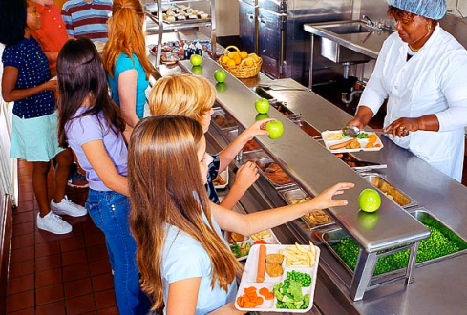
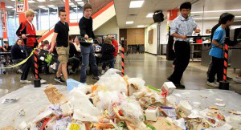
Required Elements: Reimbursable Portions Served
Reimbursable Portions Served
  Number of portions of each food item that is actually served in a reimbursable meal
A la carte/non reimbursable portions served
  Adult meals, second meals, snacks
Leftovers
  Helps with forecasting
  Prevents overproduction
Notes:
The number of reimbursable portions served must be recorded on production records. Reimbursable portions served are the number of portions of each food item that is actually served for a reimbursable meal. The reimbursable portion column must be completed for each menu item. This includes the main entrée, vegetables, fruit, milk, and condiments.
This is the column that tells state officials whether the reimbursable meal was actually served.
The number of a la carte and non reimbursable portions served must be recorded and differentiated from the reimbursable meals column. This information is important when calculating the SFA’s non-program food costs.
This column includes adult meals, second student meals, snacks, and extra menu items that are not included in the reimbursable meal.
The number of leftover portions must be recorded before anything is discarded. Tracking leftovers helps prevent overproduction for future meals. This information is also important if leftovers are utilized the next day. Salad bar leftovers may be estimated.

Slide 10

Elements:
Date (required)
  Important to distinguish when foods are actually served.
Recipe Number (optional)
  Reference between production record and standardized recipe
Notes:
The date is required on the production record. The day of the week is also very helpful but this is optional.
If standardized recipe numbers exist, they should be listed on the production record as it serves as a reference between the production record and specific information contained in the standardized recipe.
It’s best practice to include recipe numbers to ensure nothing gets left out of production record, this helps avoid fiscal sanctions.

Slide 11

Required Elements:
Comments and Notes Section
This is a mechanism to communicate any changes in meal service.
Factors affecting meal counts
  Class trips, weather, illness
Helpful for forecasting
Communication tool
Notes:
The comments and notes section of the production record is a great place where the SFA can communicate any changes in meal service. For example, maybe the meal counts are higher or lower than normal and in the comments you can note why that is.
Sometimes factors such as class trips, weather, or illness; and comments made by students provide valuable written history for the future. These factors can help to spot trends, evaluate what works best with your students, and help you decide what to change. Recording this information is helpful when you refer back to already completed production records for future forecasting.
Production records serve as a communication tool, so they should be kept in a place that staff may have access. Production records should be a working document which all staff uses daily.

Slide 12
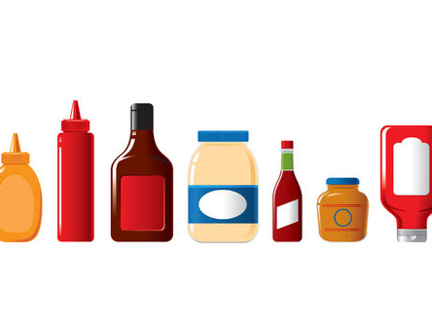
Condiments & Toppings
Condiments & Toppings must be included as they contribute to nutrient specifications
P.C. Packets/Pre-portioning
  Track the number served as part of the reimbursable meal
Self-Serve
  Track the total amount of the item used & determine how many students consume based on the average portion size
Notes:
Condiments and toppings must be included and documented on the production record as they contribute to nutrient specifications. SFAs have several options for documenting condiments. The condiment may be included as part of the standardized recipe for a menu item, such as including ketchup and mustard in the cheeseburger recipe. The condiments may be listed individually on the production record for portion control packaging. A condiment recipe is generally used when the meal site utilizes a standard, self-serve condiment bar. When using P.C. packets or pre-portioning, the number served as part of the reimbursable meal must be tracked and documented.
When students are using self-serve condiments, the staff should track the total amount of the item used and determine how many students consume the condiment or topping based on the average portion size.
Be sure to monitor condiment stations to ensure students aren’t overusing condiments.

Slide 13


When to complete Production Records
Complete before meal service:
School / Site Name
Date/ Day
Age / Grade Group
Service (Breakfast / Lunch / Snack)
Menu Item
Recipe Name
Portion Size
Total Portions Offered (#)
After Meal Service:
Reimbursable Portions
Non-Reimbursable Portions
Leftovers
Time / Temperature (Optional)
Comments / Notes
Notes:
Certain information on a production record can be completed before meal service begins
This information includes the name of the school or service location, the date, the type of meal service; breakfast, lunch or snack; the age/grade group being served; the name of the menu (or food) item; including condiments, recipe names and numbers, the portion sizes, and the total number of portions being offered.
Again, condiments must be included on the production records.
The total portions offered and the portion size can be completed ahead of time and ensure that the portion size meets the required minimum portion size for the age/grade group being served.
After meal service is complete the actual number of reimbursable meals served, the non-reimbursable portions served; including a la carte, second and adult meals, leftovers, time and temperature, and total reimbursable meals served. It is also important to note if any substitutions were made or any comments regarding feedback from the meal service.
Completely information before the meal service will save time during the rush of the day
13

Slide 14

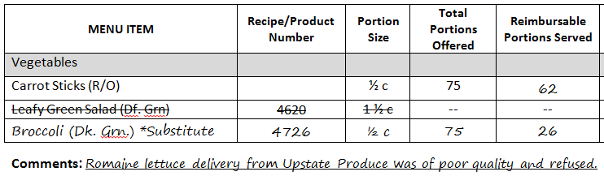
Substitutions
Vegetable sub-groups
  Ensures appropriate substitutions
  Substitute within the same vegetable subgroup
    Example: Romaine Salad replaced with broccoli
Notes:
All menu items served to students must be included on the production record, even if it is a last minute change.
The menu must offer five different vegetable subgroups of vegetables that count toward the daily and weekly vegetable requirements. It is important to know which vegetables are in each vegetable subgroup when making substitutions to the menu.
For example, if a raw Leafy Green romaine salad is on the menu, but romaine lettuce is not available, the salad should be substituted with another vegetable from the dark green vegetable subgroup, such as broccoli. Substitutions must also be documented in the notes and comments section of the production record to support the claim for reimbursement.
SFAs should always have a backup vegetable for emergencies.
The vegetable subgroup chart can be found under Nutrition Standards in the National School Lunch and Breakfast programs in the Food Based Menu Planning tab on the Child Nutrition Knowledge Center website.

Slide 15


Common Errors
Missing/ Incomplete production records
Not separating age/grade groups
Portion sizes
Listing “vegetable”
Incorrect vegetable subgroup substitutions
Weight vs volume
Notes:
This is a list of the common errors founds during Administrative Reviews.
Missing productions records: SFAs are not filling them out for each meal service. Production records are required for breakfast, lunch, and after school snack.
Incomplete production records have been found to be missing food items, not adding condiments and milk variety to the production records, serving size is not listed, not listing daily alternative meals and not completed after the meal service.
Age/ grade groups need to be separated on productions records because there are specific portion requirements for each group served.
Portion size is the amount of the item that is available to each student and it must be listed for ALL items. For example, if serving chicken nuggets, write 5 nuggets versus 1 pan. This ensures that the meal pattern is being met for each age/grade groups.
When a production records just list “vegetable” this does not show what vegetable subgroup is being served during the meal service.
When making a vegetable subgroup substitution, make sure the vegetable being substituted falls under the same group. For example, if carrots are listed on the menu,you could switch to sweet potatoes.
When completing production records, weight verses volume will change the number of calories.

Slide 16

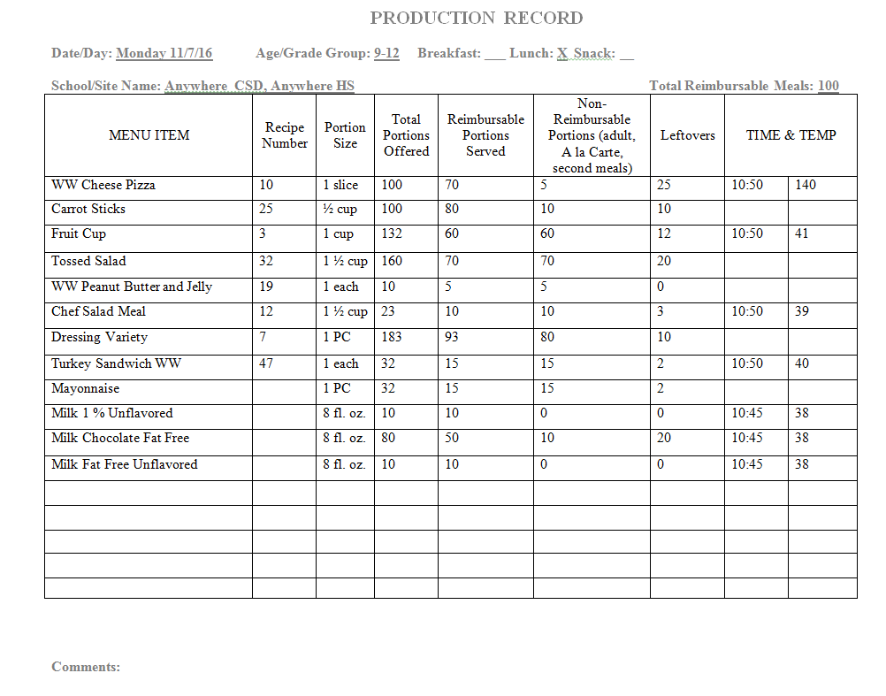
Example of Properly Completed
Production Record
Notes:
This is example is legible and easy to obtain important production information from. Production records are generally handwritten, ensure the information can be read.
All menu items are neatly written, and milk options are written separately
Recipe numbers are recorded for all menu options with two or more ingredients
Portion sizes for all menu items recorded-If more than one age/grade group is on the same production record be sure to clearly identify each age/grade groups portion size
Total portions offered, reimbursable portions served, non-reimbursable portions served, and leftovers are clearly written
If your site has multiple serving times, it is recommended that you take the temperature of your hot and cold items before each service.
Items stored in coolers with temperatures already recorded on the separate freezer and cooler temperature log do not need to be re- temped and recorded on the production record.
The date, age/grade group, meal, and school are clearly written

Slide 17

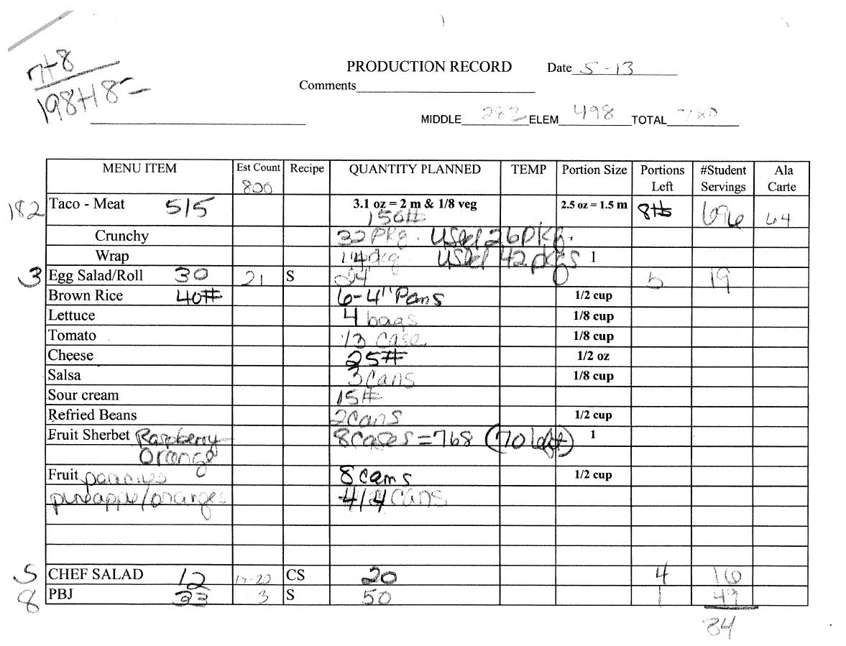
Example of Poorly Completed
Production Record
Notes:
This production record is poorly completed.
What is wrong with this production record?
Answer:
It is illegible. Be sure your production records are legible, often we cannot read them and therefore cannot confirm that program requirements are being met.
This production record is sloppy, illegible and difficult to interpret usable information.
It is also incomplete. The age/grade groups are not specified, quantities planned are inconsistent and incorrect, there should be continuity between the production record and the standardized recipe, number of reimbursable and a la carte meals served is not completed and the date is incomplete.
Also, milk is not shown on this production record. Therefore it will be implied that milk was NOT served with this meal.

Slide 18

Record Keeping
Production Records must be retained for 3 years plus the current year.
Notes:
Child Nutrition Record Retention requirements apply to production records, 3 years plus the current year.

Slide 19

This concludes Production Records
New York State Education Department
Child Nutrition Program Administration
(518)473-8781
CN@nysed.gov
Notes:
Thank you. This concludes Production Records.
Remember to record completion of this training for Annual Professional Standards Training requirements.
If you have any additional questions, please do not hesitate to call or email us.

