Slide 1

Procurement Review
Child Nutrition Program Administration

Slide 2
Procurement Basics
 | Informal |  | Formal
 | Micro Purchases | Small Purchase | Sealed Bids (IFB) | Competitive Proposals (RFP) | Non-Competitive Proposals
Regulations | 200. 320(a) 200.67 | 200.320(b) 200.88 | 200. 320(c)(1)(i-ii) 200. 320(c)(2)(i-v) | 200. 320(d)(1) | 200.320(f)(1)
Basic Procedures | Purchases not exceeding (Federal=$3,500) may award without soliciting competitive quotations if price is reasonable; equitable distribution | Purchases not exceeding applicable Small Purchase Threshold (Fed=$150,000). Minimum two preferably three or more price quotes | Technical specifications Advertise bid Public bid opening Firm fixed price Award to lowest responsive and responsible bidder | Solicitation includes evaluation criteria Award based on score with primary weight on price | Item available only from a single source; public exigency; competition deemed inadequate
SA oversight | Assurance of reasonable and necessary costs; purchases distributed equitably among qualified suppliers; Buy American food; documented | Assurance of competition; Buy American food; documented | Assurance of advertising, bid opening, resulting in fixed price contract Required provisions--7 CFR Part 210 2 CFR Part 200 Appendix II; Buy American food; contract award to lowest responsive and responsible bidder | Assurance of advertising, evaluation/award with price as primary and no unallowable cost provisions, Results in fixed price or cost reimbursable Required contract provisions (7 CFR Part 210,2 CFR Part 200, Appendix II); Buy American food; ensure SFA receives discounts, rebates and credits in cost reimbursable contracts | Assure adherence to 200.320(f)(1)
Notes:
The procurement of goods and services is a significant responsibility of a SFA.
Obtaining the most economical purchase should be considered in all purchases when using the nonprofit food service account.
Federal, state and local laws and regulations specify the methods SFAs must follow to properly procure goods and services and award contracts only to responsible contractors. Additionally, SFAs must not restrict competition and must follow all procurement standards in Program regulations in 7 CFR 210.21 and the government-wide requirements in 2 CFR 200.318-.326. SFAs must prohibit conflicts of interest, use required procurement methods, take affirmative steps to use small, minority, women's business and labor surplus enterprises, when possible, and oversee contractors to ensure all contract provisions are fulfilled for the duration of the contract.
SED is required to ensure that SFAs comply with the applicable regulations.

Slide 3

Review Process
Procurement Review conducted concurrently with the Administrative Review
  Procurement activities from most recently completed school year
1) Documents requested by SED
  Procurement Review Worksheet
  List of all expenses by vendor, including procurement method used
  Procurement Policy and Code of Conduct
2) SED selects a sample of vendors from each procurement method and requests additional documents for these vendors
3) SED completes procurement review and documents any findings, corrective action, and technical assistance
Notes:
The Procurement Review is conducted the same year as the Administrative Review. SED will be reviewing the SFA’s Procurement activities from most recently completed school year.
SED developed a Procurement Review Worksheet that will be sent to SFAs to collect all SFA staff responsible for procurement, vendor names, goods and services provided, total amount paid to vendor, number of purchases from the vendor during the year, number of bids received. Based on the SFA’s responses, SED will ask for more documentation of specific purchases.

Slide 4
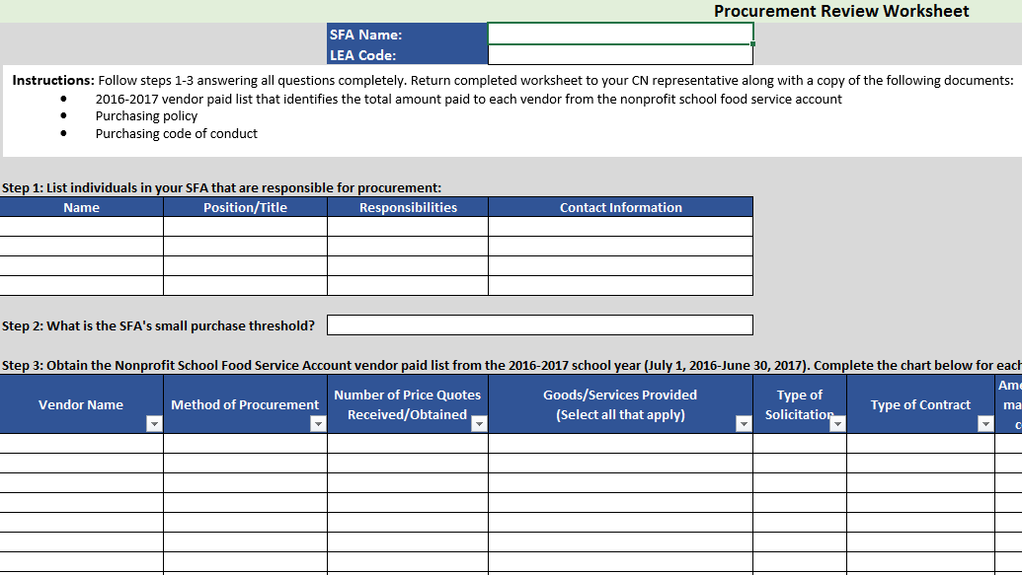
Procurement Review Worksheet
Notes:
The “Procurement Review Worksheet” that will be sent is shown here.

Slide 5

  Who procured goods/services
  Name, title, contact information
  Method of Procurement
  Micro, small or formal
  Type of solicitations
  IFB, RFP
  Type of contract
  Fixed price or cost reimbursable
Notes:
SFAs need to know what method was used when conducting procurements, who conducted the procurement and how quotes were received to complete the procurement review worksheet.

Slide 6


Procurement Policy
Roadmap for how procurement is conducted in compliance with regulations
  How it is determined which method will be used
  Assuring open and fair competition
  Perform a cost/price analysis with every formal procurement action
  Steps that will be taken to use small, minority, and women’s business enterprises and labor surplus firms when possible
Notes:
All SFAs should be following their own written procurement plan when conducting any procurement. This is a comprehensive plan that clearly defines responsibility and establishes guidelines the SFA and the procurement person within the organization must follow.

Slide 7

What should I include in my procurement plan?
Definitions
Basic Organizational Concepts
Source Selection
Specifications
Buy American
Minority/Women-Owned Businesses
Conflict of Interest / Code of Conduct policy
Notes:
The procurement plan should clarify terms used in the policy which may need further explanation (such as responsive and responsible bidder)
Basic organizational concepts, such as which people in the organization are responsible for ordering and who approves purchases. A best practice is to establish different financial levels for procurement.
Source selection establishes which method of procurement will be used
Developing good specs ensures your procurement is competitive and not too restrictive, including using the Buy American provision and purchasing from minority or women-owned businesses.
A procurement plan would not be complete without a conflict of interest and code of conduct policy for everyone involved in the procurement process. It documents the steps to take if there is a conflict of interest and the consequences if there is a violation of the policy. The policy should address areas such as:
Gratuities and kickbacks
Miscellaneous fees – fees that aren’t attributable to the purchase
Process for violations of the procurement policy

Slide 8

Code of Conduct
Procurement Code of Conduct
Prohibits real or apparent conflicts of interest for employees engaged in the selection, award, and administration of contracts
  Prohibits soliciting or accepting favors, gifts, etc.
  Provides for disciplinary actions for violations
Notes:
No employee, officer, or agent may participate in the selection, award or administration of a contract supported by a Federal award if he or she has a real or apparent conflict of interest. Individuals involved in the conflict of interest should excuse themselves from the process.
Each SFA must adopt a written conflict of interest policy that clearly sets forth the procedures to be followed in an instance where a member of the entity has personal or business interests that may be advanced by an action, including a provision that such member may not participate in any decision to approve any transaction where such conflicting interests may be advanced. The policy should be reviewed by the SFAs attorneys and/or auditors prior to its adoption.
The officers, employees and agents on the entity must neither solicit not accept gratuities, favors or anything of monetary value.

Slide 9
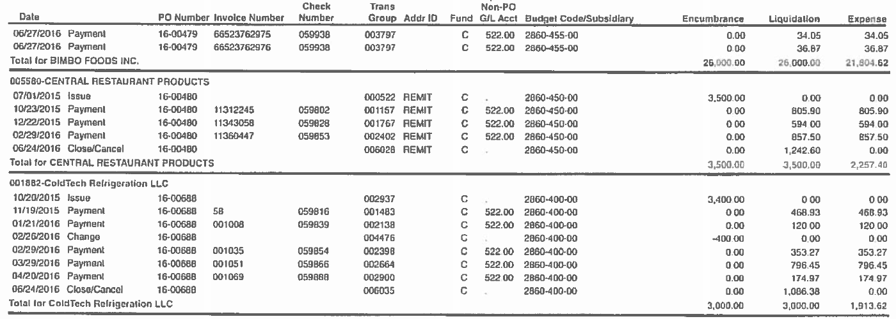
Vendor Paid List
List of all vendors paid with Child Nutrition funds from the previous school year
Includes total amount paid to vendor
  Broken down by each transaction
Notes:
SFAs will also provide SED with a list of all vendors that were paid with CN funds during the previous school year.
This list needs to include each transaction, with the total amounts paid to each vendor.

Slide 10

Buy American
Purchase domestic commodities and products that are:
  Produced in the US or
  Processed using agricultural commodities produced in the US
    Includes Guam, American Samoa, Virgin Islands, Puerto Rico, and Northern Mariana Islands
Include requirement in all solicitation and contract documents
  Can require country of origin on all products and/or invoices
  Can state only domestically grown products will be approved

Slide 11

Buy American
Before buying a non-domestic good
Consider alternatives first
  Other domestic sources?
  Domestic substitution?
  Time of year?
Exceptions are rare and should only be used as a last resort

Slide 12

Micro Purchases
Purchases made without first soliciting competitive quotes
  Must be under $3,500
For each selected vendor:
  3 receipts/invoices
    3 from 1 month
    1 per month for 3 consecutive months
    1 per quarter for each quarter
  Explain how it was determined prices were reasonable
  Explain how purchases were spread equitably
    Must spread the wealth

Slide 13
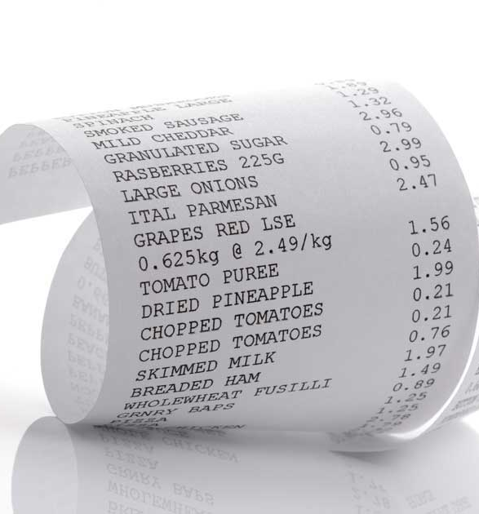
Small Purchases
Vendors were informally contacted for quotes prior to purchasing
  Must be below the small purchase threshold
For each vendor:
  Solicitation documentation
  Responses received
    Was the most responsive and responsible bidder selected?
  3 receipts/invoices
    Were the items purchased the products solicited?

Slide 14
Small Purchases
Solicitation Documentation
2 or more vendors contacted
No unreasonable requirements
If specifying a brand name, allow an equal product
Clear and accurate description of the product solicited
Buy American requirement

Slide 15
Formal Contracts
Documents requested depends on type of formal contract
  BOCES Contracts
  New York State Contracts
  All other contracts
Be sure to know which method was used to obtain each formal contract

Slide 16
BOCES Contracts
Solicitation and award documents reviewed at the BOCES by SED Audit Team
For each selected vendor:
  Awarded contract
  3 Purchase orders and vendor receipts/invoices
    Are the items purchased included in the contract?
    Does the item price match the contract price?
  Contract performance management documentation
    Description of the steps taken to ensure vendors are complying with the pricing and terms of the contract

Slide 17

State Contracts
Must still determine buying from State contract provides best possible price
For each selected vendor:
  Awarded contract
  Quote for specific purchase
  3 purchase orders and invoices
  Contract management documentation

Slide 18
All Other Contracts
Cost/price analysis
Solicitation documentation
Responses received
Evaluation criteria
Final awarded contract and notification documentation
3 purchase orders and receipts/invoices
Amended contract language and contract renewals, as applicable
Contract performance management documentation

Slide 19

All Other Contracts
Solicitation Documentation
Include copy of advertisement
  Publicly advertised?
  Adequate time provided for responses?
Solicitation includes all specifications and evaluation factors
  Price must be primary factor
No unreasonable requirements
If specifying a brand name, allow an equal product
Required clauses
  Appendix II to Part 200
  Termination for cause, Equal Employment Opportunity, Contract Work Hours/Safety Standards Act, Davis Bacon Act, Rights to Inventions, Debarment and Suspension, Byrd Anti-Lobbying Amendment, Buy American

Slide 20
All Other Contracts
Evaluation/Award
Was the contract awarded to the lowest responsive and responsible bidder?
Were bids evaluated and awarded as published?
Any unallowable cost items included?
Geographic preference correctly used?
All records must be maintained
  All responses

Slide 21

All Other Contracts
Contract Management
Items purchased included on contract
Each item price matches contract price
Vendors following all requirements in contract

Slide 22
Food Service Management Company Contracts
3 FSMC invoices
  Contracts originating in 2015-16 or later
3 FSMC monthly operating statements
  Contracts originating prior to 2015-16
FSMC monitoring
  Advisory board
  SFA On-site monitoring
  Receiving discounts, rebates, and/or credits
  Crediting for full value of USDA foods

Slide 23
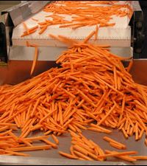
Processing Contracts
MUST be procured following proper procurement methods
Documents requested depends on procurement method used
Did you receive the full value of USDA foods from the processor?
Are you efficiently using USDA foods for processing?
  K-12 Foodservice
  Processing Link

Slide 24

Procurement Review Process
SED reviews documents, provides SFAS with technical assistance and corrective action as applicable.

Slide 25

Child Nutrition Program Administration
89 Washington Avenue, 375 EBA
Albany, NY 12234
(518) 473-8781
www.cn.nysed.gov
cntraining@nysed.gov

