Slide 1

Offer Vs. Serve
New York State Education Department
Child Nutrition Program Administration
Notes:
Offer vs. Serve is a concept that applies to menu planning and the meal service. Offer vs. Serve allows students to decline some of the food offered in a reimbursable lunch or breakfast. The goals of Offer vs. Serve are to reduce food waste and to permit students to choose the foods they want to eat.

Slide 2

Professional Standards
This PowerPoint will contribute 1 Training Hour towards the Professional Standard training requirements
Required to track the number of training hours earned each year and maintain documentation of the trainings attended
Notes:
The Final Rule requires all school food service personnel to complete annual continuing education/training requirements. The number of required training hours varies depending on the position of the school food personnel.
This webinar will contribute 1 Training Hour towards the Professional Standards Training requirements.
You are required to track the number of training hours you earn each year and maintain documentation of the trainings that you have attended.

Slide 3
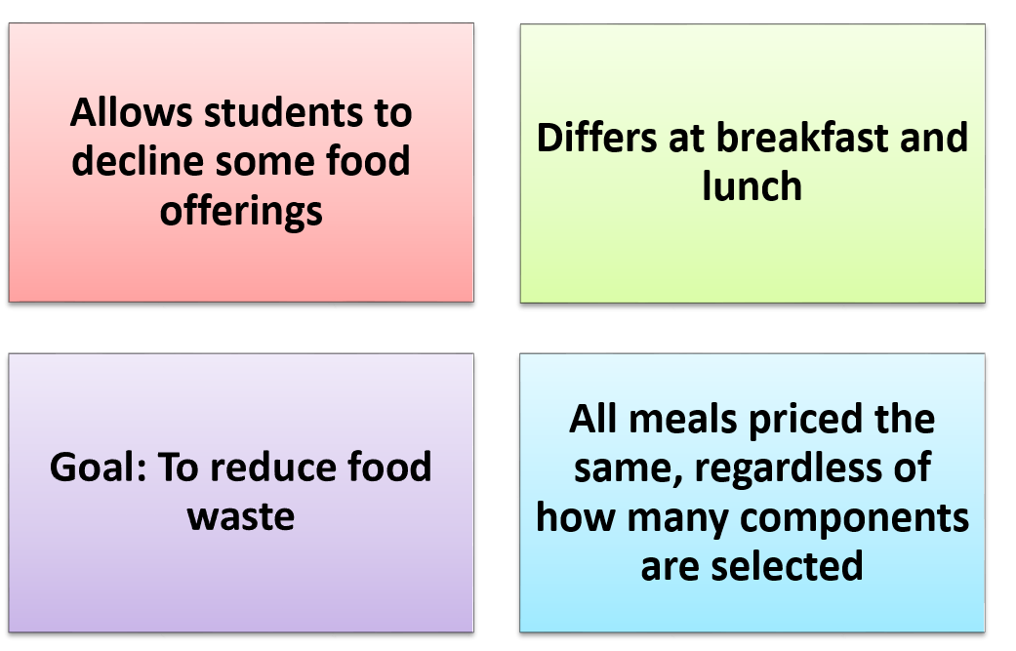
Offer Versus Serve
Notes:
Offer Versus Serve does not affect the meal’s unit price established by the SFA. Students who take 3, 4, or 5 food components for lunch or 3 or more food items for breakfast pay the same price
The goal of Offer vs. Serve is to eliminate food waste.
We continue to encourage schools to offer a variety of food choices to students; this increases the likelihood that students will select the foods they prefer, which increases consumption and reduces waste.

Slide 4


Meal Components
Lunch Meal Components
  Fruits
  Vegetables
    Dark green
    Red/Orange
    Beans/Legumes
    Starchy
    Other
  Grains
  Meat/Meat Alternate
  Fluid Milk
Breakfast Meal Components
  Fruits/Vegetables
  Grains
    Meat/Meat Alternate Optional
  Fluid Milk
Notes:
There are three meal components for breakfast and five meal components for lunch.
For breakfast, the three meal components are: fruits/vegetables, grains/meat/meat alternates, and fluid milk.
For lunch, the five meal components are: fruits, vegetables (including the five vegetable subgroups listed on the slide), grains, meat/meat alternates, and fluid milk.
It is important to note that while fruits and vegetables, and grains and meats/meat alternates are considered combined meal components in the breakfast program, they are each separate components in the lunch program.

Slide 5

Breakfast
OVS is optional for all age/grade groups at breakfast
Schools must offer all 3 components (grain, milk, fruit/vegetable)in at least the minimum required amounts
Schools must offer at least 4 food items from the 3 components
Students must select at least 3 food items, with one of the food items being at least ½ cup of fruit or vegetable
Notes:
Offer Versus Serve is optional at breakfast for all age/grade groups.
A food component is one of three food groups that comprise reimbursable breakfasts. These are: fruits (or vegetables as substitute); grains (with optional meats/meat alternates); and fluid milk. Schools must always offer all three food components in at least the minimum daily required quantities.
A food item is a specific food offered within the three food components. For the purposes of Offer vs. Serve, a school must offer at least four food items from the three required food components (fruits, grains, milk). Under Offer vs. Serve, the student must select three food items, including at least ½ cup of fruits or vegetables, to have a reimbursable breakfast.
Please note, you must offer one ounce equivalent grain component before you can offer a meat/meat alternate component as an option. However, the student does not have to select the grain option. For example, if you were offering yogurt with graham crackers, the student would not have to select the graham crackers with the yogurt as long as the student selected two other items including a ½ of fruit (or vegetable).
Please also note, if you are substituting vegetables for the fruit component, you must offer 2 cups of vegetables from the dark green, red/orange, or legumes subgroups before offering starchy vegetable.

Slide 6
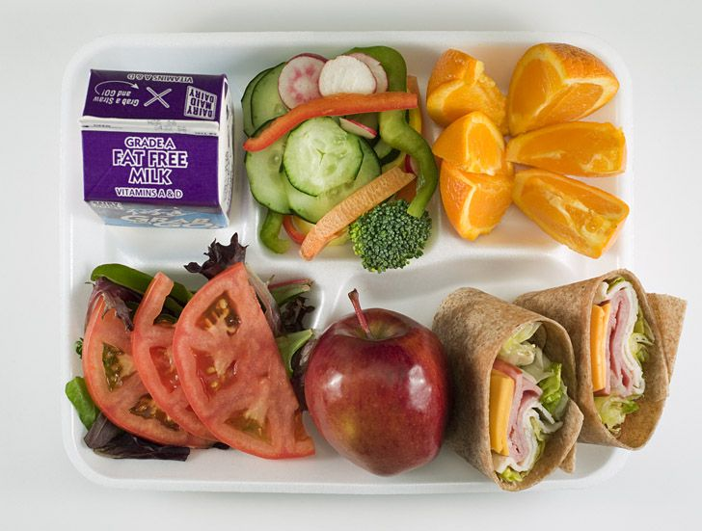
Lunch
Offer vs. Serve is required for students in the 9-12 age/grade group
must offer all 5 components in at least the minimum required amounts
Students must select at least 3 food components
Students must take a minimum of a ½ cup of fruit or vegetable
Notes:
For lunch, Offer vs. Serve is required for the 9-12 age/grade group and is optional for all other age/grade groups at lunch.
If you participate in Offer vs. Serve, you must offer all 5 lunch components in at least the minimum required amounts for each age/grade group.
A food component is 1 of 5 food groups that comprise reimbursable lunches. These are: meats/meat alternates; grains; fruits; vegetables; and fluid milk.
Schools must always offer all five food components in at least the minimum required quantities. Students must select 3 of the components, with one being a ½ cup of fruit or vegetable.
When selecting the 3 components, the student must have 2 full components along with at least ½ cup of fruit or vegetable in order to be considered a reimbursable meal.
For example:
A student in the K-5 age/grade group selects ½ cup carrots and a 2 oz. eq. hamburger on a 1.5 oz. eq. whole wheat bun. This would be considered reimbursable.
A student in the 9-12 age/grade group selects ½ cup carrots and a 2 oz. eq. hamburger on a 1.5 oz. eq. whole wheat bun. This would not be considered reimbursable because the grain is not a full component. The grain must be 2 oz. eq. for the 9-12 age/grade group.

Slide 7
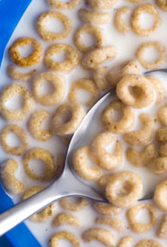
Crediting Food Items
The menu planner decides how to credit the items
Double portions may count as multiple food items or one food item
Food items that are more than 2 oz. eq. grain, may count as more than one item
For example:
2 Servings of a 1 oz. eq. cereal = 2 food items or 1 food item
2 servings of ½ cup of peaches=2 food items or 1 food item
Notes:
The menu planner decides how they want to credit the items. When the menu planner decides how to credit the item, they must keep documentation showing the crediting information.
It is important to recognize that offering a variety of choices within the food components and items is different from Offer vs. Serve. If choices within food components or food items are offered, the menu planner must indicate to the students what choices or combination of choices the student may select to have a reimbursable meal.
An example for the School Breakfast Program is cereal types. Offering four different varieties of cereal and instructing students to “select one” is not the same as offering four grain items. Because the student can only “select one,” only one grain item (cereal) is being offered to each student, even though the student can select from several cereal options.
Another example relates to the fruits or vegetables components. The menu planner may choose to offer a variety of fruit and would instruct the student to select a specific amount.
If ½ cup portions of three different varieties of fruits are offered, the menu planner could indicate that the student may select “up to two” servings. This provides food choices to the student and shows the student how to select a reimbursable lunch. Although three different fruits are offered, since the student is instructed to select up to only two servings, only two fruit items are being “offered.”

Slide 8


Crediting Food Items
2 oz. eq. Grain Bagel
2 oz. eq. grain muffin
The menu planner could credit this bagel two different ways:
2 oz. eq. = 2 items
2 oz. eq. = 1 item
The menu planner could credit this muffin two different ways:
2 oz. eq. = 2 items
2 oz. eq. = 1 item
Notes:
Here are some examples on how you can credit food items differently.
In this bagel example, you can credit the 2 oz. eq. bagel as two different food items or as one food item. This decision is up to the menu planner, however, the menu planner must document on how they will credit the items.
The blueberry muffin, there are also two ways to credit. The menu planner may credit the muffin as two different items or as 1 item.

Slide 9
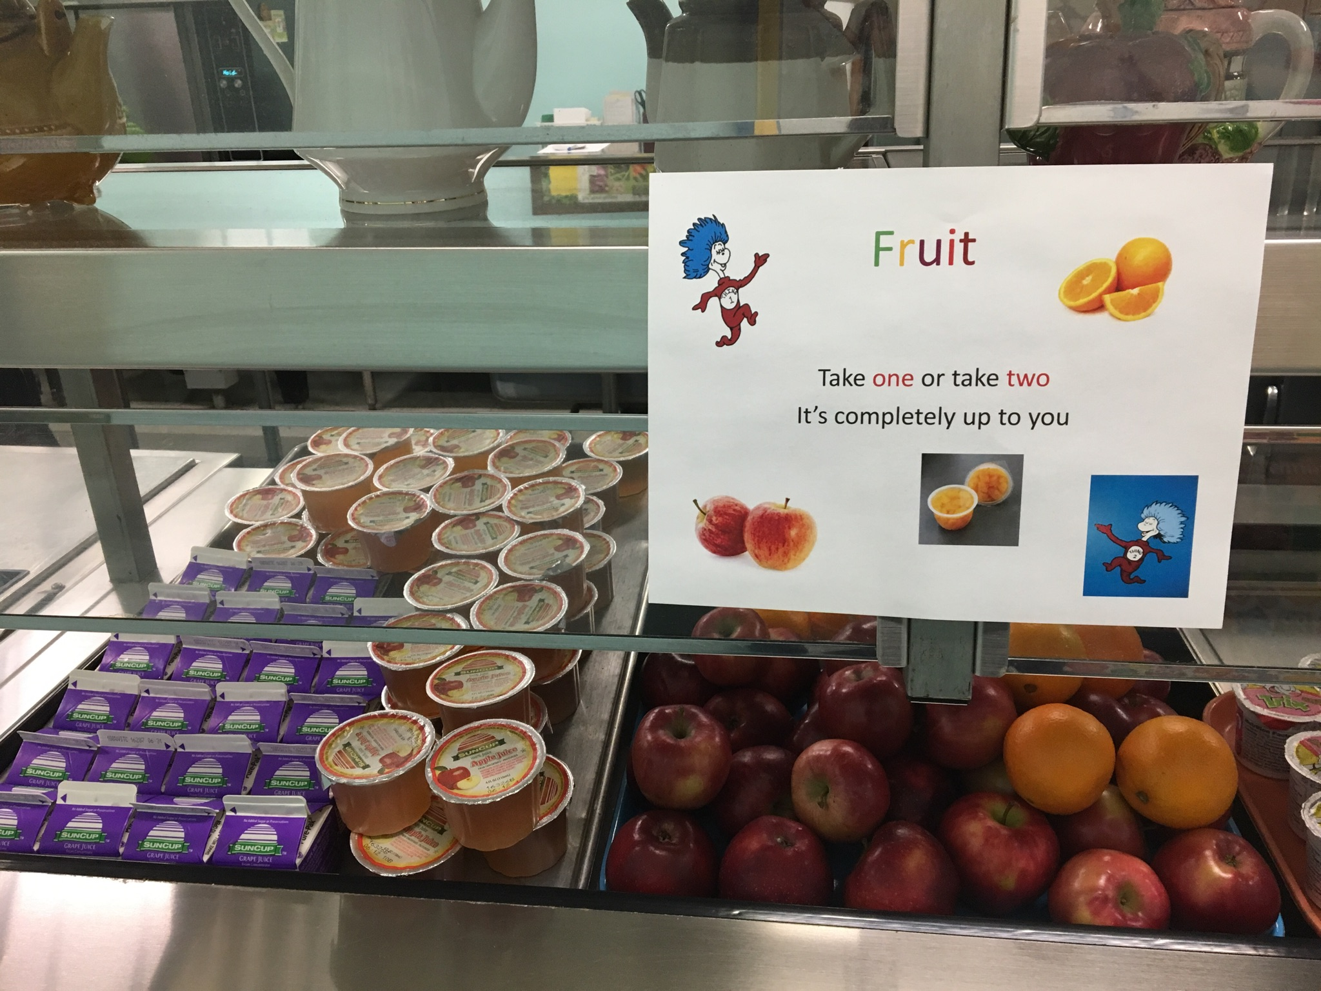
Fruit
Notes:
The menu must offer 1 cup of fruit at breakfast. The menu planner can portion the fruit into ½ cup so students can select 2 different fruits.
Under Offer vs. Serve, a student would only have to select ½ cup of fruit as long as the student chose two other full components.
For example, here they are offering 4 fl. ounces of grape or apple juice, and apples, and oranges. The menu planner is allowing students to select two or 1. For a reimbursable meal, a student could select toast, yogurt, and an apple.
It is up to the menu planner to determine whether students are allowed to select duplicate food items for school meals, and it is important that this information be communicated to school nutrition staff and students clearly (such as through signage or on menus).
**Photo provided from Pine Plains CSD.

Slide 10
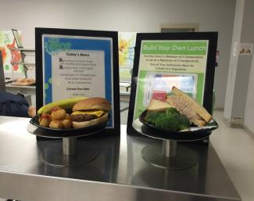
Signage
Signage and menus should provide clear information about allowable choices so students can easily determine what a reimbursable meal contains
Notes:
Signage should provide clear information about allowable choices for breakfast and lunch. This will help students easily build a reimbursable meal and is especially important to avoid problems at the point of service.
A good practice is to provide sample meal displays at or near the beginning of the service line. This will help students visualize reimbursable meals and also advertise the daily meal.

Slide 11
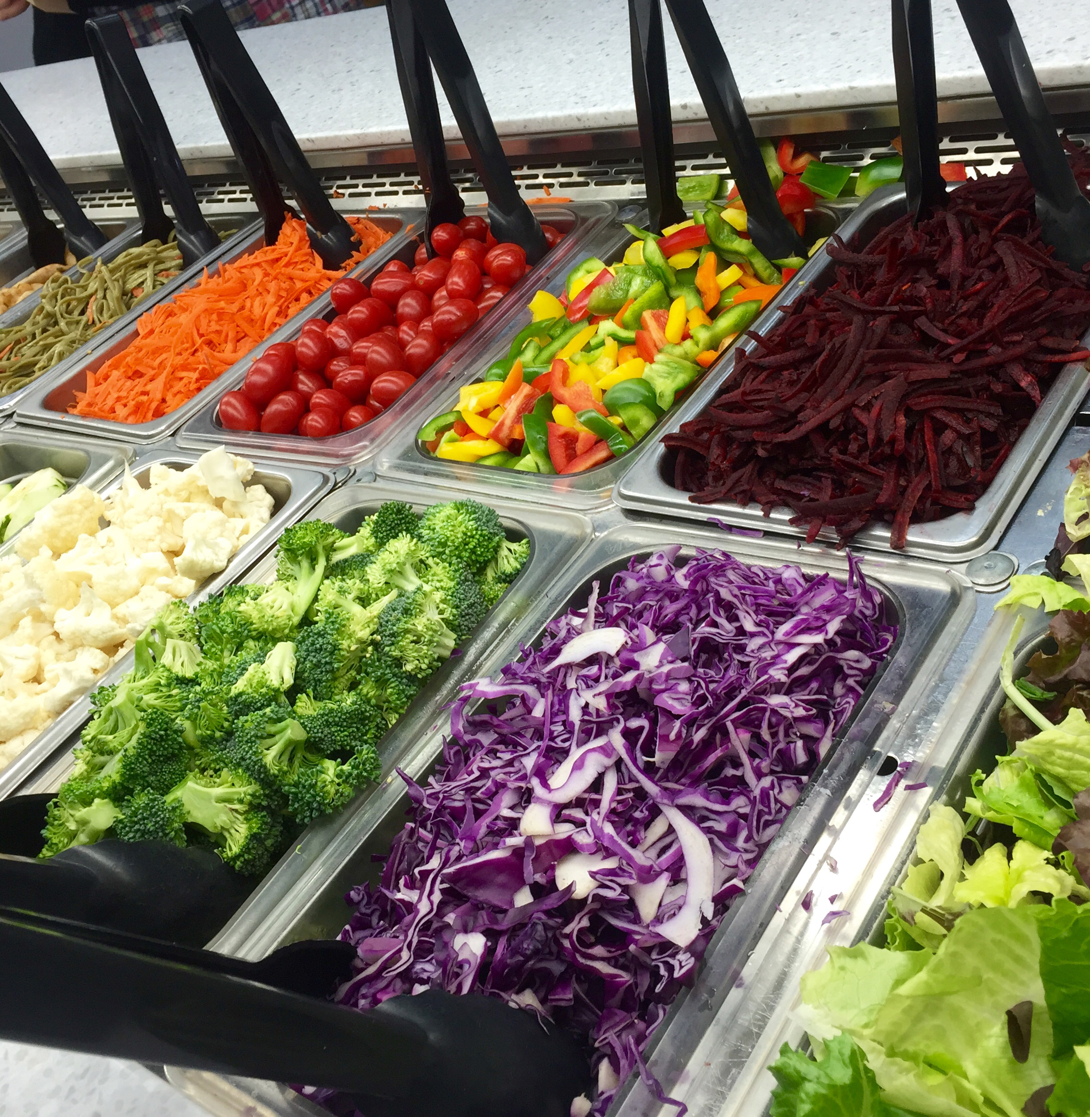
Different Meal Service Options
Food Bars/Salad Bars
Pre Packaged Meals/Grab and Go
Family Style
Notes:
Schools are encouraged to use food bars and salad bars as a way to offer a wider variety of vegetables and fruits and to lower plate waste. Food and salad bars are permitted with Offer vs. Serve because they offer a lot of variety, which may facilitate students selecting foods they will consume. To help students and cashiers easily identify reimbursable meals from food bars, menu planners must clearly identify the food components/food items provided on the bars and the minimum serving size for each food component/food item. The menu planner must also indicate which foods and combinations of foods the students may choose to select a reimbursable meal under OVS. Cashiers must also be trained and informed on what constitutes a reimbursable meal at the point of service.
Pre-packaged meals or Grab and go meals are allowed at all age/grade levels. Schools are encouraged to have some food components/food items with choices and/or the option to decline, such as fruit or milk.
A school or RCCI may serve meals “family style.” Family style meal service allows students to serve themselves from common dishes of food with assistance from supervising adults. While family style meal service allows students to make choices in selecting foods, the supervising adult should initially offer the full planned serving of each food component/food item to each student. Because of the Offer vs. Serve requirement that each student select at least ½ cup of a fruit or vegetable, the adult supervisor must ensure that each student selects at least a ½ cup of fruit or vegetable or a combination of both during the course of a family style meal service.

Slide 12

Reimbursable Meal?
Notes:
Let’s go over some examples to determine if it is reimbursable.

Slide 13
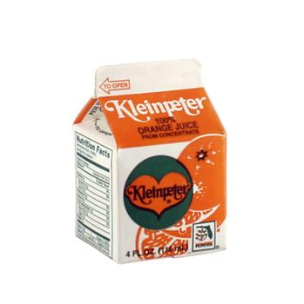






Today’s Menu
Scrambled Egg
1 oz. eq.
Whole Wheat toast
1 oz. eq.
Cereal
1 oz. eq.
*May select 2
Raspberries
½ cup
Orange Juice
4 fl. oz.
Variety Milk
8 fl. oz.
Notes:
Always be sure to have appropriate signage to indicate meal choices at or near the beginning of the food service line. If duplicate items may be selected, be sure to indicate on your signage.
This menu offers 1 oz. eq. of Whole Wheat toast, 1 oz. eq. of scrambled eggs, 1 oz. eq. of cereal, ½ cup of raspberries, 4 fl. oz. of juice, and 8 fl. oz. of milk.
When implementing offer vs. serve, you must offer at least 4 items within the three components. All the required components are being offered and more than 4 items are offered in this example.

Slide 14
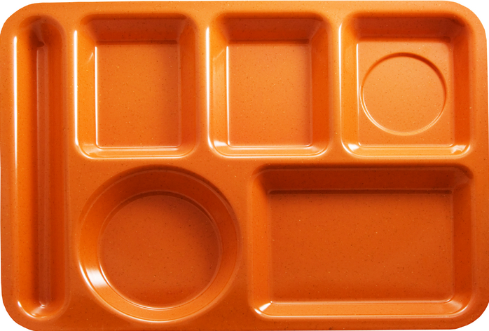
Reimbursable Meal?
YES!
Notes:
In this example, the student selected scrambled eggs, milk, and 4 fl. ounces of juice which is the minimum requirement for the fruit/vegetable.
This is a reimbursable meal because all 3 items were selected with one of those items being at least ½ cup of fruit/vegetable.
The student did not have to take the toast in order to be a reimbursable meal because the 1 oz. eq. grain just needs to be offered with the meat/meat alternate. Students do not have to select both in order for it to count.

Slide 15

Reimbursable Meal?
YES!
Notes:
In this meal, the student selected 3 items, one of this being a ½ cup of fruit or vegetable. This would be a reimbursable meal.
Remember for breakfast each cereal can count as two different items as long as the menu planner menus it that way.

Slide 16
Reimbursable Meal?
NO!
Notes:
This would not be a reimbursable meal because the student did not select a ½ cup of fruit or vegetable.

Slide 17

Reimbursable Meal?
NO!
Notes:
In this example, the student selected 3 items but did not select a ½ cup of a fruit or vegetable. This meal would not be reimbursable.

Slide 18

Reimbursable Meal?
YES!
Notes:
In this example, the student selected 3 items with one of the items being at least ½ cup of a fruit/vegetable. This meal would be a reimbursable meal.

Slide 19






Today’s Menu
Peanut butter
1 oz. eq.
Bagel
2 oz. eq.
Raisins
¼ cup (1/2 cup credit)
Banana
½ cup
Assorted Milk
8 fl. oz.
Notes:
Always be sure to have appropriate signage to indicate meal choices at or near the beginning of the food service line.
This menu offers Peanut Butter, Whole Wheat Bagel, Raisins, bananas, and milk.
All four items are offered within the 3 required components.

Slide 20
Reimbursable Meal?
YES!
Notes:
The student selected a whole wheat bagel which counts as 2 items plus ¼ cup of raisins which credits as a ½ cup of fruit because dried fruit doubles in volume.
This would be a reimbursable meal.

Slide 21
Reimbursable Meal?
NO!
Notes:
The student selected a whole wheat bagel and milk.
This would not be a reimbursable meal because the student did not select a fruit or vegetable.

Slide 22

Reimbursable Meal?
YES!
Notes:
The student selected raisins, banana, and peanut butter. The student selected 3 items with one of the items being a fruit/vegetable.

Slide 23
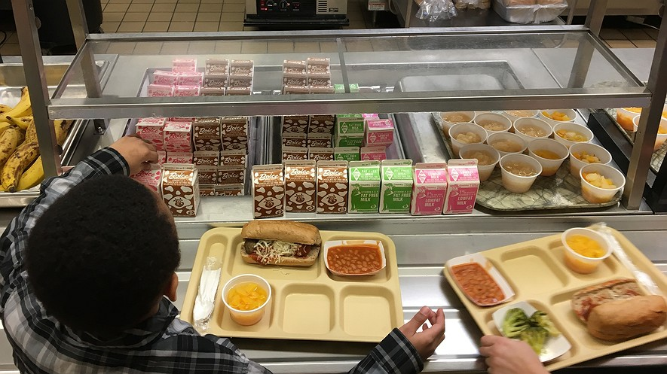
Reimbursable Meal?

Slide 24
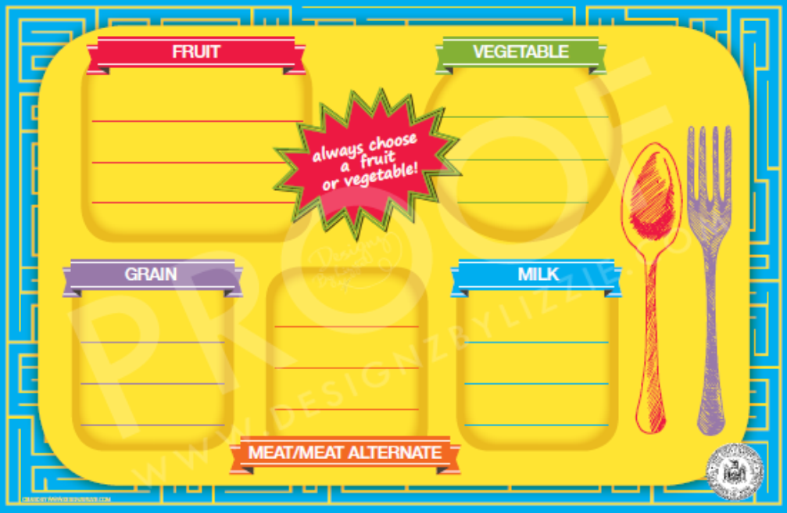
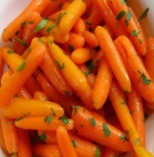

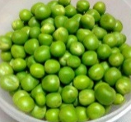
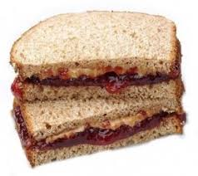

Today’s Menu
PB & J
2 oz. eq. M/MA
2 oz. eq. Grain
Apple
1 Cup
Carrots
½ Cup
Peas
½ Cup
Assorted Milk
8 fl. oz.
Notes:
Always be sure to have appropriate signage to indicate meal choices near the beginning of the food service line.
This menu offers Peanut Butter and Jelly Sandwich, Apple, Carrots, Peas, and assorted milk.
The menu is offering the required 5 components in the required minimum quantities.

Slide 25
Reimbursable Meal?
NO!
Notes:
The student selected 3 components but did not select ½ cup of fruit or vegetable. This would not be a reimbursable meal.

Slide 26
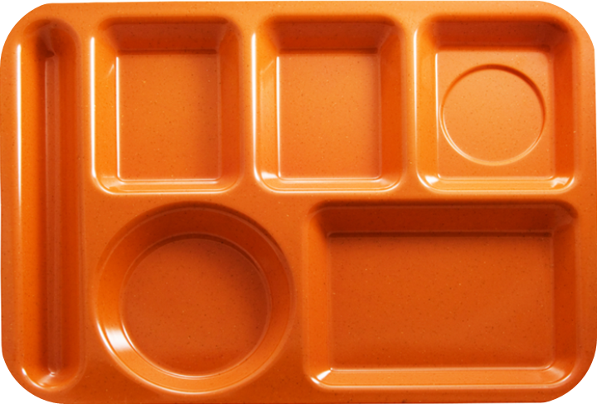

Reimbursable Meal?
YES!
Notes:
The student selected two full components plus ½ cup of fruit. This would be a reimbursable meal.

Slide 27

Reimbursable Meal?
YES!
Notes:
The student selected a peanut butter and jelly sandwich, carrots, and milk.
This would be a reimbursable meal because the student selected 3 components plus the ½ cup of vegetable.

Slide 28

Reimbursable Meal?
NO!
Notes:
The student selected milk, peas, and carrots.
The student must select two full components plus ½ cup of fruit and vegetable.
For Offer Vs. Serve purposes, the vegetable component can only credit once, therefore, this would not be a reimbursable meal.

Slide 29
Reimbursable Meal?
YES!
Notes:
The student selected milk, apple, and peas and carrots.
This would be a reimbursable meal because the student selected two full components plus ½ cup of a fruit/vegetable.

Slide 30
Example of Appropriate Signage
Fresh Pear
Romaine Salad
Diced Peaches
Steamed Broccoli
Select at least
3 components!
Choose one:
Fat Free Chocolate
1% White
Choose one:
Spaghetti & Meatballs
Turkey Sandwich
Notes:
This is an example of appropriate signage. As you can see, the menu offerings are listed by component to inform students what constitutes a reimbursable meal. The signage also informs students to select at least three components, including a ½ cup of fruit of vegetable.

Slide 31
Signage Examples
Notes:
These are some examples of appropriate signage from schools.
**Signage was provided by Onteora CSD.

Slide 32

Child Nutrition Program Administration
518-473-8781
CNTRAINING@NYSED.GOV
Notes:
If you have any questions, contact your Child Nutrition representative or email the training team at cntraining@nysed.gov. Thank you.

