Slide 1

MICRO PURCHASES in Child Nutrition Programs
1 Hour Professional Standards Training
Notes:
This PowerPoint will contribute 1 hour towards Professional Standards training requirements. This training reviews Micro Purchases in Child Nutrition Programs.
The Micro Purchase Method is the most misunderstood method for procuring goods and services.
This presentation will review how the micro purchase method is included in your SFA’s Procurement Policy, what is considered a Micro Purchase, when is it most beneficial to utilize the Micro Purchase Method, when it might not be advantageous to utilize the Micro Purchase Method, record retention, and what to expect when your CN Representative reviews your SFA’s Micro Purchases during the Procurement Review.
For the purpose of this presentation, the federal micro purchase threshold of $3,500 will be used. Your school or school district may set a lower threshold. The most restrictive threshold applies. SFAs are not obligated to use the micro purchase method. A better price may be obtained using another method that allows for more competition. Use this guide to assist you in purchases under $3,500.

Slide 2

Procurement
Obtaining goods and/or services
  At the best possible price
  Multi-step process
  Proper planning is worthwhile and critical
  Systematic approach
Notes:
We will start out by discussing procurement principles.
Generally, when we use the term “procurement,” it refers to the purchasing of goods and services.
Procurement is an important part of operating the Child Nutrition Programs, because federal dollars are being used to purchase goods and services, and all purchases made with federal dollars must be properly procured. Therefore SFAs need to understand and comply with local, state, and federal procurement guidelines to make sure the federal dollars are spent wisely.
In large part, the procurement rules were put in place to correct discrepancies in the process such as nepotism, improper awards, kickbacks, incentives, and other improper practices when purchasing goods and services.
Obtaining the more economical purchase should be considered in all purchases when using the nonprofit food service account. This particularly is important when considering the use of the Micro Purchase Method.

Slide 3
Principles of Good Procurement
Free and open competition
Fairness and integrity
Responsive and responsible vendor
Notes:
There are three binding principles of good procurement: free and open competition, fairness and integrity, and responsive and responsible vendors.
These are the principles schools should think about in every step of the procurement process from setting procurement policies to monitoring their procurements.

Slide 4
Procurement: A multi-step process
Procurement Procedures
Forecasting
Selecting the Proper Procurement Method
Developing a Solicitation
Advertising the Solicitation
Evaluating Proposals/Offers
Awarding the Contract
Managing the Contract
Notes:
Competition drives the procurement process. The procurement process is a multi-step process for obtaining the best goods and services at the best possible price. An effective process ensures that SFA procurement procedures are well thought out, reflect needs, are completed properly in compliance with regulations, and, in the end, are managed properly at the contract award level.
The steps in this multi-step process include:
Procurement planning
Forecasting ones needs
Choosing the appropriate procurement method
Developing a solicitation
Advertising the procurement
Evaluating proposals/offers
Awarding a contract or making a purchase
Managing the resulting contract and keeping documentation
So now that we have reviewed the principles and the process, let’s look at what a micro purchase is, when to select the micro purchase method, and see how the micro purchase method is put into practice.

Slide 5
Micro-Purchase Method
Aggregate dollar amount $10,000 or less
Distribute equitably among qualified suppliers
Quotes not required if SFA considers the price to be reasonable
Buy American in effect
Included in your Procurement policy
Notes:
Procurement by micro-purchase is the acquisition of supplies or services, the total dollar amount of which does not exceed $10,000 per procurement transaction, whether weekly, monthly, or annually. The purpose of the micro-purchase is to expedite the completion of your lowest-dollar small purchase transactions and minimize the associated administrative burden and cost.
Consideration should be given to consolidating the acquisition of products or services when consolidation will result in more economical purchases. This is true even if consolidation increases the dollar amount over the micro-purchase threshold, and therefore requires a more complex procurement method. When appropriate, an analysis should be made to determine the most economical approach.
To the extent practicable, micro-purchases must be distributed equitably among qualified suppliers. This can happen at the time of the purchase or over several purchasing events. For example a school procuring apples may purchase them either:
from various suppliers at the same time (the total of the purchases cannot exceed $10,000) or choose one supplier for the purchase of the apples and another supplier the next time apples need to be purchased (each of the purchases cannot exceed $10,000).
Micro-purchases may be awarded without soliciting competitive quotations if the non-Federal entity considers the price to be reasonable. (CFR 200.320) Ways to verify the reasonableness of a price is to compare previous purchases, have personal knowledge of the item being purchased, or compare to similar items being purchased.
Costs should be necessary and reasonable, and the Buy American provision is still in effect.

Slide 6

Situations to consider when selecting the Micro Purchase Method. Is this the appropriate method to utilize?
Does my SFA require price quotes for all purchases?
Does one vendor provide the best service, or a product accepted better by the students?
Is it more of an administrative burden to distribute purchases among qualified vendors?
Long story short, the micro purchase method may not be the most appropriate and/or practical procurement method to select in the situations described above.
Notes:
The key to selecting a procurement method is to not only look at the aggregate dollar value of the purchase but to also look at the process. Many SFA’s require price quotes for all purchases, regardless of the value. In this situation the process of obtaining price quotes will categorize the procurement method as Small Purchase Method, despite the dollar value being below the small purchase threshold.
If you obtain services from a vendor that fall below the $10,000.00 threshold but you know the services are the best value and the best service, it will benefit you to obtain price quotes and conduct the procurement of the service as a small purchase. By utilizing the Small Purchase procurement Method you know you will be able to return to this vendor for the same product or service again. The same idea would come into play if your students preferred a specific food item and you would have to change the expected food product to another if you had to distribute purchases among qualified vendors. It would be more practical and beneficial to obtain price quotes and conduct procurement for this item as a small purchase.
Lastly, is it more time efficient to obtain 3 price quotes on an item or service that you utilize throughout the year than to try to distribute the purchases among qualifies vendors? If so, obtaining 2-3 quick price quotes and completing the procurement as a small purchase would make sense.
As you can see, just because purchases fall below the $10,000.00 threshold, it may be more practical and appropriate to utilize another procurement method.

Slide 7
Micro-Purchase: Basic Steps
Include the use of the micro-purchase option in your written procurement plan
Develop written specifications, required terms, conditions, and document all purchases.
Determine what is a reasonable price and keep supporting documentation
Contact vendor to make the purchase
Manage the contract
Notes:
Basic steps of a Micro-Purchase:
1. Include the use of the micro-purchase option in your written procurement plan
2. Develop written specifications, required terms, conditions, and document all purchases.
3. Determine what is a reasonable price and keep documentation on file in the determination that the price is reasonable.
4. Contact vendor to make the purchase.
5. Manage the contract

Slide 8
Micro Purchase: Implementation
Maximize purchasing during a single transaction
1
Do NOT deliberately buy smaller quantities to stay under the micro-purchase threshold
2
Avoid choosing the same vendor/supplier for each purchase
3
Verify the reasonableness of a price
4
Maintain documentation
5
Notes:
To effectively implement the micro-purchase threshold, SFAs should:
Maximize purchasing during a single transaction.
Do NOT deliberately buy smaller quantities to stay under the micro-purchase threshold. If SED reviews the purchases and determines those purchases are intentionally broken-up to fall under the micro-purchase threshold, the purchases would not be allowable.
Avoid choosing the same vendor/supplier for each purchase, to the maximum extent practicable. The goal of effective procurement is to “spread the wealth” and enable competition. For SFAS that may have access to only one vendor/supplier, the SFA should keep that documentation showing there to be only one and traveling to an outside vendor/supplier would not be cost effective.
Reasonable Price: To verify the reasonableness of a price, the organization could compare previous purchases, have personal knowledge of the item being purchased, and/or compare to similar items being purchased.
Records: Documentation must be kept for all purchases regardless of the procurement method used, including micro-purchases. Best practice: Maintain all micro-purchase documentation in one file.

Slide 9
Questions to Ask
Will this transaction fall below the threshold?
Were purchase prices reasonable?
Did the I spread purchases equitably among all qualified sources?
Notes:
When following the micro purchase guidelines, be sure to ask yourself the following:
Will this transaction fall below the micro purchase threshold?
If not, follow your procedures for a small/ informal or formal purchase.
Were purchase prices reasonable?
Would a prudent person pay the same price as the SFA paid? You should be doing some market research before purchasing to see what reasonable is, which could be looking online or through local circulars.
Did the I spread purchases equitably among all qualified sources?
Think of “spreading the wealth”. Your written procurement procedures should state that purchases must be rotated among qualified suppliers.

Slide 10
Benefits of Micro Purchase
Districts can react quickly to changing markets and urgent needs
Helpful for small SFAs or storage limits
Purchasing local
Notes:
The micro-purchase process allows districts to react quickly to changing markets and urgency. It also proves useful to smaller SFAs where a number of purchases fall under $3,500. Micro-purchases may also prove especially useful when purchasing local products. Perhaps a SFA is committed to purchasing a variety of products seasonally and has built flexibility into its menu to be able to purchase small quantities of produce when local farmers might have a surplus.

Slide 11
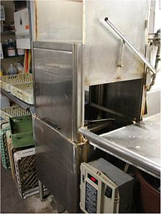
Micro Purchase: Example #1
A SFA’s dishwasher breaks mid-week. The repairs will cost less than $10,000.
Notes:
For example, a SFA’s dishwasher breaks mid-week. The repairs will cost less than $10,000. Due to the need for immediate repairs, a repair company may be contacted, and the micro-purchase threshold applied. The SFA would not have to aggregate total repair costs with this particular company for the program year.

Slide 12

Micro-Purchase: Example #2
A SFA wants to procure fresh produce on a monthly basis due to fluctuating prices in the produce market.
Notes:
Another example, a SFA wants to procure fresh produce on a monthly basis due to fluctuating prices in the produce market. When determining the threshold to use in the procurement process in this example, the SFA would consider the aggregate cost of each monthly purchase and NOT the aggregate cost over the program year.
Remember: Consideration should be given to consolidating the acquisition of products or services when consolidation will result in more economical purchases. This is true even if consolidation increases the dollar amount over the micro-purchase threshold, and therefore requires a more complex procurement method. When appropriate, an analysis should be made to determine the most economical approach.

Slide 13

Micro-Purchase: Example #3
A small SFA is making purchases for food at local grocery stores and does not have adequate storage. The total cost per week is well under $10,000.
Notes:
For example, a small SFA is making purchases for food at local grocery stores and does not have adequate storage (insufficient storage space is a good example when a SFA would use the micro-purchase). The total cost per week is well under $10,000. The SFA could apply the micro-purchase threshold. The SFA would not have to consider total food purchases over the entire program year.

Slide 14

All documentation related to procurement process activity are subject to the record retention requirement.
Notes:
All documentation related to procurement process activity are subject to the record retention requirement, 3 years previous, plus the current year.
Next, let’s look at what to expect when your Child Nutrition Representative is reviewing the SFA’s Micro Purchases.

Slide 15

Procurement Review Process
SFA completes Procurement Review Worksheet
SED selects a sample of vendors from each procurement method and requests additional documents for these vendors
SED completes procurement review and documents any findings, corrective action, and technical assistance
Notes:
The Procurement Review is conducted the same year as the Administrative Review. SED will be reviewing the SFA’s Procurement activities from the most recently completed school year.
SED developed a Procurement Review Worksheet that was sent to SFAs with your administrative review materials. In addition to responding to the instructions, SED will review your procurement tool: vendor names, goods and services provided, total amount paid to vendor, number of purchases from the vendor during the year, and number of bids received. Based on the SFAs responses, SED will ask for more documentation of specific purchases.

Slide 16
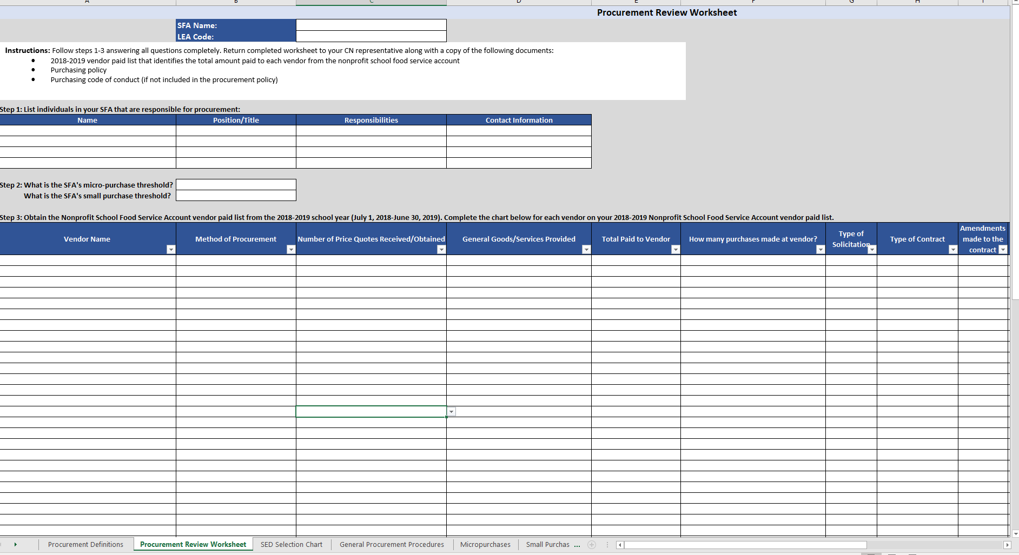
The Procurement Review Worksheet
Notes:
The Procurement Review Worksheet will be completed for the most recently completed school year. This will be the only tab on the Excel Tool that you will be completing. The rest of the form will be completed by your Representative as they go through the review process.
The worksheet will include all vendors the SFA procured goods or services from in the previous school year that appear on your vendor paid list. This will not include items such as association dues, postage, refunds to student accounts, annual licensing registration fees for software products already procured, and uniform allowances for staff. These items are not items that are procured.
Most of the columns on the worksheet have a dropdown box feature for you to answer the questions in the column with. When the dropdown feature is available, please use that to complete the information requested.
**Remember, if you obtained price quotes on a purchase of less than the Micro Purchase threshold of $10,000, then the procurement method utilized is categorized as the Small Purchase Method. When categorizing the procurement method utilized in a purchase like this, always look at the aggregate dollar value and the process used for vendor selection.
So now we will look specifically at Micro Purchases in the Procurement Review.

Slide 17
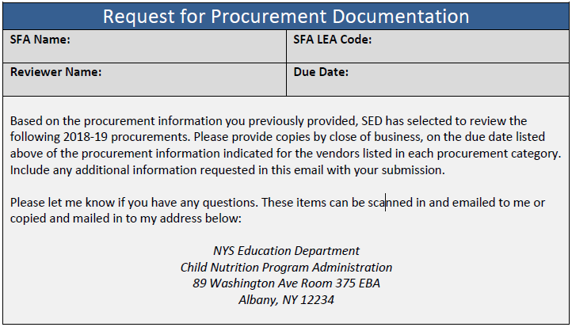
2018-2019 Request for Procurement Documentation
Notes:
Once SED receives the procurement review sheet, vendor paid list, purchasing policy and purchasing code of conduct, vendors will be selected, and you will receive a request for procurement documentation.

Slide 18
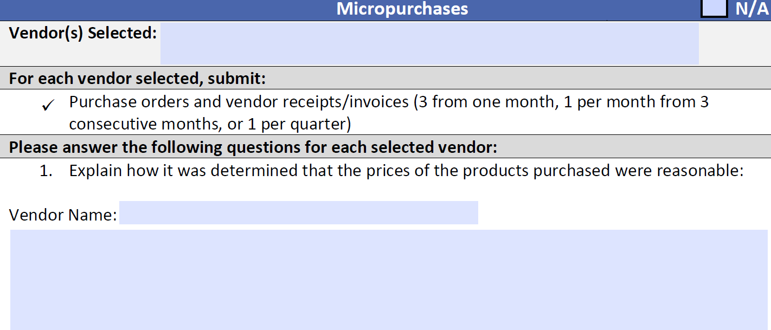
Micro Purchases
Purchases made without first soliciting competitive quotes (Must be under $10,000)
SED will request:
Purchase orders and vendor receipts/invoices (3 from one month, 1 per month from 3 consecutive months, or 1 per quarter)
SFA must explain how it was determined that the prices of the products purchased were reasonable
SFA must explain how purchases were equitably distributed among qualified sources
Notes:
SED will request the following information on the selected vendors with purchases categorized as Micro Purchases :
Purchase orders and vendor receipts/invoices (3 from one month, 1 per month from 3consecutive months, or 1 per quarter)
SFA must explain how it was determined that the prices of the products purchased were reasonable
SFA must explain how purchases were equitably distributed among qualified sources.

Slide 19
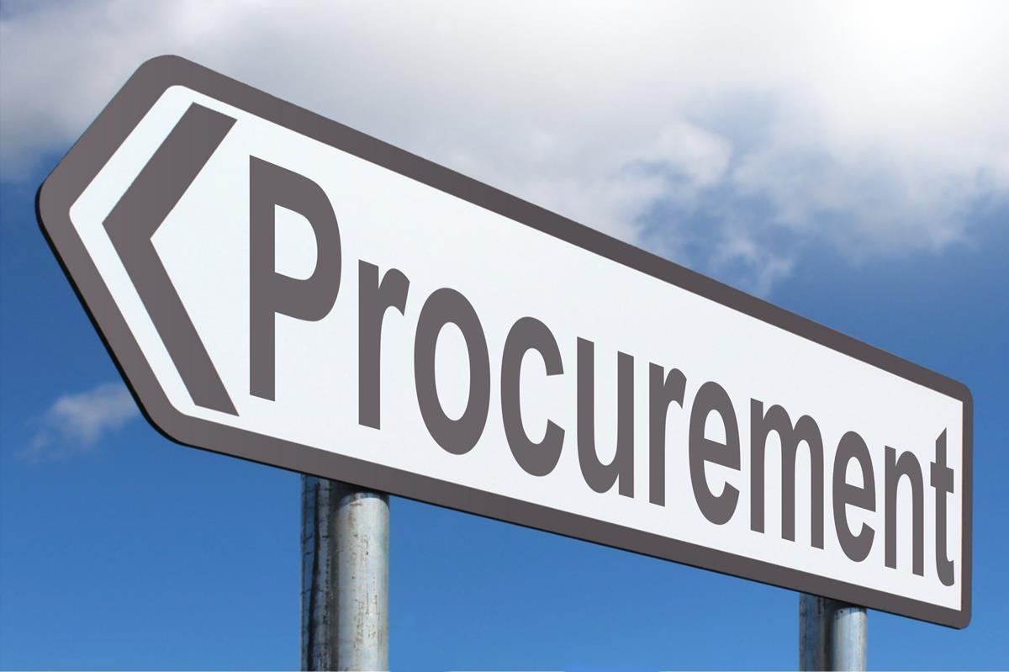
Procurement Review Findings
One of the most common procurement review finding
Finding:
-The policy did not have a written code of conduct that provides disciplinary actions for violations by officers, employees, or agents
-The SFA did not take steps to ensure that small, minority, and surplus firms are used when possible. women's business enterprises and labor
-The SFA did not equitably spread purchases among all qualified sources when utilizing the micro purchase method
-The SFA did not monitor the FSMC through periodic on-site monitoring
-The SFA did not conduct procurement
Corrective Action:
-The code of conduct will provide for disciplinary actions for violations
-Ensure that small, minority, and women's business enterprises and labor surplus firms are used when possible during all procurement procedures
To the extent practicable, the SFA will distribute micro-purchases equitably among all qualified sources.
-Monitoring the activities of the FSMC to ensure the FSMC is meeting the requirements agreed upon in the management contract
-The SFA will ensure that proper procurement requirements are followed and executed in accordance with federal, State and local regulations and requirements when procuring goods and/or services. A detailed history of every procurement will be kept on file.
Notes:
Here are some common findings for the Procurement Review and what the Corrective Action is. You will see that one of the most common findings on the Procurement Review is under the Micro Purchase category. It is the equitable spread of purchases among all qualified sources. Selecting the most appropriate procurement method, as explained earlier, or keeping records proving that you distribute micro purchases of like products/services among all qualified sources, will prevent this finding.
As always, if you have any questions, please reach out to your CN Representative.

Slide 20
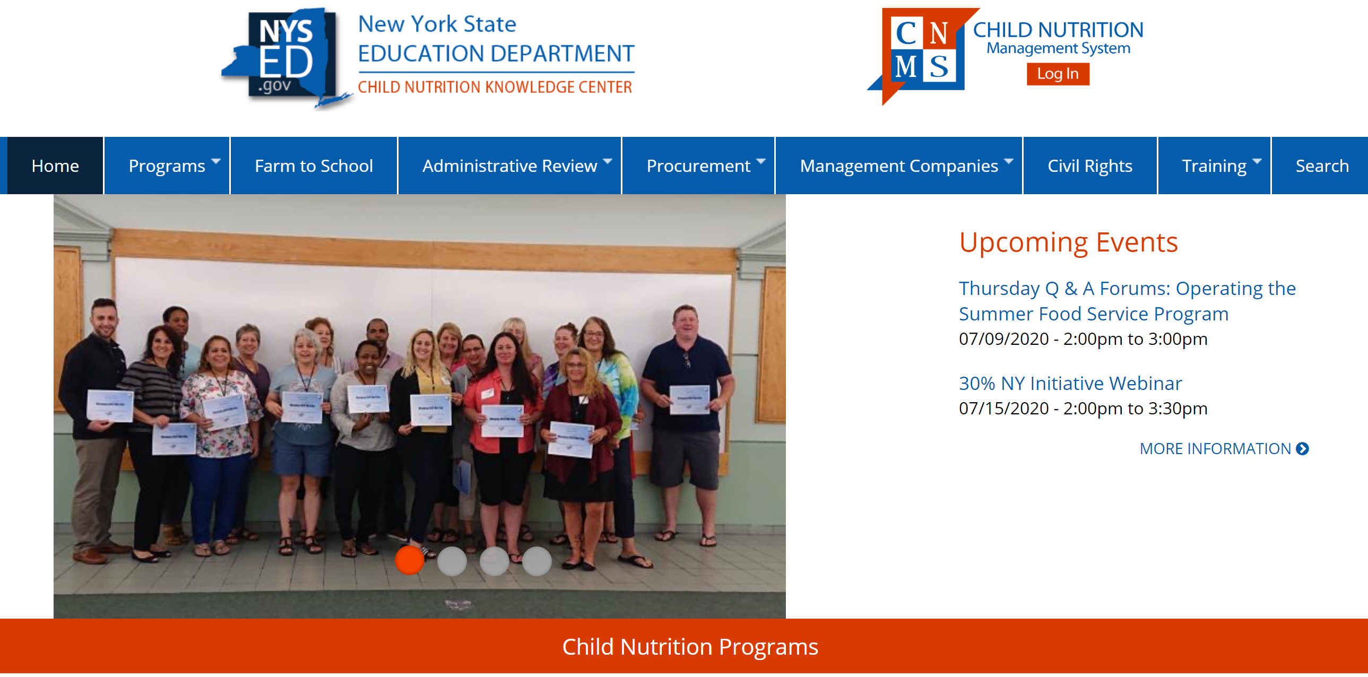
Additional Resources
Review additional resources on the Child Nutrition Knowledge Center :
Writing Specifications
Small/Informal Purchases
Formal Purchases
Buy American
Procurement Review
Notes:
Please review the Child Nutrition Website for additional procurement training opportunities.

Slide 21

This concludes Micro Purchases in Child Nutrition Programs
New York State Education Department
Child Nutrition Program Administration
(518)473-8781
CN@nysed.gov
Notes:
Thank you. This concludes Micro Purchases in Child Nutrition Programs.
Remember to record completion of this training for Annual Professional Standards Training requirements.
If you have any additional questions, please do not hesitate to call or email us.

