Slide 1

Accommodating Individuals with Disabilities in Child Nutrition Programs
1 hour Professional Standards Training
Notes:
This PowerPoint will contribute 1 hour towards Professional Standards training requirements. This training reviews meal modifications requirements to accommodate individuals with disabilities in the Child Nutrition Programs.
The National School Lunch Program and School Breakfast program aim to provide all participating children, regardless of background, with the nutritious meals they need to be healthy.
School Food Authorities (SFAs) must comply with the USDA regulation 7 CFR 15b Non Discrimination on the Basis of Handicap in Programs or Activities Receiving Federal Financial Assistance.
This includes ensuring children with disabilities have an equal opportunity to participate in and benefit from the National School Lunch and School Breakfast programs.
It is imperative that SFAs recognize the importance of ensuring access to meal benefits and understand their obligation to provide reasonable modifications for children with disabilities.

Slide 2

Schools must make substitutions for students who are considered to have a disability under 7 CFR 15b.3 and whose disability restricts their diet.
7 CFR 210.10(m)
Notes:
A reasonable modification is a change or alteration in policies, practices, and/or procedures to accommodate a disability that ensures children with disabilities have equal opportunity to participate in, or benefit from, a program. A request for a reasonable modification must be related to a child’s disabling condition. Federal law and USDA regulations at 7 CFR 15b.13 require that schools make reasonable modifications to accommodate children with disabilities. Reasonable modifications to effectively accommodate children with disabilities must be made on a case-by-case basis. A meal modification must be related to the disability or limitations caused by the disability
Within your SFA, requests from parents for a meal modification may be placed with staff outside of food service. Your school must develop a procedure that ensures all requests are put into place timely.

Slide 3
Civil Rights Authorities
Title VI of the Civil Rights Act of 1964
Civil Rights Restoration Act of 1987
Section 504 of the Rehabilitation Act of 1973
ADA of 1990
ADA of 2008
Title IX of the Education Amendments of 1972
Age Discrimination Act of 1975
7 CFR Parts 15, 15a, 15b and 15c
FNS 113-1
Executive Order 12250
Executive Order 13166
28 CFR 41
USDA Departmental Regulation 4330-2
2017 Edition of Accommodating Children with Disabilities in the School Meal Programs
Notes:
Just to name a few, here are some of the authorities on Civil Rights.

Slide 4
ADA Amendments Act of 2008:
Implementation
The term “substantially limits” requires a lower degree of functional limitation than the standard previously applied by the courts . An impairment does not need to prevent or severely or significantly restrict a major life activity to be considered “substantially limiting.” Nonetheless, not every impairment will constitute a disability.
The term “substantially limits” is to be construed broadly in favor of expansive coverage, to the maximum extent permitted by the terms of the ADA.
The determination of whether an impairment substantially limits a major life activity requires an individualized assessment, as was true prior to the ADAAA.
With one exception (“ordinary eyeglasses or contact lenses”), the determination of whether an impairment substantially limits a major life activity shall be made without regard to the ameliorative effects of mitigating measures, such as medication or hearing aids.
An impairment that is episodic or in remission is a disability if it would substantially limit a major life activity when active.
In keeping with Congress’s direction that the primary focus of the ADA is on whether discrimination occurred, the determination of disability should not require extensive analysis.
Notes:
This act expanded and clarified the definition of DISABILITY.
This act reminds us that there should not be a burden placed on an individual to “prove” the disability.
It did not change the expectation that SFAs will provide a reasonable modification to students.

Slide 5

The expanded definition of DISABILTY:
Major Life Activities:
Seeing, hearing, walking, speaking, learning, eating, breathing
Major Bodily Functions:
Digestive Immune system, respiratory, circulatory, neurological/brain
Notes:
The Americans with Disabilities Act Amendments Act of 2008 made important changes to the meaning and interpretation of the term “disability” . These changes were intended to make it easier for individuals to establish that they have a disability. After the passage of the ADA Amendments Act, most physical and mental impairments will constitute a disability. The central concern for school food authorities should be working collaboratively with families to ensure equal access to Program benefits for children with disabilities.

Slide 6


MAJOR LIFE ACTIVITIES
Major Bodily Functions
Major Life Activities
Caring for oneself
Performing manual tasks
Seeing, hearing, speaking
Eating, Sleeping, Walking
Standing
Lifting, Bending
Breathing
Reading, Learning, Thinking
Communicating
Working
Functions of the immune system
Normal Cell Growth
Digestive, Bowel, Bladder
Neurological, brain
Respiratory
Circulatory
Endocrine
Reproductive
Notes:
These are some examples of “ Major Life Activities” that may be impacted by a disability.
Major life activities include but are not limited to: caring for oneself, performing manual tasks, seeing, hearing, eating, sleeping, walking, standing, lifting, bending, speaking,
Breathing, learning, reading, concentrating, thinking, communicating, and working.
Significantly, this also includes major bodily functions such as functions to the immune system, normal cell growth, digestive system, bowel, bladder, neurological, brain and respiratory.
A food intolerance may be considered a disability if it substantially limits a major life activity.

Slide 7
Reasonable
Modifications
Notes:
Procurement of Special Meals- Federal regulations specifically prohibit disability discrimination through contractual means, including vended contracts. SFAs must make reasonable modifications for children with disabilities, regardless of whether the SFA operates the food service or contracts with a Food Service Management Company (FSMC). As applicable, modifications for children with disabilities must be included in the FSMC contract. SFAs that do not need dietary modifications at the time an FSMC bid is prepared should still include sufficient information in the bid to make certain the FSMC is aware that dietary modifications may be required during the term of the contract.
The NYSED FSMC prototype contract includes this language.

Slide 8
Program accessibility
Ensure all food service areas are accessible
Provide auxiliary aids and services, such as: Adaptive feeding equipment, or food service aides
Notes:
Ensure food service areas are accessible
Provide auxiliary aids and services, if needed. Examples include:
Food service aides
Adaptive feeding equipment
Meal tracking assistance
Other effective methods

Slide 9
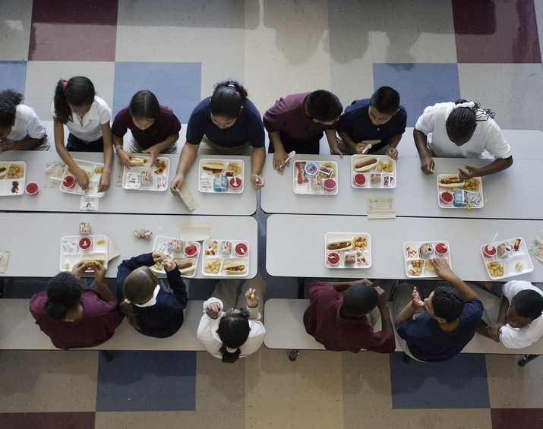
Integrated Environment
Section 504 contains an integration clause
Applies to food allergies
Balance safety versus stigma
Notes:
The integration clause in Section 504 means that individuals with disabilities should be accommodated in the least restrictive and most integrated setting as possible.
This is important to keep in mind when accommodating food allergies.
SFAs must always balance safety vs stigma.

Slide 10
Reasonable modification
A change or alteration in policies, practices and procedures to accommodate a disability
Providing the modification is your goal, not determining if the individual has a disability
You may negotiate a modification, the modification requested does not always have to be the modification provided
Case by case basis

Slide 11
For Your Consideration
Refer to:
Accommodating Disabilities in the School Meal Programs: Guidance and Questions and Answers (Q&As)
Costs/Resources
Facts
“Lifestyle” choice versus disability
follow this link
https://fns-prod.azureedge.net/sites/default/files/cn/SP26-2017os.pdf
Health concerns or preferences that a child eat a specific diet because the parent/guardian believes it is healthier for the child are not disabilities and do not require a modification.
Notes:
You must consider the cost of the request and what resources you have available to you. If the modification requested would cause undue financial burden on the program that would make continued operation of the program unfeasible, the modification need not be provided.
The meal modifications do not have to mirror the meal or meal item substituted.
Remember stereotypes cannot influence your decision, it must be based on facts.
“Lifestyle” choices are not considered disabilities and do not need to be accommodated. For example, a vegan diet would not need t be considered unless it is related to an underlying disability and stated in the documentation provided from the licensed healthcare professional.

Slide 12
Modification provided:
Should be related to the disability or limitations caused by the disability
Does not have to be the modification requested
Must (generally) be free of charge
Should be implemented even when the person requesting the modification believes more should be done

Slide 13

Food Allergies
Many food allergies fall under the
definition of disability
Notes:
The SFA must also provide the child with a safe environment to consume the meal. This includes ensuring proper storage, preparation, and cleaning techniques are used to prevent exposure to allergens through cross contamination and may involve preparing a separate meal “from scratch” using ingredients allowed on the modified diet rather than serving a meal using processed foods. In general, school food professionals should exercise caution at all times, and should not serve foods to children with severe food allergies if the full ingredient list of a food product is not available

Slide 14
Medical statement requirements
Statement :
Provides information about impairment-DIAGNOSIS NOT REQUIRED
States how diet is restricted
States how to accommodate condition
You may seek clarification:
Do not delay modification
Do not request medical records
Do not require note signed by physician, it may be signed by any State licensed healthcare professional
(Physician, Nurse Practitioner, Physician’s Assistant)
Notes:
SFAs must obtain a written medical statement from a State licensed health care professional in order to receive reimbursement for meal modifications when the modified meal does not meet the Program meal pattern requirements.
The written medical statement is no longer required to identify the specific disability, or to use the terms “disability” or “disabled” (though statements that use these terms are sufficient). Instead, the medical statement need only include a description of the child’s physical or mental impairment that is sufficient to allow the SFA to understand how it restricts the child’s diet. The medical statement should also include a description of what must be done to accommodate the child’s impairment.
If the Child’s IEP or 504 plan includes the information required in the medical statement, or if the SFA obtains written medical verification of the impairment during the IEP/504 plan process, it is not necessary for the SFA to also obtain a separate medical statement.
Do not delay providing modification! SFAs should work with the child’s parent or guardian to obtain a supplemental medical statement.

Slide 15

Food Allergy Medical Statement
*Includes 3 essential components:
The food to be avoided (allergen)
Brief explanation of how exposure affects the student
Recommended substitute(s)
Notes:
An example of documentation is a medical statement that includes these 3 essential components:
The food to be avoided
Brief explanation of how exposure affects the student
Recommended substitute(s)
Remember, SFAs may receive reimbursement for a meal modification request without a medical statement when the accommodation can be made within the Program meal pattern. For example, if a child has a common allergy to one fruit or vegetable, the school food service can simply substitute another fruit or vegetable. FNS encourages schools to use flexibilities whenever possible.

Slide 16

Food allergy management training designed specifically for Child Nutrition Program staff
Refer to Child Nutrition Knowledge Center Training tab, under CN Snip-Its
Notes:
Refer to the Training tab for food allergy management training designed specifically for staff working in a school kitchen. The training will familiarize staff with how common food allergies are and review common terminology, The training shows staff how to prevent cross-contact with allergen containing foods and how to handle food items for students with identified food allergies throughout the flow of food through the kitchen. In addition, the training reviews how to identify students who may be having an allergic reaction and general guidance on how to handle this situation. Of course all schools have their own specific policies regarding food allergies, but this training reviews general food allergy guidance and provides helpful tips and practices to keep in mind.

Slide 17

Food Service Role
Tracking Dietary Intake
Food Safety/Sanitation
Notes:
Some children may need to track their dietary intake. For example, diabetic children must track their carbohydrate intake. To accommodate a diabetic child, a medical statement may require a SFA to provide nutritional information for food options made available to the child.
The SFA is not required to provide all nutrition information for all program meals. SFAs can develop a cycle menu with the child’s parent or guardian, and the nurse. Nutrition information can be made for just the food on the cycle menu as opposed to all foods offered in all programs.
It is important to ensure school food service professionals understand the potential severity of even a small amount of exposure to a food allergen and the role proper food handling and sanitation play in a potentially life-threatening situation.
Including a Food Allergy Action Plan in the Food Safety Program can help school food service professionals and others who are present when food is served to prevent food related emergencies.

Slide 18

Special Circumstances
Portion Sizes
Brand Name Requests
Offer vs. Serve
Procurement of Special Meals
Notes:
A modification request may include portion sizes exceeding the minimum quantity requirements set forth in Program regulations. When specifically prescribed in the medical statement, the SFA must provide the child with larger portions. SFAs will not receive any additional reimbursement to cover the extra costs associated with providing extra food.
In some situations, a medical statement may request a particular brand name of a product as a substitute on the medical statement. If a modification request indicates a brand name item, a generic brand is sufficient, unless a brand name item is medically necessary. This can be determined through the interactive process with the child’s parent or guardian.
Offer vs. Serve allows children to decline some food components or food items, as long as their meal meets certain requirements. At SFAs who participate in Offer vs. Serve, children with disabilities must have the option to select all food components/items made available to other children. SFAs cannot accommodate for a child’s disability by asking the child to exclude a food component/item from their selection. The SFA may not use Offer vs. Serve to eliminate a specific food component for a child with disability.
Federal regulations specifically prohibit disability discrimination through contractual means, including vended/Food Service Management Company contracts. As applicable, modifications for children with disabilities must be included in the FSMC contract.

Slide 19
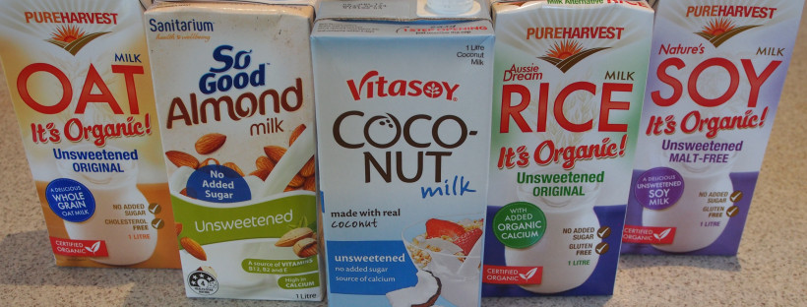
Fluid Milk Substitute Nutrient Requirements
Nutrient | 8 Fluid Ounces
Calcium | 276 mg
Protein | 8 g
Vitamin A | 500 IU
Vitamin D | 100 IU
Magnesium | 24 mg
Phosphorus | 222 mg
Potassium | 349 mg
Riboflavin | 0.44 mg
Vitamin B-12 | 1.1 mcg
Notes:
Fluid Milk substitutions must meet FNS nutrient requirements listed above. SFAs will not received Federal reimbursement for a meal that substitutes juice or water for milk for a non disability reason.
If a child’s medical statement indicates the child cannot consume milk due to a disability and requests the child receive a substitute, the SFA must provide the requested substitute regardless of whether it meets the nutrient requirements.
In a disability situation, the SFA will continue to receive reimbursement for the meal based on the signed medical statement.

Slide 20

Procedural Safeguards and Training
SFAs must have a procedure in place to ensure parents know how to request a meal modification and how to file an grievance if a requested modification is not granted
Must include:
  How to file a grievance
  Receive a prompt and equitable resolution
  Request and participate in an impartial hearing to resolve the grievance
  Must be represented by counsel at the hearing
  Examine the record
  Receive notice of the final decision and procedure for review
Notes:
SFAs must have a procedure in place to ensure parents/guardians know how to request a meal modification for their child, understand the right to examine the record, understand their right to file a grievance in situations where a requested modification is not granted, and receive notice of the final decision and the procedure for review. .
Let’s look at this at each of these a little closer.

Slide 21

Compliance
SFA must develop procedures for parents/guardians to request modifications
Train school and food service staff
Appoint a 504 coordinator
Assemble a team (best practice)
Notes:
SFAs must ensure their procedure for requesting a meal modification provides for a prompt and equitable resolution of grievances, and must designate at least one person to coordinate compliance with disability requirements.
Your SFA may already have procedures in place to address requests to accommodate children with disabilities in the school that are in compliance with Section 504 of the Rehabilitation Act of 1973 and/or the Individuals with Disabilities Education Act, and these may be used to fulfill the requirement to maintain a Procedural Safeguards process for meal modifications.
This individual is often referred to as the Section 504/ADA Coordinator. In many cases, the Section 504/ADA Coordinator is responsible for addressing requests for accommodations in the school in general. As part of their general responsibilities, this individual also may be responsible for ensuring compliance with disability requirements related to meal modifications and the meal service. Regardless of whether the coordinator works in the school food service, the coordinator must ensure school food service professionals understand the procedures for handling meal modification requests.
SFAs are strongly encouraged to develop a Section 504/ADA Team to discuss best practices and develop a holistic plan to create a safe learning environment for children. Using a “team approach” encourages information sharing throughout the school, and may help protect children in situations where food is served outside the cafeteria, such as during classroom parties

Slide 22
Parent/Guardian Notification
Provide notice of:
Process for requesting modification
Decisions
Procedural Rights
Opportunity to examine the record and file a grievance
Impartial hearing
Review procedure
Notes:
SFAs must provide a process for the prompt resolution of grievances that includes the option for an impartial hearing. This procedural safeguard process requires SFAs to provide notice and information to families regarding how to request a reasonable modification.
The notice must explain the families procedural rights which include: File a grievance if they believe a violation has occurred regarding the request for a reasonable modification, receive a quick resolution of the grievance, request and participate in an impartial hearing to resolve the grievances, be represented by counsel at the hearing, examine the record, and receive notice of the final decision and procedure of the review in writing, for example the right to appeal the hearing decisions.

Slide 23
Additional Guidance
SP 26-2017: Accommodating Disabilities in the School Meal Programs: Guidance and Questions and Answers (Q and As)
http://www.fns.usda.gov/school-meals/accommodating-disabilities-school-meal-programs-guidance-and-qas.
Notes:
USDA issued memo SP: 59 2016, which replaced FNS Instruction 783-2, Rev. 2: Meal Substitutions for Medical or other Special Dietary reasons as the instruction relates to the School Meals programs.
This memo requires SFAs to make reasonable modifications to accommodate children with disabilities. This includes providing special meals, at no extra charge, to children with a disability which restricts their diet.
Additionally , on May 1, 2017, FNS issued SP 26-2017: Accommodating Disabilities in the School Meals Programs: Guidance and Questions and answers. The Q and A’s discuss relatively common situations which have raised questions in the past and provide direction for SFAs working to ensure children with disabilities have an equal opportunity to participate in the School Meals Programs.

Slide 24
Questions
Contact your CN representative with any questions
New York State Education Department
Child Nutrition Program Administration
(518) 473- 8781
CN@nysed.gov
Notes:
Thank you. This concludes Accommodating Individuals With Disabilities in Child Nutrition Programs.
Remember to record completion of this training for Annual Professional Standards Training requirements.
If you have any additional questions, please email the Training Team.

