Slide 1
Local Wellness Policy and Assessment
1 hour Professional Standards Training
Notes:
This PowerPoint will contribute 1 hour towards Professional Standards training requirements. This training reviews the Local Wellness Policy (LWP) and Assessment.

Slide 2
Local Wellness Policy and Assessments
Notes:
SFA’s participating in the National School Lunch Program and/or School Breakfast Program are required to develop a local school wellness policy that promotes the health of students and addresses the problem of childhood obesity. Wellness policies are tailored to the unique needs of each SFA and present an opportunity to improve the health of each community. On July 29, 2016, the USDA Food and Nutrition Service (FNS) finalized regulations to create a framework and guidelines for written wellness policies established by SFAs. The final rule required SFA’s to begin developing a revised local school wellness policy during school year 2016-2017. The revised policy was to be in place by June 30, 2017, with the first triennial assessment of the SFA’s policies being in place by June 30, 2020.
The Intent of a Local Wellness Policy (LWP) is to address and improve the wellness and health of the SFA and its community. Healthy lifestyles for fitness and nutrition are put into place during the school day. The goal is to grow this education and awareness of health and wellness into daily lifestyles of the students and to the entire community being served by the SFA. This way a new generation of healthy productive citizens will grow into our communities and existing community members will be involved and will benefit from this environment of improved health and wellness.
The LWP is much more than just a “policy” t o be put in a policy book and forgotten. It is a roadmap to a program addressing the goals and unique wellness status of the community. The policy is a living and ever-changing document outlining the needs and goals of the community, the progress made towards meeting these needs/goals, and how the goals for the community evolve.
Now, lets dig into the elements of a LWP.

Slide 3
WHO NEEDS TO HAVE A LOCAL SCHOOL WELLNESS POLICY?
Each SFA MUST establish a local school wellness policy for all schools participating in the National School Lunch Program and/or School Breakfast Program.
This includes Residential Child Care Institutions, jails/detention centers, private schools including religious private schools, and charter schools.
Notes:
All schools (public and nonpublic), RCCIs, jails, and any school that received federal funds through NLSP and SBP are required to have a wellness policy/ plan and make it public

Slide 4
WHO IS RESPONSIBLE FOR DEVELOPING THE LOCAL SCHOOL WELLNESS POLICY?
SFAs are responsible for developing a local school wellness policy (7CFR 210.31(a)).
A best practice would include having each school, within the SFA, customize the policy at the local level.
If the SFA feeds a site that they do not have educational administrative responsibility for (i.e., a non-public school, a BOCES building, another school district), that site is held accountable for creating their own local school wellness policy and assessments and not the LEA that they are fed under although the SFA will be cited during an Administrative Review if that site fails to have a local school wellness policy.
SFAs are required to allow parents, students, school food authority representatives, teachers of physical education, school health professionals, the school board, school administrators, and members of the general public to participate in the development, implementation, and periodic review and update of the local school wellness policy (7CFR 210.31(c)(5)).
Follow this link to an example LWP
http://www.schoolnutritionandfitness.com/schools/rsd_1506091857328281/WellnessPolicy.pdf
Notes:
SFA’s can utilize a model LWP template or develop their own policy. SFA’s do not need to re-invent the wheel and can use a model template. If they decide to develop their own policy, it is recommended that the SFA review a model. The link on this slide is an example of a policy based on the template from the Alliance for a Healthier Generation- the fillable template is attached to this Module . Reviewing this against the SFA’s LWP will ensure all required elements of an LWP are included. When utilizing the template, it is important to individualize the policy. As this presentation moves through each of the LWP requirements, you will see where the opportunities for individualizing the policy will be.
Some SFA’s consist of multiple sites/schools. Each district is responsible for developing their own customized plan as an SFA, but each site must have a plan individualized to the site/school. Best practice is for each building in the district to develop a plan specific to that building and then all buildings share their plans with each other. This is especially important to keep in mind if schools are using a template from an overseeing group such as BOCES.

Slide 5
WHAT IS REQUIRED TO BE INCLUDED IN THE LOCAL SCHOOL WELLNESS POLICY?
SFAs have flexibility to develop specific content BUT the policies must include:
Specific goals for nutrition promotion and education, physical activity, and other school-based activities that are designed to promote student wellness (7CFR 210.31(c)(1));
Standards and nutrition guidelines for all foods and beverages available on the school campus during the school day that are, at a minimum, consistent with Federal regulations for program meals and the Smart Snacks in School nutrition standards, and designed to promote student health and reduce childhood obesity (7 CFR 210.31(c)(2) and (3));
Policies that allow marketing or advertising of only those foods and beverages that may be sold on the school campus during the school day, i.e., those foods and beverages that meet the Smart Snacks in the school nutrition standards (7CFR 210.319(c)(3)(iii)).
Notes:
7 CFR 210.31(a) defines a local school wellness policy as a written plan that includes methods to promote student wellness, prevent and reduce childhood obesity, and provide assurance that school meals and other food and beverages sold and otherwise made available on the school campus during the school day are consistent with applicable minimum Federal standards.
For the purpose of competitive food standards implementation…
School campus means all areas of the property under the jurisdiction of the school that are accessible to students during the school day (7CFR 210.11(a)(4)).
School day means the period from the midnight before, to 30 minutes after the end of the official school day (7CFR 210.11(a)(5)).
Local school wellness policies are required to address food and beverages that are both sold AND made available at no costs to students.
Let’s look a little closer at All Foods and Beverages available to students at no cost to students on the school campus, during the school day.

Slide 6
ALL FOOD AND BEVERAGES AVAILABLE TO STUDENTS AT NO CHARGE
Local school wellness policies are required to address food and beverages that are both sold AND made available at no costs to students.
SFAs MUST develop standards and nutrition guidelines for all foods and beverages available, but not sold to students on the school campus during the school day (i.e., classroom parties or rewards). These standards are not required to be consistent with Smart Snacks standards as stated in (7CFR 210.31(c)(3)(iii)), local jurisdictions have the discretion to adopt standards consistent with Federal school meals and Smart Snacks or adopt more or less stringent standards.
For food and beverages sold to students, the local school wellness policy MUST include standards and nutrition guidelines that are consistent with the school meal requirements and Smart Snacks nutrition standards.
Notes:
Districts must set and follow standards and nutrition guidelines for ALL foods and beverages available on the school campus during the day that are consistent with federal regulations for NSLP and SBP and SMART SNACKS and designed to promote student health and reduce childhood obesity. This includes items that are available at no cost, such as foods and beverages for classroom parties or rewards. While these items do not necessarily have to be consistent with smart snacks standards, districts have the discretion to adopt standards that are more or less stringent than federal guidelines. Many SFAs allow only foods consistent with the standards to be available to students, while others set limits on foods that are not consistent with standards.
If food or beverage items are SOLD to students, the wellness policy must include nutrition guidelines that are consistent with NSLP, SBP, and Smart Snack standards.
NOTE: The policy/ plan can only promote marketing/advertising of foods and beverages that meet smart snack standards.

Slide 7
WHAT IS REQUIRED TO BE INCLUDED IN THE LOCAL SCHOOL WELLNESS POLICY? (continued)
SFAs are also required to:
Review and consider evidence-based strategies in determining local school wellness goals (7CFR 210.31(c)(1));
Involve, inform, and update the public (including parents, students and other stakeholders) about the content and implementation of the local school wellness policy (7CFR 210.31(d)(2) and (3));
Conduct an assessment, at least once every 3 years, to determine compliance, progress, and the extent to which the policy compares to model local school wellness policies (7CFR 210.31(e)(2));
Update or modify the local school wellness policy as appropriate (7CFR 210.31(e)(3)).
Notes:
Also required to be included is that the district will look at evidence-based strategies to help determine which wellness goals will work for them. Not all strategies will work for all districts/ buildings in the district.
Districts are required to invite outside interested parties, such as parents, local healthcare providers, students, etc. to participate on their wellness committee. In addition, districts are required to let the public know about their wellness policy/ plan; what’s in it, if they have meet previously established goals, and what new goals are for the future.

Slide 8
Assessments of the Local School Wellness Policies
Triennial Assessment- at a minimum, assessments must be conducted once every 3 years (7CFR 210.31(e)).
This assessment is separate from the Administrative Review conducted by the State Agency.
The final rule required LEAs to begin developing a revised local wellness policy by August 29, 2016. These revised policies were to be in place by July 1, 2017. Therefore, the first triennial assessment must be completed by June 30, 2020.
Notes:
Districts must also conduct an assessment of their wellness policy/ plan
SFAs can utilize their own assessment tool but it is recommended that SFAs review their assessment against model assessment tools. We will look at a couple tools in the upcoming slides

Slide 9
What must be included in the triennial assessment?
The LEA must develop a triennial assessment report that describes:
the extent to which its schools comply with the local school wellness policy;
the extent to which the local policy aligns with model policies; and
The Alliance for a Healthier Generation, in conjunction with USDA, developed a model local school wellness policy template that may be used for this comparison.
a description of progress towards attaining policy goals (7CFR 210.31(e)(2)).
***THIS TRIENNIAL ASSESSMENT REPORT MUST BE MADE AVAILABLE TO THE PUBLIC (7CFR 210.31(d)(3))***
*Follow this link to a model LWP
http://www.schoolnutritionandfitness.com/schools/rsd_1506091857328281/WellnessPolicy.pdf
Notes:
As mentioned in a previous slide, the assessment will evaluate the progress made towards meeting their previously established goals.
The assessment will also look at how closely your wellness plan aligns with model wellness plans, like the example of an LWP provided on slide 3 and provided here again.

Slide 10
WHAT TOOLS ARE THERE FOR ASSESSING COMPLIANCE?
The SFA can develop their own tool for assessing compliance with specific components of their local school wellness policy.
The SFA must document when and how they evaluated their policy (i.e., agenda, attendance sheet from a stakeholders meeting).
The SFA can use our NYS Local School Wellness Assessment Tool
http://www.cn.nysed.gov/common/cn/files/nyslswpassessmenttool.pdf
The SFA can use other developed tools/resources (i.e., WellSAT Tool)
http://www.wellsat.org/
Notes:
SFAs can utilize their own assessment tool but it is recommended that SFAs review one of the resources provided. Districts will ensure meeting assessment requirements by utilizing one of these provided resources.

Slide 11
Who should conduct the assessments?
SFAs must designate at least one school official as responsible for determining the extent to which each school is in compliance with their wellness policies (7CFR 210.31(e)(1)).
The SFA has discretion in determining who is responsible for overseeing the wellness policy including assessments. Some SFAs have positions titled “Wellness Coordinator”, while others have the School Nutrition Director or Health Educator oversee the policy.
In addition to the official identified, other stakeholders must be permitted to be involved in the review process (7CFR 210.31(d)(1)).
Notes:
Districts must assign someone to oversee the wellness committee that develops, implements, and assesses the wellness plan. Some districts choose the superintendent, others will select the school nurse, health teacher or Food Service Director. This person will be responsible for coordinating the committee and may designate individuals to review and assess progress towards the goals the district has put in place.
All other stakeholders (parents, faculty, staff, outside community members, healthcare providers, etc.) must permitted to be involved in this review process.

Slide 12
How should SFA’s engage stakeholders in the policy?
Each year stakeholders must be provided with the opportunity to participate in the development, implementation, periodic review, and update of the local school wellness policy (7CFR 210.31(d)(1)).
It is the LEAs discretion on how stakeholders are invited. Suggestions include:
Sending a letter to parents/families
Providing status updates in teacher/staff trainings
Posting a call for volunteers on the LEAs website
Including a blurb on the school, LEA, or local community newspaper, newsletter, and/or blog
Partnering with community organizations to spread the information
Posting information about the process on social media
Notes:
The SFA must have a plan in place to communicate to all stakeholders regarding the development, implementation, review, and update of the LWP. Each SFA is unique and will determine the best mode of communicating this information.

Slide 13
HOW SHOULD THE LEA NOTIFY THE PUBLIC ABOUT THE POLICY AND UPDATES?
SFAs must inform the public each school year of basic information about the local school wellness policy including content and updates (7CFR 210.31(d)(2)).
It is recommended that the information be provided early in the school year
It is also encouraged for LEAs/schools to include a summary of each school’s events or activities related to the local school wellness policy implementation on their annual public notification.
Best practices include:
Highlighting the policy on school websites
Linking to the policy on individual school social media accounts
Sending updates in parent/school newsletter
Including the policy in parent/staff meeting presentations
Providing copies of the policy at back-to-school nights
Featuring the policy on parent or student specific webpages
Posting on school bulletins
Placing a blurb in a local newsletter or newspaper
Posting on a community website or blog
Sharing updates or accomplishments on a local radio station/television show
Notes:
This slide describes options for letting their communities know about their wellness plan, as required by regulations

Slide 14
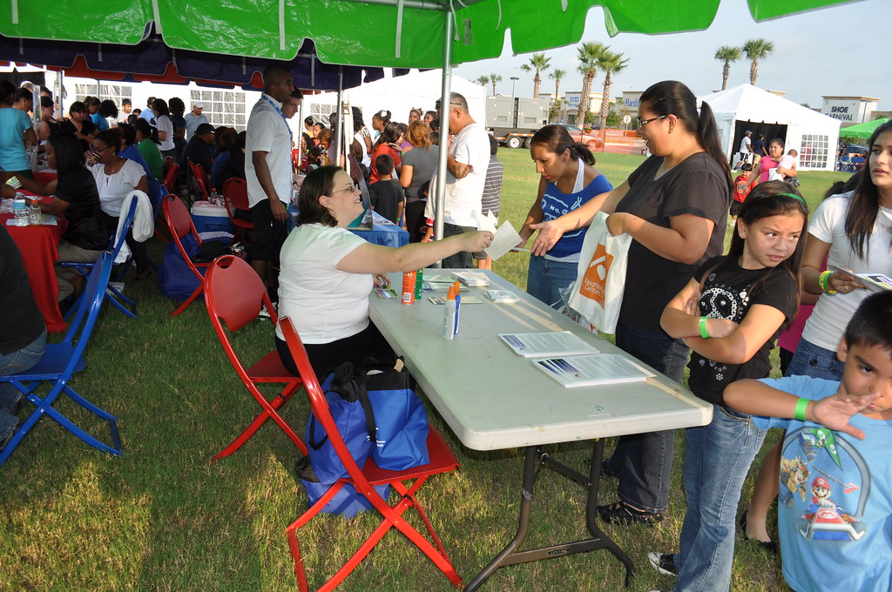
Be sure not to miss out on all local wellness opportunities
Notes:
Here are a few ideas to consider when engaging the school and the community to be involved in the SFA’s LWP.
There are probably programs and events already happening at your school that will perfectly fit into the LWP. There may be some ideas you have always wanted to implement in the SFA and weren’t quite sure how to introduce the ideas or where they would fit in. The LWP is also a great place for many unique and fun ideas that will involve and engage the students and community, while illustrating how healthy lifestyle habits will fit into their daily lives and how it will impact their lives.
Events to consider and include: Farm to School events, school gardens, Health Fairs, Walk-a-thons or other walking or fitness events, open gym/workout room/walking track hours the school may offer to the community.
Be creative and use the talent in your community to add to the variety of wellness activities and events. Schools are usually pleasantly surprised with how many community members will volunteer their time and talents.

Slide 15
Where can I get more information regarding technical support and funding opportunities.?
Tools are available to help SFAs develop, update and assess local school wellness policies. These websites contain resources on the local school wellness policy process, required wellness policy elements, success stories/best practices, trainings, grants/funding opportunities, and wellness policy implementation:
theicn.org/cnss
healthiergeneration.org
wellsat.org
www.cdc.gov/healthyyouth/npao/publications.htm
Notes:
Read slide

Slide 16
This concludes Local Wellness Policy and Assessments
New York State Education Department
Child Nutrition Program Administration
(518)473-8781
CN@nysed.gov
Notes:
Thank you. This concludes Local Wellness Policy and Assessments..
Remember to record completion of this training for Annual Professional Standards Training requirements.
If you have any additional questions, please do not hesitate to contact us.

