Slide 1
School Year 2019-2020:
Flexibilities for Milk, Whole Grains, & Sodium

Slide 2
Today’s Agenda
Final Rule (83 FR 63775)
Background
Permanent Flexibilities
Next Steps
Questions

Slide 3
Background
May 2017: USDA issues Commitment to School Meals Proclamation; FNS memorandum grants menu planning flexibilities through SY 2017-2018
November 2017: FNS interim final rule extends menu planning flexibilities through SY 2018-2019
December 2018: Final rule provides long-term menu planning flexibility for Program operators

Slide 4
Developing the Final Rule
FNS focused on public comments specific to the three menu planning flexibilities.
Intended benefits:
Reduced regulatory burden
Increased student participation
Reduced food waste

Slide 5
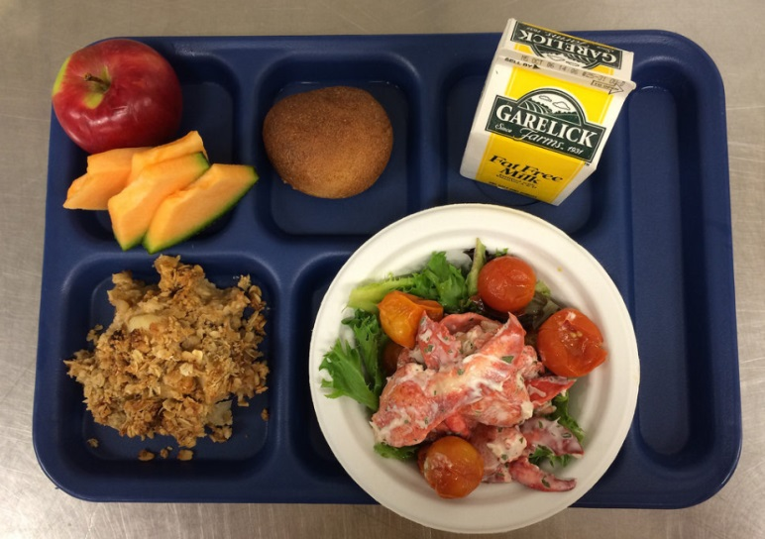
Wholesome and Appealing Meals
Children will continue to have access to fruit, an array of vegetables, whole grains, and fat-free and low-fat milk.

Slide 6
Final Rule Flexibilities
Effective July 1, 2019

Slide 7
Milk Flexibility
Allows flavored, low-fat milk in schools (lunch, breakfast, a la carte)
Also allowed in:
Special Milk Program (ages 6+)
Child and Adult Care Food Program (ages 6+)
No exemption request required

Slide 8
Milk Flexibility
Schools must offer unflavored milk at each meal service in NSLP/SBP.
Variety must not be limited to flavored milk choices (e.g., flavored fat-free and low-fat milk).
Milk variety requirement does not apply to CACFP.

Slide 9
Whole Grain-Rich Flexibility
At least half of the weekly grains offered in the NSLP and SBP must be whole grain-rich.
Other grains in the weekly menu must be enriched.

Slide 10
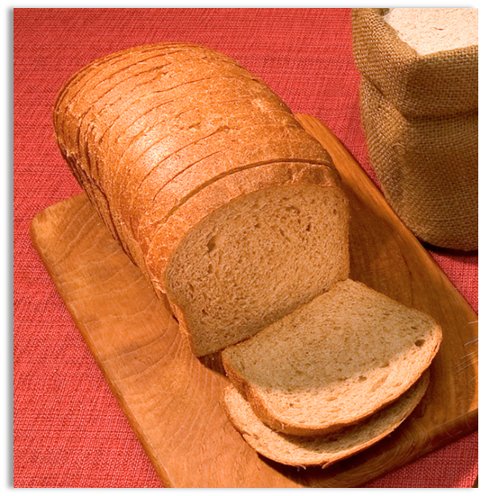
Whole Grain-Rich Criteria
No change to the whole grain-rich criteria specified in FNS memo SP 30-2012 (Elements 1 and 2)
Whole grain-rich products must contain at least 50 percent whole grains and the remaining grains in the product must be enriched.

Slide 11
No exemption requests SY 2019/20
Whole grain-rich exemption requests are not required beginning SY 2019-2020

Slide 12
Sodium Flexibility
Retains Target 1 through SY 2023-2024
Moves Target 2 to SY 2024-2025
Removes Final Target

Slide 13
In Summary: SY 2019-2020
Flavored, low-fat milk will be allowed in NSLP/SBP, and for participants ≥ 6 years in CACFP and SMP.
Milk variety in NSLP/SBP must include unflavored milk.
Half of the weekly grains in NSLP/SBP must be whole grain-rich.

Slide 14
In Summary: SY 2019-2020
There will be no change to the “whole grain-rich criteria.”
Enriched grains will be allowed without exemption requests.
Sodium Target 1 will continue.

Slide 15
Minimum Standards May be Exceeded
Sodium and whole grain-rich requirements in NSLP/SBP set a floor and not a ceiling.
State agencies have discretion to set stricter standards that are not inconsistent with Federal requirements.
Meal reimbursement is based on compliance with Federal standards.

Slide 16
Next Steps

Slide 17
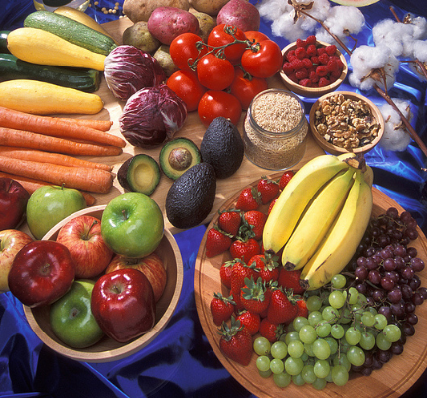
Expected Impact
More operational flexibility to meet student preferences
More opportunities to incorporate local and regional favorites
Increased consumption of wholesome meals

Slide 18
Looking Ahead
USDA will continue to provide guidance, resources, and training.
Beginning SY 2019-2020, the Administrative Review will assess compliance with the updated grains and sodium requirements.
The Dietary Guidelines for Americans will continue to inform the overarching nutrition requirements.

Slide 19
USDA Resources
Nutrition Standards for School Meals: https://www.fns.usda.gov/ school-meals/nutrition-standards-school-meals
Team Nutrition: https://www.fns.usda.gov/tn/team-nutrition
School Meals Policy: https://www.fns.usda.gov/ school-meals/policy

Slide 20
Questions?

Slide 21
Does the final rule impact CACFP?
Only the milk flexibility impacts CACFP operators.
Flavored, low-fat milk may be offered to participants ages 6 and older.
Exemption requests are not required.
The requirement that milk variety must include unflavored milk does not apply to CACFP.

Slide 22
Is compliance with the nutrition standards based on this final rule?
Yes. Beginning SY 2019-2020, the Administrative Review process will assess compliance with the milk, grains, and sodium standards implemented by this final rule.
For example, State agencies will ensure that schools offer at least half of the weekly grains as whole grain-rich.

Slide 23
May State agencies impose stricter nutrition standards?
Yes. For example, a State agency has the option to require that all weekly grains offered in SY 2019-2020 be whole grain-rich, as currently required.
State agencies must reimburse meals served that meet the Federal standards.
State agencies may only take back State funds for violations of State standards.

Slide 24
Does the final rule impact milk contracts?
See memorandum SP 17-2012 on procurement Q&As
A material change to a contract depends on the SFA’s initial solicitation document and the resulting contract.
Some current contracts will not be inconsistent with the final rule. Those contacts may require only nonmaterial changes.

Slide 25
Will Exhibit A be updated?
Exhibit A is the Ounce Equivalency (Oz Eq) Requirements for School Meal Programs. It helps determine how many ounces or grams of a particular grain food must be served to count as an ounce equivalent. Example: a bagel must weight 28 grams (or 1 oz) to count as 1 oz equivalent.
Minimal updates will be made to Exhibit A to remove the titled reference to Whole Grain-Rich Ounce Equivalency, but the data in the charts will not change.
Exhibit A will continue to be used as the first step in determining if a product is a whole grain-rich food item.

Slide 26
Is an entrée with enriched grains exempt from the Smart Snacks requirements?
Yes. Schools may continue to offer entrée items, that include enriched grains, for sale as a la carte foods on:
the day they are served as part of the meal, and
the day after.

Slide 27
Thank you!

