Slide 1


FINANCIAL MANAGEMENT IN CHILD NUTRITION PROGRAMS
1 hour Professional Standards Training
Notes:
This PowerPoint will contribute 1 hour towards Professional Standards training requirements. This training reviews Financial Management in the Child Nutrition Programs.
Understanding how to manage the SFA’s program finances is critical in making the Child Nutrition Program self sustaining. This presentation will review the regulations and practices you will need to understand to operate a financially successful and compliant Program.

Slide 2

School Nutrition Programs
Serve millions of children daily
Managing the financial resources of these programs is critical
Ability to interpret the financial outcomes of operational decisions
Benchmark best practices
Notes:
The School Nutrition Programs serve millions of children nutritious lunches, breakfast, and snacks daily.
Managing the financial resources of these programs is critical to the success of maintaining quality standards and accountability. The ability to interpret the financial outcomes of operational decisions and benchmark best practices is necessary to long term planning and effective management of the school district’s School Nutrition Programs.

Slide 3

Financial Management Competencies
Develop financial management guidelines that supports school nutrition program operational goals and comply with regulations
Establish cost control goals to effectively manage the school nutrition program
Notes:
The cost of serving students meals at school continues to increase quicker than the generation of revenue, leaving directors with difficult decisions to make about long-term goals that will ensure sustainability of the program.
At the same time, demands are increasing for more accountability in all nutrition programs. The implementation of sound financial management concepts and principles in the operation of a school nutrition program are critical to ensure the program succeeds in meeting its goal.
The ability to interpret and analyze the financial outcomes of your operational decisions is essential to effective management of school nutrition programs. It requires developing financial management guidelines that support the food service program’s operational goals and comply with regulations. It is an SFAs responsibility to establish cost control goals and effectively manage the school nutrition program.

Slide 4

Activities for Effective Financial Management
  Develop an annual budget & adjust as needed
  Maintain a written internal control policy
  Apply efficient cost control measures
  Increase productivity
  Identify ways to increase resources
Notes:
It’s important to be pro-active when operating the food service program. Some activities schools can do to effectively manage the program include:
Tracking responsibilities by creating an organizational chart and list each employee’s job duties.
Developing an annual budget and adjusting the figures as needed. This assists schools in monitoring costs over the course of the fiscal year.
Maintain a written internal control policy that details the hierarchy within the program and explains the responsibilities for purchasing and cash handling.
Apply efficient cost control measures by evaluating the program’s expenses. Review the program’s expenses each month to see if the expenses are within the budgeted amounts.
Increase productivity by evaluating the meals per labor hour.
Identify ways to increase resources through other sources, such as a la carte items.

Slide 5

Financial Management System
Uniform and consistent financial reporting structure
Meaningful and timely financial management information
Understanding federal, state, and local reporting requirements
  NSLP – 7 CFR 210.14
  UGG 2 CFR 200
Notes:
It is important that Child Nutrition Directors are supported with uniform and consistent financial reporting structure. In public schools, “Fund C” is the cafeteria fund. All revenues and expenses are reported annually. Financial reporting requirements are reviewed in more detail in the Resource Management Module.
Food service directors must be supported with meaningful and timely financial management information. There needs to be open lines of communication between the food service director and the school’s business official.
Food service directors must have an understanding of federal, state, and local reporting requirements. The National School Lunch Program regulations for resource management are found at 7 CFR 210.14 and procurement regulations can be found in the Uniform Grants Guidance, codified at 2 CFR 200.

Slide 6

Evaluating Revenue
Determine if and where revenue should be increased
Analyze revenue by source
Identify areas in which revenue should be monitored for revenue loss
Notes:
It is important to evaluate your SFA’s revenue on a regular basis to determine if the revenues the SFA receives are within its forecast by evaluating the revenues by their source. Taking a pro-active approach to the program will enable a food service director to:
Determine what and if a revenue source should be increased. For example, paid student lunch sales may be lower than originally forecasted at the beginning of the year but offering foods that appeal to more students may help in increasing sales.
Analyze the revenue by its source, such as federal reimbursement, state reimbursement, ala carte sales, miscellaneous sources, or fund transfer.
Identify areas in which revenue should be monitored for revenue loss.

Slide 7
Revenue Analysis
Calculate average revenue per meal or meal equivalent
Compare revenue generated per meal with costs per meal
Establish consistent guidelines for pricing non-program food items to ensure revenue is equal to or greater than costs
Notes:
There are many ways to review a food service program’s revenue. One of the quickest ways is to calculate the average revenue per meal or meal equivalent.
Compare the average revenue per meal against how much it costs to make a meal. Is the food service making enough money to cover all of the costs that go into making one meal?
Confirm that your SFA establishes consistent guidelines for pricing non-program food items to ensure the revenue is equal to or greater than costs.

Slide 8
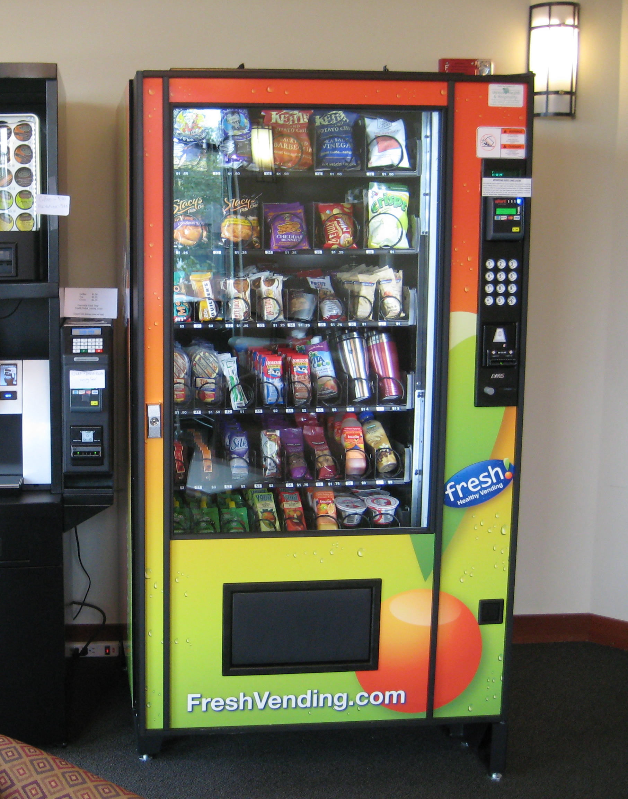
Revenue:
Non-Program Foods
  Adult meals
  Sale of second meals
  A la carte
  Individual food items
  Catering
Notes:
Non-program foods are foods and beverages sold in a participating school which do not include reimbursable meals. Non Program foods are purchased using funds from the non-profit school foodservice account. Details regarding Nonprogram food and the completion of the Nonprogram Food Revenue Tool can be found in the Resource Management Module.
If revenue requirements are not met as determined by the Tool, the SFA must evaluate non program food pricing.
These include adult meals, the sale of a second meal to a student, a la carte sales, catering, and individual foods sold that make up a reimbursable meal. Adult Meal Pricing is reviewed in detail in the Resource Management Module. Each SY review the Adult Meal Price requirement for your SFA.

Slide 9

Non-Program Foods Sales
Catered food or meals
Contract meals
Special school function meals such as banquets
Notes:
Non-Program Foods Sales Sold Away from Campus or Outside the School Day are considered sources of non-program revenue. The total cost for providing the food or meals must be replenished to the nonprofit food service account.
Food or meals catered by the food service program for events such as:
Catered food or meals to school organizations or school administrative offices
Contract meals; and/or
Special school function meals such as banquets

Slide 10
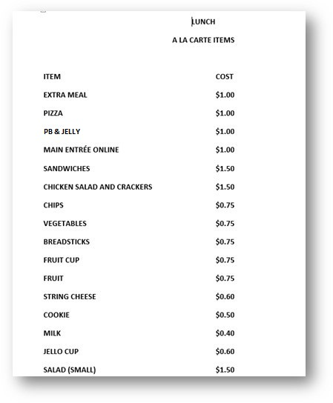
Revenue:
A la Carte Pricing (Nonprogram)
Evaluate pricing
Pricing matters
Notes:
SFAs must evaluate the non-program items pricing to ensure the price charged is adequate.
Some SFAs double the cost of non program food items to ensure they are creating enough revenue. Keep in mind, it would not make sense to double the cost on some smaller items like crackers or small cookies. Always use common sense, do not use that “rule of thumb” across the board. Pricing does matter!

Slide 11

Evaluating Expenditures
  Patterns or trends
  Significant changes in cost categories
  Deviations from financial goals
  Possible abuse or theft
  Transaction errors
Notes:
Expenditures are those allowable costs that can be identified specifically with the production and service of meals to school children.
Analyzing financial reports, such as the profit and loss statement, can provide information on trends, significant changes in categories such as labor costs or food costs from one year to another, deviations from budgeted amounts, and give a food service director time to correct any transaction errors before closing out the period.

Slide 12
Classification of Expenditures
Labor
Employee Benefits
Professional and Technical Services
Property Services
Purchased Foods and USDA Foods
Supplies
Capital Assets
Miscellaneous
Indirect Costs
Fund Transfer-Out
Notes:
A drop in fund balance over a period of time may be a red flag to examine the amount of spending in each of the specific categories of expenditures. A significant increase in funds may be an indication that the nutrition program is not spending funds for program improvements in areas such as food quality or equipment upgrades. Some expenditures we review during a review of the nonprofit food service account are:
Labor- salaries, fringe benefits
Food- foods purchased, donated commodities and food production supplies
(40-50% of the SNP budget is a general accepted guideline.)
Supplies- non-food items such as silverware, paper supplies, menu printing, office
supplies and cleaning products
Other expenses-utilities, telephones, postage, waste management, and pest control

Slide 13

Criteria for Allowable Costs
Necessary
Reasonable
Allocable
Applied uniformly to both federal and non-federal activities of the entity
Consistently treated as direct or indirect
Determined in accordance with Generally Accepted Accounting Principles (GAAP)
Not included as a cost or matching contribution to any other grant
Adequately documented
Notes:
2 CFR 200.403 lists factors that affect the allowability of costs. It is the SFA’s responsibility to determine whether a cost meets the following criteria before the cost is paid from the school food service account:
Necessary ‐ In order to be allowable, the cost must be necessary to the nonprofit school food service program and the program cannot be operated without incurring the cost. For example, a school food service cannot be operated without incurring the cost of appropriate food.
Reasonable ‐ A cost is reasonable if, in its nature and amount, it does not exceed the cost that under the same circumstances a prudent person would also pay. The cost must be the result of sound business practice and competitive prices.
Allocable ‐ A cost must be assigned to the programs or activity that benefit from that cost. Each cost objective must be charged proportionate to the benefit received.
SFAs must conduct transactions using Child Nutrition funds in the same way that it conducts transactions with its own non‐Federal funds. A cost item must be treated consistently as direct or indirect in all activities of the SFA unless legislation, regulations, or guidance unless directed otherwise. For instance, a cost may not be
assigned to Child Nutrition funds as a direct cost if that same cost, incurred for the same purpose in similar circumstances, has been assigned to other Federal awards as an indirect cost.
Adequately documented ‐ All records of the nonprofit food service operation must be able to stand on its own, without depending on augmentation, interpretation, or “spin” by the SFA.

Slide 14
Types of Expenditure Analysis
Operating ratios: Cost of food/total revenue = %
Total cost to produce one meal
Costs to produce a meal compared with the average revenue generated per meal
Meals per labor hour: Number of meal equivalents served in a day/number of paid hours
Notes:
SFAs can analyze their expenses using several tools. One way is through operating ratios. Operating ratios are an analysis of financial data to measure the efficiency of the operation of the school nutrition program. An expenditure as a percentage of revenue is an example of an operating ratio, such as the cost of food compared to the revenue. Other calculations that SFAs can use are the total costs to produce a meal, and the costs to produce a meal compared with the average revenue generated per meal.
The most common measure of productivity in school nutrition is the meals per labor hour as labor is an essential cost to food service. This is calculated by dividing the number of meal equivalents produced and served in a day by the number of paid labor hours
It is recommended that Food Service Directors utilize the Meals Per Labor Hour tool to evaluate labor and productivity.

Slide 15

Expenditure: Controlling Labor
Labor is an essential cost to food service
Meals Per Labor Hour tool evaluates labor and productivity
Meal Equivalents
Notes:
Labor is an essential cost to food service. It is recommended that Child Nutrition Directors utilize the Meals Per Labor Hour tool to evaluate labor and productivity.
When using a staffing formula, it is essential to know the average number of meals served for breakfast, snacks, and lunch and the average dollars in other sales.
A meal equivalent is recommended to determine meals per labor hour or the productivity rate.

Slide 16

Using Meal Equivalents in Program Analysis to Measure Performance
By converting food sales to meal equivalents, the school nutrition director can determine:
  Meal cost
  Labor productivity ratios
  Average revenue earned per meal/meal equivalent
Notes:
The meal equivalent is a statistical tool used to convert all meals and cash sales to a standard unit of production, in this case a reimbursable student lunch. It is not a unit of production, but it allows SFAs to equate all meals and other sales to a standard.
By converting food sales to meal equivalents, the school nutrition director can determine:
-Meal cost
-Labor productivity ratios
-Average revenue earned per meal/meal equivalent

Slide 17
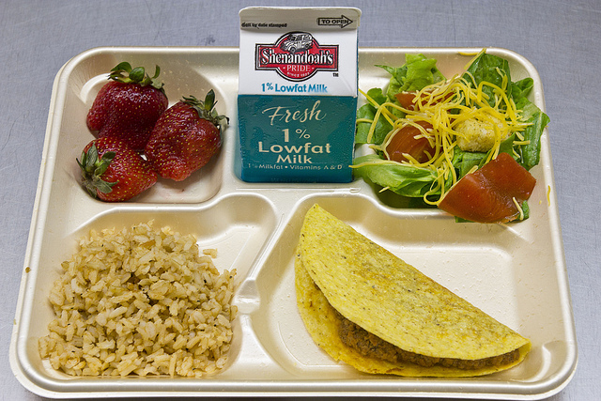
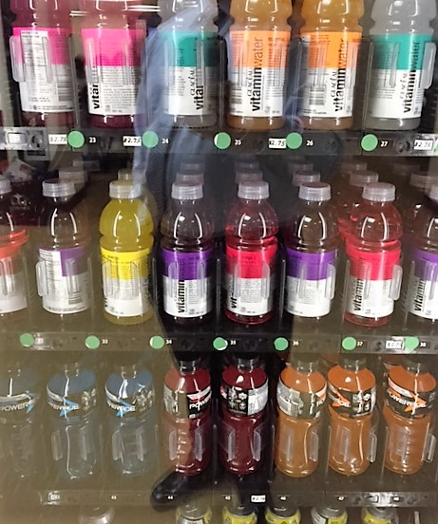
Meal Equivalent Conversions
1 lunch = 1 meal equivalent
3 breakfasts = 2 meal equivalents (2/3 = .67)
3 snacks = 1 meal equivalent (1/3 = .33)
Meal Equivalent Formula for Non program Food Sales
Nonprogram Food Sales
Free lunch reimbursement rate + USDA Foods Value
Notes:
A meal equivalent equalizes the labor expended on meals. Lunch is generally the most labor-intensive meal to produce therefore, one lunch equals one meal equivalent. Breakfast is a little less labor intensive so, 3 breakfasts equal 2 meal equivalents, and lastly 3 snacks equal 1 meal equivalent. Snacks refer to After School Snack Program snacks only.
To calculate meal equivalents from non program food is a bit more complicated. The formula used to calculate meal equivalents for non program food uses non program revenue data from your school. You will need to have the average non program food sales. Take the non program food sales and divide that amount by the total of the SFA’s current free lunch reimbursement rate plus the current USDA Foods value per lunch; this equals the non program food meal equivalents.

Slide 18
Calculate Total Labor Hours
This example - Employee hours paid daily include manager
Calculate the current total hours of labor paid daily by building because each building has its own unique circumstances related to preparation and serving meals.
Number of Employees | Number of Daily Hours | Total Number of Hours
1 | 6.5 | 6.5
3 | 3 | 9
Total Paid Labor Hours assigned Daily: 15.5 hours
Notes:
Calculate the number of labor hours in a day by taking the number of employees you have, multiple each employee by the number of hours each employees works, and then add all total number of hours worked.
In this example we have one Manager who works 6.5 hours in a day and 3 employees that work 3 hours each per day.
(1 x 6.5) + (3 x 3) = 15.5 total labor hours/day
*When calculating paid labor hours per building, determine whether the Manager is included and in which building the Manager will be included. Always
Specify and then be consistent when including or excluding the Manager from the paid labor hours per building- this may be determined by your Business Office, depending on their accounting practices.

Slide 19

Meals Per Labor Hour Formula
Number of Meal Equivalents ÷ Number of Paid Labor Hours =
Meals Per Labor Hour (MPLH)
Notes:
The productivity index of meals per labor hour (MPLH) is used by many school foodservice administrators to monitor the efficiency of their operation and to determine appropriate staffing. This important information indicates to administrators whether they are making good use of their resources. This measure can help in determining how many employees are needed in a single production unit or throughout the district. The MPLH index is most effectively used to compare labor utilization within a system because labor is so dependent on the type of operation used in food production.
To calculate the meals per labor hour, we take the number of meal equivalents and divide it by the number of paid labor hours.

Slide 20

Meals Per Labor Hour Example
A food service director wanted to calculate the meals per labor hour from the previous day. The lunch program reported the following meals served and labor hours paid:
  425 lunches, 150 breakfasts, 175 snacks
  32 labor hours
Lunch 425.00 Meal Equivalents
Breakfast (150 x .67) 100.50 Meal Equivalents
Snack (175 x .33) 57.75 Meal Equivalents
Total 583.25 Meal Equivalents
583.25 meal equivalents ÷ 32 labor hours = 18.227 or 18 Meals Per Labor Hour
Notes:
A food service director wanted to calculate the meals per labor hour from the previous day. The lunch program reported 425 lunches, 150 breakfasts and 175 snacks served. The program paid 32 hours of labor to prepare and serve the meals.
We begin by calculating the meal equivalents. One lunch is equivalent to one meal. Two breakfast are equivalent to one meal, and three snacks are equivalent to one meal. When we convert the meals to meal equivalents, we get a total of 583.25. We divide the 583.25 meal equivalents by the 32 labor hours and get a Meals Per Labor Hour of 18.

Slide 21

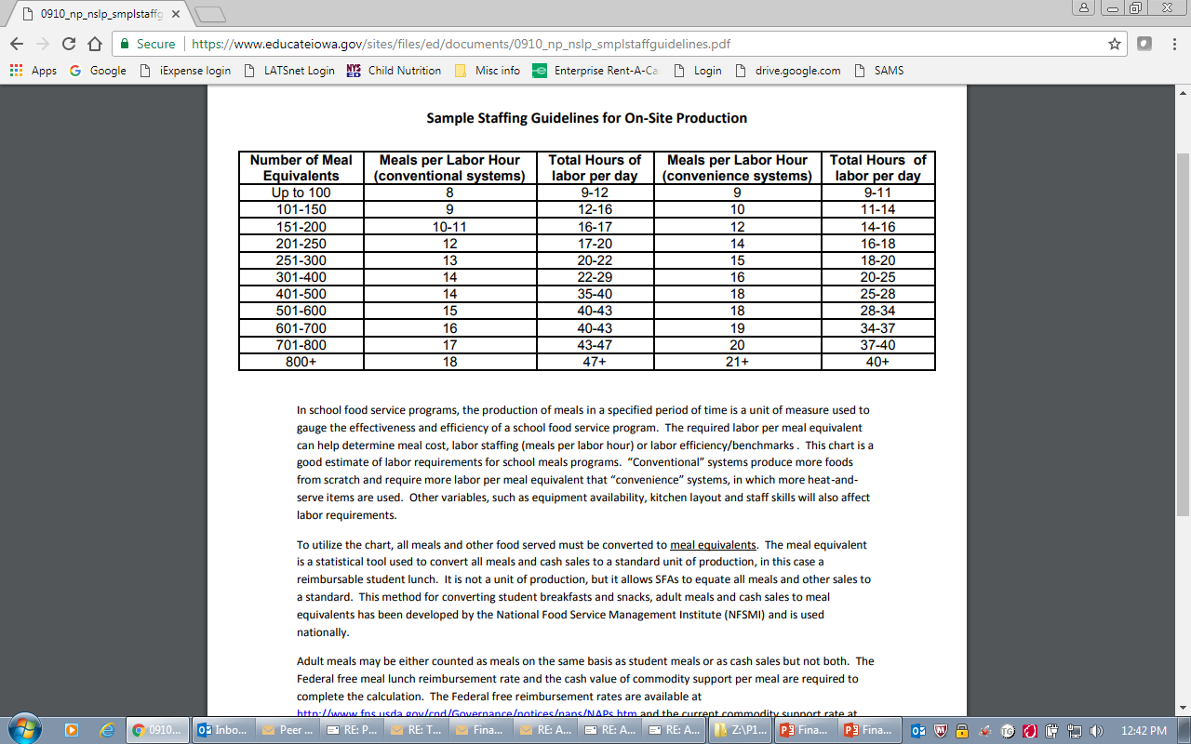
Meals Per Labor Hour
Notes:
This chart is an example of the staffing guidelines good estimate of labor requirements for school meals programs. You will notice there are two guideline numbers – one for conventional systems and one for convenience systems. “Conventional” systems produce more foods from scratch and require more labor per meal equivalent than “convenience” systems, in which more heat-and-serve items are used. Other variables, such as equipment availability, kitchen layout and staff skills will also affect labor requirements.
In our example on the previous slide, we calculated 583 meal equivalents divided by 32 labor hours equaled 18 meals per labor hour. Assume the lunch program uses a convenience system. We go to the 501-600 meal equivalent line and go to meals per labor hour convenience systems. We see that the guideline is 18 meals per hour with a recommended 28-34 labor hours so we can surmise that the lunch program is operating efficiently.

Slide 22

Factors Affecting Meals Per Labor Hour
Size of operation
Number of serving lines
Type service provided
Scheduling of lunch periods
Production system
Amount of convenience foods used
Skill level of employees
Complexity of the menu
Notes:
Please be aware that there are factors that may affect MPLH as a productivity measure are: size of operation, number of serving lines, type of service provided, scheduling of lunch periods, production system, amount of convenience foods used, skill level of employees and complexity of the menu, etc. Remember to document for yourself any factors that might affect the meals per labor hour

Slide 23
Expenditure: Indirect Cost
Share of general schools’ costs that are incurred for common or joint purposes
Indirect costs include:
Human resources, payroll, accounting, budgeting, purchasing, utilities (light, head, etc.), etc.
See USDA memo SP60-2016, dated September 30, 2016
Notes:
Indirect costs are those costs which benefit the SFA’s organization as a whole and aren’t specific to an SFA’s child nutrition program.
Administrative costs of the SFA, such as human resources, payroll, accounting, budgeting, purchasing, utilities (light, heat, etc.), etc. are incurred for the common or joint purpose and benefit all activities of the school district. The portion that benefits any specific activity, such as foodservice, is generally determined through a mathematical allocation process prepared by the SFA and approved by SED’s Grants Finance Office.
USDA memo SP60-2016 provides guidance on indirect costs.

Slide 24
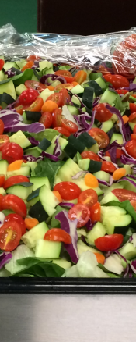
Participation
Participation is key to creating a financially healthy and successful Child Nutrition Program
SFAs are encouraged to be innovative and creative in delivery of their child nutrition programs
  Taste testing
  Marketing
Notes:
Participation is key to creating a financially healthy and successful Child Nutrition Program.
SFAs are encouraged to be innovative and creative in delivery of their child nutrition programs. For example, NYC schools offer “NY Thursdays” where all the components of the reimbursable meal are grown or produced in NYS. Another way is to encourage student participation by offering taste tests of potential menu items to get feedback from students.

Slide 25
Calculate the Cost of Food
Determine if costs are within guidelines,
Ascertain if there are sufficient funds to pay expenditures,
Establish the cost of each meal equivalent served, and
Prevent waste and food theft through monitoring food usage.
Notes:
Calculate the Cost of Food
Determine if costs are within guidelines,
Ascertain if there are sufficient funds to pay expenditures,
Establish the cost of each meal equivalent served, and
Prevent waste and food theft through monitoring food usage.

Slide 26
Calculating Cost of Food Used
Beginning Food Inventory
+ Total Food Purchases
= Total Food Available
- Ending Food Inventory
= Cost of Food used
Notes:
Calculating the cost of food used assists school nutrition directors in maintaining operational oversight of the school nutrition program.
Beginning Food Inventory
+ Total Food Purchases
= Total Food Available
- Ending Food Inventory
= Cost of Food used

Slide 27
Example of Calculations for Cost of Food Used
Example | Annually | Monthly
Beginning Inventory | $ 8,000 | $ 8,000
Food Purchases | + 300,000 | 25,000
Food Available | $ 308,000 | $ 33,000
Less: ending inventory | - 7,000 | - 7,000
Cost of Food Used | $ 301,000 | $ 26,000
Notes:
These are some examples of calculating cost of food used.

Slide 28
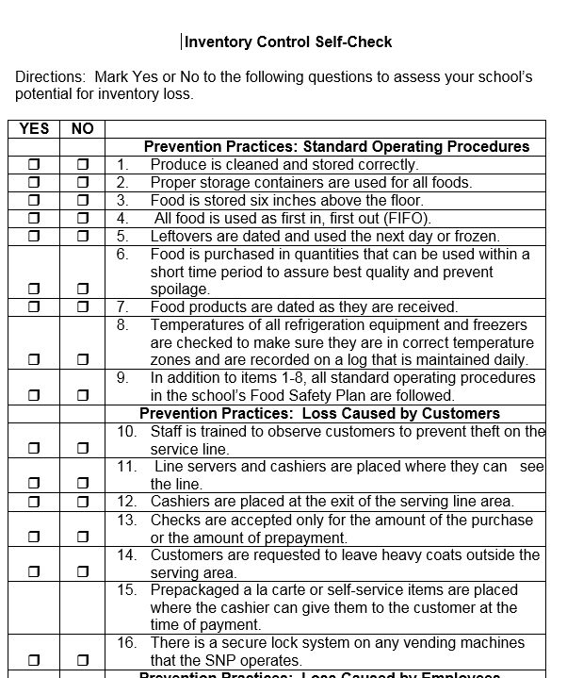
Inventory Management
Best Practices
  Monitor inventory
  Use an inventory check list
  Have an effective food safety plan
  Buy American
Notes:
Best Practices for inventory management include:
Monitor inventory on a regular basis and work with managers.
Use an inventory self-check list on a regular basis.
Have an effective food safety plan in place to prevent loss of inventory.
Make sure the inventory conforms to the Buy American provision.

Slide 29
Helpful Resources and Training:
Child Nutrition Knowledge Center – www.cn.nysed.gov, Training Tab
USDA Food and Nutrition Service - https://www.fns.usda.gov/school-meals/child-nutrition-programs
The Institute of Child Nutrition – www.theicn.org
School Food & Nutrition Service Management Book
Managing your Child Nutrition Program Training; 4-day training in July Training Topics: Financial Management, Menu Planning, Procurement
Notes:
Here are some helpful resources to assist schools in Financial Management.
Each year in July, Child Nutrition offers a 4 day-training for food service managers called Managing Your Child Nutrition Program. Topics include financial management, menu planning and costing, procurement, local purchasing and communication. It’s a great way to learn new information, network with other food service directors and earn continuing education credits.
Child Nutrition Knowledge Center – www.cn.nysed.gov, Training Tab
USDA Food and Nutrition Service - https://www.fns.usda.gov/school-meals/child-nutrition-programs
The Institute of Child Nutrition – www.theicn.org
School Food & Nutrition Service Management Book
Managing your Child Nutrition Program Training; 4-day training in July Training Topics: Financial Management, Menu Planning, Procurement

Slide 30
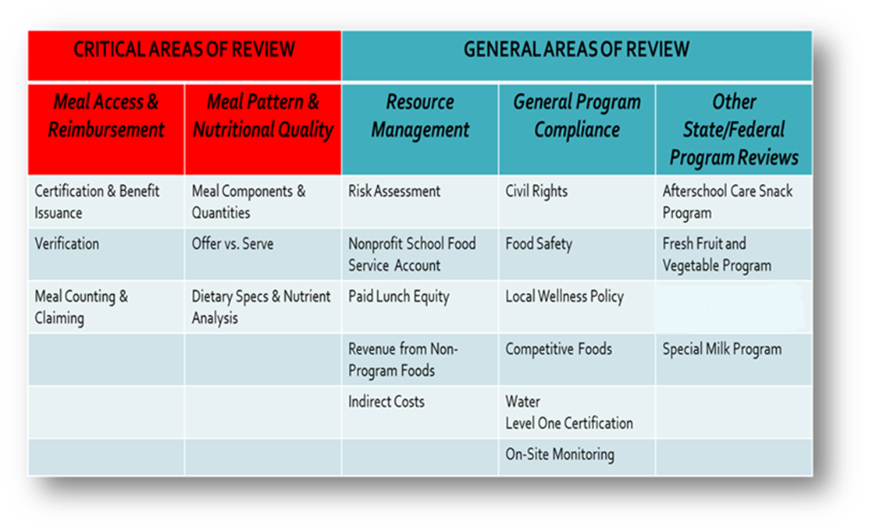
Accountability:
The Administrative Review
Notes:
The Administrative Review has two Critical areas of review and three General Areas of review.
Resource management is a general area and involves a risk assessment of your school lunch operations. If an SFA demonstrates a high risk for non-compliance with resource management, reviewers will conduct a comprehensive review of the area at high risk. Documentation will be requested to gage compliance with regulations.
The four areas within Resource Management are: Maintenance of the Nonprofit Food Service Account, Paid Lunch Equity, revenue from Non-Program Foods and Indirect Costs. The four areas within Resource Management are discussed in detail in the Resouce Management Module.
The Nonprofit Food Service Account is used to account for the revenues and expenses of operating your food service program.
Paid Lunch Equity uses a tool to determine if the SFA’s paid lunch price is adequate for covering the cost of serving meals to students who are ineligible for free or reduced-price meals.
Revenue from Non-Program Foods is used to determine if the SFA is earning enough revenue to cover the cost of non-program food.
Indirect Costs are those costs which are not directly attributable to the food service program, but to the SFA’s overall operations.

Slide 31

This concludes Financial Management in Child Nutrition Programs
New York State Education Department
Child Nutrition Program Administration
(518)473-8781
CN@nysed.gov
Notes:
Thank you. This concludes Financial Management in Child Nutrition Programs.
Remember to record completion of this training for Annual Professional Standards Training requirements.
If you have any additional questions, please do not hesitate to contact us.

