Slide 1
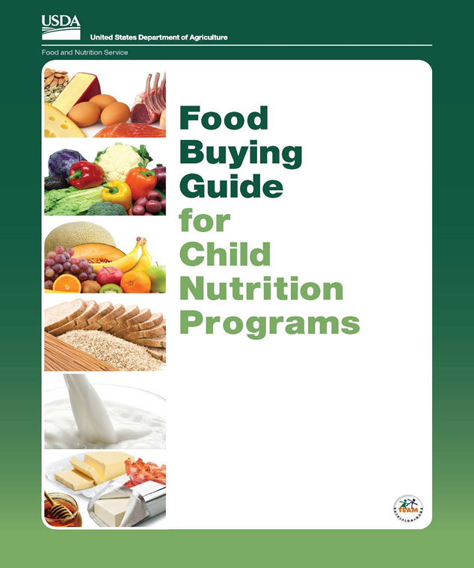

The Food Buying Guide
Overview
1 Credit Hour
Professional Standard Training
Notes:
Welcome to an overview for the Food Buying Guide for School Meal Programs. This resource was designed by the USDA to help you in two ways: to assist as a purchaser by buying the correct amount of food and to help with determining crediting foods with the meal pattern requirements. It is necessary to ensure inventory and food costs are controlled while ensuring meal pattern requirements are being met. This presentation is a brief overview of the Food Buying Guide designed to introduce you to the guide. We will review information found in the guide, searching food items, introduce tools associated with the Food Buying guide and how these tools can make your job easier.
This slide shows you the cover of the most recent edition of the Food Buying Guide and can be found on the Child Nutrition Program or USDA websites.
To access the Food Buying Guide, go to: www.cn.nysed.gov, scroll to the bottom of the webpage to find the “Popular Topics” column. Click “Food Based Menu Planning”, “Food Crediting”, then “USDA Food Buying Guide for National School Lunch Program and School Breakfast Program” or scroll to the bottom of the webpage to “Quick Access” and click on “Food Buying Guide”.
On the USDA website go to: fns.usda.gov/tn/food-buying-guide-for-child-nutrition-programs
This CN snip training it will contribute 1 credit hour towards the Professional Standards requirements.

Slide 2
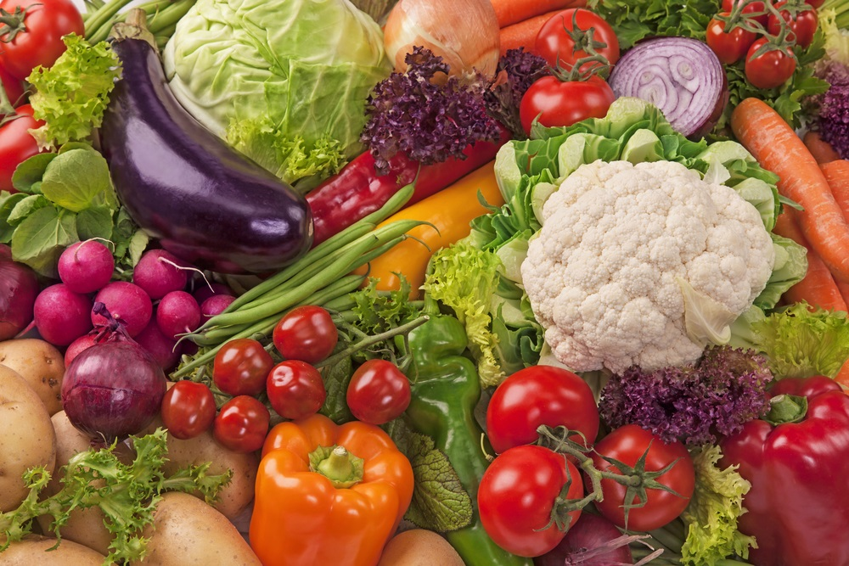
Food Buying Guide (FBG)
Determines specific crediting information
Currently available as an Interactive Web-Based Tool and Mobile App
Assists with purchasing the correct amount and type of food for your school meals program(s)
Notes:
The Food Buying Guide for Child Nutrition Programs was originally published in 1947 and is an all-in-one source to help purchase the correct amount of food and determine crediting for whole foods and limited processed food items to ensure you are in compliance with the Child Nutrition Programs.
This resource allows a search feature which will navigate and compare food yields and create a favorite foods list.
The current Food Buying Guide has an interactive web-based tool and mobile app which allows you to easily search food items, crediting information, and find food yields.
Some additional features are:
-The FBG Calculator
-Exhibit A Grains Tool
-Download PDF Food Buying Guide
-Recipe Analysis Workbook (RAW)

Slide 3
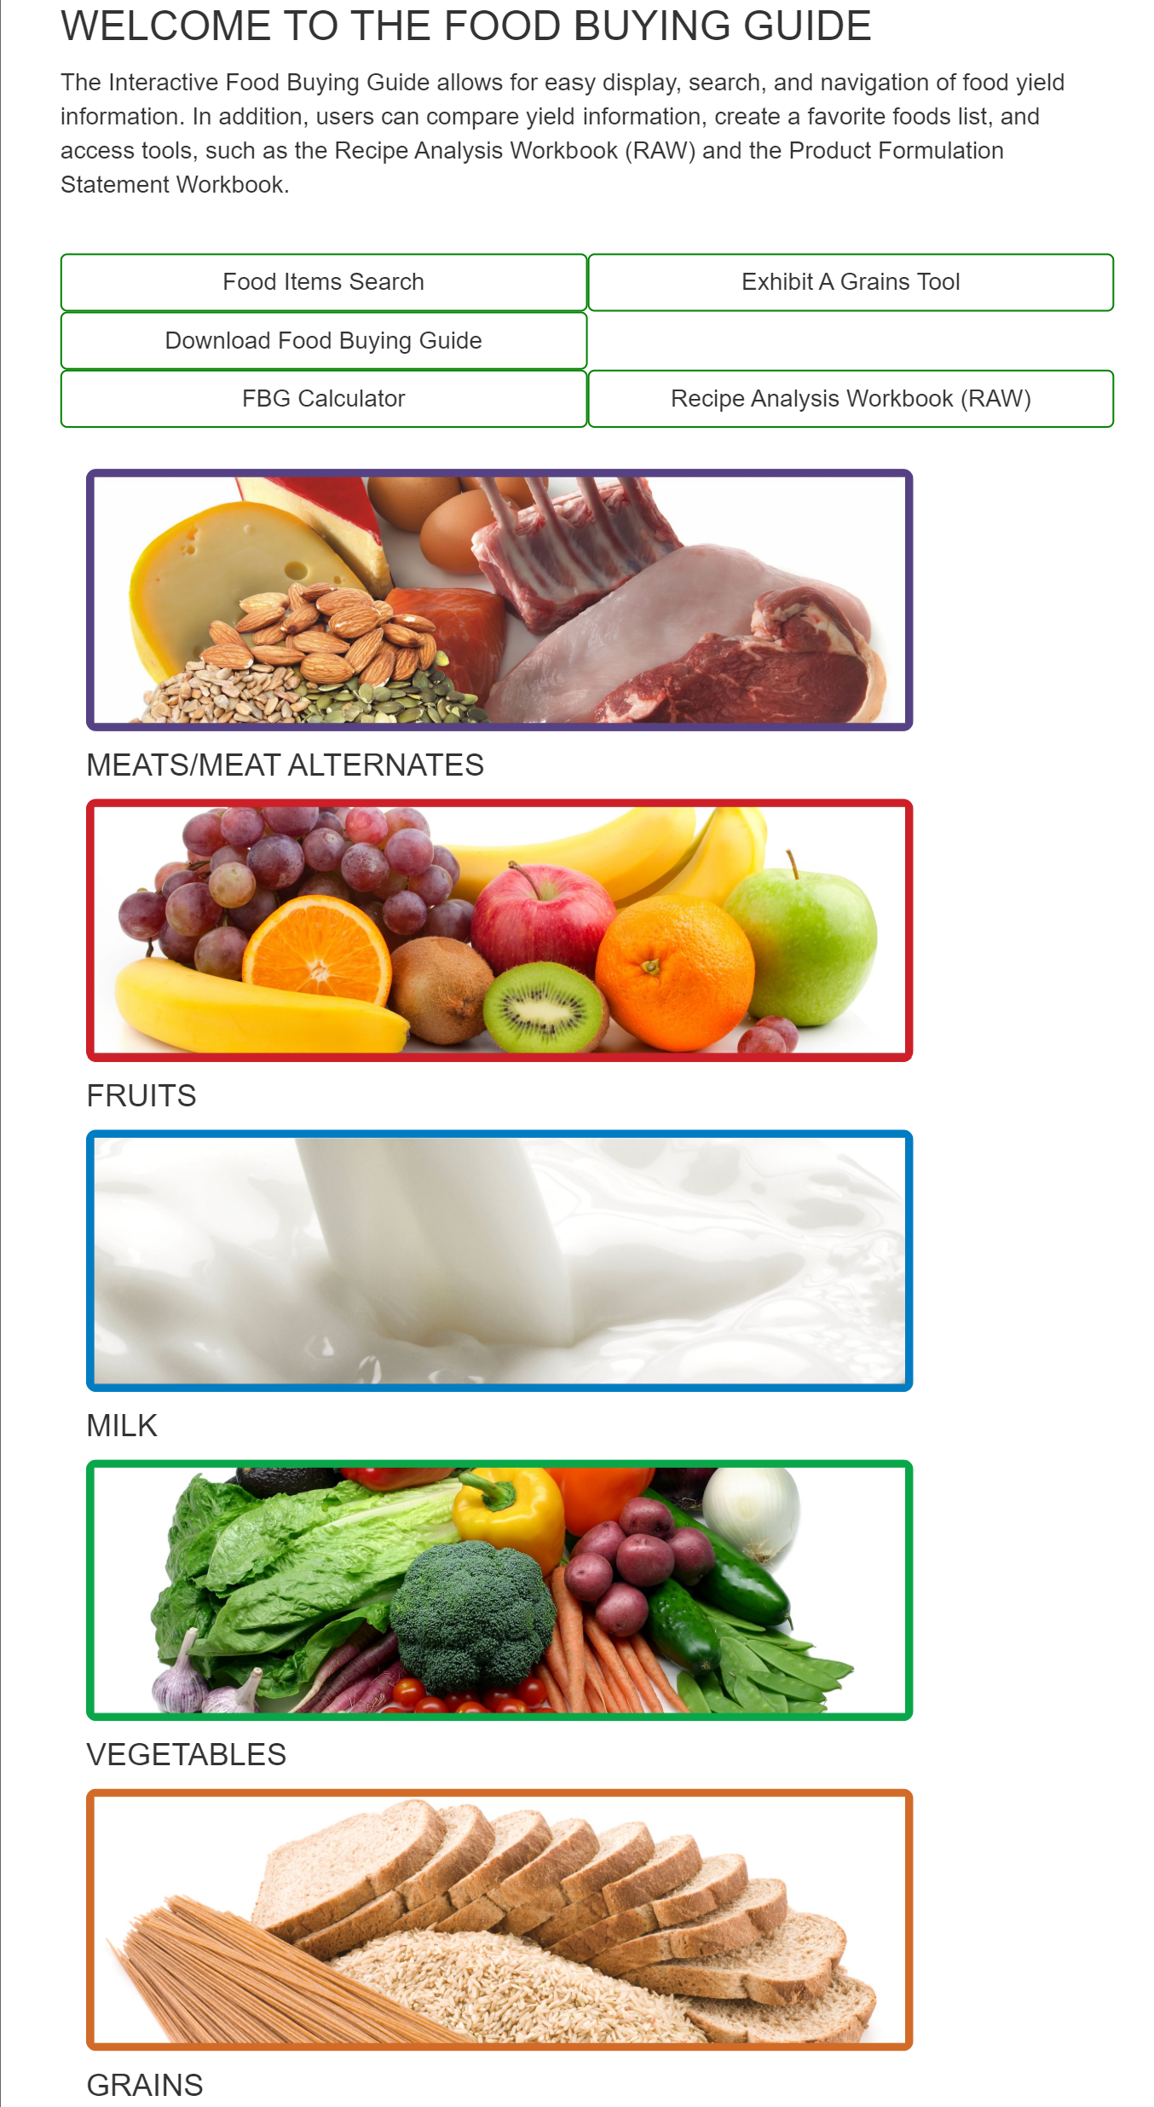
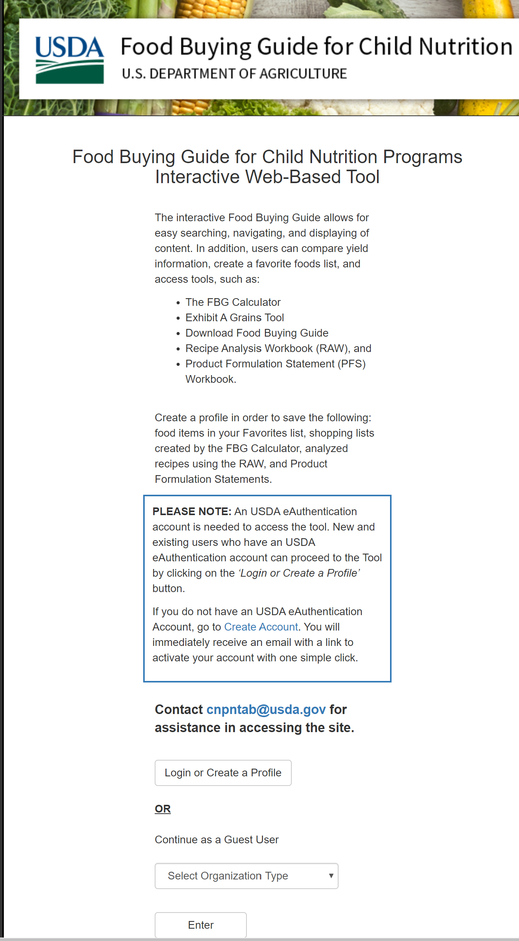
To access the FBG site Login or continue as a guest
Food items are searchable by using the “Food Item Search” or by component
Notes:
To access the FBG, you must either create a login or enter as a “Guest User”. The FBG has three main user groups: Guest User, Registered User, and Administrator User. Each user can belong to one Organization Type: FNS National Office, FNS Regional Office, Vendor, State Agency, School, and Other.
Entering as a Guest User will allow you to search food items, but you will not have full access to all the tools. The functionality available to each user depends on his user group and Organization Type. When using the “Guest User”, the public users can access key components of the FBG through the Internet without providing login credentials or creating a user account. Guest users can search and view food items, create a Favorites list, and use FBG Calculator. However, the Favorites list and FBG Calculator Shopping Lists will only remain active while the user is actively using the FBG site. If the user closes the FBG site and returns to it, the Favorites list and Shopping Lists will not be saved.
If a profile is created to become a “Registered User”, this will allow you to fully utilize all tools associated with the FBG. ​
​
The Food Items search allows you to search food Items by keywords and additional categories such as meal component and school meal program.
​

Slide 4
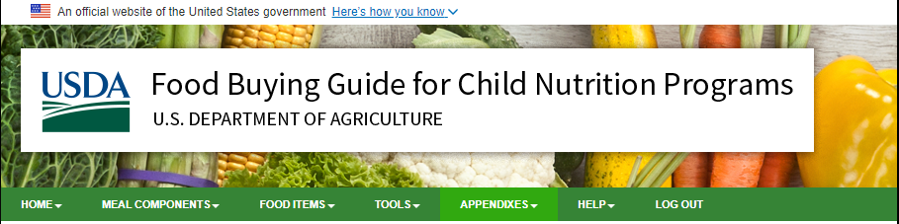






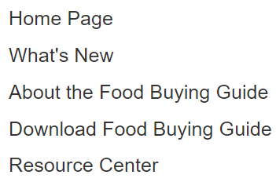
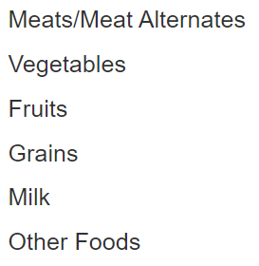
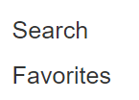
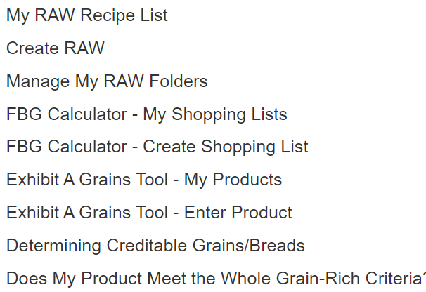
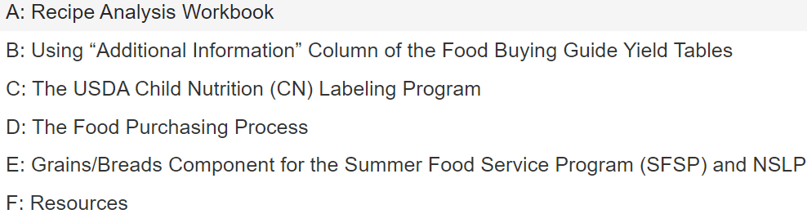
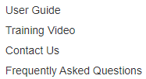

Food Buying Guide Headings
Click on arrows on the right side of heading topic
Click here to access the FBG Calculator and other tools
Notes:
The green topic headings have a drop-down menu which lists more options.
Home Page: Users can view the FBG home page screen by selecting “Home Page” which allows easy access when on a different page.
What’s New- Users can view the list of announcements by the FNS staff by selecting this choice. This screen will list currently active announcements.
About the Food Buying Guide- Users can view this screen for helpful information about the Food Buying Guide.
Download the Food Buying Guide-Users can access the Food Buying Guide in a PDF document.
Resource Center-Provides user with meal pattern charts and reference tables to support information found in the Food Buying Guide.
Meal Components-Users can select an individual meal component to view more information on the specific meal component. ( Ex. Grains, M/MA, Fruits, Vegetables, Milk)
Food items: Users can select search function to search food items. Users can also select “Favorites” which goes to the favorite list.
Tools-Users can access different tools such as RAW Recipe list, Creating RAW, Product Formulation List, FBG calculator, Exhibit A Grains Tool and Whole Grain Rich information.
Appendixes-Users can access more information about specific items.
Help- Users can view access user guides in PDF format, Training Videos, FNS contact information, and FAQ’s.
Log out-Users session ends and signs the user out. Any saved information like recipes, favorites, or Product Formulation Statements is stored.

Slide 5
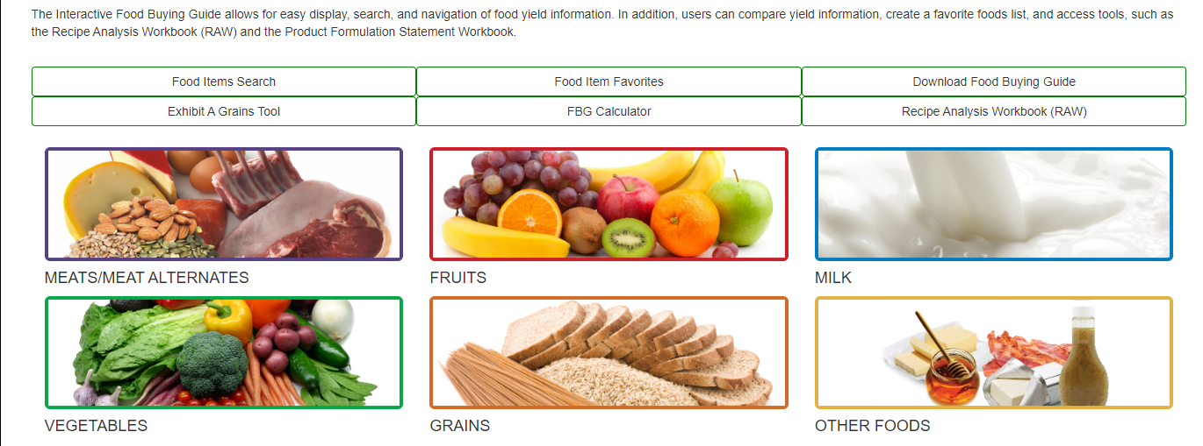
Food Buying Guide Features
Features allow for easy display, search, and navigation of food yield information
Notes:
This page displays different features found in the Food Buying Guide.
Food Item Search- Food items are searchable by keyword and meal component.
Food Item Favorites- This will open a PDF document containing information on Favorites list. The PDF can be saved or printed. The export button opens an Excel document that contains all the information on the favorite list screen except footnotes.
Download the FBG-Click on the “download Food buying guide” button to open the download food buying guide screen. This screen will contain links to the FBG introduction, six meal component sections with the corresponding yield tables, and appendixes in PDF format.
Exhibit A Grains Tool- This online tool will determine the ounce equivalent (oz eq) grains or grains/bread servings for your grain product, the amount of a grains product to serve in order to provide a specific ounce equivalent (oz eq) grains or grains/bread servings, and the amount of a grains product to serve in order to meet Minimum Grains Requirement as appropriate for the specific age group/grade group. **Please note: Only Registered Users will be able to save and retrieve the calculated result of your grain product at any time. If you are not a Registered User, download the PDF of the calculated result of your grain product before exiting the Exhibit A Grains Tool.
FBG Calculator- This online tool will create a shopping list to assist Child Nutrition Program Operators in ordering food for their programs. This tool will assist you in ordering the correct amount of each food item to assure meeting quantity/portion size requirements for the Food Based Meal Pattern. **Please note: Only Registered Users will be able to save and retrieve a shopping list. If you are not a Registered User, export or email your shopping list before exiting FBG Calculator.
Product Formulation Statement Workbook- allows manufacturers to easily calculate their product’s contribution statement and generate crediting documentation.
Recipe Analysis Worksheet (RAW): This tool is a calculator that will determine how your recipe will contribute towards the meal pattern and can print out a contribution statement. Please note that only Registered Users can utilize RAW.
To view information about meal components, click on the corresponding meal component image on the home screen.
OTHER FOODS-These are items that may not be creditable such as cream cheese, condiments, etc.

Slide 6
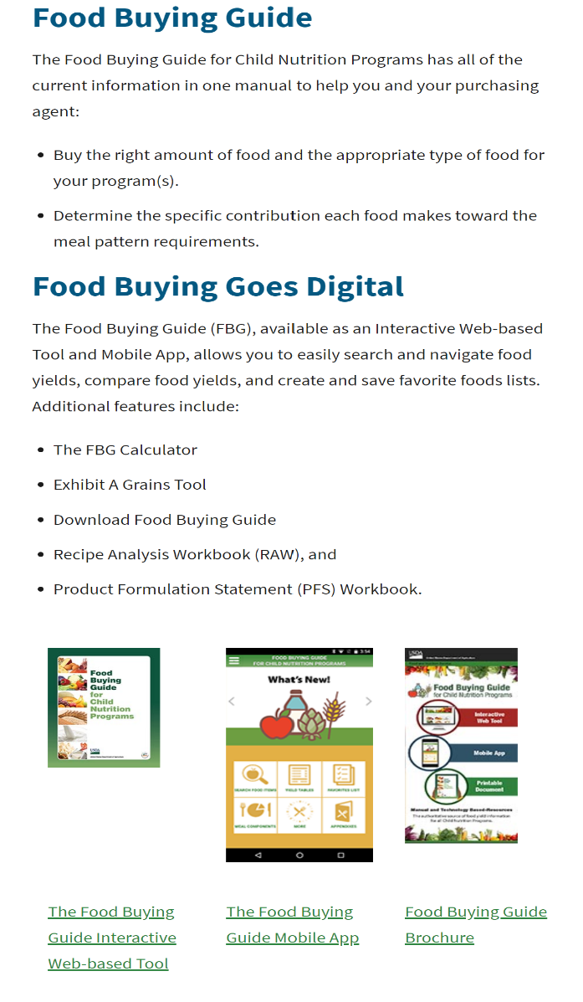
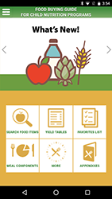
Link to the Food Buying Guide
*follow the link below to the FBG
Mobile App
available
Access entire web-based food buying guide
https://www.fns.usda.gov/tn/food-buying-guide-for-child-nutrition-programs
Notes:
Access to the Food Buying Guide will help in planning your menus and purchases.
It is available on the USDA website with the latest updated link: http://www/fns.usda.gov/tn/food-buying-guide-for-child-nutrition-programs
The Food Buying Guide for Child Nutrition Programs is available on mobile app also.
Some schools/facilities have the book version; however, just keep in mind it will need to be updated to reflect new foods offered and any other updates. ​The FBG is updated on a continual basis.

Slide 7
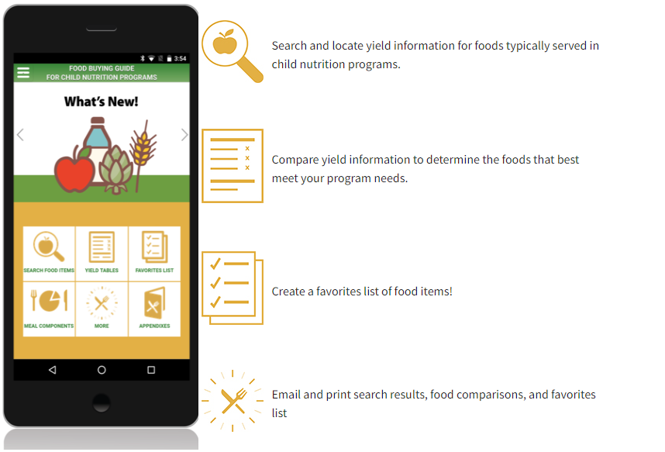
Food Buying Guide Mobile App
Notes:
Here is an example of the Food Buying Guide mobile app that allows schools to easily search information.

Slide 8
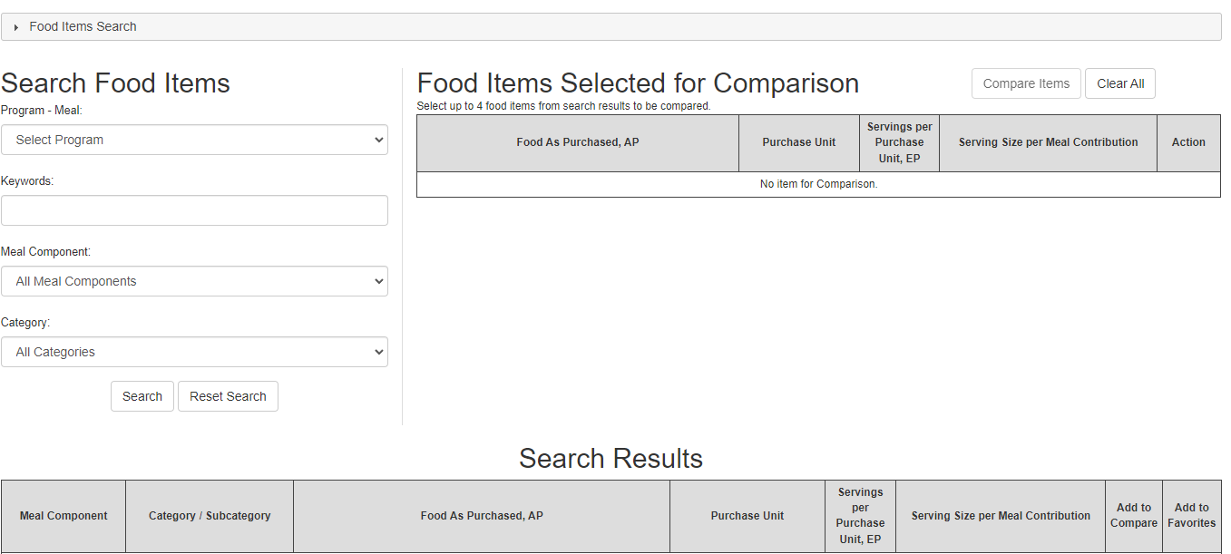
Food Buying Guide Columns
Click here to search for food items
Drop Down: School Meals Program
Enter Keyword to find item
Shows the Orange is fresh and the count in a box
Drop Down: Select Meal Component
To add food items to favorites
Click here
Drop Down: Select Category/Subcategory
To compare food items: click on Add to Compare
These columns are populated from the drop-down boxes
Displays food items by the form as purchased (fresh, frozen, canned)
How item is purchased
(lb., case)
Edible Portions per unit
How the serving contributes
Notes:
This slide shows how the information for each food product is presented. For each food item, there are 6 columns, each describing specific information about the food item the user is searching.
The meal component column selects how the food item is categorized such as grain, fruit, or vegetable and the category/subcategory drop down displays the type of food item such as fruit-fruit juice.
The Food as Purchased (AP-As Purchased) column displays food items demonstrating how the food was purchased. The type of foods are arranged in alphabetical order and listed according to the form they were purchased in. (example: fresh, frozen, canned, or dried).
.
The unit of purchase column describes what unit the food is packaged and purchased. (example: units specified by the pound, case, etc.)
Servings per purchase unit (EP-Edible Portion) is the number of edible portions contained in a purchase unit.
Serving size per meal contribution shows the meal pattern contribution per serving size of the food item. (example: ¼ cup fruit and liquid, ½ peeled orange)
The information provided for each food item allows the user to determine how much product they will need to purchase in order to prepare enough food for the number of customers being served and to assure contributions of each meal component are meeting meal pattern requirements.

Slide 9
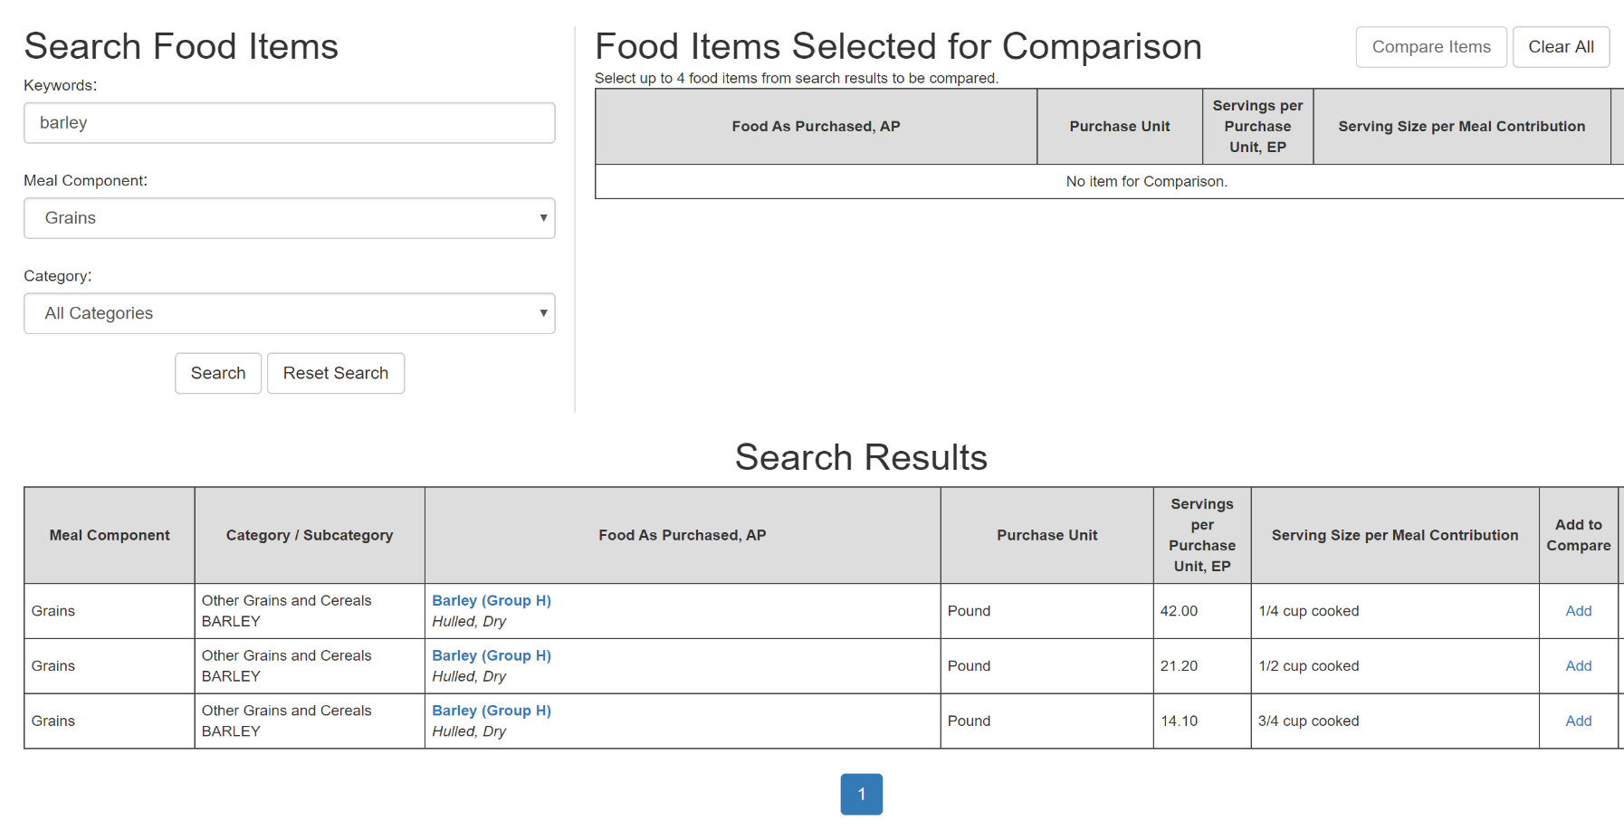
Food Buying Guide Example
Search the Grains component for Barley. The menu planner has indicated the portion to be served is ½ cup. Search under the grain category and select the ½ cup serving size.
Notes:
Here is an example for searching the keyword “Barley” under the Grains component.
The menu planner has planned for ½ cup portions. Find the row indicating the serving size of ½ cup, then click on the “Food Item As Purchased” , Barley (Group H), which is highlighted in blue - This link will take you to the Food Item Details page for Barley, ½ cup cooked product.

Slide 10
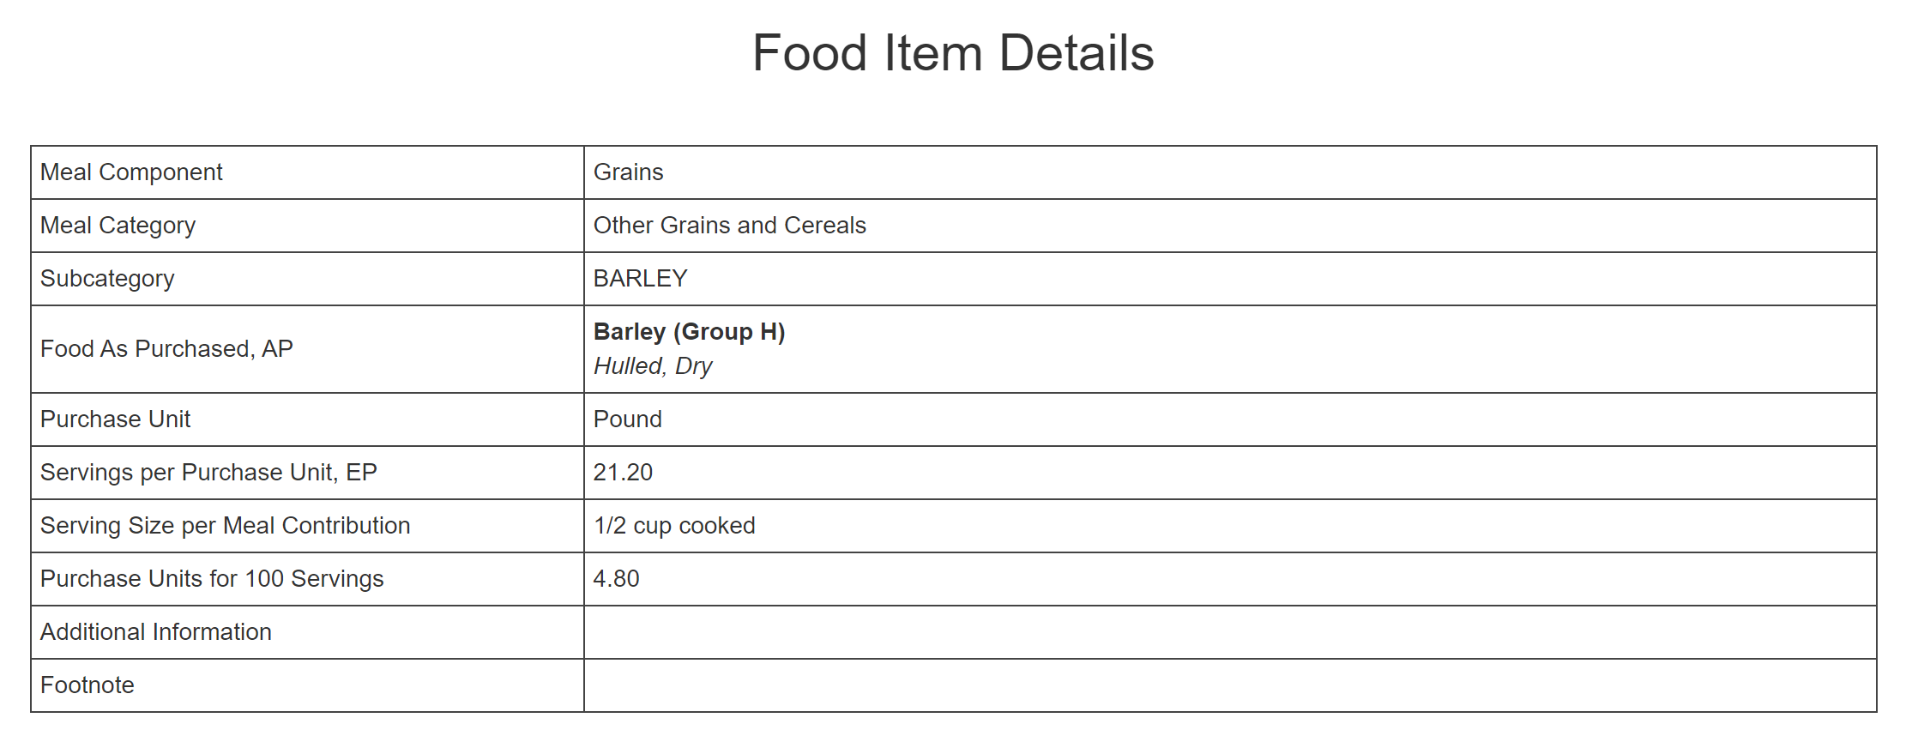
Food Buying Guide
Example: (plan for preparing 100 ½ cup portions)
1 pound of dry hulled barley yields 21.20 - ½ cup cooked barley servings. The Food Item Details also indicate that we need 4.8 pounds of the product as purchased to produce 100 ½ cup portions of cooked barley. This means that you need 5 pounds of dry barley in your house inventory in order to serve 100 students a ½ cup portion.
Notes:
The food item details will assist you in purchasing the correct amount of product to feed the number of customers you are serving, in the portion size that has been planned.
Here is an example showing us how the Food Buying Guide will assist in ensuring that enough barley is purchased to prepare 100 ½ cup servings.
1 pound of dry hulled barley yields 21.20 ½ cup portions of cooked barley.
The purchase unit is one pound, and the food item details indicate that you will need 4.80 pounds of dry barley to produce 100 ½ cup servings.
Since the barley is purchased by the pound, we would round up to 5 pounds. You would need 5 pounds of barley in the house inventory to be able to produce the planned 100 servings for the menu.

Slide 11
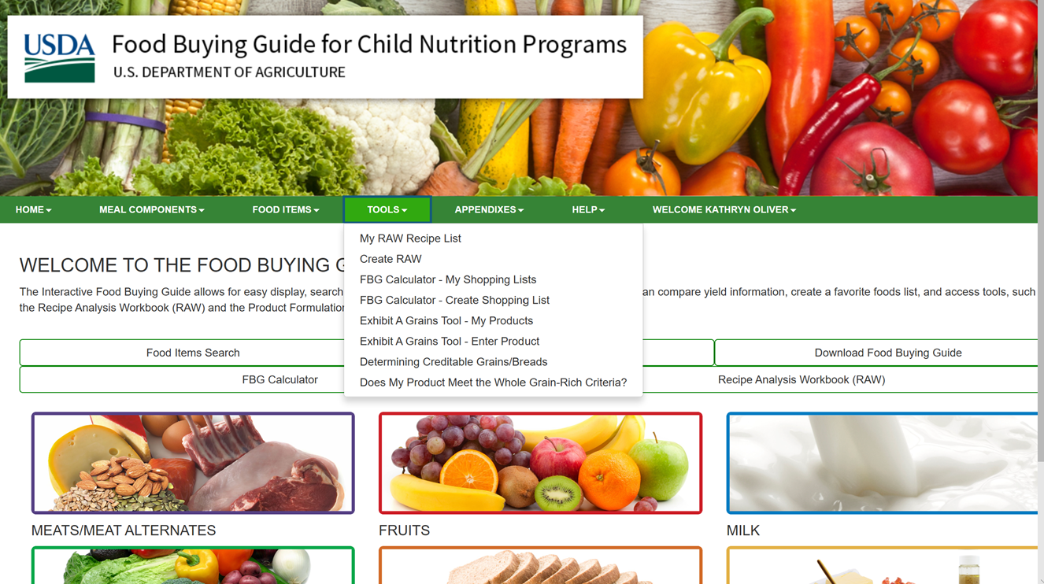
Food Buying Guide Tools
Recipe Analysis Worksheet (RAW):
  Calculator to determine how your recipe will contribute towards the meal pattern
To create a Recipe Analysis Worksheet (RAW)
Food Buying Guide Calculator:
  Create shopping lists for purchasing adequate amounts of food items
To create shopping lists using the calculator
Exhibit A Grain Tool:
  Determines ounce equivalents of grain products
Notes:
In addition to simply searching food item details, you will find additional helpful tools that will assist you in ensuring meal pattern compliance. This is the screen view you will see after you log in. Remember to fully utilize the tools, create a profile and Register.​
​
When using recipes from sources other than the USDA, it is necessary to use the Food Buying Guide to calculate the contribution the recipe makes in relationship to the menus.
Tools like “As Purchased” versus “Edible Portion” will acknowledge desired yields and prevent waste, buying the wrong item, or the purchasing an item in the wrong form. (ex- dried vs. fresh herbs, cooked vs. raw meat) It is important to know what you need to make your menu items, then having the ability to purchase the correct items to produce the product in a controlled fashion.
The Recipe Analysis Worksheet is a calculator which will determine how the recipe will contribute towards the Food Based Meal Pattern requirements. The FBG Calculator will assist with creating shopping lists that will ensure purchasing foods in adequate amounts to produce the recipes on your menu as planned.​
​
The Exhibit A Grains Tool will determine: the ounce equivalent (oz eq) grains or grains/bread servings for your grain product, the​ amount of a grains product to serve in order to provide a specific ounce equivalent (oz eq) grains or grains/bread servings, and the​ amount of a grains product to serve in order to meet Minimum Grains Requirement as appropriate for the specific age group/grade group.
**Please note: Only Registered Users will be able to save and retrieve the calculated result of your grain product at any time.​

Slide 12
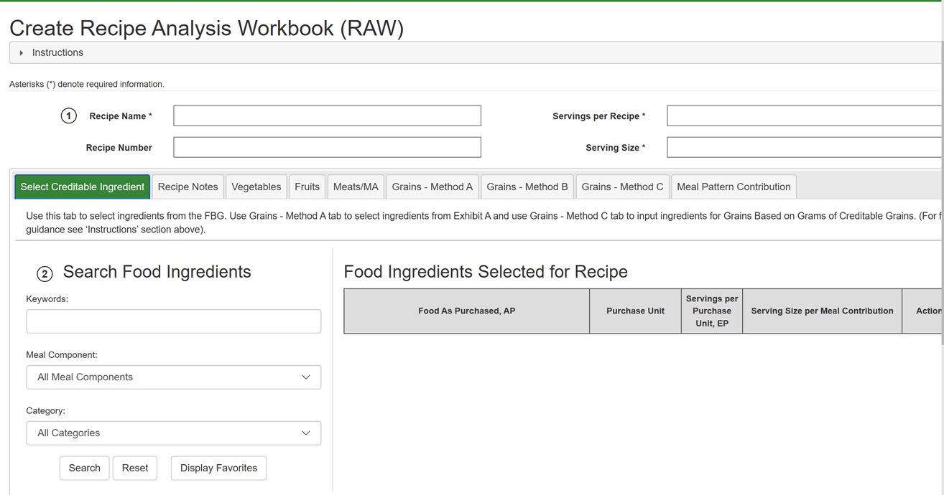
RECIPE ANALYSIS WORKSHEET
(RAW)
This tool will help you determine how your recipes contribute towards meal pattern requirements
Notes:
The Recipe Analysis Worksheet (RAW) is a tool to help you determine your recipe's expected meal pattern contributions. Keep in mind that RAW is not a tool to evaluate dietary specifications (calories, sodium, and saturated fat).
RAW also can not determine whether the serving size information entered is correct for crediting. If incorrect information is entered, the results will be inaccurate.
Start out with a developed standardized recipe because it is required in the school meal programs. The specific food items utilized in the recipe must also be identified.
This tool contains a series of worksheets (tabs) with formulas for each food group. If you look at the tabs after section 1 on this page, you will see labeled tabs for each food group (except for milk). There is also a tab marked “Recipe Notes" that may be used to write notes.
To find guidance on using the tool, click on “Instructions” at the top of the page, as circled in red on this slide.

Slide 13
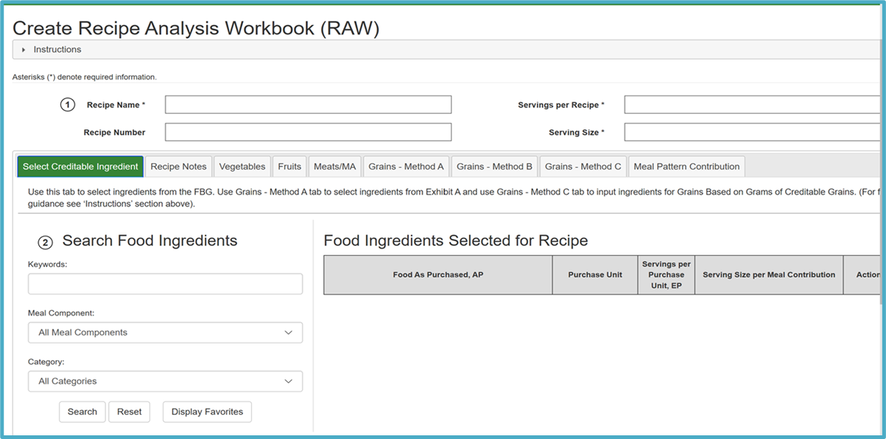
Meal Pattern Contribution
(per serving)
Notes:
Once the standardized recipe information is entered into this tool, click on the Meal Contribution tab, as circled on this slide. This will display the expected meal contribution for each component contained in the recipe.

Slide 14
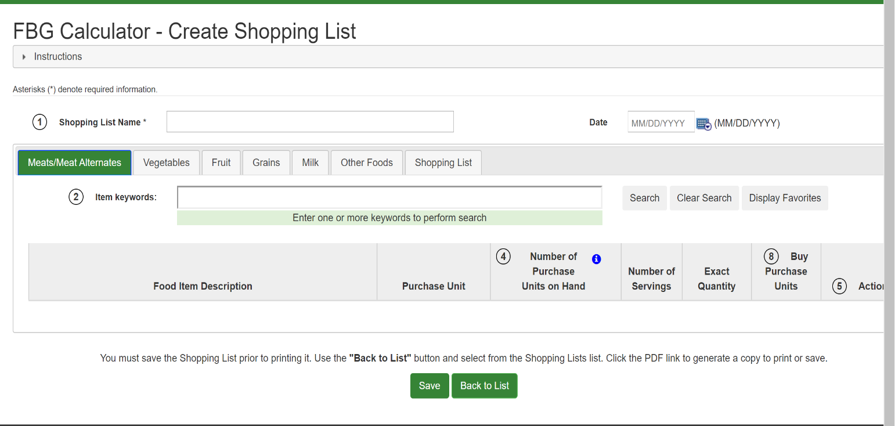
Food Buying Guide Calculator
Notes:
Another tool available on the USDA site in addition to the buying guide is a “ FBG Calculator”.
This allows to create specific shopping lists which can calculate the amount of food items needed to purchase based on the recipes being prepared and the amount of each food product existing in inventory. This will allow to control costs while ensuring meal pattern requirements are being met. The instructions for using this tool are found by clicking on the Instructions tab at the top of the page.

Slide 15
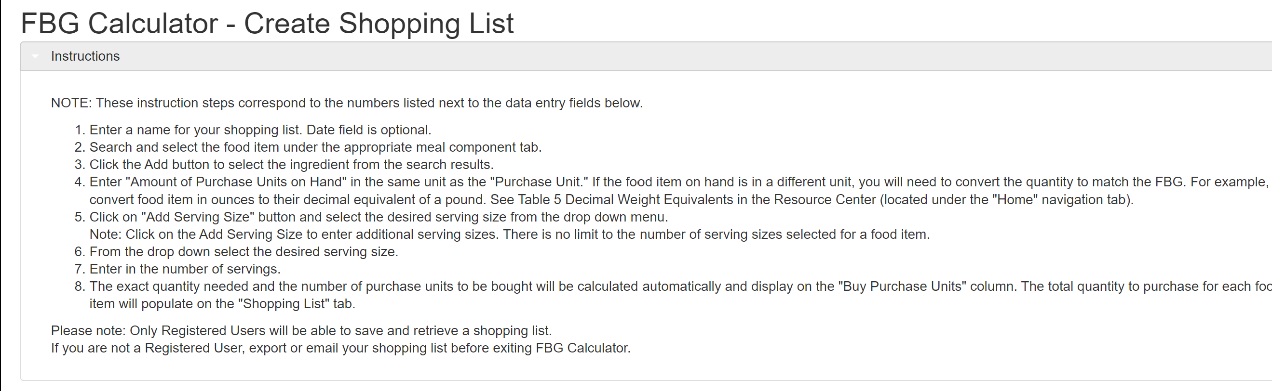
Food Buying Guide Calculator
Notes:
This online tool will create a shopping list to assist Child Nutrition Program Operators in ordering food for their programs.
Please note, only Registered Users will be able to save and retrieve a shopping list. If you are not a Registered User, export or email your shopping list before exiting FBG Calculator.

Slide 16
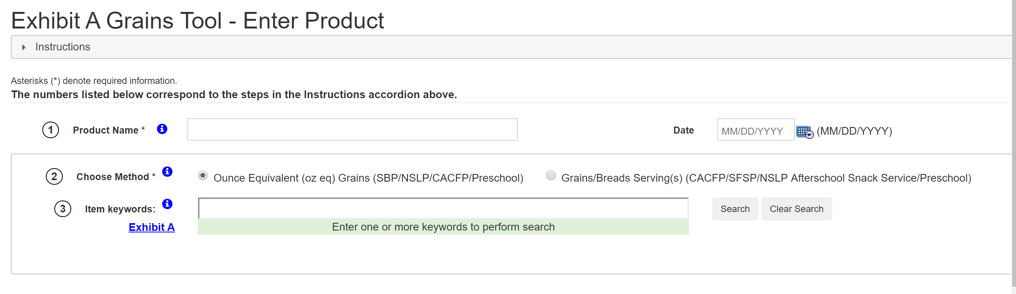
Exhibit A Grains Tool
Notes:
This online tool will determine:
The ounce equivalent (oz eq) grains or grains/bread servings for your grain product
The amount of a grains product to serve in order to provide a specific ounce equivalent (oz eq) grains or grains/bread servings
The amount of a grains product to serve in order to meet minimum grains requirement as appropriate for the specific age group/grade group
*Please note, only Registered Users will be able to save and retrieve the calculated result of your grain product at any time.
If you are not a Registered User, download the PDF of the calculated result of your grain product before exiting the Exhibit A Grains Tool.

Slide 17
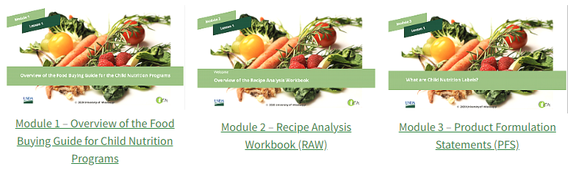
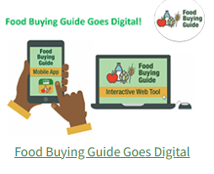
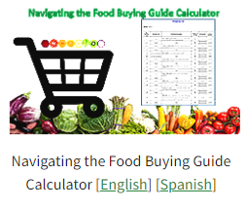
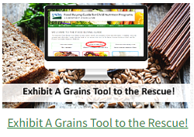
Tools and Resources
https://www.fns.usda.gov/tn/food-buying-guide-training-resources
Notes:
To find guidance on navigating the Food Buying guide and how to utilize the associated tools and information on the FBG mobile App and Interactive web tools, use the link in the slide. These modules are a step-by-step training which demonstrates the full process.

Slide 18

Food Buying Guide Questions
Child Nutrition Program Administration
(518)473-8781
CNtraining@nysed.gov
or contact your CN Rep
Notes:
If you have any questions, please contact the training team at CNtraining@nysed.gov or call your CN rep. Please do not hesitate to contact us!
Thank you!!

