Slide 1
Alternate Daily Meals
1 Hour Professional Standards Training
Notes:
This PowerPoint will contribute 1 hour towards Professional Standards training requirements. This training reviews Alternate Daily Meals. Offering alternate daily meals can help in increasing your program’s participation but there are considerations to keep in mind when planning your menu. This presentation will review the advantages of providing alternate daily meals and how to plan alternate meals compliant with the Food Based Meal Pattern requirements.

Slide 2
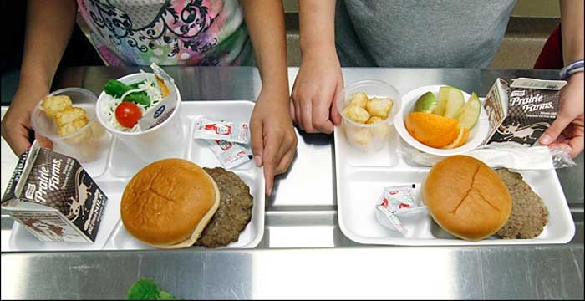
Advantages of Alternate Daily Meals
Multiple menu selections adds variety
Multiple menu selections increase student participation
Increased participation increases revenue
Notes:
Daily alternate meals can be an option in addition to your featured entrée. Daily alternate meals are not required for the National School Lunch Program or School Breakfast Program. However, the menu planner may find advantages to having multiple meal choices for students.
These Advantages may include exposure to new or different foods and increased student participation which will increase Program revenue.

Slide 3
What to consider when planning alternate meals
Customer preferences and requirements
Staffing and equipment
Ease of preparation
Notes:
As you start planning alternate meals it is critical to know what your customers like and what do they require. Talking with the students and staff or completing a survey will help access customer preferences. What specific foods would they purchase.? How much time do they have for lunch? Do they want hot or cold options or do they require a grab and go or a hand-held type option.
Also keep in mind your staffing and available equipment. Offering alternate meal options cannot overwhelm your staff or the equipment you have available.

Slide 4
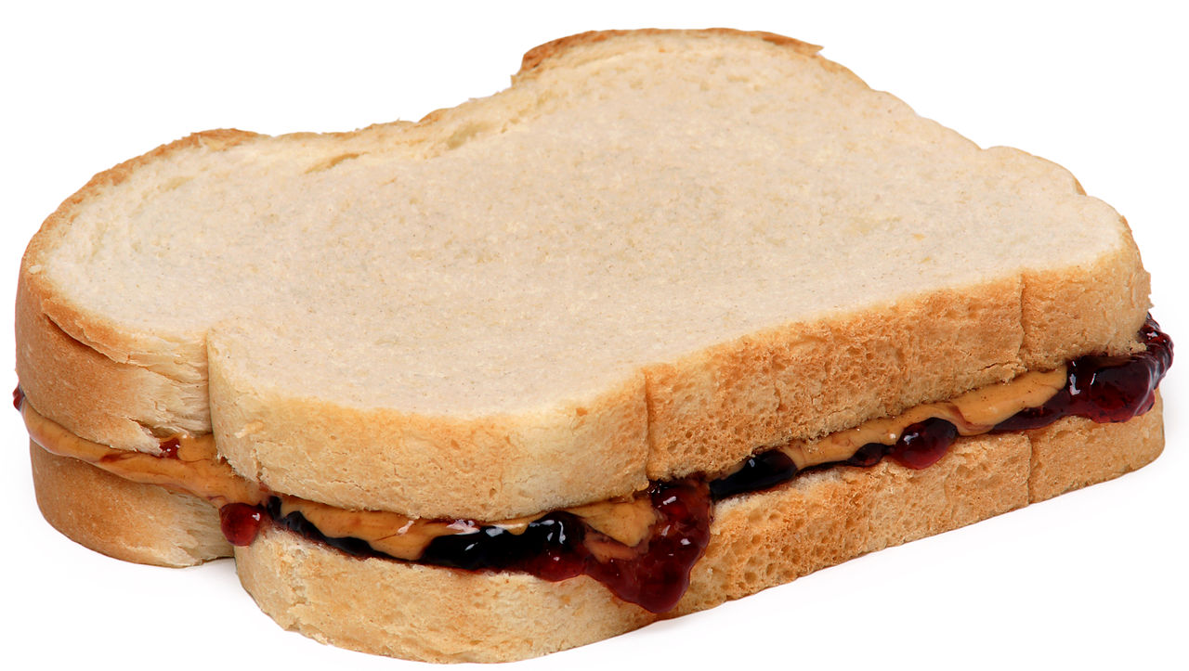
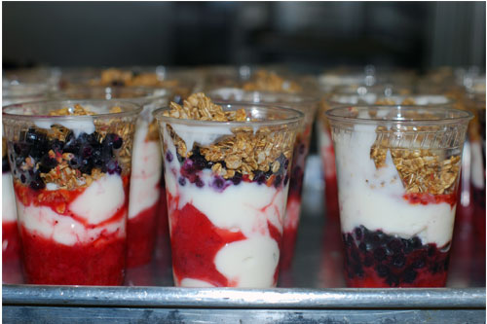
Common Daily Meal Examples
Lunch
Peanut Butter and Jelly Sandwich
Assorted Deli Sandwiches
Yogurt Meal
Assorted Salad Meals
Breakfast
Assorted Cereal
Assorted Muffins
Yogurt Meal
Notes:
These are some common alternate meal examples for lunch:
Peanut butter and jelly sandwich
Assorted Deli Sandwiches
Yogurt Meal
Chef Salads, Vegetarian Salad with Cheese, Taco Salad,
Breakfast Meals may include:
Assorted Cereals
Assorted Muffins
Yogurt Meal

Slide 5
Lunch Requirements
Breakfast Requirements
Lunch Meal Components
Fruits
Vegetables
Dark green
Red/orange
Beans/Peas (legumes)
Starchy
Other
Grains
Whole grain rich
Meats/Meat Alternates
Fluid Milk
Breakfast Meal Components (3)
Fruits / Vegetables
Grains
Whole grain rich
M/MA (optional)-Must offer 1 oz. grain before offering M/MA
Fluid Milk
Sodium targets per meal on average
K-5 ≤ 540 mg
6-8 ≤ 600 mg
9-12 ≤ 640 mg
K-8 ≤ 540 mg
Dietary Specifications (4)
Min-max calorie range
Saturated fat maximum
Trans fat restriction
Sodium
Sodium targets
K-5 ≤ 1230 mg
6-8 ≤ 1360 mg
9-12 ≤ 1420 mg
K-8 ≤ 1230 mg
Dietary Specifications
Min-max calorie range
Saturated fat maximum
Trans fat daily requirement restriction
Sodium
Notes:
When offering alternative meals at lunch and breakfast, the meals offered at lunch must comply to the Food Based Meal Pattern requirements. Here is a quick recap:
For lunch, the menu planner must offer the following components: fruits, vegetables (including the five vegetable subgroups listed on the slide), grains, meat/meat alternates, and fluid milk.
In addition, the menu planner must ensure the menu is in compliance with the dietary specifications for each age/grade group. The dietary specifications include: minimum and maximum range for calories, and a maximum amount for saturated fat, sodium, and trans fat.
For breakfast, the menu planner must offer three components: fruits/vegetables, grains, and fluid milk.
When implementing offer vs. serve for breakfast, the menu planner must offer 4 items within the 3 components (Grain, Fruit, Milk).
Meat/Meat Alternate is optional for breakfast. If the menu planner chooses to offer a Meat/Meat Alternate for breakfast, they must first offer a 1 oz. eq. of grain.
In addition, the menu planner must ensure the menu is compliant with the dietary specifications for each age/grade group. The dietary specifications include: minimum and maximum range for calories, and a maximum amount for saturated fat, sodium, and trans fat.

Slide 6
Meal Pattern Chart
Notes:
As we discussed in Part 1, this is the meal pattern chart that demonstrates the minimum daily and weekly requirements for all age/grade groups. This meal pattern chart also demonstrates the minimum/maximum amount for the dietary specification such as sodium, calories, and saturated fat.
When planning your menu, this meal pattern chart should be what you reference to ensure you are meeting daily and weekly meal pattern requirements.
The meal pattern chart is available on the Child Nutrition Knowledge Center.

Slide 7
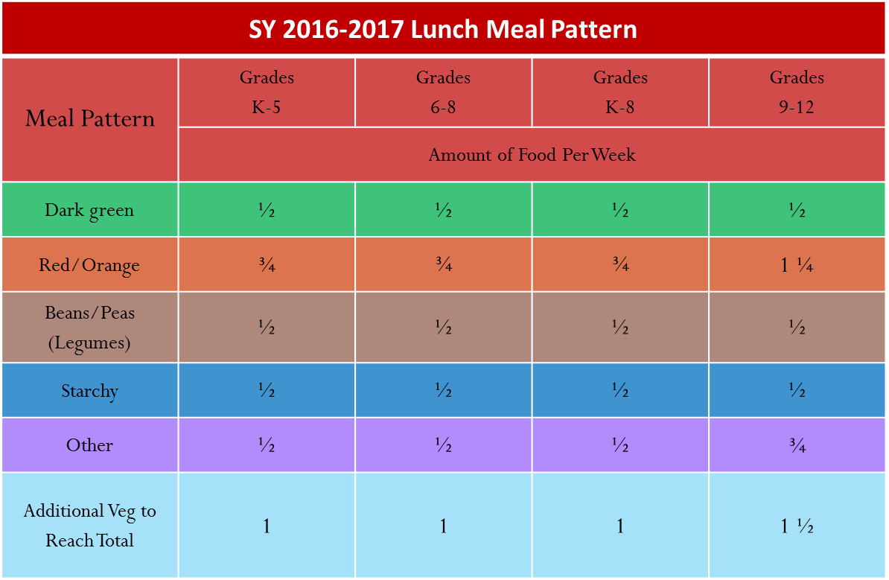
Compliance with Weekly Requirements
All vegetable subgroups must be offered in the minimum required amounts for the week.
All students must have access to all vegetable subgroups for the week. This includes students who choose the daily alternate meal .
*Providing alternate daily vegetable choices is a great way to ensure that all vegetable subgroups are being offered in minimum amounts per week.
Notes:
In addition, all vegetable subgroups must be offered in the minimum required amounts for the week. Providing alternate daily vegetable choices is a great way to ensure that all vegetable subgroups are being offered in minimum amounts per week.
All students must have access to all vegetable subgroups for the week. This includes students who receive the daily alternate meal.
Some menu planners like to offer carrots (cooked or raw) three times a week in ½ cup portions. This ensures that the menu planner is meeting the red/orange vegetable for all age/grade groups.

Slide 8
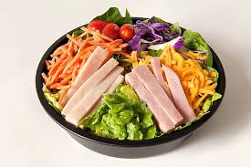
Menu Example 1
Daily Alternate:
Chef Salad includes:
1 oz. eq. Turkey breast
1 oz. eq. American Cheese
Total: 2 ounce equivalent (oz. eq.) Meat/Meat Alternate(M/MA)
2 cups Romaine Lettuce
1.75 oz. Whole Wheat Kaiser Roll
Main Entree
Chicken Burrito includes:
2 oz. eq. Chicken
½ cup Black Beans
2 oz. eq. Brown Rice
¼ cup Salsa
2 oz. eq. WG Tortilla Shell
Notes:
Here is an example of crediting vegetable subgroups incorrectly:
The daily alternate meal is a Chef Salad which credits as the following:
The turkey and cheese amounts were added together and totaled 2 oz. eq. meat/meat alternate.
The Kaiser rolls credits as 1. 75 oz. eq. towards the grain component.
There are 2 cups of Romaine Lettuce which equals 1 cup of creditable vegetable because raw leafy greens count as half the volume.
The Main entrée is a Chicken Burrito which credits as the following:
The chicken in the burrito is 2 oz. eq. of meat/meat alternate.
The tortilla shell credits as 2 oz. eq. towards the grain component.
The black beans in the burrito counts as ½ cup vegetable and the salsa as 1/4 cup of vegetable.

Slide 9
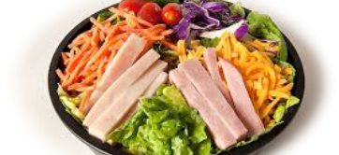
Let’s Look at this Example
The black beans in the Chicken Burrito cannot count towards the beans/peas (legumes) vegetable subgroup because not all students have access to those black beans.
The romaine lettuce contained in the Chef Salad cannot count towards the dark green vegetable subgroup because not all students have access to the romaine lettuce.
The salsa cannot be counted towards the red/orange vegetable subgroup because not all students have access to the Salsa.
Notes:
In our example, even though the meals are offering vegetables within the meal, they do not necessarily count towards the vegetable subgroups.
The student who selects the Chef Salad will be receiving the dark green vegetable subgroup (Romaine). However the student that selects the other meal option(Chicken Burrito) does not have access to the dark green vegetable(romaine lettuce).
The student who selects the Chicken Burrito will be receiving the beans/peas (legumes) vegetable subgroup and also the red/orange vegetable subgroup. However, the student that chose the chef salad does not have access to these specific vegetable subgroups.
Since all students must have access to all vegetable subgroups, menu planners must ensure that other vegetable subgroups are offered in the minimum required amounts in addition to the entrees.

Slide 10
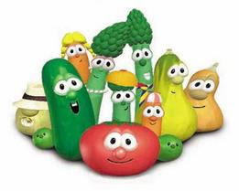
Ways to correct this:
Menu all vegetable subgroups so all students have access to each one every week.
There are 5 Vegetable Subgroups: Menu one vegetable subgroup per day for the week
Monday: Broccoli (dark green)
Tuesday: Sweet Potatoes (red/orange)
Wednesday: Green Beans (other)
Thursday: Black Beans (beans/legumes)
Friday: Peas (starchy)
If you are offering the Chicken Burrito, offer additional black beans and salsa for all other students that will be selecting other meal options.
Notes:
Every student must have access to all vegetable subgroups.
Since there are 5 vegetable subgroups and most schools serve 5 days, some menu planners chose one vegetable subgroup each day to make menu planning easier.
For example: Monday-1 cup Broccoli (Dark Green), Tuesday 1 cup of Sweet Potatoes (Red/Orange), Wednesday 1 cup of Green Beans (Other), Thursday-1 cup of black beans(Beans/Legumes), and Friday 1 cup of Peas (Starch). This ensures that all vegetable subgroups are being offered in the required amounts for all age/grade group.
A best practice would be to offer additional vegetables to other students that will not be getting the same vegetables as if they selected the daily alternate meal.
For example: If you are offering black beans and salsa with the Chicken Burrito, offer additional black beans and salsa to all other students selecting other options.

Slide 11
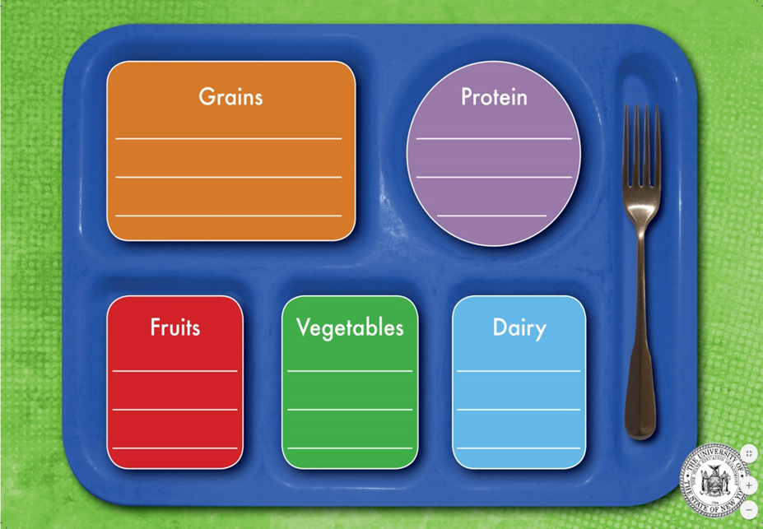
Signage
Signage must display all daily alternate meals
Whole Grain Bread
Tortilla Shells
Peanut Butter
Turkey
Apples
Banana
Milk
1% or FF
Broccoli
Notes:
Signage is required for both breakfast and lunch.
Signage must be posted at or near the beginning of each service line and must indicate to students what food items are offered as part of a reimbursable meal.
It must also include all daily alternate meals that are offered.
In this example: Turkey Wrap is the main meal and Peanut Butter and Jelly Sandwich is the alternate meal. The menu planner includes both selections.

Slide 12
Compliance with Weekly Requirements
Steps for determining minimum amount of each food component offered weekly:
Calculate the amount (ounce equivalent or cups) of meat/meat alternate, grain, fruit, and vegetable subgroups for every reimbursable meal offered.
This includes any alternate meals such as a salads, assorted sandwiches, and yogurt meals.
Notes:
When structuring daily alternate meals in your menu, it is crucial to calculate how these items are contributing to the required weekly minimum amounts for each meal component, for each age/grade group.
This ensures that SFA’s are in compliance with meal pattern guidelines.
Menu planners must calculate the amount of (ounce equivalents or cups) of meat/meat alternate, grain, fruit, and vegetable subgroups for EVERY reimbursable meal offered.
This includes any alternate meals such salads, assorted sandwiches, and yogurt meals.

Slide 13
Menu Example 2
Daily Alternate:
Turkey and Cheese Deli Sandwich
1 oz. eq. Turkey breast
1 oz. eq. American Cheese
Total: 2 ounce equivalent (oz. eq.) Meat/Meat Alternate(M/MA)
1.75 oz. Whole Wheat Kaiser Roll
Main Entree
Chicken Patty on WG Bun
2.5 oz. eq. M/MA 1 oz. eq. Grain Chicken Patty
2 oz. eq. WG Bun
All meals are offered 1 cup of carrot sticks, 1 cup fruit and 8 fl. oz. milk
Notes:
In this example: The daily alternate meal is a Turkey and Cheese Deli Sandwich which credits as the following :
The turkey and cheese amounts were added together and totaled 2 oz. eq. meat/meat alternate.
The Kaiser rolls credits 1. 75 oz. eq. towards the grain component.
The Main entrée Chicken Patty on a WG bun credits as the following:
The chicken patty credits as 2.5 oz. eq. of meat/meat alternate.
The WG bun credits 2 oz. eq. and the breading on the chicken patty counts as 1 oz. eq. towards the grain component totaling 3 oz. eq. grain.

Slide 14
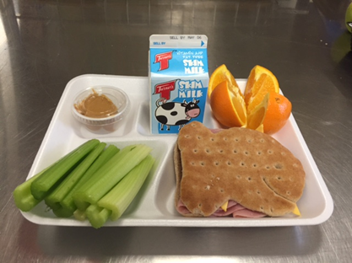
STEPS
Determine the lowest creditable amount offered for every food component for each day. The lowest amount for each food component is not necessarily from the same reimbursable meal.
Add the lowest creditable amount from each day to determine the weekly amount offered.
Notes:
So in this example we are going to determine what the lowest creditable amount is offered for each component.
Step 1: Determine crediting
Step 2: Find the lowest amount of Meat/MA offered each day
Step 3: Add the lowest amount offered from each day throughout the week
Let’s start with the M/MA: The Turkey Selection contains 1 oz. eq. Turkey and 1 oz. eq. American Cheese which totals 2 oz. m/ma.
The Chicken Patty on WG Bun contains 2.5 oz. eq. M/MA
So what would be the lowest creditable amount for the day? It would be the Turkey Sandwich because the 2 oz. eq. is lower than the 2.5 oz. eq. chicken patty.
You continue to calculate out the lowest creditable amount each day throughout the week and then compare to the weekly minimum requirements that are found on the meal pattern chart.
This must be done for grains, meat/ma, vegetables, fruit, and milk.

Slide 15
Example K-5 Menu
Monday | Tuesday | Wednesday | Thursday | Friday
Hamburger = 2 oz. eq. grain, 2 oz. eq. m/ma Bagel with Yogurt = 2 oz. eq. grain, 2 oz. eq. m/ma Pizza = 1.5 oz. eq. grain, 2 oz. eq. m/ma | Chicken patty on bun = 2 oz. eq. grain, 2 oz. eq. m/ma Ham and cheese sandwich = 2 oz. eq. grain, 2 oz. eq. m/ma Pizza = 1.5 oz eq grain, 2 oz m/ma | French toast sticks with sausage = 2 oz. eq. grain, 2 oz. eq. m/ma Nachos = 2 oz. eq. grain, 1 oz. eq. m/ma Pizza = 1.5 oz. eq. grain, 2 oz. eq. m/ma | Chicken nuggets = 1 oz. eq. grain, 2 oz. eq. m/ma Turkey and cheese wrap = 2 oz. eq. grain, 2 oz. eq. m/ma Pizza = 1.5 oz. eq. grain, 2 oz. eq. m/ma | Pizza supreme = 2 oz. eq. grain, 2 oz. eq. m/ma Grilled cheese = 2 oz eq grain, 2 oz m/ma Pizza = 1.5 oz. eq. grain, 2 oz. eq. m/ma
Notes:
Here is an example of a K-5 menu. We will be determining the grain component for this example.
So here we see that Pizza is our daily alternate which needs to be counted along with the other meal options.
So we begin to find the lowest amount of grain offered each day.
Monday: 1.5 oz. eq. (pizza) + Tuesday 1.5 oz. eq. (pizza) + Wednesday 1.5 oz. eq. (pizza) + Thursday 1 oz. eq. (Chicken Nugget ) + Friday 1.5 oz. eq. (pizza) = 7 oz. eq. grains offered weekly
While this menu meets the minimum daily requirement of 1 oz. eq. grain, the minimum weekly grain is deficient by 1 oz. eq. for grades K-5.
The required minimum weekly amount of grain oz. eq. for grades K-5 is 8 oz. eq.
There are many ways the menu planner can correct this menu in order to be in compliance. One option would be to serve a pizza daily that is 2 oz. eq. grain. Another option would be to only serve the 1.5 oz. grain oz. eq. pizza two days during this week.
Since the pizza is offered every day for 5 days a week, it can never meet the minimum weekly requirements because 1.5 oz. eq. x 5(days a week) =7.5 oz. eq.

Slide 16
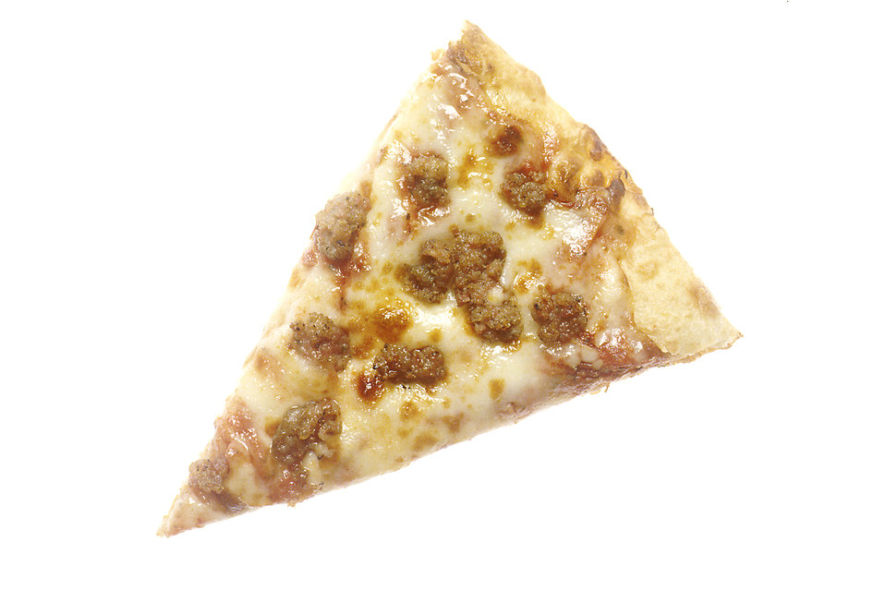
Menu Example 3
Daily Alternate
Peanut Butter and Jelly Sandwich
2 Tablespoons (1 oz. eq.) Peanut Butter
1 oz. eq. Cheese Stick
Total: 2 ounce equivalent (oz. eq.) Meat/Meat Alternate(M/MA)
1 Tablespoon Strawberry Jelly
2 Slices (2 oz. eq.) Whole Wheat Bread
Main Entree
Whole Wheat Cheese Sausage Pizza
3 oz. eq. M/MA Mozzarella Cheese + Sausage
2.5 oz. eq. grain Whole Wheat Crust
All meals are offered 1 cup of carrot sticks, 1 cup fruit and 8 fl. oz. milk
Notes:
In this example: The daily alternate meal is a Peanut Butter and Jelly Sandwich which credits:
2 oz. eq. of m/ma because we add the peanut butter with the cheese stick and it totaled 2 oz. eq.
Some alternative options for a meat/meat alternate are offering 4 tbsp. of peanut butter to equal a 2 oz. eq. M/MA or offer a 4 oz. yogurt instead of the cheese stick which is 1 oz. meat/meat alternate and add with the peanut butter.
The whole wheat bread credits 2 oz. eq. towards the grain component.
The Main entrée offers a Whole Wheat Cheese and Sausage Pizza which credits as the following:
The cheese and the sausage total 3 oz. eq. of m/ma.
The WW crust credits 2.5 oz. eq. towards the grain component.
For Lunch 5 components must be offered in the minimum required components. In this example: the Peanut Butter and Jelly Sandwich and the Whole Wheat Cheese and Pepperoni Pizza offered (Meat/MA, Grain, Vegetable, Fruit, Milk).

Slide 17
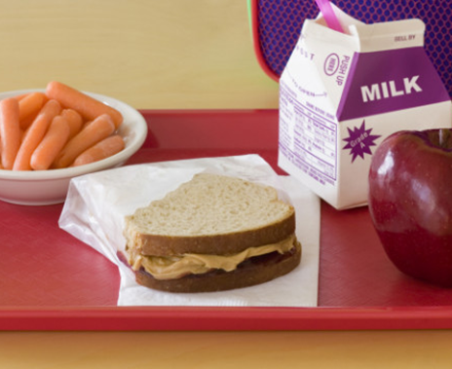
STEPS
Determine the lowest credible amount offered for every food component for each day. The lowest amount for each food component is not necessarily from the same reimbursable meal.
Add the lowest credible amount from each day to determine the weekly amount offered.
Notes:
So in this example we are going to determine what the lowest creditable amount is offered for each component.
Step 1: Determine crediting
Step 2: Find the lowest amount offered each day
Step 3: Add the lowest amount offered from each day throughout the week
Let’s start with the M/MA: The PB&J Selection contains 1 oz. eq. Peanut Butter and 1 oz. eq. Cheese Stick which totals 2 oz. m/ma.
The Pizza contains 3 oz. eq. M/MA from the cheese and sausage on the pizza.
So what would be the lowest creditable amount for the day? It would be the PB&J because the 2 oz. eq. is lower than the 3 oz. eq. Pizza.
You continue to calculate out the lowest creditable amount each day throughout the week and then compare to the weekly minimum requirements that are found on the meal pattern chart.
This must be done for grains, meat/ma, vegetables, fruit, and milk.

Slide 18
Example 9-12 Menu
Monday | Tuesday | Wednesday | Thursday | Friday
Hamburger = 2 oz. eq. grain, 2 oz. eq. m/ma Bagel with Yogurt = 2 oz. eq. grain, 2 oz. eq. m/ma Chef Salad = 1 oz. eq. grain, 2 oz. oz. m/ma | Chicken patty on bun = 2 oz. eq. grain, 2 oz. eq. m/ma Ham and cheese sandwich = 2 oz. eq. grain, 2 oz. eq. m/ma Chef Salad = 1 oz. eq. grain, 2 oz. eq. m/ma | French toast sticks with sausage = 2 oz. eq. grain, 2 oz. eq. m/ma Nachos = 2 oz. eq. grain, 1 oz. eq. m/ma Chef Salad = 1 oz. eq. grain, 2 oz. eq. m/ma | Chicken nuggets = 1 oz. eq. grain, 2 oz. eq. m/ma Turkey and cheese wrap = 2 oz. eq. grain, 2 oz. eq. m/ma PB&J = 2 oz. eq. grain, 2 oz. eq. m/ma | Pizza supreme = 2 oz. eq. grain, 2 oz. eq. m/ma Grilled cheese = 2 oz. eq. grain, 2 oz. eq. m/ma Chef Salad = 1 oz. eq. grain, 2 oz. eq. m/ma
Notes:
Here is an example of a 9-12 menu. We will be determining the grain component for this example.
So here we see that a Chef Salad is our daily alternate which needs to be counted along with the other meal options.
So we begin to find the lowest amount of grain offered each day.
Monday: 1 oz. eq. (Chef Salad) + Tuesday 1 oz. eq. (Chef Salad) + Wednesday 1 oz. eq. (Chef Salad) + Thursday 1 oz. eq. (Chicken Nugget) + Friday 1 oz. eq. (Chef Salad) = 5 oz. eq. grains offered weekly
Keep in mind that the minimum daily requirement for grades 9-12 is 2 oz. eq. grain, so the minimum daily and weekly grain is deficient by 1 oz. eq. daily and 5 oz. eq. weekly for grades 9-12.
The required minimum weekly amount of grain oz. eq. for grades 9-12 is 10 oz. eq.
There are many ways the menu planner can correct this menu in order to be in compliance. One option would be to serve a dinner roll or breadstick with the chef salad that is 2 oz. eq. grain (that could also be served with the chicken nuggets).
If the chef salad was offered every day for 5 days a week, it could never meet the minimum weekly requirements as it is on this menu because 1 oz. eq. x 5 (days a week) =5 oz. eq. weekly.

Slide 19
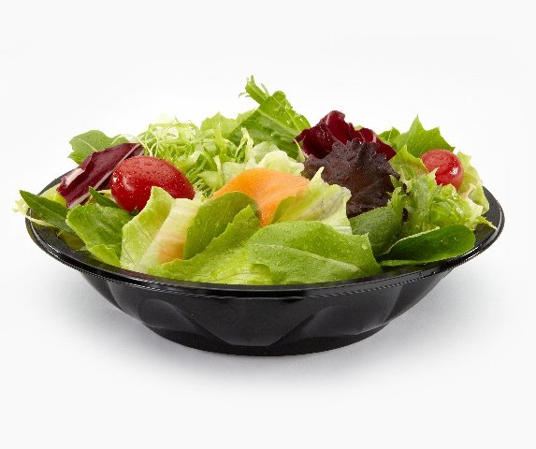
Common Errors
PBJ sandwich served daily at 1 oz. eq. grain and 1 oz. eq. m/ma. This would make the weekly minimum offered only 5 oz. eq. grain and 5 oz. eq. m/ma which does not meet any grade group requirement.
Salads served daily with only a 1 oz. eq. grain.
Yogurt parfaits served daily with only a 1 oz. grain.
1 oz. eq. grain equivalent cereals or muffins served at breakfast daily.
Notes:
Common errors typically seen for alternate daily meals include the following examples:
PB&J Sandwich with only 1 oz. eq. grain equivalent and 1 oz. eq. meat/meat alternate (2 TBSP or peanut butter = 1 oz. eq. meat alternate)
Chef Salad only served with 1 oz. eq. grain equivalent
Yogurt meal only served with 1 oz. eq. grain equivalent
Cereals or muffins only served in 1 oz. eq. portions at breakfast
Deli meat is not ounce for ounce. Schools must have product formulation statements showing how the deli meat credits. For example, 2 slices of turkey = 2oz M/MA (2 oz of sliced turkey product is not 2 oz of actual meat, due to fillers and other added ingredients)
Don’t forget that breakfast and lunch both have daily and weekly minimum amounts.

Slide 20
Reminders
Graham crackers are considered a grain based dessert at lunch. There is a maximum of 2 oz. eq. of grain based desserts for lunch per week.
All grains must be whole grain rich
Must provide documentation on how you credit food items (CN label, Product Formulation Statements, or use Exhibit A)
Breakfast: must offer 1 oz. eq. grain before you can offer a meat/meat alternate
Processed M/MA products are not always ounce for ounce due to fillers and added ingredients
Notes:
Important information to remember includes:
Graham crackers are commonly used in yogurt meals. However, please remember that graham crackers are considered a grain based dessert at lunch and cannot exceed 2 oz. eq. per week.
Graham crackers may be used at breakfast with no maximum requirements.
All grains must be whole grain rich
SFAs must provide documentation on how food components/items credit. This can be in the form of product formulation statements, using exhibit A, or using CN Labels.
Menu planners must offer at least 1 oz. eq. grain before they can offer a M/MA for breakfast.
M/MA commercial or processed products are usually not ounce for ounce. These processed products contain fillers, other ingredients and water. You must have a product formulation statement or a CN Label to demonstrate the crediting.

Slide 21
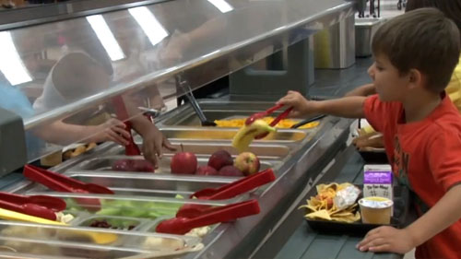
Suggestions to Improve Compliance
Pair PB&J with a 1 oz. eq. cheese stick or 4 oz. yogurt(1 oz. eq. m/ma) to increase the amount of meat/meat alternate offered
Pair Chef Salad with a 2 oz. eq. grain equivalent dinner roll or 2 (1 oz. eq. grain equivalent) rolls
Serve 2 oz. eq. grain equivalent granola (½ cup) with yogurt meal or 1 oz. eq. grain equivalent granola (¼ cup) and a 1 oz. eq. grain equivalent dinner roll
Allow students to take 2 (1 oz. eq.) cereal bowls or 2 muffins or pair with another grain/m/ma item.
Notes:
To avoid having any errors with alternate daily meals, try these suggestions to improve compliance and meet weekly requirements:
Pair PB&J sandwich with a 4 oz. yogurt or 1 oz. cheese stick
All commercially prepared processed meats need a CN label or Product Formulation Statement demonstrating crediting
Use deli meats with a CN label or product formulation statement (since 1 oz. deli meat typical does not equal 1 oz. eq. m/ma)
Pair Chef Salad with 2 oz. grain equivalent dinner roll or 2 (1 oz.) dinner rolls
Serve 2 oz. grain equivalent granola (½ cup) with yogurt meal or 1 oz. grain equivalent granola (¼ cup) and a 1 oz. grain equivalent dinner roll
Allow students to take 2 (1 oz.) cereal cups or 2 (1 oz.) muffins or pair with another item to equal 2 oz. eq.

Slide 22
This concludes Alternate Daily Meals
New York State Education Department
Child Nutrition Program Administration
(518)473-8781
CN@nysed.gov
Notes:
Thank you. This concludes Alternate Daily Meals.
Remember to record completion of this training for Annual Professional Standards Training requirements.
If you have any additional questions, please do not hesitate to call or email us.

