Slide 1




Civil Rights
Requirement Reminders
NYSED Child Nutrition
0.5 Credit Hour

Slide 2

Annual Requirements: Train staff annually
Local agencies are responsible for training their subrecipients, including “frontline staff” who interact with applicants or participants on an annual basis.
•New employees before participating in Program activities
•Volunteers must receive training

Slide 3
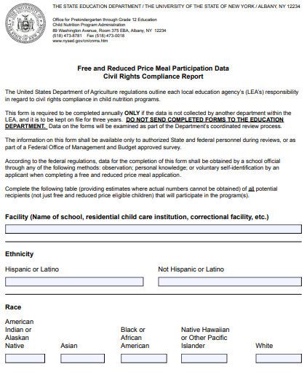
Collect and report racial and ethnic data through
Basic Educational Data System (BEDS) report or the Civil Rights Compliance Report.

Slide 4

USDA
“AND JUSTICE FOR ALL” Poster
Display the poster in a prominent location for all to view
Required in classrooms only if students do not visit the cafeteria.

Slide 5
Review your NDS for Accuracy
In accordance with Federal civil rights law and U.S. Department of Agriculture (USDA) civil rights regulations and policies, the USDA, its Agencies, offices, and employees, and institutions participating in or administering USDA programs are prohibited from discriminating based on race, color, national origin, sex, disability, age, or reprisal or retaliation for prior civil rights activity in any program or activity conducted or funded by USDA.
Persons with disabilities who require alternative means of communication for program information (e.g. Braille, large print, audiotape, American Sign Language, etc.), should contact the Agency (State or local) where they applied for benefits. Individuals who are deaf, hard of hearing or have speech disabilities may contact USDA through the Federal Relay Service at (800) 877- 8339. Additionally, program information may be made available in languages other than English.
To file a program complaint of discrimination, complete the USDA Program Discrimination Complaint Form, (AD-3027) found online at: http://www.ascr.usda.gov/complaint_filing_cust.html, and at any USDA office, or write a letter addressed to USDA and provide in the letter all of the information requested in the form. To request a copy of the complaint form, call (866) 632-9992. Submit your completed form or letter to USDA by:
mail: U.S. Department of Agriculture Office of the Assistant Secretary for Civil Rights 1400 Independence Avenue, SW Washington, D.C. 20250-9410;
fax: (202) 690-7442; or
email: program.intake@usda.gov.
This institution is an equal opportunity provider

Slide 6


Common Error
SFAs must ensure all materials have the most up to date non discrimination statement
  Websites
  Flyers
  Program materials
  CN related forms
  Translations: Other languages are available on the FNS Civil Rights web page: https://www.fns.usda.gov/fns-nondiscrimination-statement

Slide 7

Evaluate Your Language Access Plan
Review Your Plan:
What language assistance services do you have?
How can you provide meaningful access to LEP individuals?
Have you identified ways in which language assistance will be provided ?
Is your staff trained?
Are you monitoring and updating your plan?
An Effective Language Access Plan will:
Ensure access to online automation services and telephone voice mail menus
Provide a method for identifying persons who need language assistance at the point of service
Record and track the language spoken by LEP persons and the language assistance provided at the point of service to each LEP person
Train staff on how to meet their LEP access obligations, including how to use telephone and in-person interpreter services
Involve community in implementing the Recipient’s LEP Plan
Monitor the LEP persons’ access to services and the Recipient’s language assistance measures

Slide 8
Language Access Plan
See additional guidance by The Department of Justice:
https://www.lep.gov/resources/2011_Language_Access_Assessment_and_Planning_Tool.pdf

Slide 9
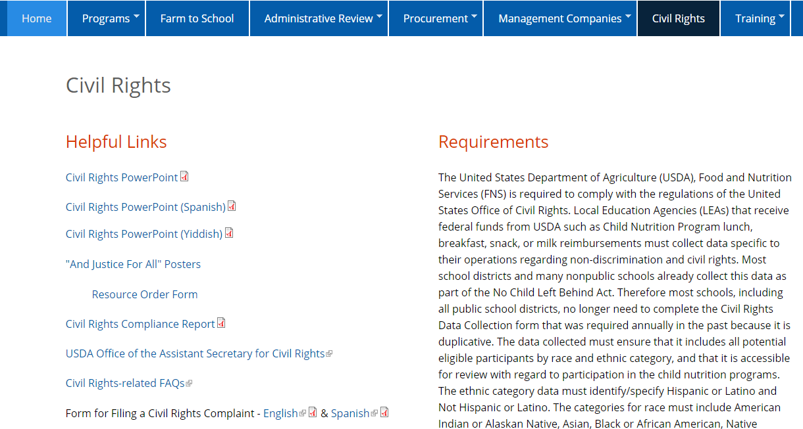
Review your Complaint Policy
Ensure all complaints of discrimination are forwarded to the USDA
Train staff on your complaint process
Review FNS 113-1
See USDA’s complaint form

Slide 10
Meal Modification Guidance
Refer to SP-59-2016, Policy Memorandum on Modifications to Accommodate Disabilities in the School Meal Programs
Review your policy and procedures

Slide 11

The expanded definition of DISABILTY:
Major Life Activities:
Seeing, hearing, walking, speaking, learning, eating, breathing
Major Bodily Functions:
Digestive Immune system, respiratory, circulatory, neurological/brain
Notes:
How a disability was previously defined- was as a person with a physical or mental impairment that substantially limits one or more major life activity.
The ADA Amendments Act of 2008 made important changes to the meaning and interpretation of the term “disability” . These changes were intended to make it easier for individuals to establish that they have a disability. After the passage of this Act, most physical and mental impairments will constitute a disability. The central concern for school food authorities should be working collaboratively with families to ensure equal access to Program benefits for children with disabilities.

Slide 12
Medical statement requirements
Statement :
Provides information about impairment-DIAGNOSIS NOT REQUIRED
States how diet is restricted
States how to accommodate condition
You may seek clarification:
Do not delay modification
Do not request medical records
Do not require note signed by physician, it may be signed by any State licensed healthcare professional
Notes:
SFAs must obtain a written medical statement from a State licensed health care professional in order to receive reimbursement for meal modifications when the modified meal does not meet the Program meal pattern requirements.
In addition, meals that do not meet the Program meal pattern are not eligible for reimbursement unless supported by a medical statement.
The written medical statement is no longer required to identify the specific disability, or to use the terms “disability” or “disabled” (though statements that use these terms are sufficient). Instead, the medical statement need only include a description of the child’s physical or mental impairment that is sufficient to allow the SFA to understand how it restricts the child’s diet. The medical statement should also include a description of what must be done to accommodate the child’s impairment.
Do not delay providing modification! SFAs should work with the child’s parent or guardian to obtain a supplemental medical statement.

Slide 13

Food Allergy medical statement
*Includes 3 essential components:
The food to be avoided (allergen)
Brief explanation of how exposure affects the student
Recommended substitute(s)
Notes:
An example of documentation is a medical statement that includes these 3 essential components:
The food to be avoided
Brief explanation of how exposure affects the student
Recommended substitute(s)
Remember, SFAs may receive reimbursement for a meal modification request without a medical statement when the accommodation can be made within the Program meal pattern. For example, if a child has a common allergy to one fruit or vegetable, the school food service can simply substitute another fruit or vegetable.

Slide 14
Assurance Statements
Agreements/ Contracts with a FSMC must contain a written assurance that the program or facility will operate in compliance with Civil Rights laws and regulations
FNS 113-1
SFAs are responsible for ensuring that their FSMC are in compliance with CR requirements
  *This language is already included in the NYSED FSMC prototype

Slide 15
QUESTIONS?
EMAIL : CNTRAINING@NYSED.GOV

