Slide 1
Community Eligibility Provision (CEP)
1 hour Professional Standards Training
Notes:
This PowerPoint will contribute 1 hour towards Professional Standards training requirements. This training reviews Community Eligibility Provision (CEP).
The Community Eligibility Provision is a counting and claiming alternative available to schools with high economic need. This Module will review what CEP is , the benefits of CEP, and how does an SFA qualify. In addition, you will receive an overview of the application process and look at the benefits of implementing CEP, even if your SFA does not qualify to receive 100% reimbursement at the free reimbursement rate.

Slide 2
Community Eligibility Provision (CEP)
The CEP is a viable and valuable alternative for the SFA/group of schools/individual school(s) in high poverty areas as it reduces the administrative paperwork and cost of operating Child Nutrition Programs, while making it easier for children to receive meals at school.
Must participate in National School Lunch and School Breakfast programs.
CEP enables the qualified School Food Authority(SFA)/group of schools to serve meals at no charge for 4 successive school years, with a potential of a 5th grace year.
All students in the qualified SFA/group of schools receive meals at no charge.
CEP eliminates the SFA’s need to conduct eligibility certification and verification processes and simplifies the process of claiming reimbursable meals in participating schools.
Notes:
The Community Eligibility Provision (CEP) is a counting and claiming alternative available to schools with high economic need. CEP is a wonderful opportunity that an eligible SFA, group of schools, or individual school should consider as it reduces administrative paperwork and costs, while making it easier for children in low income communities to receive meals at no charge in the National School Lunch and School Breakfast Programs. It also increases program integrity by relying on data from other means-tested certifications, such as SNAP and Medicaid.
CEP is a four year provision with a potential for a fifth grace year.
Those SFA/group of schools/individual school that qualify to participate agree to cover any excess costs for serving breakfast and lunch at no charge to all students with funds from other sources if they cannot sustain operations on CEP reimbursements received. If the reimbursement received from CEP covers the cost of serving all meals to all students, no transfer of funds is needed while ensuring the quality of the reimbursable meal.
Schools using CEP must participate in both breakfast and lunch.
All meals are provided to all students at no charge during all years of CEP participation.
Let’s look at how schools apply and qualify.

Slide 3
How to Apply
Applications must be based on April 1 enrollment and DCMP data (previous school year)
Application and attachments can be found on CNKC website
www.cn.nysed.gov
Be on the lookout in the Spring for the new application!
Notes:
Schools can apply for CEP in the spring of each school year.
The ISP must represent the number of identified students and the student enrollment as of April 1 of the school year, prior to CEP implementation. However, data matching counts which take place before or after April 1 should be reflective of the enrollment as of April 1.
For example: Sam Smith was enrolled in your school as of April 1 as a paid student. On May 15, you conducted DCMP using the April download. Sam Smith was found on the DCMP list as SNAP. Even though you did not conduct DCMP until May 15, Sam Smith was enrolled as of April 1; therefore, you would include him in your CEP application ISP.
Attachments found in the CEP memo include, the application, the most recent CEP Q and A, a reimbursement estimator, planning, and implementation guidance, as well as Title 1 and E-rate guidance.
Schools must retain records used in the development of the ISP during the entire period CEP is in effect. In addition, this documentation must be retained for three years after submission of the final claim for reimbursement under that claiming percentage. All other standard record keeping requirements (meal counts, production records, etc.) continue to apply.

Slide 4
How does an SFA/Group/Individual school(s) qualify?
Any school district can use this option if at least one of its schools has 40 percent or more students certified for free meals without application (called “Identified Students”)
The ISP is comprised of SNAP/Medicaid from the Direct Certification Matching Process(DCMP)/ NYSSIS & extensions, or Directly Certified through foster, homeless, migrant, runaway, Headstart, and Evenstart. A letter or list from a group home from students who are wards of the State may also be included.
HOW CAN AN SFA PARTICIPATE:
-By Individual School
With 40% or more Identified Students
-By Group
SFA’s may choose to group schools together any way they wish and calculate the Identified Student Percentage (ISP) for the group of schools as a whole, using combined enrollment and total number of Identified Students, as long as percentage is 40% or higher
No limit to number of groups
Within the same school district, some schools can participate individually and some can participate as a group
By entire SFA
All schools in the SFA participate as a single group with the same free claiming percentage as long as it is 40% or higher
Notes:
An eligible SFA may elect CEP on behalf of a single school, a group of schools, or by district as long as the identified students in that single school, group of schools or district is at least 40% of the total enrollment for that single school, group of schools or SFA.
There is no limit to the number of groups. Within the same school district, some schools can participate individually, and some can participate as a group.

Slide 5
Children certified for free meals without submitting a school meal application: Includes children who are directly certified (through data matching ) for free meals because they live in households that participate in the - Supplemental Nutrition Assistance Program (SNAP) -Temporary Assistance for Needy Families Cash Assistance (TANF) -Food Distribution Program on Indian Reservations (FDPIR) -Medicaid (only if identified as receiving Medicaid benefits from the Direct Certification Matching Process) -Includes children who are certified for free meals without application because they are In Foster care -In Headstart/Evenstart (Note : UPK programs are not categorically eligible and therefore not included in the ISP) -Homeless -Migrant -Child living in group home as a ward of the state
Who are Identified Students?
Notes:
CEP is available to SFA’s and schools with 40% or more “identified students” as of the April 1 enrollment data from the previous school year in which CEP will be implemented.
Identified students are those that are directly certified for free meals without a school meal application. Students can be directly certified for free meals through data matching because they live in households that participate in the following assistance programs: SNAP, TANF, FDPIR or Medicaid (this only includes those households identified as receiving Medicaid through the direct certification matching process), a child deemed homeless by the appropriate authorities such as the Homeless Liaison and/or State or local Migrant Outreach Coordinator; and a child living in a group home as a ward of the State.
Identified Students also include those students that are certified for free meals without an application because they are in foster care, in Head Start/Evenstart.
(Note: Universal Pre-K (UPK) programs are not categorically eligible and are not included in the ISP unless a student is directly certified by other means.)
Now that you understand how students are “identified” for CEP purposes, let’s start recording the data required for the application process.

Slide 6
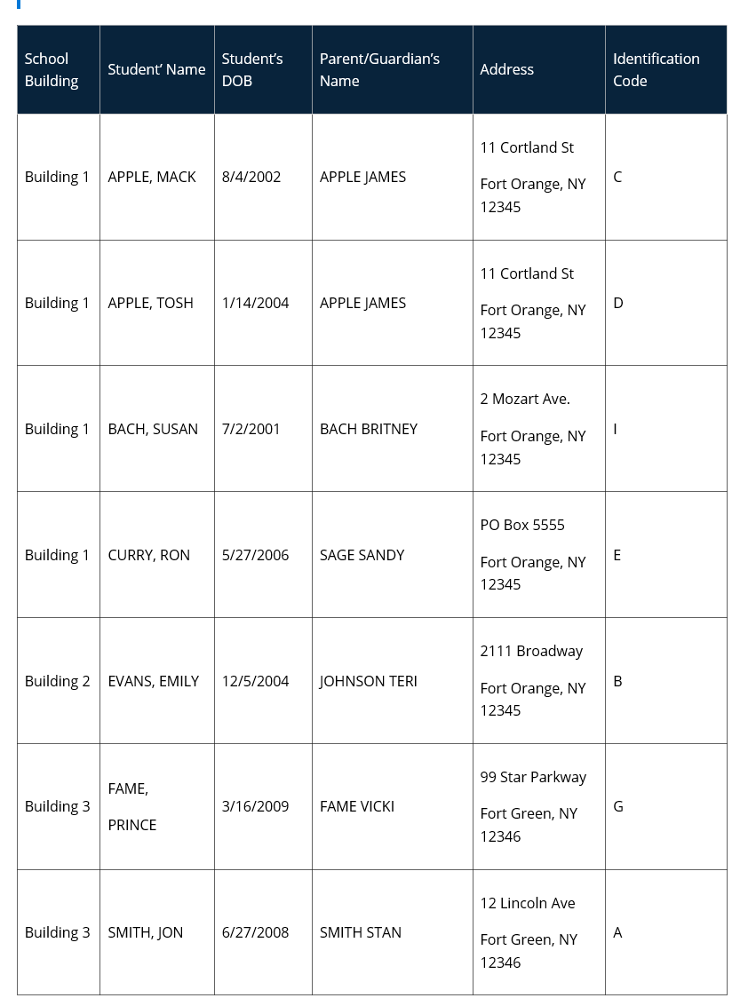
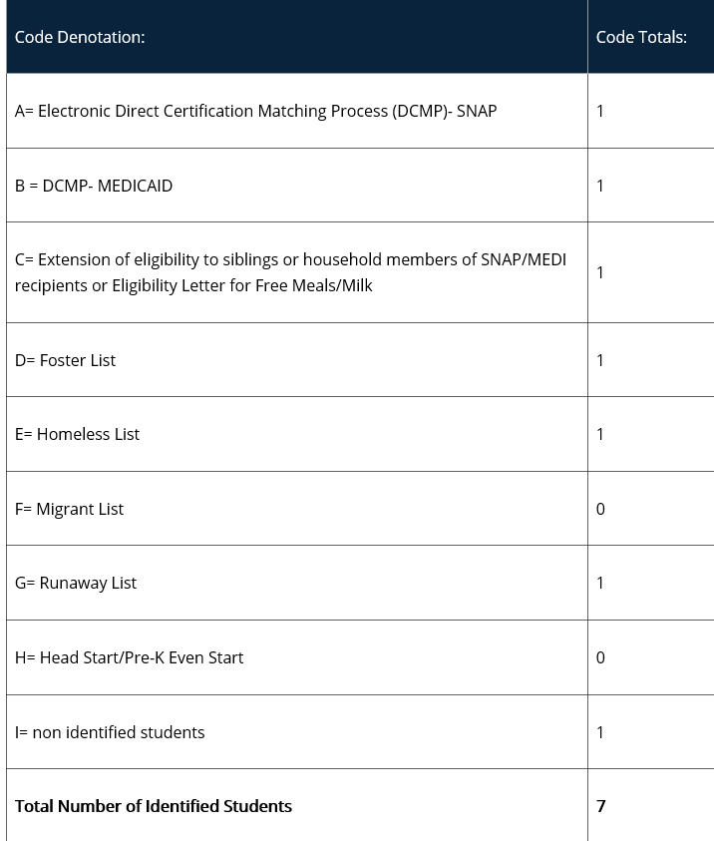
Sample Coded Student Enrollment Record/ Master List
This data should be organized by qualifying school building within the SFA. The enrollment record/master list must include ALL students and be coded to indicate which students were identified to be eligible for the CEP based on: SNAP/Medicaid Direct Certification Matching Process (DCMP), extension of direct certification eligibility to other household member, foster, migrant, runaway, homeless, and Head Start/Even Start
Exhibit B
Exhibit A
As of April 1st
Notes:
The SFA will be utilizing the enrollment data from April 1st of the year the school is completing the application in. This means the application process will not begin sooner than April 1st. When an SFA is approved, the Provision is applied to the following school year and is approved for a 4-year cycle. Any time during the 4-year cycle the SFA may opt out or if the SFA sees an increase in the ISP, the SFA may reapply and start a new cycle with the improved reimbursement rates.
Every student enrolled as of April 1st will be listed and the students will be coded to indicate whether or not they are identified and if they are identified: how were they identified to be eligible. The list must also include additional student identifiers, refer to the exhibit A on the slide.
This data should be organized by qualifying school building within the SFA.
The master list, in Excel format, will now allow you to obtain totals by identified category- refer to exhibit B on the slide.

Slide 7
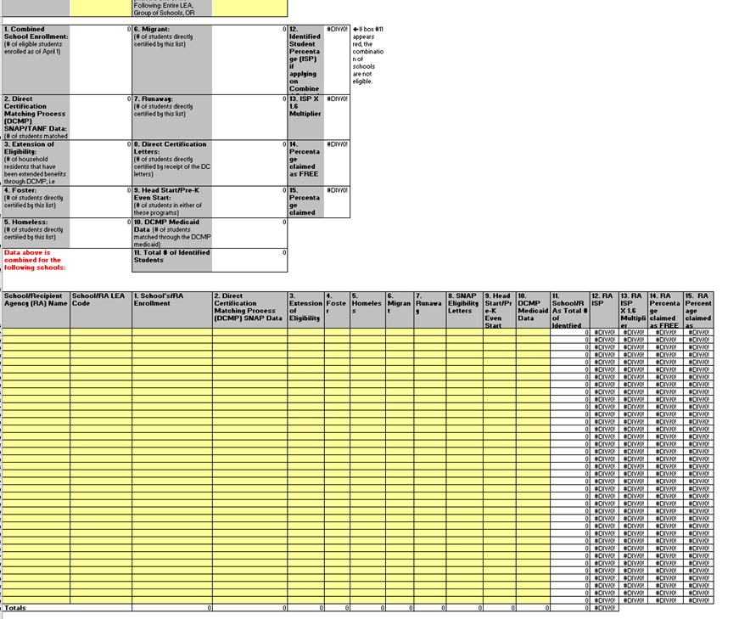
Complete the application utilizing the the Coded Enrollment List
Notes:
Complete the application utilizing the information from the coded enrollment list. Enter totals for each identified category by building.
Save the coded enrollment and the completed CEP application form to your computer. You will be submitting these files per the submission process procedures and will need to keep them on file for record retention requirements (3 years previous, plus the current year).

Slide 8
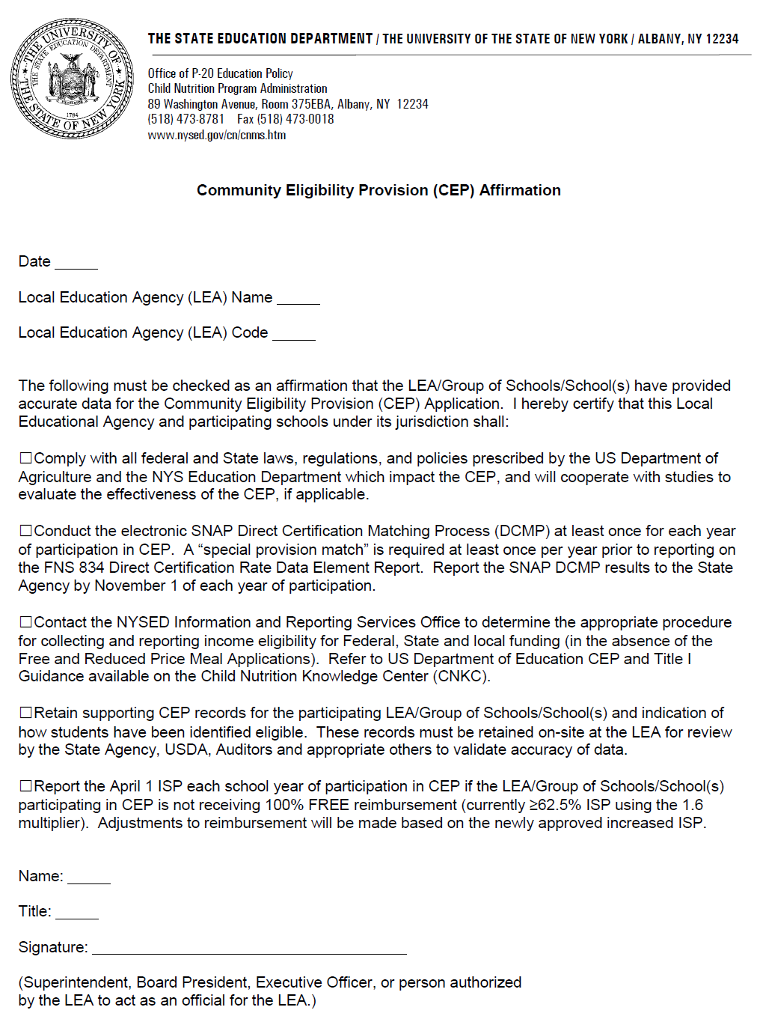
The CEP Affirmation must be signed, scanned, and submitted with the application. All boxes must be checked to be approved for the CEP.
Notes:
Since the CEP requires significant changes to the counting and claiming process and continues to require the SFA to collect eligibility information for other federal, State and local reporting purposes, a signed CEP Affirmation from the Superintendent or Chief Executive Officer agreeing to the terms must accompany the application.
Save a copy of the signed affirmation form along with the application and coded enrollment for record retention requirements.
Its time to look at the submission process.

Slide 9
Application Process
Application is a 2-step submission process has been put in place to ensure that data is securely transferred using a private and safe data stream.
Step 1- Submit the following 2 documents to: childnutceo@nysed.gov
A. The CEP Application Form (excel spreadsheet)
must be “saved as” to your computer prior to completing. Once it has been completed and saved, you can attach it to the email.
B. The Affirmation Form (pdf form)
must be scanned and attached to the email or sent through the mail because it requires a signature. All boxes must be checked to be approved for the CEP.
Step 2- Once your SFA has submitted the CEP Application and Affirmation, you will be sent an e-mail which will detail the steps you must take to create an account and access the secure server to upload your enrollment records/master list.
Notes:
A 2-step submission process has been put in place to ensure that data is securely transferred using a private and safe data stream. The CEP Application and Affirmation Form can be e-mailed to childnutceo@nysed.gov.
The enrollment records/master list must be uploaded to a secure NYSED GoAnywhere SFTP account; which your SFA will be provided access to once your application has been submitted.
Next, let’s look at how participating SFA’s are reimbursed.

Slide 10
Determining the Identified Student Percentage (ISP) and Reimbursement
Reimbursements in free and paid categories only
Reimbursements based on the CEP multiplier
ISP X 1.6 = Free Reimbursement
Remainder of reimbursement in paid category
SFA must provide additional funding from other than federal funds if operations cannot be sustained on CEP reimbursements
Participating schools are guaranteed to receive the same reimbursement rate (or a higher one if the Identified Student Percentage increases) for 4 years
Notes:
To determine the ISP, divide the number of identified students as of April 1 by the number of enrolled students and multiply by 100. ISP’s can not be rounded. A percentage of 39.98 does NOT meet the threshold. The CEP Application calculates these percentages for you.
The next chart illustrates some ISP’s and what the reimbursement rates would be.
CEP provides reimbursement in the free and paid categories only.
Reimbursements are based on the identified Student Percentage times a federal multiplier which is written into regulation as between 1.3-1.6. The federal multiplier is currently 1.6. The result of the ISP multiplied by 1.6 provides the level of free reimbursement, the remainder of the reimbursement is in the paid category.
For example, if a school has attained an ISP of 50 percent, they would receive reimbursements based on 50 times 1.6, which would equal 80 percent of reimbursements in the free category and the remaining 20 percent in the paid category. If a school can attain an ISP of 62.5 percent using the 1.6 multiplier, they will receive 100 percent reimbursements in the free category.
SFAs must provide funding from other non-federal funds if operations cannot be sustained on the reimbursements received. If the reimbursement received from CEP covers the cost of serving all meals to all students, no transfer of funds is needed.
School grouping could allow some schools with an ISP below 40% to participate as long as the group ISP is at least 40%. The ISP for a group of schools is calculated by taking the sum of the Identified Students for the group and dividing that # by the sum of the total student enrollment for that group of students.
New schools that will not have direct certification data from April 1 from the prior year, may instead use direct certification data from a later month to establish CEP eligibility. If the number of identified students and total enrollment are available before the counting and claiming of meals begins and the new school meets the eligibility requirements, then they may apply for participation in CEP. New schools can elect CEP only if the number of identified students and enrollment are available because the ISP is the basis for claims for reimbursement.

Slide 11
Meal Reimbursements with Community Eligibility
Percentage Identified Students | Percentage Free | Percentage Paid
40% | 64% | 36%
45% | 72% | 28%
50% | 80% | 20%
55% | 88% | 12%
60% | 96% | 4%
65% | 100% | 0%
The reimbursement rate for both lunch and breakfast is determined by multiplying the percent of Identified Students by the CEP multiplier (currently 1.6). The resulting number is the percent of meals reimbursed at the “free” reimbursement rate, with the rest reimbursed at the “paid” rate.
Notes:
This is a chart so that you can see what the reimbursement would be based on the ISP.
62.5% is the minimum ISP needed to get 100% reimbursement in the free category. There is no free reimbursement in excess of 100%.
Those LEA/group of schools/individual school that qualify to participate, agree to maintain the quality of the meal and cover any excess cost for serving breakfast and lunch at no charge to all students with funds from other sources than the non-profit food service account, if they cannot sustain operations on CEP reimbursements received.
Any funds other than Federal reimbursement available to the nonprofit school food service account may be used. Examples of non-Federal sources include, but are not limited to” any portion of State revenue matching funds that exceeds the minimum requirement established in 7CFR Part 210.17, profits from a la carte sales, cash donations, and in-kind contribution funds from outside sources, such as, volunteer services.

Slide 12
USDA Estimator Tool
Should our school participate and what would be the financial impact?
USDA’s Estimator Tool can help you access if CEP is your best option!
The tool compares estimated federal reimbursement under CEP to federal reimbursement received under the standard operating procedures.
Tool can be found on the CNKC website
Notes:
The USDA’s Estimator Tool can help assess the financial impacts of CEP by comparing an estimated federal reimbursement under CEP to the federal reimbursement received under standard operating procedures.
The tool can be found on the CNKC under Community Eligibility Provision.

Slide 13
Other situations to consider:
Does your community think feeding all of the students is a priority?
Does your school have high unpaid meal debt?
Would Program participation increase if all students were able to eat at no charge?
Notes:
When the USDA Estimator Tool is completed the school will be able to determine the financial implications that participating in CEP will have.
Keep in mind that even if the SFA will not be receiving 100% reimbursement at the FREE rate, CEP may still be a valuable option to consider.
Many school communities place a very high priority on feeding the kids. Even when the school qualifies at the very minimum of 40%, the community feels that the cost of making up the difference is not a burden but is an investment to the future of their community.
There are also numerous SFA’s that have very high unpaid meal debt. For SFA’s having high unpaid meal debt or if the debt keeps rising and the school finds it very difficult to budget for this unpredictable cost, CEP may be the answer. The cost of feeding all the kids under CEP may be less costly than the burden of unpaid meal debt and the cost of CEP is a more predictable and the school can more effectively budget for this cost.
Many schools find that when meals are served at no charge, Program participation rises. As participation rises Program revenue improves, which will offset some of the cost.

Slide 14
Benefits of CEP
Lessens administrative work
Schools no longer have to collect and verify school meal income applications and can focus on feeding children
Increases participation
When all children can eat at no charge, stigma is eliminated and more children participate
Improves efficiency
Schools don’t have to collect fees or count each meal served by category, simplifying implementation of service models that boost participation
Notes:
Schools implementing CEP have experienced great success, allowing them to make numerous improvements to their school nutrition programs including, but not limited to, less administrative work, increased participation, and more efficient meal service lines.

Slide 15
Counting and Claiming Meals
School counts only total reimbursable meals for breakfast and lunch
Recommend counting by student name or POS ID to ensure accuracy of claims
Must ensure no second meals claimed
Edit Checks
Non-reimbursable meals
Notes:
The schools using Community Eligibility Provision are exempt from categorical meal counts-only total meals for breakfast and lunch are required for claiming purposes. However, serving lines must be adequately supervised to confirm that all meals claimed for reimbursement meet meal pattern requirements and that reimbursement is only claimed for one meal/child/day.
Participation in CEP does not change the requirement to conduct edit checks. Similar to non-CEP schools, when an edit check is exceeded, schools must demonstrate why and apply corrective action if necessary.
USDA encourages schools to maintain an accurate Point of Sale(POS) system that has proven track record of reliability and security while taking advantage of CEP’s elimination of meal categories to streamline operations at the point of service.
While students may not be charge for reimbursable meals under CEP, schools may continue to charge students for non-reimbursable meals under CEP. Schools may continue to charge students for non-reimbursable meals through A La Carte sales. For example, if a student declines to select the required ½ cup fruit or vegetable necessary for a reimbursable meal or if a student chooses to take additional food items, the SFA may charge students on A La Carte basis, ensuring the requirements for non-program foods is maintained. If the school allows a student to take food for free; the cost is not an allowable cost to the non-profit food service account.

Slide 16
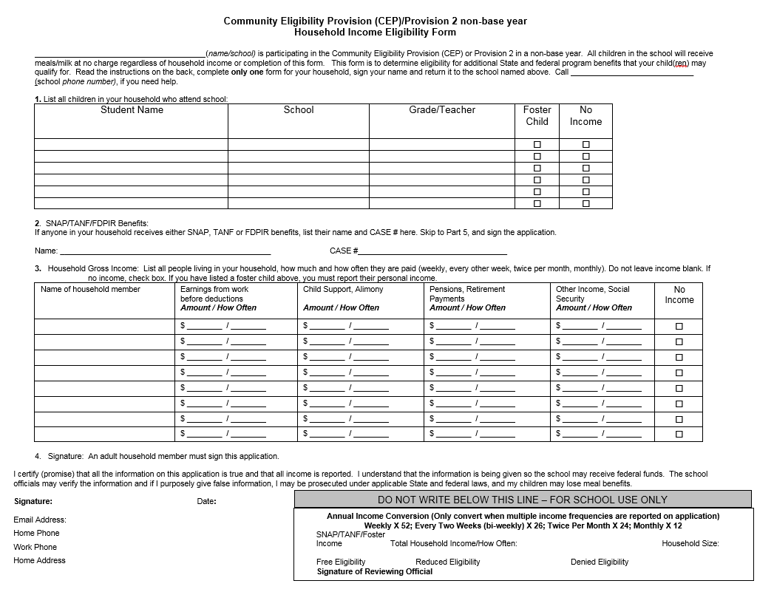
Alternate Income Forms/Notifying Households
Schools may collect family income information using an alternative collection form for other federal, stated, and local funding
These activities may NOT be charged to Child Nutrition Program funds
Modified Media Release and Parent Letter
Notes:
Since SFAs use the free and reduced price data as a proxy for poverty for many SFA functions, such as BEDS reporting, E-rate, and other local, state, and federal funding; SFAs may opt to collect family income data in addition to the required annual Direct Certification process for theses reporting purposes. While the Direct Certification process that is required each year for CEP reporting purposes is an allowable cost to Child Nutrition Program funds, the collection of income information from families is an activity that is not considered an allowable expense and therefore is not chargeable to Child Nutrition Program Funds.
Notifying households about CEP and explaining it’s benefits will help to minimize confusion about school meals. SFAs participating in CEP should use their usual channels of communication to notify the community of school meals that will be available at no charge to students regardless of income.
Our office will make this Alternate Income Inquiry form available for schools approved to implement CEP, along with the modified parent letter and media release. These documents are included as links on the CEP approval E-mail.

Slide 17
This concludes Community Eligibility Provision
New York State Education Department
Child Nutrition Program Administration
(518)473-8781
CN@nysed.gov
Notes:
Thank you. This concludes Community Eligibility Provision.
Remember to record completion of this training for Annual Professional Standards Training requirements.
If you have any additional questions, please do not hesitate to contact us.

