Slide 1
Accommodating Children with Disabilities
Child nutrition Program
Notes:
This PowerPoint will contribute 1 hour towards Professional Standards training requirements.
The National School Lunch Program and School Breakfast program aim to provide all participating children, regardless of background, with the nutritious meals they need to be healthy.
School Food Authorities (SFAs) must comply with the USDA regulation 7 CFR 15b Non Discrimination on the Basis of Handicap in Programs or Activities Receiving Federal Financial Assistance.
This includes ensuring children with disabilities have an equal opportunity to participate in and benefit from the National School Lunch and School Breakfast programs.
It is imperative that SFAs recognize the importance of ensuring access to meal benefits and understand their obligation to provide reasonable modifications for children with disabilities.

Slide 2
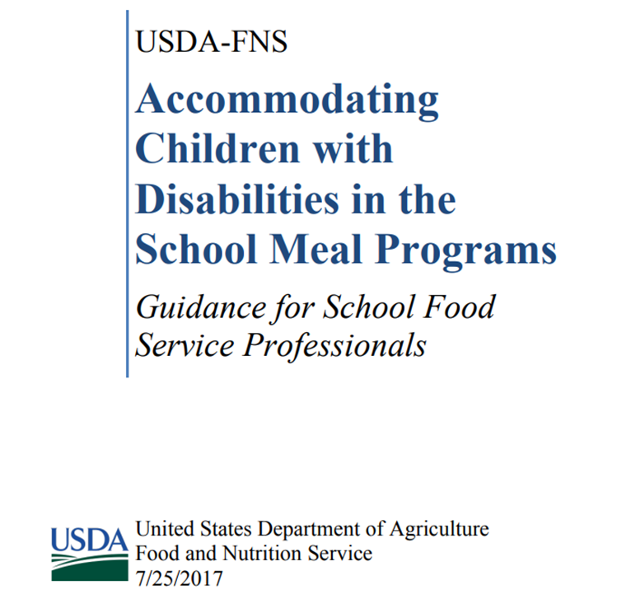
Guidance for School Food Service Professionals
National School Lunch Program
School Breakfast Program
Special Milk Program
Afterschool Snack Program
Fresh Fruit Vegetable Program
Notes:
This resource is designed to provide additional guidance for SFAs and can be found on our Child Nutrition Website.
This resource includes information about departmental requirements to modify polices, practices, and procedures to accommodate children with disabilities.,
As well as developing procedure safeguards for modification requests, making a modification to program meals or the meal service area, reimbursement for modified meals, the option to accommodate food preferences for children without disabilities and additional resources for SFAs that can be used in their efforts to build a safe, inclusive environment for children with disabilities.

Slide 3

DISABILITY
Disability means a physical or mental impairment that substantially limits one or more major life activities of such individual
Physical or mental impairments do not need to be life threatening to constitute a disability
Disability can be temporary and episodic and when it is active may limit major life activity
Health concerns or preferences that a child eat a specific diet because the parent/guardian believes it is healthier for the child are not disabilities and do not require a modification.
Notes:
After the passage of the ADA Amendments Act, most physical and mental impairments constitute a disability.
According to the ADA Amendments Act, the term disability means a physical or mental impairment that substantially limits one or more major life activities of such individual; a record of such an impairment; or being regarded as having such an impairment.
The ADA lists several examples of “major life activities” that may be impacted by a disability. The major life activities include(but are not limited to): caring for oneself, performing manual tasks, seeing, hearing, eating, sleeping, walking, standing, lifting, bending, speaking, breathing, learning, reading, concentrating, thinking, communicating, and working.
Physical or mental impairments do not need to be life threatening to constitute a disability. For example, a food allergy does not need to cause anaphylaxis in order to be considered a disability and require a meal modification, if it impacts a major life activity.
The child must be provided a reasonable modification if the disability is temporary or episodic, if when active will limit a major life activity. The question of whether a temporary impairment is a disability must be resolved on a case-by-case basis, taking into consideration both the duration of the impairment and the extent to which it actually limits the a major life activity of the affected individual.
However, health concerns such as a preference that a child eat a specific diet because the parent believes it is healthier for the child are not considered a disability and do not require a meal modification.

Slide 4

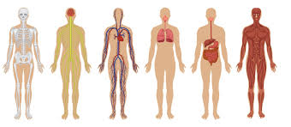
MAJOR LIFE ACTIVITIES
Major Life Activities
Major Bodily Functions
Caring for oneself
Performing manual tasks
Seeing, hearing, speaking
Eating, Sleeping, Walking
Standing
Lifting, Bending
Breathing
Reading, Learning, Thinking
Communicating
Working
Functions of the immune system
Normal Cell Growth
Digestive, Bowel, Bladder
Neurological, brain
Respiratory
Circulatory
Endocrine
Reproductive
Notes:
These are some examples of “ Major Life Activities” that may be impacted by a disability.
Major life activities include but are not limited to: caring for oneself, performing manual tasks, seeing, hearing, eating, sleeping, walking, standing, lifting, bending, speaking,
Breathing, learning, reading, concentrating, thinking, communicating, and working.
Significantly, this also includes major bodily functions such as functions to the immune system, normal cell growth, digestive system, bowel, bladder, neurological, brain and respiratory.
A food intolerance may be considered a disability if it substantially limits a major life activity.

Slide 5

MEDICAL STATEMENTS
SFAs must obtain a written medical statement signed by a State licensed health care professional in order to receive reimbursement for meal modifications when the meal modification does not meet meal pattern requirements.
The medical statements do not need to be received on a regular basis
The medical statement needs to be on file and updated as needed
Departmental regulations require recipients to notify participants, beneficiaries, and applicants that they do not discriminate on the basis of disability and to identify the individual responsible for providing the modification
Notes:
SFAs must obtain a written medical statement from a State licensed health care professional in order to receive reimbursement for meal modifications when the modified meal does not meet the program meal pattern requirements.
Schools may receive reimbursement for a meal modification request without a medical statement when the accommodation can be made within the program meal pattern. For example, if a child has a food allergy to an apple, the school food service can simply substitute another fruit.
Departmental regulations require recipients to notify participants, beneficiaries, and applicants that they do not discriminate on the basis of disability and to identify the individual responsible for providing the modification. SFAs are encouraged to make the process as straight forward and simple as possible.
SFAs must notify families of the process for requesting meal modifications. As part of the notification, SFAs should explain when parents need to submit supporting documentation for their child’s modification request.
SFAs are encouraged to include information about modification requests when sending out applications for free/reduced price school meals, post fliers near the cafeteria, include information about modifications in the student handbook, or post information on school district websites.

Slide 6

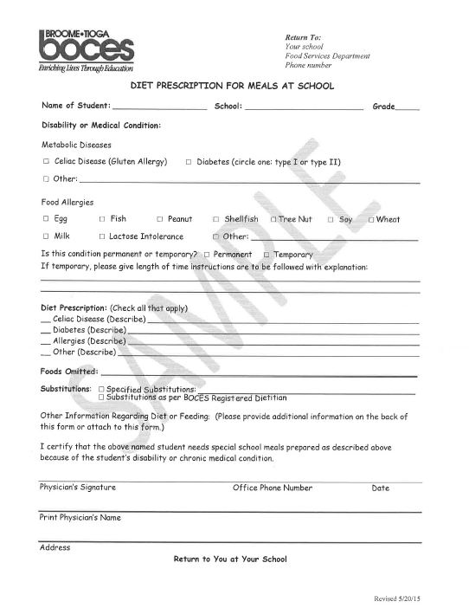
MEDICAL STATEMENTS
Medical statements must include:
Information about the child’s physical or mental impairment that is sufficient to allow the SFA to understand how it restricts the diet
Explanation of what must be done to accommodate the child’s disability
Food or foods to be omitted and recommended alternatives
If the medical statement is not detailed enough, SFAs should contact the parent or guardian for guidance
Notes:
When the medical statement is required because the modification does not meet meal pattern requirements, the medical statement must include information about the child’s physical or mental impairment that is sufficient to allow the SFA to understand how it restricts the child’s diet. It must also include, an explanation of what must be done to accommodate the child's disability and the food(s) to be omitted with recommended alternatives.
If the Child’s IEP or 504 plan includes the information required in the medical statement, or if the SFA obtains written medical verification of the impairment during the IEP/504 plan process, it is not necessary for the SFA to also obtain a separate medical statement.
The medical statement must include the signature of an individual who is authorized to write medical prescriptions under state law.
If the medical statement is provided and does not fully explain the modification needed, the SFA should immediately contact the child's parent or guardian and ask the family to provide an amended medical statement as soon as possible. However, clarification of the medical statement should not delay the SFA from providing the meal modification.
SFAs should retain copies of medical statements when making meal modifications.
SFAs generally should not decline to provide a meal modification to accommodate a child’s disability if the modification request is related to the child's physical or metal impairment and is supported by a medical statement. If a SFA declines a request, the SFA must, under the procedural safeguard requirements, ensure that the child’s parent understands their right to file a grievance, receive a quick equitable resolution of the grievance, request and participate in an impartial hearing to resolve the grievance, be represented by counsel at the hearing, and receive notice of the final decision and procedure for review, for example, right to appeal the hearings decision.

Slide 7

Food Allergies
90% of all food-based allergic reactions are from:
  Peanuts
  Milk
  Eggs
  Wheat
  Soy
  Tree Nuts(Almonds, Pecans, or Walnuts)
  Fish
  Crustacean Shellfish(Crab, Lobster, or Shrimp)
Notes:
When accommodating a child’s food allergy, no food item offered to the child may contain traces of substances that may trigger an allergic reaction. This means that food labels or specifications on food items which children with allergies will consume must be checked for allergens.
If a food label for a product served, does not provide adequate information, it is the responsibility of the school food service to obtain the information necessary to ensure no allergic substances are present.
The SFA must also provide the child with a safe environment to consume the meal. This includes ensuring proper storage, preparation, and cleaning techniques are used to prevent exposure to allergens through cross contamination, and may involve preparing separate meal “from scratch” using ingredients allowed on the modified diet rather than serving a meal using processed foods.
SFAs should not serve foods to children with severe food allergies if the full ingredient list of a food product is not available.
Common allergic reactions include:
Hives, Itching, or skin rash
Swelling of the lips, face, tongue, and throat
Wheezing, nasal congestion, or trouble breathing
Abdominal pain, diarrhea, nausea, or vomiting
Dizziness, lightheadedness, or fainting
To view the full list of reactions, please see Food Allergies in Schools
http://www.cdc.gov/healthyschools/foodallergies/index.htm

Slide 8

Food Service Role
Tracking Dietary Intake
Food Safety/Sanitation
Notes:
Some children may need to track their dietary intake. For example, diabetic children must track their carbohydrate intake. To accommodate a diabetic child, a medical statement may require a SFA to provide nutritional information for food options made available to the child.
The SFA is not required to provide all nutrition information for all program meals. SFAs can develop a cycle menu with the child’s parent or guardian, and the nurse. Nutrition information can be made for just the food on the cycle menu as opposed to all foods offered in all programs.
It is important to ensure school food service professionals understand the potential severity of even a small amount of exposure to a food allergen and the role proper food handling and sanitation play in a potentially life threatening situation.
Including a Food Allergy Action Plan in the Food Safety Program can help school food service professionals and others who are present when food is served to prevent food related emergencies.

Slide 9

Special Circumstances
Portion Sizes
Brand Name Requests
Offer vs. Serve
Procurement of Special Meals
Notes:
A modification request may include portion sizes exceeding the minimum quantity requirements set forth in Program regulations. When specifically prescribed in the medical statement, the SFA must provide the child with larger portions. SFAs will not receive any additional reimbursement to cover the extra costs associated with providing extra food.
In some situations, a medical statement may request a particular brand name of a product as a substitute on the medical statement. If a modification request indicates a brand name item, a generic brand is sufficient, unless a brand name item is medically necessary. This can be determined through the interactive process with the child’s parent or guardian.
Offer vs. Serve allows children to decline some food components or food items, as long as their meal meets certain requirements. At SFAs who participate in Offer vs. Serve, children with disabilities must have the option to select all food components/items made available to other children. SFAs cannot a child’s disability by asking the child to exclude a food component/item from their selection. The SFA may not use Offer vs. Serve to eliminate a specific food component for a child with disability.
Federal regulations specifically prohibit disability discrimination through contractual means, including vended/Food Service Management Company contracts. As applicable, modifications for children with disabilities must be included in the FSMC contract.

Slide 10

Fluid Milk Substitute Nutrient Requirements
Nutrient | 8 Fluid Ounces
Calcium | 276 mg
Protein | 8 g
Vitamin A | 500 IU
Vitamin D | 100 IU
Magnesium | 24 mg
Phosphorus | 222 mg
Potassium | 349 mg
Riboflavin | 0.44 mg
Vitamin B-12 | 1.1 mcg
Notes:
Fluid Milk substitutions must meet FNS nutrient requirements listed above. SFAs will not received Federal reimbursement for a meal that substitutes juice or water for milk for a non disability reason.
If a child’s medical statement indicates the child cannot consume milk due to a disability and requests the child receive a substitute, the SFA must provide the requested substitute regardless of whether it meets the nutrient requirements.
In a disability situation, the SFA will continue to receive reimbursement for the meal based on the signed medical statement.

Slide 11

Procedural Safeguards and Training
SFAs must have a procedure in place to ensure parents know how to request a meal modification and how to file an grievance if a requested modification is not granted
Must include:
  How to file a grievance
  Receive a prompt and equitable resolution
  Request and participate in an impartial hearing to resolve the grievance
  Must be represented by counsel at the hearing
  Examine the record
  Receive notice of the final decision and procedure for review
Notes:
SFAs must have a procedure in place to ensure parents/guardians know how to request a meal modification for their child and understand the right to examine the record and file a grievance in situations where a requested modification is not granted.
SFAs must provide a process for the prompt resolution of grievances that includes the option for an impartial hearing. This procedural safeguard process requires SFAs to provide notice and information to families regarding how to request a reasonable modification.
The notice must explain the families procedural rights which include: File a grievance if they believe a violation has occurred regarding the request for a reasonable modification, receive a quick resolution of the grievance, request and participate in an impartial hearing to resolve the grievances, be represented by counsel at the hearing, examine the record, and receive notice of the final decision and procedure of the review. For example the right to appeal the hearing decisions.

Slide 12
Resources
http://www.fns.usda.gov/policy-memorandum-modifications-accomodate disabilities-school-meal-programs.
SP 26-2017: Accommodating Disabilities in the School Meal Programs: Guidance and Questions and Answers (Q and As)
http://www.fns.usda.gov/school-meals/accommodating-disabilities-school-meal-programs-guidance-and-qas.
Notes:
USDA issued memo SP: 59 2016, which replaced FNS Instruction 783-2, Rev. 2: Meal Substitutions for Medical or other Special Dietary reasons as the instruction relates to the School Meals programs.
This memo requires SFAs to make reasonable modifications to accommodate children with disabilities. This includes providing special meals, at no extra charge, to children with a disability which restricts their diet.
Additionally , on May 1, 2017, FNS issued SP 26-2017: Accommodating Disabilities in the School Meals Programs: Guidance and Questions and answers. The Q and A’s discuss relatively common situations which have raised questions in the past and provide direction for SFAs working to ensure children with disabilities have an equal opportunity to participate in the School Meals Programs.

Slide 13

Child Nutrition Program Administration
(518) 473-8781
cn.nysed.gov
cntraining@nysed.gov
Notes:
If you have any questions please contact your Child Nutrition Program Representative or a member of the Training Team.

