Slide 1
2015 Professional Standards and Policy Webinar
New York State Education Department Child Nutrition Program Administration

Slide 2
Regulatory Authority
7 CFR
Part 210– National School Lunch Program
Part 215– Special Milk Program
Part 220– School Breakfast Program
Part 235– State Administrative Expense
Part 245– Free and Reduced Price Eligibility
Part 3016- Procurement for Public & Charter Schools
Part 3019- Procurement for Non-Public Schools
Part 3052- Audit Requirements
Public Law 111-296 (Healthy, Hunger-Free Kids Act of 2010)
2 CFR Chapter I, and Chapter II, Parts 200, 215, 220, 225, and 230- Uniform Administrative Requirements, Cost Principles, and Audit Requirements for Federal Awards; Final Rule
Supersedes and streamlines requirements from OMB CIRCULARS A-87; A-122
All USDA, SED guidance, memos, and instructions
Notes:
We just want everyone to be aware of the program regulations listed on the screen. These are the Federal and state regulations, policies, instructions and memos that govern the Child Nutrition Programs and are important for you to familiar.

Slide 3
Professional Standards
Minimum Hiring Standards
Continuing Education

Slide 4
Professional Standards for State and Local Nutrition Program Personnel (Final Rule)
Effective July 1, 2015
This webinar will contribute up to 1 Training Hour toward the Professional Standards training requirements
Required to track the number of training hours earned each year and maintain documentation of the trainings attended
SED prototype tracking excel document for School Nutrition Directors
USDA Learning Topic Codes: 3400 and 3430
Notes:
USDA has established minimum professional standards requirements for school nutrition professionals who manage and operate the National School Lunch and School Breakfast Programs.
The standards, another key provision of the Healthy, Hunger-Free Kids Act of 2010 (HHFKA), aim to institute minimum education standards for new State and local school nutrition directors as well as annual training standards for all school nutrition professionals. These new standards will ensure school nutrition personnel have the knowledge, training and tools they need to plan, prepare, and purchase healthy products to create nutritious, safe, and enjoyable school meals.
Professional Standards for State and Local Nutrition Program Personnel Final Rule became effective July 1, 2015.
The Final Rule requires all school food service personnel to complete annual continuing education/training requirements. The number of required training hours varies depending on the position of the school food personnel.
This webinar will contribute up to 1 Training Hour toward the professional standards training requirements.
You are required to track the number of training hours you earn each year and maintain documentation of the trainings that you have attended. Our office has developed a simple excel document that you may use to do this. SFAs may use this excel document to track staff training hours and may add columns and other necessary information specific to the SFA. Our tool may be found within the Professional Standards training memo located on the Child Nutrition Knowledge Center. You may also use the USDA’s version or your own tracking method to track staff training hours.
If you are using USDA Learning Topic Codes, the topic codes for today’s Professional Standards and Policy webinar are 3400 – Human Resources and Staff Training, 3430- Develop employee training plans, including a plan for tracking training.

Slide 5
Professional Standards
Hiring standards for new Directors hired after 7/1/15
Based on SFA enrollment
Current directors are grandfathered in
If a director moves to a larger category SFA, the director must meet the hiring standards for the larger SFA prior to being hired.
All SFAs MUST have a representative from the SFA acting in the program director capacity
Notes:
Minimum hiring standards are only for Food Service Directors hired after 7/1/2015. All hired prior to 7/1/2015 are grandfathered in. However, if the FSD moves to a larger SFA category, the grandfathered director MUST meet the hiring standards established for the larger SFA prior to hiring.
School nutrition program directors are those individuals directly responsible for the management of the day-to-day operations of the school food service for all participating schools under the jurisdiction of the SFA.
When the director is responsible for multiple SFAs, include the enrollments of all SFAs the director is responsible for. For example, if a director is responsible for four SFAs with enrollments of 1,000, 4,000, 3,000 and 2,000 – for a total cumulative enrollment of 10,000, then the director would be required to meet the standards for the SFAs with 10,000-24,999 student category.
The October enrollment should be used when assessing the SFA size to identify the appropriate hiring standards.
If the individual is hired to perform more than one school nutrition job, the hiring standards for the higher level position will apply. For example, if the individual is hired in the cook/manager title but is responsible for the overall administration of the federal programs, this individual would be required to meet the standards established for the school nutrition program director.
If an individual will serve in two completely different capacities, such as principal and school nutrition program director, the minimum hiring standards for the appropriate SFA size still apply.
SFAs who receive meals from a vendor must still employee a food service director who meets the hiring standards.
Consultants are not required to meet the final rule standards. However, it is in the best interest of the SFA to include desired education requirements, a level of experience in the operation of one or more federal nutrition programs and relevant food safety training in their contract specifications for procuring a consultant.
SFAs have the discretion to develop their own professional standards should they wish to do so, as long as such standards are not inconsistent with the minimum standards established by USDA. For instance, an SFA may choose to consider additional factors such as State certifications as an aspect of the required professional standards criteria.
SED also has the discretion to approve the employment of a candidate that meets the minimum education requirements but has less than 3 years experience in buildings with less than 500 students on a case by case basis.

Slide 6
Pop Quiz
True or False?
Minimum hiring standards are only for Food Service Directors (FSDs) hired after 7/1/2015. All hired prior to 7/1/2015 are grandfathered in. However, if the FSD moves to a larger SFA category, the grandfathered director MUST meet the hiring standards established for the larger LEA/SFA prior to hiring.
Notes:
It is now time to test your knowledge regarding hiring standards. There will be six polling questions throughout that are either true or false or multiple choice. When a poll is opened on the right side of your screen you will have about thirty seconds to answer each question. Remember to click “submit” to make your selection.
True or False?
Minimum hiring standards are only for Food Service Directors (FSDs) hired after 7/1/2015. All hired prior to 7/1/2015 are grandfathered in. However, if the FSD moves to a larger SFA category, the grandfathered director MUST meet the hiring standards established for the larger LEA/SFA prior to hiring.
The answer is True

Slide 7
Pop Quiz
What month should be used when assessing the LEA size to identify the appropriate hiring standards?
September
October
May
July
Notes:
What month should be used when assessing the LEA size to identify the appropriate hiring standards?
September
October
May
July
The answer is October

Slide 8
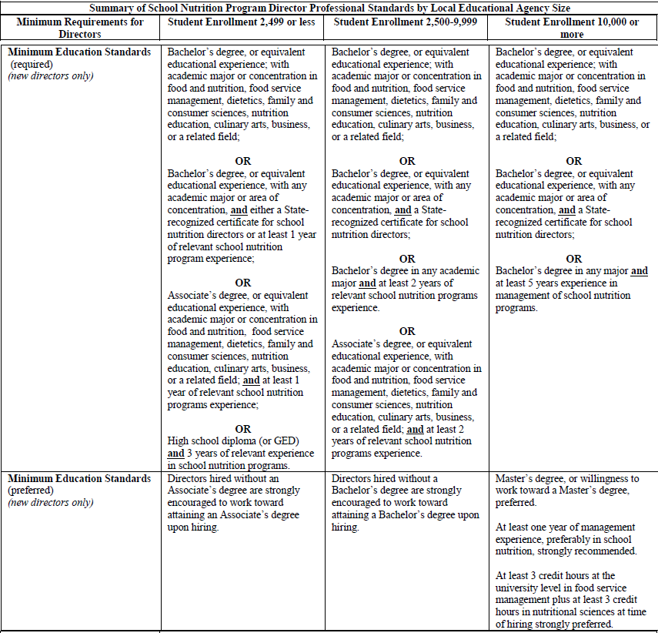
Notes:
This summary chart is included as a resource. To print or save this, go to File at the top of your screen and select “Transfer”. Click on the file that appears in the file transfer screen and select “Download” to open the zipped file and to print or save the files to your computer. This chart is also available in the Professional Hiring Standards memo available on the Child Nutrition Knowledge Center.

Slide 9
Professional Standards
Training requirements for directors
Prior To Hiring: new directors must have at least 8 hours of food safety training within five years prior to their start date or within 30 calendar days after their start date
SY 2015-2016 ONLY: at least 8 hours of annual continuing education/training
This is in addition to the food safety training required in the first year of employment.
Beginning SY 2016-2017: at least 12 hours of annual continuing education/training
Recommended Training Topics:
Administrative practices (including training in application, certification, verification, meal counting, and meal claiming procedures), and
any specific topics required by USDA, as needed, to address Program integrity or other critical issues.
Notes:
These are the training requirements for directors. These training requirements are in addition to the food safety training required for new directors.
New directors must have at least 8 hours of food safety training either not more than 5 years prior to their starting date or completed within 30 calendar days of the employees start date.
As stated previously, school nutrition program directors are those individuals directly responsible for the management of the day-to-day operations of the school food service for all participating schools under the jurisdiction of the SFA
Please be aware that the number of hours of annual training increases from 8 to 12 hours beginning in the 2016-17 SY.

Slide 10
Pop Quiz
For the 2015-16 School Year, food service directors must have how many hours of continuing education/training?
4
6
8
12
Notes:
For the 2015-16 School Year, food service directors must have how many hours of continuing education/training?
4
6
8
12
The answer is 8

Slide 11
Professional Standards
Training requirements for managers
SY 2015-2016 ONLY: at least 6 hours of annual continuing education/training
Beginning SY 2016-2017: at least 10 hours of annual continuing education/training
Recommended Training Topics:
Administrative practices (including training in application, certification, verification, meal counting, and meal claiming procedures),
The identification of reimbursable meals at the point of service.
Nutrition, health and safety standards, and
Any specific topics required by USDA, as needed, to address Program integrity or other critical issues.
Notes:
These are the training requirements for School Nutrition Program Managers. Managers are those individuals directly responsible for the management of the day-to-day operations of school food service for a particular school or schools. This may include, for example, those individuals who prepare and serve meals, process transactions at the point of service, and review free and reduced price applications.
Again, please be aware that the number of annual training hours increases from 6 to 10 hours beginning in the 2016-17 SY.

Slide 12
Pop Quiz
True or False?
Food Safety training is an additional requirement for new Food Service Directors?
Notes:
True or False?
Food Safety training is an additional requirement for new FSDs?
True

Slide 13
Professional Standards
Training requirements for staff (work >20 hours/week)
SY 2015-2016 ONLY: at least 4 hours of annual continuing education/training
Beginning SY 2016-2017: at least 6 hours of annual continuing education/training
Part-Time Staff (work <20 hours/week)
Each year, at least 4 hours of annual continuing education/training, regardless of the number of part-time hours worked.
Volunteers
SA discretion
Required Civil Rights training
Recommended Training Topics:
Free and reduced price eligibility, Application, certification, and verification procedures,
The identification of reimbursable meals at the point of service.
Nutrition, health and safety standards, and
Any specific topics required by USDA, as needed, to address Program integrity or other critical issues.
Notes:
Here are the training requirements for School Nutrition Program staff. These staff are those individuals without managerial responsibilities who are involved in the day-to-day operations of the school food service for a participating school or schools.
For all directors, managers and staff, if hired January 1 or later, an employee must only complete half of the required training hours for that school year.
Required training for volunteers was not established in the Final Rule but allows for State Agencies to extend the trainings to these employees. SED is requiring that at a minimum, volunteers participate in the required Civil Rights training that is available on the Child Nutrition Knowledge Center. However, SED encourages all employees, including volunteers to participate in job-specific training.
If the SFA contracts with a FSMC, the SFA directors must ensure that the FSMC employees providing services for the school meal programs have the required annual training.
Training standards to not apply to staff of the vended meal provider (for example, a commercial entity off-site from the school food service that provides meals). However, the SFA director must ensure that vendors providing meals for the school nutrition programs have the knowledge and skills to supply safe and nutritious meals that meet the meal pattern requirements and dietary specifications.

Slide 14
Pop Quiz
True or False?
Staff that work less than 20 hours are not required to meet annual continuing education/training
Notes:
True or False
Staff that work less than 20 hours are not required to meet annual continuing education/training
The answer is False, staff that work less than 20 hours must meet annual continuing training requirements.

Slide 15
Professional Standards
General Training Requirements for Directors, Managers and Staff
Four key areas:
Nutrition
Operations
Administration
Communications/Marketing
In a variety of formats
Virtual/web-based and in-person
Including free or low-cost options
From a variety of sources
USDA
NFSMI
Professional Associations and organizations
In-house
State
Commercial vendors
Notes:
The minimum standards for annual continuing education are for all Food Service Directors, Food Service Managers and Food Service Staff beginning 7/1/2015.
USDA plans to create a certificate program that includes four core areas of focus, namely, nutrition, operations, administration, and communications/marketing
These trainings will target areas beneficial to each school food service staff title. For example, a director position may need to receive additional training in menu planning, standard operating procedures for ordering, receiving and storage, purchasing, compliance with accommodating students with special dietary needs, etc., while food service staff who work as cooks/servers may need training in receiving and storage, point of service cashiering, food production, and serving food. It is intended that all staff will receive food safety training.
USDA will be providing additional funding to one or more food service management organizations such as the National Food Service Management Institute to assist with the development and management of training and certification.
It is USDAs intent to provide this continuing education training in a variety of formats, including both virtual/web-based and in-person sessions. Such trainings would include free or low-cost options for States and SFAs.
In SY 2015-2016: Training received three months prior to July 1, 2015, counts toward the first year’s training requirements for all SFA personnel

Slide 16
Database of Professional Standards Trainings
http://professionalstandards.nal.usda.gov/
Notes:
This is the comprehensive Professional Standards Web site provides a database of training options. School nutrition staff can search for training that meets their learning needs in one easy-to-use location.
Each key area drills in to specific topics and learning objectives within each topic that is shown on the next slide

Slide 17
Notes:
Once you select the key area, in this example, we selected “Nutrition”, you will see the key topics within that area and training subjects.
Each Key Area has several Key Topics and specific training subjects with objectives that will assist those who are planning or taking training. These same categories are used in the on-line database of trainings as well as in the optional downloadable Tracking Tool.
Allowable training should focus on the day-to-day management and operation of the school nutrition programs. As a guide when planning your training, use the list of key training areas and topics
Training must be job-specific and intended to help employees perform their duties well. Training needs are best assessed by an employee in consultation with their manager, the SFA director, or the State agency. Employees should always seek guidance from a supervisor before taking a specific training course to meet the professional standards requirements.
School nutrition program personnel may carry over excess annual training hours to an immediately previous or subsequent school year and demonstrate compliance with the training requirements over a period of two school years, provided that some training hours are completed each school year.

Slide 18
Professional Standards
Training Costs
Allowable expense to the non-profit school food account
Costs must be reasonable, allocable and necessary
Costs incurred to meet the educational criteria necessary to be hired as a new director are not allowable
Cannot pay any cost associated with obtaining college credits
http://professionalstandards.nal.usda.gov
Notes:
Training costs are an allowable expense to the non-profit school food service account. The costs must be reasonable, allocable and necessary.
Again, SED will be providing free training in the format of webinars throughout the year.
SFAs are encouraged to access the free or low-cost training resources listed at the website listed above.
Costs incurred to meet the educational criteria necessary to be hired as a new director are not allowable. Costs associated with obtaining college credits can not be paid out of the non-profit school food service account.

Slide 19
Professional Standards
SFA must ensure compliance
Maintain documentation
SED Tracking Tool Link
USDA Tracking Tool
http://www.USDA.usda.gov/school-meals/professional-standards
SED will monitor compliance during Administrative Review
Notes:
SFAs must maintain a recordkeeping system that annually documents compliance with the professional standards requirements for all school nutrition program employees.
Documentation must be adequate to support to the State’s satisfaction during administrative or other program reviews , that all employees are meeting the minimum professional standards.
At a minimum the SFA would review employee education/training progress periodically throughout the year and certify employee compliance no later than the end of each school year.
USDA expects to provide prototype tools that will assist SFAs in maintaining this recordkeeping system.
Professional standards will be added to the general areas of the Administrative Review Process. State agencies would be required to ensure that the SFA complies with the professional standards for nutrition program directors, managers and food service personnel.

Slide 20
Future Trainings
Administrative Reviews
Webinar Wednesdays
Master Instructors
Notes:
SED will be conducting webinars for schools scheduled for an administrative review on September 16th , September 24th and October 8th. We will post more information on our website in the near future. We will also be posting schools who are scheduled for administrative review on our website shortly.
Next week, on September 2nd, SED will be conducting a Procurement webinar.
Starting in November and throughout the school year, SED will be providing webinars on Wednesdays once or twice each month. Again, more information will be posted to our website.
SED is currently working to develop a Master Instructor Network. Our goal is to develop a network of trained instructors throughout all geographic areas of the State who can provide training on a variety of topics to School Nutrition Program Staff. The first trainings that will be available through the Network will be in food safety. Future Network training topics will be menu planning; production records and standardized recipes; and merchandising and marketing.

Slide 21
SED Policies
FEIN Numbers
DUNS #
Health and Safety
Record Keeping
MEDI/SNAP Reporting
Notes:
Now we will switch gears and update everyone of some important SED policies.

Slide 22
Federal Employer Identification Number (FEIN)/ Data Universal Numbering System (DUNS Number)
The legal entity name and FEIN number must be consistent with the organizations 501c3 provided to SED for participation in CN programs.
If applicable, provide supporting documentation that links the DBA to this same FEIN number.
All Agencies must have a DUNS Number
Register with the Federal System for Award Management (SAM)
Renew annually
Failure to comply with these requirements may delay the awarding of funds and/or payments through NYSED and may jeopardize future program participation.
Notes:
The FEIN is your agency’s 9 digit federal employer identification number, often referred to as the tax identification number or TIN.
Organizations receiving federal funding for multiple CN programs must do business using the same legal name that corresponds with the FEIN number for all CN programs. This legal entity name and FEIN number must be consistent with the organizations 501c3 provided to SED for participation in CN programs.
Furthermore, the same legal corporate name with the same corresponding FEIN number in which the sponsoring organization is doing business with SED for CN program operations is required to incur program costs. Supporting documentation should be under this same FEIN number for workers compensation, disability insurance, A-133 audits, banks accounts and bills.
Organizations operating with a DBA must be able to provide on request, supporting documentation that links the DBA to this same FEIN number that the organization is doing business with SED.
Also, in order to receive Federal funds from the NYS Education Department, all agencies must register for a Data Universal Numbering System (DUNS Number). The DUNS Number is a 9 character number issued by Dun & Bradstreet that identifies your agency. It is used by the federal government to track how federal grant funds are allocated & expended by NY State, the State Education Department, and local agencies.
Once you receive a DUNS number, you need to register with the Federal System for Award Management (SAM) and complete a new Payee Information Form. You must renew your agency’s registration in the SAM system annually
Please be advised that failure to comply with these requirements may jeopardize reimbursement and/or participation in the Child Nutrition Programs.

Slide 23
Health and Safety
Applying for a Department of Health and Mental Hygiene permit does not satisfy the regulatory requirements of other city and state agencies. It is your responsibility to apply for all other permits, licenses, and authorizations as required by other city and state agencies. The issuance of a Department of Health permit does not grant permission to use or occupy the permitted premises.
Please ensure that all buildings operating under your SFA’s jurisdiction are in compliance with the New York State Sanitary Code for Food Service Establishments which can be accessed at: http://www.health.ny.gov/regulations/nycrr/title_10/part_14/subpart_14-1.htm
A school found to be operating without the necessary health, safety and sanitation permits will be placed on withhold and may be subject to fiscal action
Notes:
[Read Slide]

Slide 24
Recordkeeping
SFA records shall be retained for a period of 3 years after submission of the final claim for reimbursement for the fiscal year to which they pertain. However, if audit findings have not been resolved the records shall be retained beyond the 3 year period as long as required for resolution of the issues raised by the audit.
Please be advised that these records must be readily retrievable or immediately available upon request.
The record retention policy will be available on the CNKC in the near future.
Notes:
[Read Slide]

Slide 25
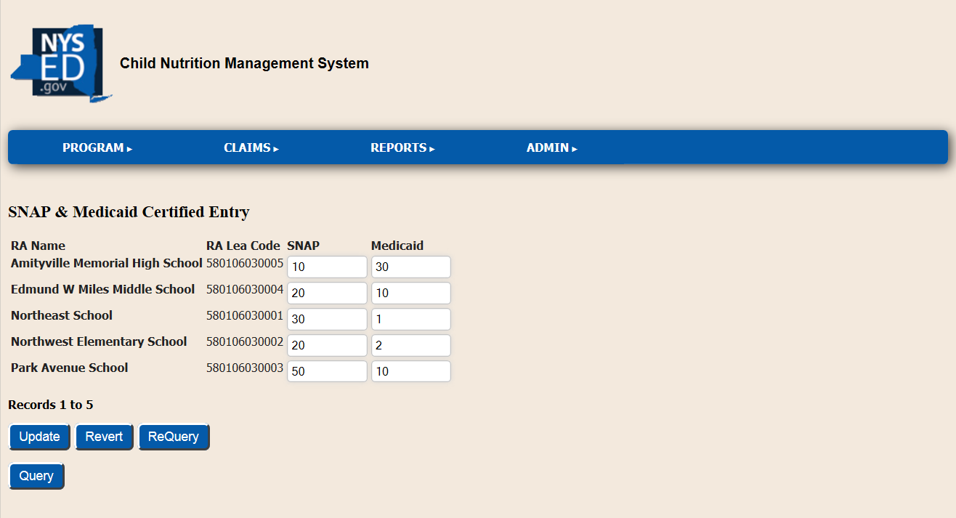
Direct Certification Data Reporting
Prior to submission of the September claim, SFAs must report the number of students directly certified through the August DCMP on CNMS
Reported by Recipient Agency
SNAP & Medicaid reported separately
Notes:
New this year- SFAs must report the number of students directly certified by recipient agency to SED prior to submitting their September claim for reimbursement. This information will only be reported on the September claim annually.
The DCMP is now available on the Child Nutrition Knowledge Center.
SFAs will report this information through CNMS. The screenshot on the slide shows what you will see when you enter this information
SFAs will be required to report the number of students identified through the August DCMP match by recipient agency including extension of benefits. The data must be broken down by the number of students receiving snap and the number of students receiving Medicaid.
It is extremely important that your SFA maintain this information to ensure accurate data is reported. If you use an electronic point of sale system to conduct the DCMP- ensure it is designed to capture the number of SNAP students separately from the number of Medicaid students
* If your SFA has more than 50 recipient agencies, we will be collecting this information separately

Slide 26
New SFA and RA Application Process
Updated Forms
New Deadlines
New SFA’s- September 1
New RA’s- 2 enrollment periods
July 1-September 1 & December 1- February 1
Training Requirements for New SFA’s
Notes:
The process for New School Food Authorities (SFA’s) and Recipient Agencies (RA’s) has changed. Forms have been updated and additional documents are required to be submitted with all applications. New deadlines have been established.
The New SFA Application Process as well as the RA application process is two-fold. The first step in the approval process requires SED to review the organization’s application and supporting documentation to determine whether the organization is eligible for participation. The next step will require, for all new SFA’s and may require for all new RA’s, SED to perform a new program pre-operational visit to ensure that the organization has the administrative and financial capability to operate CNPs in accordance with program requirements.
Potential new SFA’s are required to review PowerPoint presentations as part of the New SFA process. Training requirements may change as SED develops additional continuing education training in a variety of formats.
In order to be considered for participation, a School Food Authority (SFA) must meet eligibility requirements and complete all sections of the Application and submit all supporting documentation to SED by the established deadlines.

Slide 27
Pop Quiz
Medi/SNAP numbers must be reported on CNMS prior to submitting the September claim by:
SFA
RA
Notes:
Medi/SNAP numbers must be reported on CNMS prior to submitting the September claim by:
SFA
RA
The answer is by RA

Slide 28
Child Nutrition Program Administration
89 Washington Avenue, Room 375 EBA
Albany, NY 12234
(518) 473-8781
www.nysed.gov/cn/cnms.htm
The U.S. Department of Agriculture prohibits discrimination against its customers, employees, and applicants for employment on the bases of race, color, national origin, age, disability, sex, gender identity, religion, reprisal, and where applicable, political beliefs, marital status, familial or parental status, sexual orientation, or all or part of an individual's income is derived from any public assistance program, or protected genetic information in employment or in any program or activity conducted or funded by the Department. (Not all prohibited bases will apply to all programs and/or employment activities.)
If you wish to file a Civil Rights program complaint of discrimination, complete the USDA Program Discrimination Form, found online at http://www.ascr.usda.gov/complaint_filing_cust.html, or at any USDA office, or call (866) 632-9992 to request a form. You may also write a letter containing all of the information requested in the form. Send your completed complaint form or letter to us by mail at U.S. Department of Agriculture, Director, Office of Adjudication, 1400 Independence Avenue, S.W., Washington, D.C. 20250-9410, by fax (202) 690-7442 or email at program.intake@usda.gov.
Individuals who are deaf, hard of hearing or have speech disabilities, may contact USDA through the Federal Relay Service at (800) 877-8339; or (800) 845-6136 (Spanish).
USDA is an equal opportunity provider and employer.

