Slide 1
Standardized Recipes, Production Records and All Foods Sold in School
SY 2015-2016
New York State Department of Education
Child Nutrition Program Administration
Notes:
1

Slide 2
Professional Standards for State and Local Nutrition Program Personnel Final Rule
Effective July 1, 2015
This webinar will contribute 1 training hour towards the training requirements under the Professional Standard Requirements
USDA Learning Topic Codes:
  Standardized Recipes: 1140 & 2110
  Food Production Records: 2120
  Smart Snacks: 1110
Required to track the number of training hours earned each year and maintain documentation of the trainings attended
SED prototype tracking excel document for School Nutrition Directors
Upcoming SED webinar for more information
Notes:
Professional Standards for State and Local Nutrition Program Personnel Final Rule became effective on July 1, 2015 and requires all school food service personnel to complete annual continuing education and training requirements. The number of required training hours varies depending on the position of the school food personnel.
This webinar will contribute up to 1 training hour towards the training requirements.
If you are utilizing USDA Learning Topic Codes, the topic codes for today’s Standardized Recipes and Production Records webinar training is 1140, 2110, and 2120. The USDA Learning Topic Code for Smart Snacks is 1110.
You are required to track the number of training hours you earn each year and maintain documentation of the trainings that you have attended. Our office is developing a simple excel document that you may use to do this. SFAs may use this excel document to track staff training hours and may add columns and other necessary information specific to the SFA.
Our Child Nutrition Program Office will be covering the Professional Standards Final Rule requirements in more detail in an upcoming webinar on Thursday, August 27th. Information on how to sign up for this webinar will be posted on the Child Nutrition Knowledge Center.

Slide 3
Standardized Recipes
Have been tested, modified and retested several times
Are required for any food item with more than one ingredient
Provide supporting documentation to show meal pattern requirements are met
For consistent quality and quantity
  Use exact directions and procedures
  Use same type of equipment and quality of ingredients
  Train staff on the importance of following the recipe
Notes:
A standardized recipe as one that “has been tried, adapted, and retried several times for use by a given foodservice operation and has been found to produce the same good results and yield every time when the exact procedures are used with the same type of equipment and the same quantity and quality of ingredients”.
SFAs are required to complete and maintain standardized recipes for all menu items containing more than one ingredient.
Each standardized recipe must be named and/or numbered and include the ingredients, weights and measures, servings, yield, and preparation instructions.
Standardized recipes are a source of documentation to show SED that meal pattern requirements are being met and how well schools are meeting the statutory nutrition standards. Schools using a Food-Based Menu Planning System provide a week of menus, recipes, and production records for nutrient analysis by the State Agency. A review cannot be completed if the recipes are missing information or provide inaccurate information on ingredients, yield, or serving size.
For consistent quality and quantity in menu items, the exact directions and procedures, type of equipment, and quality of ingredients must be used. Staff must be trained on the importance of yielding a consistent product. The use of standardized recipes ensures that the menu items will be consistent in quality and quantity each time they are prepared and served.
Standardized recipes, if followed correctly, will; produce the same quality and yield each time, contribute consistent meal pattern components each time, and contribute consistent calories and nutrients to the meal each time.
Make sure your standardized recipes have been updated to accurately reflect component contributions for the Food Based Menu Plan.
3

Slide 4
Benefits of Standardized Recipes
Customer satisfaction
Consistent nutrient content / Nutrients per Serving
Food & labor cost controls
Consistent food quality
Predictable yield
Inventory control
Efficient purchasing procedures
Increased employee confidence
Reduced record keeping
Successful completion of SED Administrative Reviews
Notes:
Using standardized recipes provides many benefits to foodservice operations. These benefits include;
Customer Satisfaction
Consistent nutrient content
Food & Labor Cost Controls
Consistent food quality
Predictable yield: Which can help to reduce the amount of leftover food if there has been overproduction, will prevent shortages of servings on the line, and is especially important when food is transported from a production kitchen to other serving sites
Inventory control
Efficient purchasing procedures
Increased employee confidence, employees feel more satisfied and confident in their jobs because standardized recipes eliminate guesswork, decrease the chances of producing poor food products, and prevent shortages of servings during meal service.
Reduced record keeping: A collection of standardized recipes for menu items will reduce the amount of information required on a daily food production record. Standardized recipes will include the ingredients and amounts of food used for a menu item. The food production record will only need to reference the recipe, number of planned servings, and leftover amounts.
Successful completion of SED Administrative Reviews
4

Slide 5
Importance of Standardized Recipes
Cost
  Food cost control
  Labor cost control
    Written standardized procedures in the recipe make efficient use of labor time and allow for planned scheduling of foodservice personnel for the work day. Training costs are reduced because new employees are provided specific instructions for preparation in each recipe.
Nutrients per serving
Customer Satisfaction
Notes:
Cost; including food and labor cost controls; nutrients per serving; and customer satisfaction are three main areas of school foodservice operation negatively impacted when standardized recipes are not used.
Standardized recipes provide consistent and accurate information for food cost control because the same ingredients and quantities of ingredients per serving are used each time the recipe is produced.
Standardized recipes will ensure that nutritional values per serving are valid and consistent.
Well-developed recipes that appeal to students are an important factor in maintaining and increasing student participation levels. Schools may take a lesson from national restaurant chains that have developed popular menu items consistent in every detail of ingredient, quantity, preparation, and presentation. Standardized recipes provide this consistency and can result in increased customer satisfaction.
5

Slide 6
Cost
Example A:
Fiesta Beef Casserole calls for 35 lb of ground beef to make 200 servings. The cook uses four 10 lb packages (40 lb) of ground beef, as opposed to the 35 lb that the recipe calls for.
$0.05 per serving x 200 servings x 160 school days = $1,600
$0.12 per serving x 200 servings x 160 school days = $3,840
Fiesta Beef Casserole Cost per Serving with 35 lb ground beef $0.46 | Fiesta Beef Casserole Cost per Serving with 40 lb ground beef $ 0.51 | Difference in Cost per Serving of Fiesta Beef Casserole + $ 0.05
Example B:
  Yield: 25
  Instructions: Cut a half steam table pan (12" x 10" x 21⁄2") 5 x 5
  Cook cuts pan 4 x 5 and yielded 20 servings instead of 25.
Servings per pan 20 servings 25 servings Difference | Cost per serving $ 0.58 $ 0.46 + $ 0.12
Notes:
Recipes are developed with specific ingredient amounts. When additional amounts of ingredients are added to a recipe or recipes they become portioned incorrectly, leading to a change in the cost to produce that recipe.
For example, the school foodservice has a recipe for Fiesta Beef Casserole that calls for 35 lb of ground beef to make 200 servings. If a cook uses 40 lb of ground beef (packaged in four 10-lb packages), the cost per portion increases significantly because 5 additional pounds of meat were used.
The cost of each serving of Fiesta Beef Casserole projected by the use of a standardized recipe is $ 0.46. The cost of each serving of the casserole when the standardized recipe was not followed is $ 0.51. This is $0.05 more than projected, because five additional pounds of meat were used. If similar changes were made each day during the school year by not following standardized recipes the $0.05 per serving multiplied by 200 servings over 160 school days would be an additional total cost of $1,600.
Example B demonstrates how costs are based on the assumption that a recipe will yield a certain number of servings. The Fiesta Beef Casserole recipe is specified to yield 25 servings per pan by cutting a half steam table pan (12" x 10" x 21⁄2") five by five ways. What if the pan was cut four by five ways and yielded 20 servings instead of 25 servings?
The cost per serving for a pan that yields 20 servings is $ 0.58, and the cost per serving for a pan that yields 25 servings is $ 0.46 this is a difference of $ 0.12 per serving which if you’re serving 200 students for 160 days, an additional $3,840 over the course of the school year.
If similar mistakes are made multiple times a day, the costs really add up! Plate waste also may increase when servings are too large; and because a larger portion was served to each student, the likelihood of running out of food increases greatly.
6

Slide 7
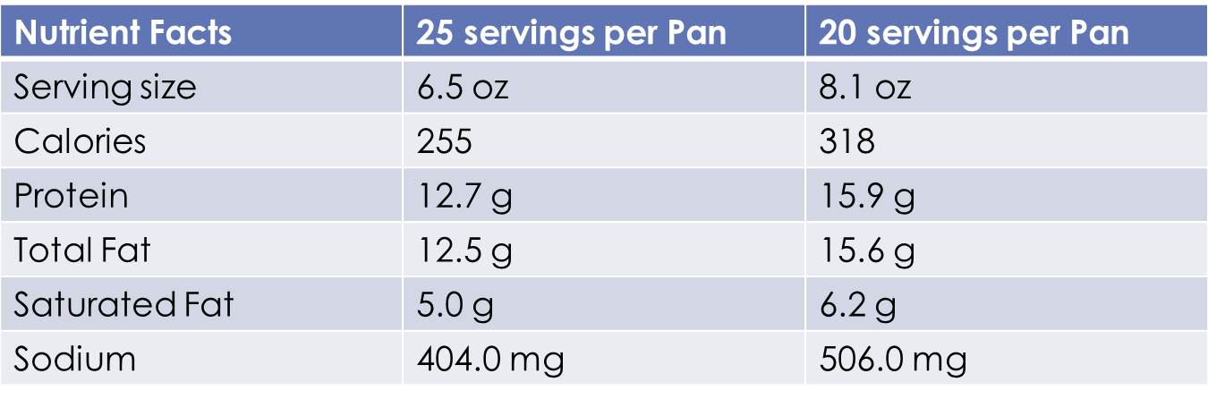
Nutrients per Serving
Nutrients per serving for a recipe can be altered significantly when a recipe is not followed
Notes:
Besides increases in cost, the nutrients per serving for a recipe can be altered significantly when a recipe is not followed. Take a look at the comparison of nutrient content of a serving of the Fiesta Beef Casserole when cut into 20 versus 25 servings.
The serving size increases which in turn increases the calories, protein, total fat, saturated fat, and sodium
7

Slide 8

Customer Satisfaction
Well developed recipes are often the most popular recipe
Increased employee confidence
Notes:
Another very important reason to use standardized recipes is keeping customers happy and satisfied. Standardized recipes provide the same recipe outcome no matter who is preparing them. Production and other staff members can become familiar with the recipes quicker because recipes have the same format. Guesswork is eliminated because staff members have confidence that the recipe will turn out how it is intended. Customers will be more satisfied and participation may increase because customers know what to expect each time a product is served. Employees feel more satisfied and confident in their jobs because standardized recipes decrease the chances of producing poor food products, and prevent shortages of servings during meal service.
8

Slide 9
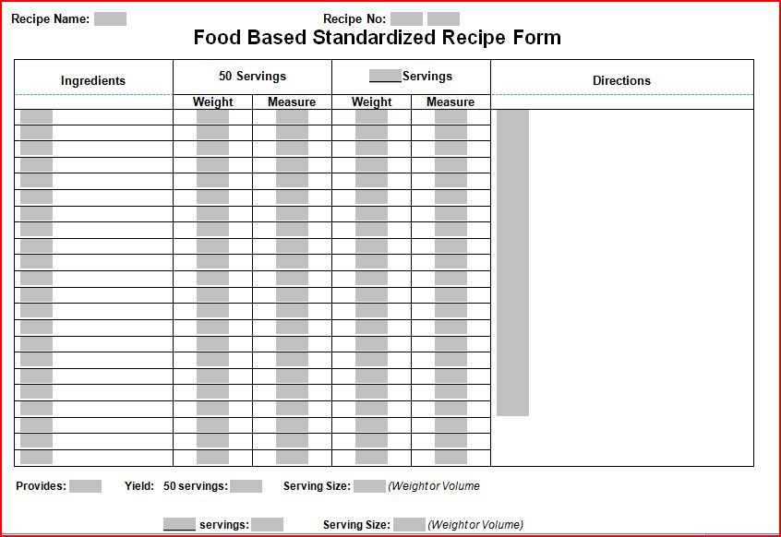
Required Elements of Standardized Recipes
Recipe Name/Number
Ingredients
Weights and Measures
Servings
Yield
Directions
Notes:
Standardized recipes for school foodservice operations should always have certain components.
The Recipe Name and or Number. Numbering your recipes is not required but may be helpful for organization and recording the standardized recipe on your production records. Each recipe should have a title. The title should be descriptive of the product and easily understood by everyone who is working in the operation and your customers. It should be appealing to your customers as well.
The ingredients are listed in the first column, and should specify alternative ingredients when necessary. Alternative ingredients are sometimes given for use in place of a similar ingredient in the recipe; for example, dehydrated onions instead of fresh onions.
When reviewing the weights and measures for each ingredient, a decision should be made whether weights, volumes, or both will be used to describe the amount of each ingredient needed for the recipe. When reviewing the recipe, if the ingredient quantity is not in the preferred weight or volume, conversions will need to be made before the recipe can be prepared. Avoid using packaging, for example; “1 package” to describe the amount of a product. Products can be packaged a number of ways and package size can vary depending on supplier. The amount of product in each package may vary depending on the product quality. Quantities should be listed in the easiest unit of measure (i.e., 1 lb 4 oz instead of 20 oz, 1⁄2 cup instead of 8 Tbsp). Standard abbreviations for units of measure should be used and in most cases, the quantity of each ingredient is given in both weight and volume measure for both number of servings 50 and 100 servings.
Serving describes the amount or size of prepared food that makes one serving. Indicate the weight 2 oz, volume ¼ cup, or measure #16 scoop. Ideally, the weight of one serving will be identified in addition to a general description of serving size such as 1⁄2 cup or 1⁄8 pie.
Yield gives the approximate total yield (or total number of servings) of the recipe in gallons, loaves, or other appropriate units. The yield is often forgotten but very important for menu planning.
Directions tell how to prepare the recipe and should indicate how ingredients are to be combined. All preparation and cooking terms should be reviewed to make sure staff members understand exactly what each means. If the correct procedures are not used, the final product will not be correct. Where appropriate, times and temperatures are given for the type of food service equipment being used.
This standardized recipe form is available on the Child Nutrition Knowledge Center for you to use as a template. You may use your own template but make sure all of the required elements are included. SFAs must have food labels, product formulation statements, and CN labels that support the recipe ingredients. Servings must be appropriate for the food item being served for example; spaghetti served in cups vs. fluid ounces
9

Slide 10
Production Records
Mandatory
Daily documentation of what was planned and served at your foodservice operation
Necessary to support the claim for reimbursable meals
Identifies information needed for the nutrient analysis
Required for Breakfast, Lunch and Snack programs
Notes:
Good recordkeeping is part of any successful food service operation. Production records are mandatory, daily documentation of what was planned and served at your foodservice operation. These records are necessary to support the claim for reimbursement. These records must show how the meals offered contribute to the required food components and quantities and appropriate calorie and nutrient requirements for each age/grade group every day. Production records identify the information required for nutrient analysis and are required for all meals served, including breakfast, lunch and snack programs. They must be completed in full, legible and separated by the age/grade group being served.
We cannot stress enough how IMPORTANT Production records are. If you list the components on your menu but leave this information off your production record, it was like the meal was never served because we cannot validate it. They are required by federal regulation and fiscal action may be assessed if they are missing.
10

Slide 11
Advantages of Production Records
An excellent planning & forecasting tool that will help the food service manager to have a successful food service operation
Valuable written history for future planning and help you to:
  Minimizes overproduction and food waste
  See trends
  Evaluate what works best with the students
  Decide what changes need to be made
  Improves participation!
Notes:
Production records are an excellent planning and forecasting tool that will help the food service manager to have a successful food service operation.
Good production records are helpful in many ways, providing a valuable written history for future planning.
They help you minimize overproduction and food waste, see trends, evaluate what works best with the students, decide what changes need to be made and improve participation. They also help track your A La Carte items for the completion of the non program food tool.
Encourage your staff not to think of production records as something “I must do” but rather an important tool in your daily process of providing meals. We understand all of the challenges with the new meal pattern but accurate and complete production records are essential and can help you meet the new meal pattern.
11

Slide 12
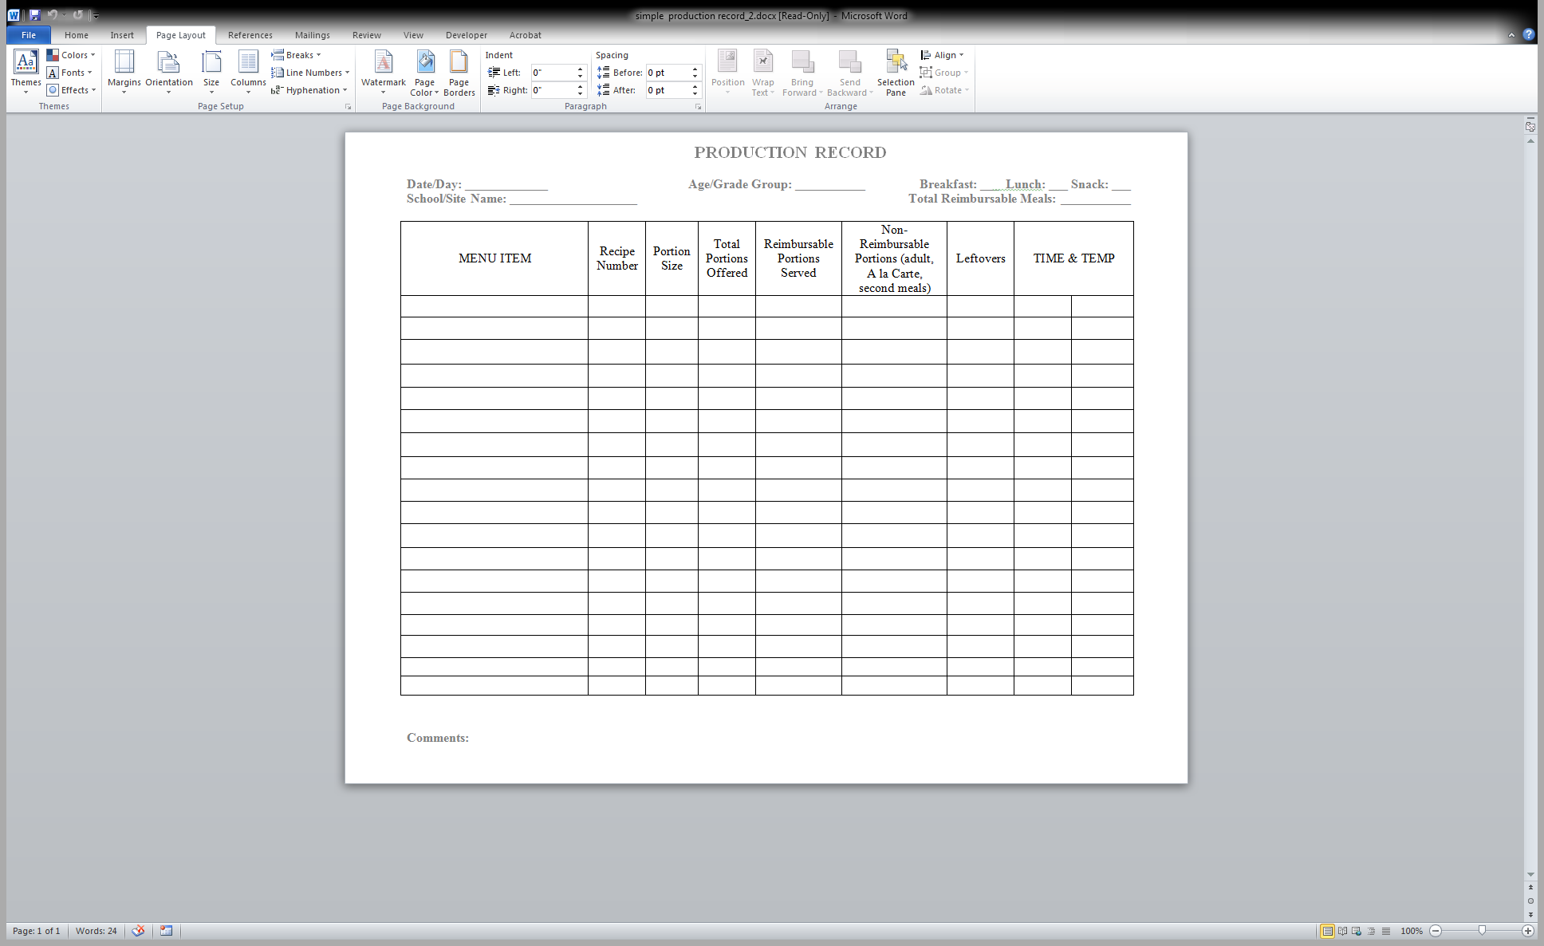
Production Record Word Template
Notes:
This is the “Simple Production Record” template for Microsoft Word. This and other production record templates are included with the resources accompanying this presentation.
12

Slide 13
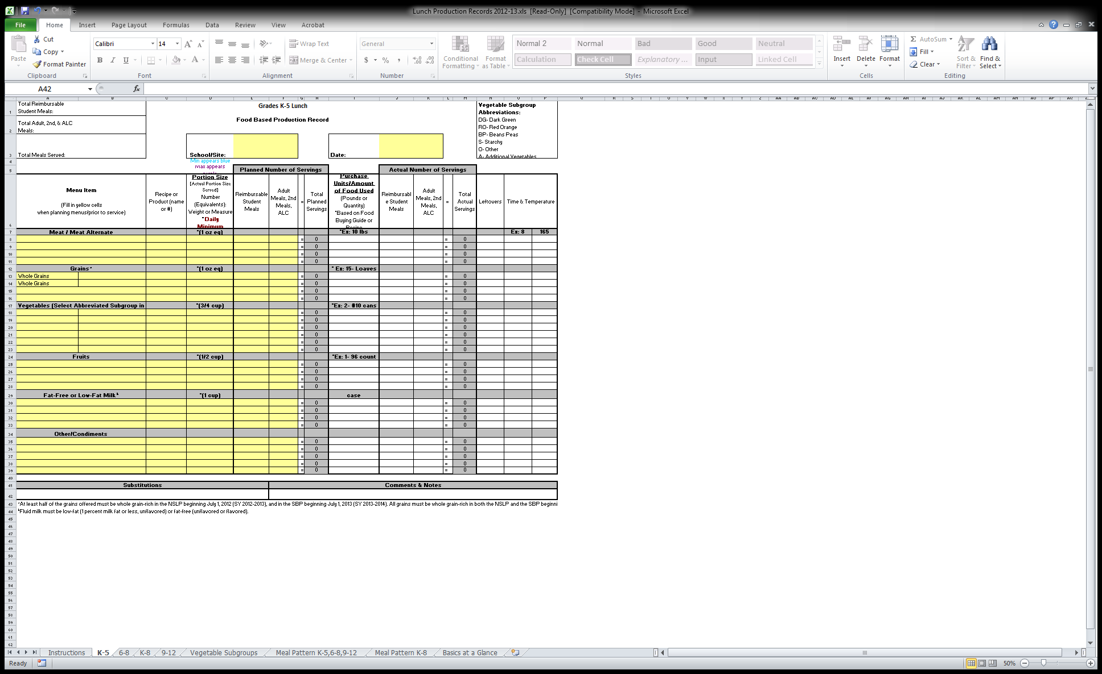
Production Record Excel Template
Notes:
This excel template is also included in today’s webinar resources.
13

Slide 14


Elements of a Production Record
Complete before meal service:
School / Service Location
Date
Menu Type (B’fast / Lunch / Snack)
Age / Grade Group
Menu (Food) Item
Recipe Name / Product Number
Portion Size
Total Portions Offered (#)
After Meal Service:
Reimbursable Portions
Non-Reimbursable Portions
Leftovers
Time / Temperature (Optional)
Substitutions
Comments / Notes
Notes:
Certain information on a production record can be completed before meal service begins. This information includes the name of the school or service location, the date, the type of meal service; breakfast, lunch or snack; the age/grade group being served; the name of the menu (or food) item; including condiments, recipe names and numbers, the portion sizes, and the total number of portions being offered.
The way a food is menued can make a difference in the outcome of the nutrient analysis. Again, condiments must be included on the production records.
The total portions offered and the portion size can be completed ahead of time and ensure that the portion size meets the required minimum portion size for the age/grade group being served. After meal service is complete the actual number of reimbursable meals served, the non-reimbursable portions served; including a la carte, second and adult meals, leftovers, time and temperature, and total reimbursable meals served. It is also important to note if any substitutions were made or any comments regarding feedback from the meal service.
14

Slide 15
Menu Item
Enter all meal choices for the day
  Including alternates
  Example: Students can choose Shepards pie or PB + J
Foods with more than one component
  Enter in only one column
  PB + J (grain and meat alternate)
  Shepards pie (starchy veg, meat)
    During reviews we will ask for the recipe
Notes:
Enter all meal choices for the day including alternates. For example, students can choose Shepard's Pie or a peanut butter and jelly sandwich
Foods with more than one component should be entered in only one column. For example, peanut butter and jelly sandwich is a grain and a meat/ meat alternate. Shepard’s pie is a starchy vegetable and a meat/meat alternate.
If a standardized recipe is available, you do not need to specify all food components on production record. Just reference recipe number and number of servings prepared, served, etc. The Standardized recipe should have all the information on it to document compliance.
15

Slide 16
Recipe or Product (Name or #)
Be as specific as possible
Examples:
  Chicken breast (Tyson, Goldkist, etc.)
  Milk (Oakhurst, Garelick)
  USDA foods
  Recipe #
Update recipes when products change
Keep your labels!
  Nutrition facts labels
  Child Nutrition labels
  Product Formulation Statements
Notes:
Be as specific as possible when documenting products used for meal production. Pack size, case weights and similarity of items can vary from vendor to vendor. Some products may work extremely well for certain recipes but other products deemed acceptable substitutes by purveyors may not function as well in the same recipes. A consistent product is essential to meeting meal pattern requirements. The meal component credit can always be determined when a standardized recipe is used. Recipes can be made for most menu items. We need recipes for all items that contain more than one ingredient. (Example Turkey Sandwich) If you serve the corn directly from the can, you can indicate “#10 can” here. If you are serving corn on the cob, you should indicate that here. When you make the corn , if you add butter and salt, you should have a recipe for the corn which includes those condiments.
For example; if using chicken, milk, USDA foods, or recipe numbers, be sure to be specific. A serving of five Tyson chicken nuggets may credit 2 oz. m/ma and 1 oz. grain equivalent, while a serving of five Purdue chicken nuggets may credit 1.5 oz. m/ma and 1.5 oz. grain equivalent. These discrepancies could result in a failure to meet meal pattern requirements.
Be sure to update recipes when products change or substitutions are made. Purveyors are often forced to offer substitutes when products run out or are no longer available. It is essential to update recipes to reflect these changes and offer alternative serving strategies. Recipes should be standardized, edited for consistency, and updated on a regular basis.
Be sure to keep your labels which include nutrition fact labels, Child Nutrition labels, or product formulation statements. A CN label clearly identifies the contribution of a product toward the meal pattern requirements, and it protects you from exaggerated claims about a product. Product formulation statements provides a warranty against audit claims if the product is used according to the manufacturer’s directions.
If you are using a computerized program to calculate compliance make sure you are updating recipes if you switch to a different product. This will affect accurate crediting and calorie and saturated fat information.
16

Slide 17
Portion Size
Number, weight, or measure
Avoid “serving”
  Fruits and vegetables: cup, 1 each (whole fruit)
  Meat/meat alternate: ounces, cup (beans- if crediting toward MA)
  Grains/Whole Grains: ounces, cups (rice/pasta)
Enter in CREDITABLE amount
  Example: Fish burger- 3 oz credits as 1.5 oz M/MA (CN label)
    Enter 3 oz (1.5 oz M/MA)
Notes:
Be sure to list the proper portion size in its number, weight, or measure
Avoid “serving”. List fruits and vegetable in cups or 1 each if offering whole fruit. List meat/meat alternate and grains in ounces or cups.
Enter in creditable amount for example, a 3 ounce fish burger credits as 1.5 oz. M/MA based on the CN label. Enter 3 oz.=(1.5 oz. M/MA).
The meal contribution is automatically generated for USDA recipes. For your own recipes the contribution information must be manually entered into the recipe
17

Slide 18
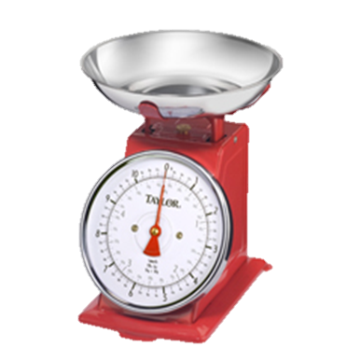
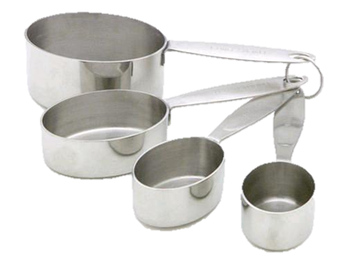
Weight vs. Volume
Cheese, grated
Weight: 2 oz. = 212 calories
Volume: ¼ cup = 84 calories
French Fries, potato puffs
Weight: 4 oz. = 252 calories
Volume: ½ cup = 142 calories
Notes:
This is one of the most significant problems we find with production records.
If using a food item such as grated cheese, be sure to list it in the correct weight or volume because it will effect the calories. For example, if measuring by weight, 2 oz. of grated cheese is equal to 212 calories. Whereas, if measuring by volume, ¼ cup grated cheese is equal to 84 calories.
Another example if using french fries. If measuring french fries by weight, 4 oz. is 252 calories and if measuring french fries by volume, ½ cup is equal to 142 calories.
Two ounces does not necessarily equal ¼ cup, and two ounces does not necessarily equal a 2 oz. equivalent.
If you have a scale and are weighing items that are being served, feel free to use weight.
It is best to measure food as indicated in the food based menu plan.
This will impact the nutrient analysis if you give us inaccurate data.
18

Slide 19
Total Portions Offered
Total Projected Servings
  Forecast, or predict the approximate number of servings needed of each menu item.
  Helps to determine how much food to prepare, how much time to allot for preparation and which equipment to use.
Complete before the meal is served
Notes:
The total projected servings offered forecast, or predict the approximate number of servings needed of each menu item. Projecting the number of servings is the first step in determining how much food to buy or order, how much time to allot for preparation and which equipment to use.
This column should be completed before the meal is served.
19

Slide 20
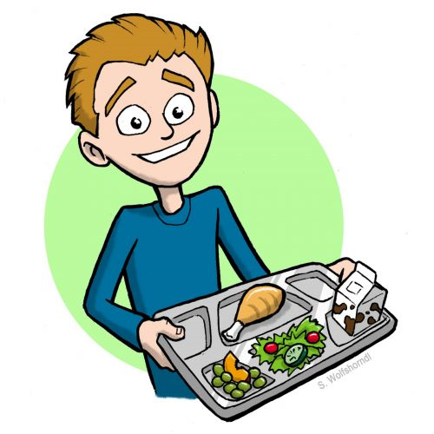
Actual Number of Meals Served
Reimbursable Portions
Non-Reimbursable Portions
  A la Carte Items
  Second Meals
  Adult Meals
Notes:
At the end of the meal service, record the number of reimbursable and non-reimbursable meals that were actually served. A reimbursable meal is a meal meeting the USDA meal pattern requirements, served to an eligible student, and priced as an entire meal rather than based on individual items. Non-reimbursable portions that must also be recorded are a la carte items, second meals purchased by students and adult meals.
20

Slide 21
Leftovers
Record the portion of leftovers for all menu items
Helps prevent overproduction in future meals
Salad bar leftovers – estimate
Examples:
  Record cups(casserole, soups)
  Record actual number (sandwiches, pizza)
Notes:
Once meal service is complete, the leftover portions must be counted and recorded before anything is thrown away. Tracking leftovers helps prevent overproduction in future meals. This information is also important if leftovers are utilized the next day.
Salad bar leftovers can be estimated. For example, if the “salad bar” recipe calls for 50 servings and it appears that only half of the students took from the salad bar, calculate how many servings half of the recipe would be. Another option is to use a separate salad bar production record for additional foods added.
If a casserole or soup was served, record the leftovers as the portion sizes in which they were served such as ½ c or 1 cup portions. If the food item is a sandwich or pizza, record the portion size as an actual number like “one each”, or “one slice/sandwich”.
21

Slide 22
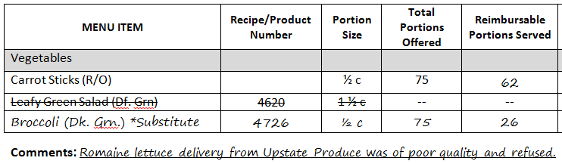
Substitutions
Know your vegetable sub-groups
  Ensures appropriate substitutions were made
  Example: Leafy Green Salad menued, but romaine lettuce was out of inventory, served broccoli instead
    Must substitute with another food item from the same vegetable subgroup (dark green)
Always have a backup!
Notes:
All food items served to students must be included on the production record, even if they are last minute. The USDA meal patterns include five subgroups of vegetables that count toward the daily and weekly vegetable requirements. It is important to know which vegetables are in each group when making substitutions to the menu.
Ensure that appropriate substitutions are being made. For example, if Leafy Green Salad is on the menu, however romaine lettuce is not available, the salad should be substituted with another vegetable from the dark green vegetable subgroup, such as broccoli.
Substitutions must also be documented in the notes and comments section of the production record to support the claim for reimbursement.
22

Slide 23
Comments and Notes
Way to communicate any changes in meal counts
  Higher or lower than normal
Factors affecting meal counts such as class trips, weather, illness, etc.
Recording this information is only helpful if you refer back to already completed production records for future forecasting
  Helpful for Administrative Reviews
Notes:
The comments and notes section of the production record is a great place where the SFA can communicate any changes in service. For example, higher or lower than normal meal counts; meal service factors such as class trips, weather, or illness; and comments made by students provide valuable written history for future reference. It can help to spot trends, evaluate what works best with your students and help you decide what to change.
Recording this information is only helpful if you refer back to already completed production records for future forecasting.
Production records serve as a communication tool, so they should be kept in a place that personnel may have access. Staff should be trained to review the production records for information on what and how much to prepare and additional staff members should be trained to record information such as servings added or leftover.
23

Slide 24
Common Production Record Errors
Missing Information
Incorrect Information Recorded
Not Broken Down By Grade Group
Portion Sizes Not Quantified
Weights vs. Volume
Missing Condiments
Missing Daily Items
Not Legible
Not Having Production Records
Notes:
This slide outlines some common production record errors.
Production records must be complete and include, at minimum the fields found on the “Simple Production Record” template. When important information is missing from the production record, SED has no way of validating that meals served and claimed for reimbursement are in compliance with all Federal and state regulations. Be sure to list the exact food items being served, for example instead of writing “vegetable” write what vegetable was actually served, for example “carrots”.
Incorrect information is often recorded when the production records are not completed during or soon thereafter the meal service, so be sure to record the information as soon as possible. Do not try to recreate the information from memory later, this can lead to errors.
We commonly see production records not broken down by age/grade group, and portion sizes that do not match what is actually being served.
Weights vs. Volume, which was discussed in detail on the previous slide.
Condiments not listed, these are part of the reimbursable meal and must be recorded.
Daily Alternative items such as peanut butter and jelly are often forgotten because they are served everyday, however everything that is served must be recorded, such as Peanut Butter and Jelly Sandwiches
Also, be sure that your production records are legible, often we cannot read them and therefore cannot confirm that program requirements are being met.
If production records are missing and there is not sufficient documentation to demonstrate if reimbursable meals are served on a daily basis, meals may be reclaimed or disallowed.
24

Slide 25
Consistent & Current
All supporting documentation for your menu should be consistent and current
  Nutrition Information
  Standardized Recipes
  Production Records
  Nutrient Analysis
Notes:
All supporting documentation for your menu should be consistent and current. During Administrative Reviews, SED often finds discrepancies between nutrition information, standardized recipes, production records and the nutrient analysis. Please ensure that all of the menu planning and supporting documentation are kept current to reflect the same menu items and an accurate nutrient analysis.
25

Slide 26
Record Retention
Have production records in a location where staff can easily refer to and complete as necessary
Production records must be kept on site and retrievable upon request for 3 years plus current
Notes:
Have production records in a location where staff can easily refer to and complete as necessary. They must also be available for SED to review during the SFAs Administrative Review. Production records must be kept on site and retrievable upon request for three years plus the current years.
26

Slide 27
SMART SNACKS in School
“All Foods Sold in Schools Standards”
August 2015
Notes:
Welcome to Smart Snacks portion of our Webinar today.
27

Slide 28

Healthy, Hunger-Free Kids Act 2010
An increasing body of research is showing strong food standards will help students make healthier choices during the day.
Congress gave authority to USDA
  Established nutrition standards for all foods and beverages sold outside of the Federal Child Nutrition Programs (CNP) in schools
Expanded our view on the school nutrition environment
Notes:
The Nutrition Standards for all foods sold in school interim final rule, also known as the “Smart Snacks” rule, is part of a package of policy improvements enacted by the Healthy, Hunger-Free Kids Act of 2010. Collectively, these policies will help combat child hunger and obesity while improving the health and nutrition of the nation’s children. The Smart Snacks rule will help schools create a healthy school environment for students outside of the federal meal programs.
Previously, foods outside of the Federal Child Nutrition Programs (CNP) have commonly been referred to as “competitive foods”, as they compete with reimbursable meals. This rule is requiring that schools expand their impact of the school nutrition environment. Since a significant portion of the calories in children’s diets are consumed at school, offering nutritious foods throughout the school campus is critical to improve the diets and overall health of American children. The Smart Snacks rule also ensures that children from all income levels will develop the kind of healthful eating habits and lifestyles that will enable them to live healthier, more productive lives.
28

Slide 29
What Are Smart Snacks?
The Smart Snacks standards apply to all foods sold:
outside the school meal programs
on the school campus
during the school day
Areas that are under the jurisdiction of the school to which students have access
Midnight through 30 minutes after the end of the instructional day
Notes:
The Smart Snacks standards apply to foods that are sold outside of the school meal programs on the school campus during the school day. This includes:
a la carte in the cafeteria, school stores, snack bars and, vending machines.
Keep in mind that a School Food Authority or SFA is responsible for all food and beverage sold to students on the school campus, even if sales are not connected with the food service department.
The school campus has been defined in the rule as any area over which the school has jurisdiction that students can access. This means that the rule does not apply to areas where students are not allowed, such as teachers’ lounges.
The school day has been defined in the rule as from midnight through 30 minutes after the instructional day ends. This means that different schools will be able to begin selling foods that do not meet the standards at different times of the day, as it is up to your school to determine your instructional day.
It is also important to note that these standards do not apply to foods that are not available for sale. This includes birthday treats or lunches brought from home. As a reminder, it is important to ensure that all foods offered in your school are compliant with your local wellness policy.
29

Slide 30

General Standards
(Food)
Be a whole grain-rich product
Have a fruit, vegetable, dairy product or protein food (meat, beans, poultry, etc.) as the first ingredient
Be a “combination food” with at least ¼ cup fruit and/or vegetable
Contain 10% of the Daily Value of calcium, potassium, vitamin D, or dietary fiber (only allowable through June 30, 2016)
Notes:
We will start with the standards that are related to foods. The standards for food items are the same for all grade levels. Each allowable food must meet one of the general standards and all of the nutrient standards that have been outlined in the rule.
Let’s go through each of the general standards. One of the following four criteria must be met:
It must be a whole grain-rich product; OR
Have a fruit, vegetable, dairy product, or protein food ( such as meat, beans, poultry, etc.) as the first ingredient; OR
Be a “combination food” with at least ¼ cup fruit and/or vegetable; OR
Must contain 10% of the Daily Value of calcium, potassium, vitamin D, or dietary fiber. This standard will only be allowable during the first two years of implementation through June 30, 2016.
30

Slide 31
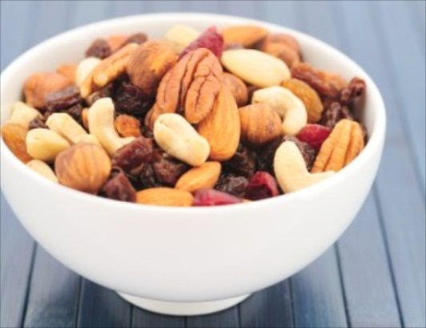
General Standards
(Food)
…make sure it meets all of the nutrient standards.
If a food meets one of the general standards…
Notes:
When evaluating a food item, you should first determine whether one of the general standards has been met.
If so, then move on to determine if it also meets all of the nutrient standards.
As a reminder, food must meet one of the general standards and ALL of the nutrient standards if it is sold to students on the school campus during the school day.
31

Slide 32

Fruits and Vegetables
Fruits
Vegetables
Fresh, frozen and canned fruits with no added ingredients except water
Fruits packed in 100% fruit juice or extra light, or light syrup
Fresh, frozen and canned vegetables with no added ingredients except water
Canned vegetables that contain a small amount of sugar for processing
Notes:
Fruits that can be included as a SMART SNACK include:
Fresh, frozen and canned fruits with no added ingredients except water
Fruits packed in 100% fruit juice or extra light, or light syrup or
Dried whole fruits, dried whole fruit pieces or dehydrated fruits with no added nutritive sweeteners would also be accepted as a smart snack.
Vegetables that may be included are:
Fresh, frozen and canned vegetables with no added ingredients except water or
canned vegetables containing only a small amount of sugar for processing or
Dried whole vegetables, dried whole vegetable pieces; and dried dehydrated vegetables with no added nutritive sweeteners.
Examples: Wasabi peas and kale chips.
32

Slide 33


Nutrient Standards
(Foods)
Entrees
Snack or Side
A combination food with meat/meat alternate and grain
A combination food with meat/meat alternate and a vegetable or fruit
A meat/meat alternate alone
  Not allowable: yogurt, low-fat or reduced-fat cheese, nuts, seeds, nut or seed butters, and meat snacks served alone
A “breakfast entrée” item
Any item that does not fit the qualifications of an entrée
Notes:
Distinct nutrient standards have been defined for both entrees and snacks or sides.
To use the criteria that has been defined for entrees, a food item must fit into one of the following categories:
a combination food of meat/meat alternate and grain;
a combination food of meat/meat alternate and a vegetable or fruit; OR
a meat/meat alternate alone, with the exception of yogurt, low-fat or reduced fat cheese, nuts, seeds, nut/seed butters, and meat snacks. These items are traditionally thought of as snacks, so they should be compared to the snack guidelines.
Since the rule was published, USDA released additional guidance related to grain-based breakfast items in the SP 35-2014 memo. Because of this, grain-only breakfast items can be classified as entrees if they are served as part of reimbursable meals as part of the School Breakfast Program. It will be up to the menu planner to determine which item offered with the daily reimbursable breakfasts will be classified as an entrée for the purpose of Smart Snacks. For example, a Bagel sold as an entrée at breakfast, may be sold as a snack at lunch, provided it meets the standards.
A product may still be allowable under Smart Snacks if it does not meet the definition of an entrée. However, it will need to be evaluated using the criteria outlined as a snack or side instead, such as popcorn.
33

Slide 34


Nutrient Standards
(Foods)
Entrees
Snack or Side
Calories: < 350
Fat: < 35% of calories
Sat. Fat: <10% of calories
Sodium: < 480 mg
Sugar: < 35% of weight from total sugar
Calories: < 200
Fat: < 35% of calories
Sat. Fat: <10% of calories
Sodium: < 230 mg*
Sugar: < 35% of weight from total sugar
* This amount will be 200 mg as of 07/01/16
Notes:
It is important to know whether your item is an entrée or a side, because the nutrient standards vary slightly.
Entrees must have no more than 350 calories, 35% of calories from fat, 480 mg of sodium, 35% of its weight from total sugar, and less than 10% of calories from saturated fat.
For snacks and sides, only two of these values are different. The item must have no more than 200 calories and no more than 230 mg of sodium.
All of these values should be assessed per serving as the item is served. If an item has two servings per bag according to the nutrition facts panel, but the bag is sold as a whole, the contents of the whole package, which would be two servings combined must be within these values.
34

Slide 35
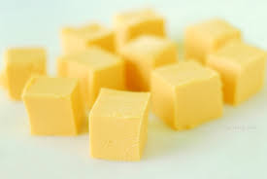

Nutrient Standards
(Foods)
There’s an exception to every rule!
Your item might be exempt from one or all of the standards if it is:
An entrée served as part of a reimbursable breakfast or lunch on the day of or day after service
Reduced-fat cheese or part-skim mozzarella
Nuts
Seeds
Nut or seed butters
Dried fruit with nuts or seeds (no added nutritive sweeteners or fat)
Seafood
Dried or dehydrated fruit/vegetables
Fresh, frozen, or canned vegetable
Notes:
The previously discussed nutrient standards apply to most foods but there are specific foods that have exemptions from some or all of the standards.
These foods are usually healthier, “whole” foods that should be encouraged. Reduced-fat cheeses are an example of a protein- and calcium-rich food we would like to encourage students to eat but cheese is, by nature, higher in total fat and saturated fat. Because of the health implications, USDA has exempted certain cheeses from both the total and saturated fat standards.
One exemption that is especially noteworthy, is that entrees that are served as part of a reimbursable lunch or breakfast are exempt from all nutrient standards on the day of and day after meal service.
35

Slide 36
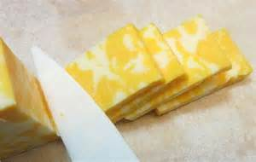
Nutrient Standards
(Foods)
Analyze the exempted standard individually
Yes
Does your product qualify for an exemption?
Analyze using the Alliance for a Healthier Generation’s product calculator*
No
https://www.healthiergeneration.org/take_action/schools/snacks_and_beverages/smart_snacks/
Notes:
It is important to understand all of the exemptions outlined in the Smart Snacks rule. The Alliance for a Healthier Generation created a Smart Snacks product calculator, which we will show you on the next slide, to assist you in determining whether a product is compliant. The Alliance For a Healthier Generation is an organization dedicated to combating the growing rate of childhood obesity. In addition to this useful calculator, they have many other resources that can be used to better understand and implement the Smart Snacks Standards. Be sure to visit their website!
USDA both encourages the use of this calculator for analyzing products and printing assessments for recordkeeping. However, the product calculator may not accurately determine if one of the exemptions is valid. Therefore, you will need to analyze your product by hand if it is one of the exempt items on the previous slide. For example part skim mozzarella cheese would qualify if the total calories and sodium are within the standards, the total fat may be exceeded making the product exempt.
Keep in mind that if any of the products have added sweeteners or fat, they no longer qualify for the exemption.
However, if your item still does qualify for an exemption, you’ll want to be sure that the exemption is accurately reflected by the product calculator or analyze the standards by hand.
For instance, the first ingredient in a peanut granola bar is a protein food (peanuts), but, it can not be selected as nuts or seeds in the calculator, as this means plain nuts and seeds without added sweeteners or fats.
36

Slide 37
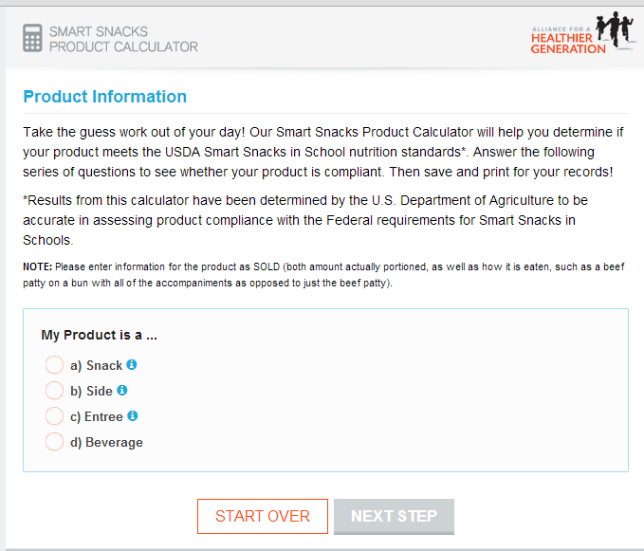
Smart Snacks Calculator
http://rdp.healthiergeneration.org/calc/calculator/
Notes:
The screen you see displayed on the slide is the starting screen for the Alliance for a Healthier Generation’s product calculator.
The first product we will look at is Smartfood Popcorn, so snack should be selected.
37

Slide 38
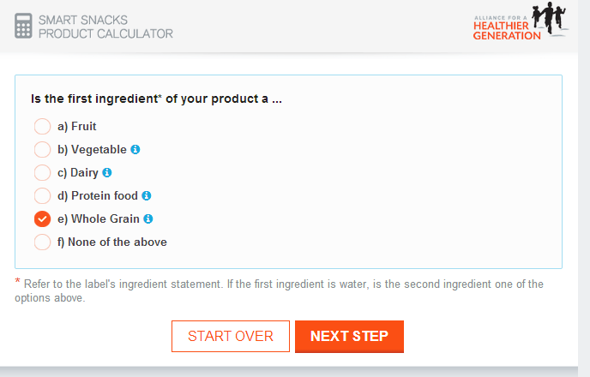
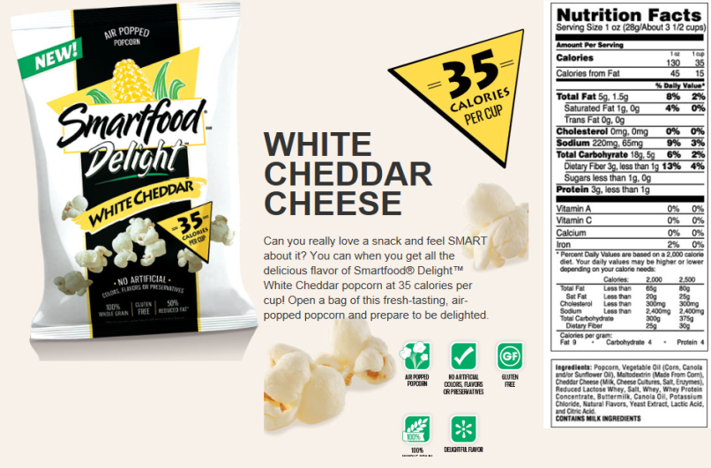
Smart Snacks Calculator
Notes:
The first ingredient in our product is popcorn and that is a whole grain.
Remember, you must first determine if a product is whole grain rich before you begin using the calculator for grain products.
38

Slide 39
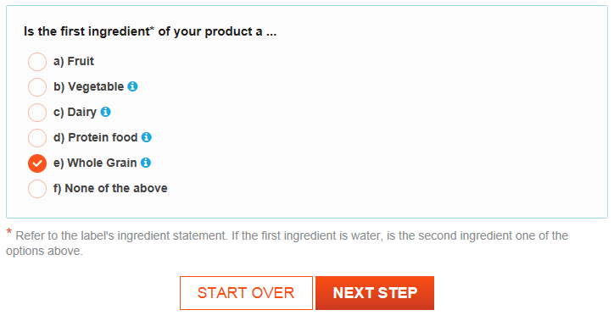
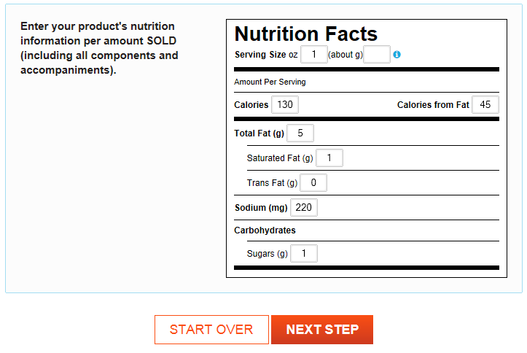
Smartfood® Popcorn Delight
Notes:
Next, we entered the nutrition information requested for the bag of popcorn, which is one serving. To determine compliance, nutrition information must consider one serving as packaged for sale.
39

Slide 40
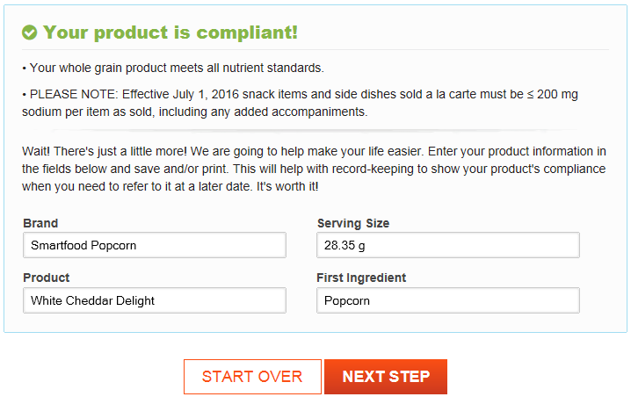
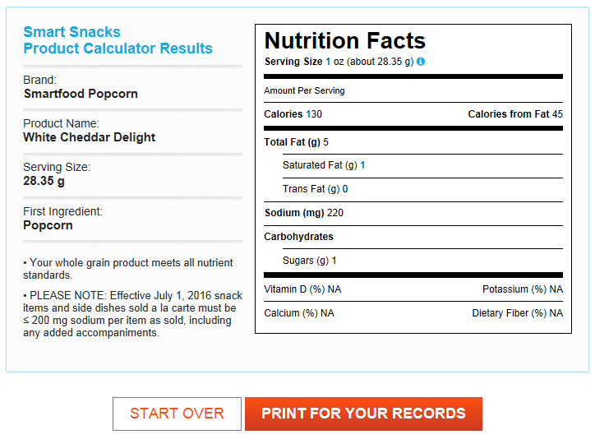
Smartfood® Popcorn Delight
Notes:
Your product is compliant!
40

Slide 41
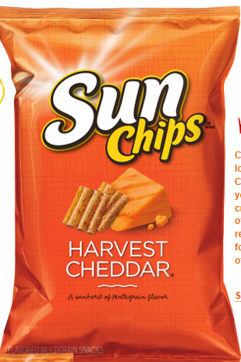
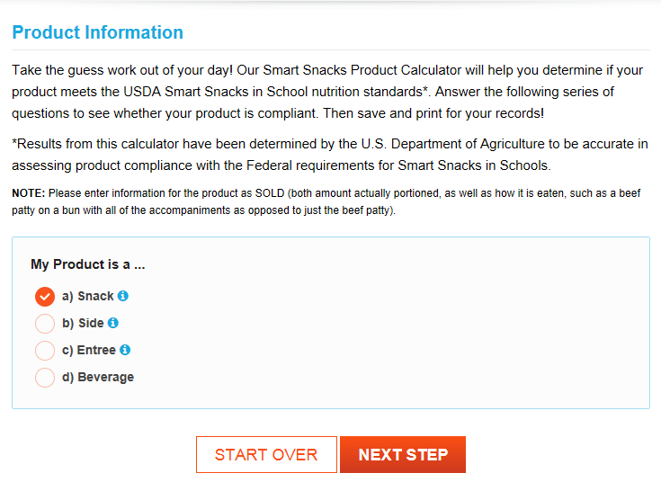
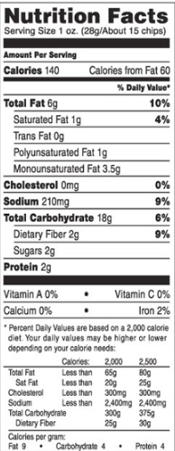
Sun Chips ® Harvest Cheddar
Notes:
The next product we will look at is Sun Chips. The product is a Snack, so snack should be selected.
41

Slide 42
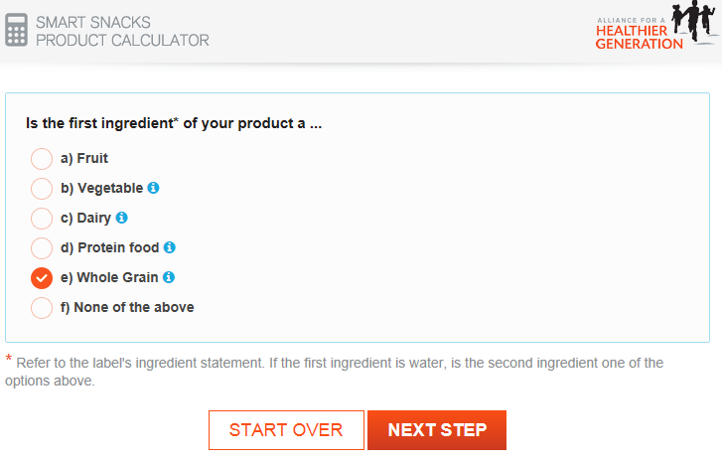

Sun Chips ® Harvest Cheddar
Notes:
The first ingredient is Whole Grain.
Enter the products nutrition information…
42

Slide 43
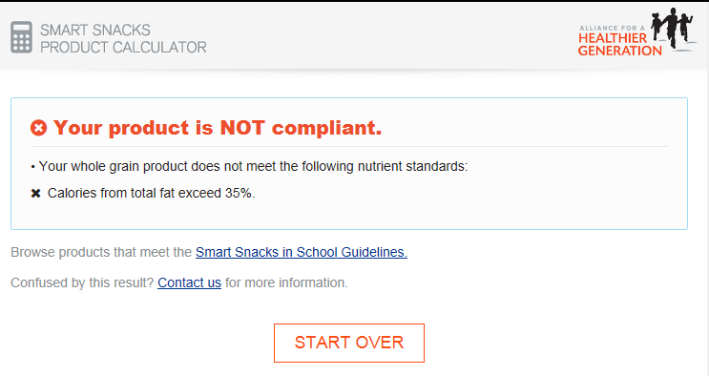
Sun Chips ® Harvest Cheddar
Notes:
This product in NOT compliant.
Calories from total fat exceed the 35% limit.
43

Slide 44
Beverage Standards
Beverages Acceptable for All Grades
Beverage | Elementary School | Middle School | High School
Plain water, carbonated or not | no size limit | no size limit | no size limit
Low fat milk, unflavored* | ≤ 8 oz | ≤ 12 oz | ≤ 12 oz
Non fat milk, unflavored or flavored* | ≤ 8 oz | ≤ 12 oz | ≤ 12 oz
100% fruit/vegetable juice ** | ≤ 8 oz | ≤ 12 oz | ≤ 12 oz
* Includes nutritionally equivalent fluid milk substitutions, as permitted by NSLP/SBP
** May include 100% juice diluted with water (with or without carbonation) & no added sweeteners.
Notes:
Next we will be talking about the Smart Snack guidelines for beverages.
The sale of these beverages is allowable to students in all grades if the serving size is appropriate.
The allowable beverages include:
Plain water (with or without carbonation)
Unflavored low-fat milk
Flavored or unflavored non-fat milk, and
100% fruit/vegetable juice.
Fruit juice may be diluted and may be sold with or without carbonation.
***Added sweeteners are allowed in juice labeled as 100% juice, just not in diluted juice. See Q 6 on the Q & A
44

Slide 45

Other Beverages in High Schools
Calorie-free beverages
Maximum serving size of 20 fluid ounces
Includes:
  Calorie-free flavored water, with or without carbonation
  < 5 calories per 8 fluid ounces
  ≤ 10 calories per 20 fluid ounces
Notes:
There are a few other allowable beverages that may be sold at the high school level only.
If middle and high school students are combined, the most strict guidelines must be followed.
It is not allowable to follow the high school guidelines in areas that middle school students will have access to these beverages.
In addition to the water, milk, and juice that were discussed on the previous slide, high school students may also be offered calorie-free and low-calorie beverages.
Calorie-free beverages have been defined in accordance with the FDA definition, meaning that there will be <5 calories per 8 fl. oz. with no more than 10 calories in 20 fl. oz.
These beverages may be offered in serving sizes up to 20 fl. oz. and may have carbonation, if desired. Examples of allowable calorie-free beverages may include fruit flavored, enhanced, or vitamin waters with or without carbonation. For Example: Switch brand carbonate 100 % fruit juices
Remember NYS Law prohibits sale of diet soda until after the last lunch even though they may meet the Smart Snack requirements.
Keep in mind, you’re able to control the sale of allowable products further through your local wellness policy.
45

Slide 46

Other Beverages in High Schools
Lower-calorie beverages
Maximum serving size of 12 fluid ounces
Includes:
  ≤ 60 calories per 12 fluid ounces
  ≤ 40 calories per 8 fluid ounces
Notes:
Lower-calorie beverages are also allowable at the high school level only.
These beverages may have up to 5 calories per fl. Oz. and may be served in a maximum serving size of 12 fl. oz.
There are many options available in the current marketplace that meet these standards, such as lower-calorie sports drinks, lower-calorie tea and light lemonade products.
46

Slide 47

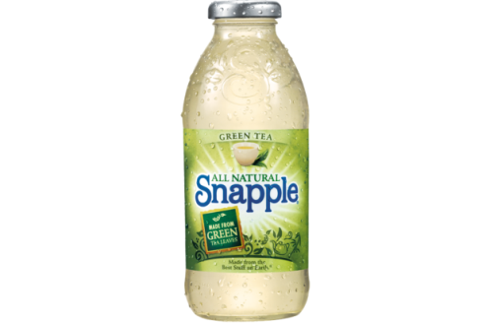

Caffeine
Foods and beverages must be caffeine-free in elementary and middle schools
There is no caffeine restriction in high schools
Notes:
The Smart Snacks rule specifies that only caffeine-free foods and beverages be allowed for elementary and middle school students. However, the rule includes an exemption for foods and beverages that contain trace amounts of naturally-occurring caffeine substances, such as chocolate milk.
The rule does not include any limitations on caffeine content of allowable foods at the high school level at this time. This is due to the fact that there is no formal standard for caffeine consumption currently.
However, USDA encourages schools to be mindful of the level of caffeine in food and beverages when selecting products that may be sold to students. USDA will continue to monitor research and recommendations on caffeine in school-aged children.
47

Slide 48
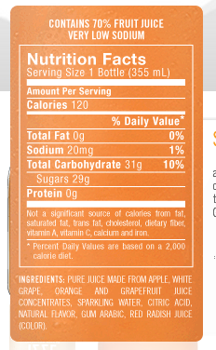
Smart Snacks Calculator
Notes:
Let’s go back to our calculator now and try to find an approved beverage.
We’re going to look at a carbonated, diluted juice product as an example. If we read the ingredients, we can see that this product is made from juice and sparkling water but does have some added natural flavors.
The natural flavors in this product are fine, though it is important to keep in mind that allowable juice products cannot contain any nutritive or non-nutritive sweeteners.
To convert mL to oz. for the calculator:
236.59 mL = 8 oz.
355mL = 12 oz.
48

Slide 49
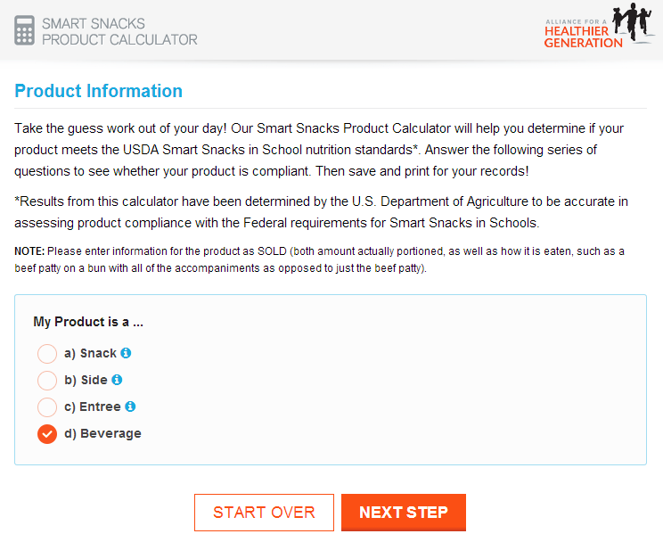
Smart Snacks Calculator
Notes:
Our product is a beverage. We will select “Beverage” before proceeding to the next step.
49

Slide 50
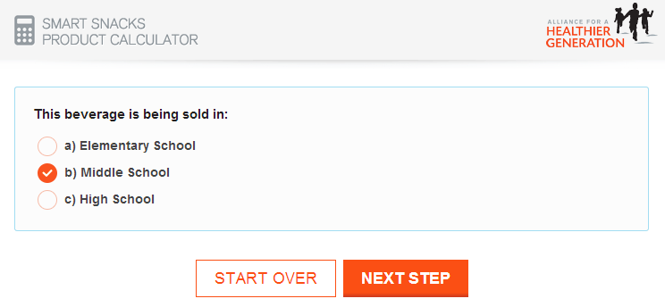
Smart Snacks Calculator
Notes:
Next, we will select the appropriate age group. For the purpose of our example, we will consider middle school students.
50

Slide 51
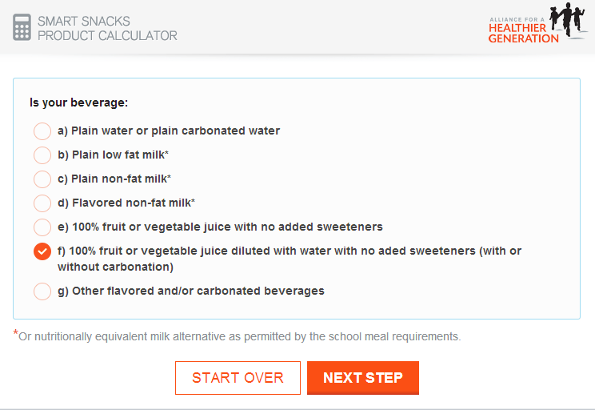
Smart Snacks Calculator
Notes:
Based on our ingredient label, we know that our product would fall into the “100% fruit or vegetable juice diluted with water with no added sweeteners (with or without carbonation)” category. The product started as full-strength juice that was diluted with sparkling water.
51

Slide 52
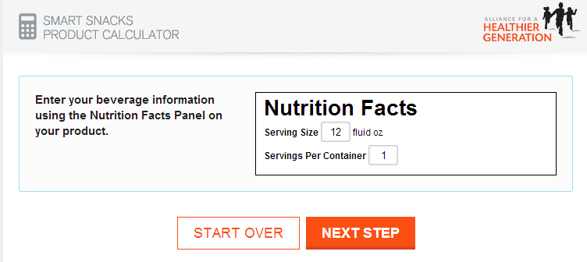
Smart Snacks Calculator
Notes:
To complete the next screen, we will enter “12 fluid ounces” as the serving size and know that there’s only one serving per bottle.
(8 oz. = 236.59 mL)
(mL = 12 oz.)
52

Slide 53
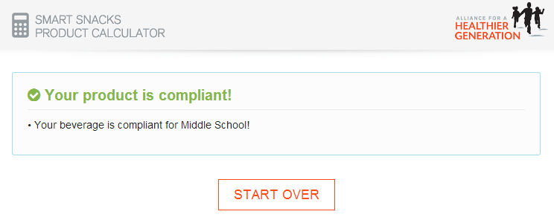
Smart Snacks Calculator
Notes:
We can see that our product made from juice, sparkling water, and natural flavors has been approved for middle school students. It would also be an approved beverage at high schools. You could also note that the portion size would need to be decreased to 8 fl. oz. to sell this product in elementary schools.
53

Slide 54

Fundraisers
Standards apply to fundraisers during school day when items sold are intended for consumption at school.
There Are No Exemptions
Standards DO NOT apply to items sold during non-school hours, weekends, or outside of school fundraising events.
Notes:
One of the most common questions we have received about the Smart Snacks rule has been about fundraisers. USDA recognizes that school-sanctioned fundraisers are a method of financing many important activities for students. However, some fundraisers may be affected by the Smart Snacks final rule. Fundraisers that are held on the school campus during the school day must comply with the Smart Snacks standards. This may affect things like bake sales and candy bar sales.
The school day is defined as the period from the midnight before to 30 minutes after the end of the official school day.
NYSED is not allowing exemptions to the standards at this time. All fundraisers during the school day must meet the standards.
The sale of food items that meet the nutrition requirements, as well as the sale of non-food items, at fundraisers would not be limited in any way.
These standards do not apply during non-school hours, weekends and off-campus fundraising events, such as concessions during sporting events and school plays.
Again, to remind you; It is also important to note that these standards do not apply to treats for birthdays or foods brought by the student from home, because they are not sold.
54

Slide 55
Recordkeeping
Districts must maintain records such as receipts, nutrition labels and product specifications.
Districts must maintain records for competitive foods sold under the nonprofit school food service account.
Notes:
Another important aspect of the Smart Snacks rule is recordkeeping and monitoring. (I.E. Non Program Food Price tool and labels/snack calculator print outs.)
USDA wants stakeholders to understand that these competitive food standards apply to all foods sold throughout the day at ALL of the venues available in a school.
This means that all individuals who are responsible for the sale of food to students anywhere on the school campus during the school day, will have a role in meeting these requirements. In most districts, it will not be feasible for the food service staff to be responsible for monitoring the sale of foods outside of the cafeteria.
How your district maintains the records to demonstrate compliance with Smart Snacks must be decided at a local level.
NYSED reviewers will be including district-wide competitive food sales as part of the Administrative Reviews that are conducted every three years to ensure that Smart Snacks standards are being met.
55

Slide 56
Resources
Interim Final Rule (June 28, 2013)
  http://www.gpo.gov/fdsys/pkg/FR-2013-06-28/pdf/2013-15249.pdf
Alliance for a Healthier Generation
  Product Calculator http://tools.healthiergeneration.org/calc/calculator/
  Product Navigator https://www.healthiergeneration.org/live_healthier/eat_healthier/alliance_product_navigator/
  Smart Snack Success Stories https://www.healthiergeneration.org/news__events/2014/04/15/912/12/
Notes:
The are are a variety of resources available to schools to assist in Smart Snacks implementation.
Link 1 is the Interim Final Rule located in Federal Register Vol. 78 #125, Friday, June 28, 2013
Link 2 is the product calculator
Navigator that shows ingredient labels and pictures of many snack products from cokes to cookies.
The Success stories link includes a school in Brooklyn that developed a school garden and sells at the local farmers market. A very successful fund raiser.
56

Slide 57

Child Nutrition Program Administration
89 Washington Avenue, Room 375 EBA
Albany, NY 12234
518-473-8781
http://portal.nysed.gov/portal/page/portal/CNKC
The U.S. Department of Agriculture prohibits discrimination against its customers, employees, and applicants for employment on the bases of race, color, national origin, age, disability, sex, gender identity, religion, reprisal, and where applicable, political beliefs, marital status, familial or parental status, sexual orientation, or all or part of an individual's income is derived from any public assistance program, or protected genetic information in employment or in any program or activity conducted or funded by the Department. (Not all prohibited bases will apply to all programs and/or employment activities.)
If you wish to file a Civil Rights program complaint of discrimination, complete the USDA Program Discrimination Form, found online at http://www.ascr.usda.gov/complaint_filing_cust.html, or at any USDA office, or call (866) 632-9992 to request a form. You may also write a letter containing all of the information requested in the form. Send your completed complaint form or letter to us by mail at U.S. Department of Agriculture, Director, Office of Adjudication, 1400 Independence Avenue, S.W., Washington, D.C. 20250-9410, by fax (202) 690-7442 or email at program.intake@usda.gov.
Individuals who are deaf, hard of hearing or have speech disabilities, may contact USDA through the Federal Relay Service at (800) 877-8339; or (800) 845-6136 (Spanish).
USDA is an equal opportunity provider and employer.
Notes:
57
You have completed view the Standardized Recipe, Production Record and All Foods Sold in School webinar and may now close out of your browser by selecting the “X” on the right side of the webinar window.
You will then be directed to complete a brief five question assessment of the content covered in the webinar.
You must complete the assessment to receive credit for viewing this webinar.

