Slide 1
Meal Pattern
School Year 2015—2016
New York State Department of Education
Child Nutrition Program Administration

Slide 2
Professional Standards for State and Local Nutrition Program Personnel (Final Rule)
  Effective July 1, 2015
  This webinar will contribute up to 1 Training Hour toward the Professional Standards training requirements
  Required to track the number of training hours earned each year and maintain documentation of the trainings attended
  SED prototype tracking excel document for School Nutrition Directors
  More information will be provided in upcoming SED webinars
  USDA Learning Topic Codes: 1110, 2150 and 2220
Notes:
Before we get started, we want to quickly discuss the Professional Standards for State and Local Nutrition Program Personnel Final Rule, which became effective July 1, 2015.
The Final Rule requires all school food service personnel to complete annual continuing education/training requirements. The number of required training hours varies depending on the position of the school food personnel.
This webinar will contribute 1 Training Hours towards the professional standards training requirements.
You are required to track the number of training hours you earn each year and maintain documentation of the trainings that you have attended. Our office has developed a simple excel document that you may use to do this. SFAs may use this excel document to track staff training hours and may add columns and other necessary information specific to the SFA. You may also use the USDA’s version or your own tracking method to track staff training hours.
Our Child Nutrition Program Office will be covering the Professional Standards Final Rule requirements in more detail in an upcoming webinar on August 27th. Information on how to sign up for this webinar will be posted on the Child Nutrition Knowledge Center.
If you are using USDA Learning Topic Codes, the topic codes for today’s Meal Pattern webinar are 1110 – USDA Nutrition Regulations, 2150 – CN Labeling and Crediting, and 2220 – Offer versus Serve.

Slide 3
Presentation Topics
Part 1—Meal Components
Part 2—Crediting
Part 3—Breakfast Requirements
Part 4—Lunch Requirements
Part 5—Offer Versus Serve (OVS)
Notes:
Today’s webinar will consist of five different topics:
Part 1 will cover meal components
Part 2 will discuss the crediting of meal components
Part 3 and 4 will go over meal pattern requirements for breakfast and lunch; and
Part 5 will cover Offer versus Serve, criteria for reimbursable meals, and appropriate signage

Slide 4
Part 1—Meal Components
Notes:
Part 1—Meal Components

Slide 5
Food-Based Menu Planning
All meals served must follow the Food-Based Menu Planning (FBMP) approach, which uses meal patterns and age/grade groups as menu planning tools
  Food group components must be served in specified daily and weekly amounts
Breakfast (SBP)
  Schools are required to use appropriate age/grade groups (K-5, 6-8, 9-12) to plan menus
  Schools may use a K-8 or K-12 menu plan as food quantity, sodium, and calorie requirements overlap
Lunch (NSLP)
  Schools are required to use appropriate age/grade groups (K-5, 6-8, 9-12) to plan menus
  Schools may use a K-8 menu plan as food quantity, sodium, and calorie requirements overlap
Notes:
All SFAs must use the Food-Based Menu Planning approach when developing breakfast and lunch menus. The Food-Based Menu Planning approach uses meal patterns according to specific age/grade groups as menu planning tools. There are both daily and weekly requirements for food group components relative to each age/grade group.
For breakfast, schools are required to use appropriate age/grade groups (K-5, 6-8, 9-12) to plan menus. Schools may also use a K-8 or K-12 menu plan as food quantity, sodium, and calorie requirements overlap.
For lunch, schools must use the age/grade groups (K-5, 6-8, 9-12) to plan menus. Schools may also use a K-8 menu plan as food quantity, sodium, and calorie requirements overlap. Please note that there is no K-12 menu plan for lunch.
When menu planning, it is recommended that schools start out simple, such as using a cycle menu.

Slide 6
Meal Components
Breakfast Meal Components
  Fruits/Vegetables
  Grains/Meat and Meat Alternates
  Fluid Milk
Lunch Meal Components
  Fruits
  Vegetables
    Dark green
    Red/Orange
    Beans/Legumes
    Starchy
    Other
  Grains
  Meat/Meat Alternates
  Fluid Milk
Notes:
There are three meal components for breakfast and five meal components for lunch.
For breakfast, the three meal components are: fruits or vegetables, grains or meat/meat alternates, and fluid milk.
For lunch, the five meal components are: fruits, vegetables (including the five vegetable subgroups listed on the slide), grains, meat/meat alternates, and fluid milk.
It is important to note that while fruits and vegetables, and grains and meats/meat alternates are considered combined meal components in the breakfast program, they are each separate components in the lunch program.

Slide 7
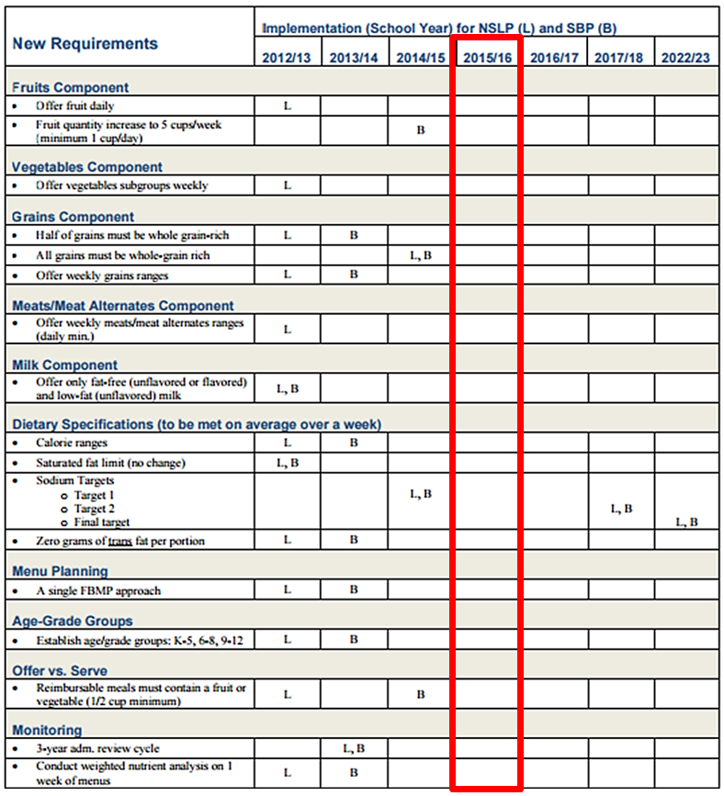
Implementation Timeline
Notes:
This slide shows the timeline for implementation of National School Lunch Program and School Breakfast Program requirements as stated in the Final Rule. This is a graphic depiction of when each requirement will be phased in for both breakfast and lunch over the next 10 years. In this chart, the letter “L” denotes lunch and “B” denotes breakfast. As you can see, there are no new requirements for the 2015-2016 school year.

Slide 8
Fruit Component
Fresh
Use the Food Buying Guide for crediting
Frozen
With or without added sugar
Canned
In light syrup or water
Dried
¼ cup dried = ½ cup fruit
100% Juice
Pasteurized, full strength fruit juice
Notes:
This slide shows the various types of fruit you may offer. You may offer fruits that are fresh, frozen (with or without added sugar), canned (in light syrup or water), dried, and in the form of 100% pasteurized, full-strength fruit juice.

Slide 9
Vegetable Component
Fresh
Use the Food Buying Guide for crediting
Frozen
Plain without added ingredients
Canned
Low sodium or no salt added
100% Juice
Pasteurized, full-strength vegetable juice
Soup
Commercially or homemade vegetable or bean soups
Notes:
Vegetables may be fresh, frozen (without any added ingredients), canned (low sodium or no salt added), in the form of 100% vegetable juice or soup.

Slide 10

Meat/Meat Alternate (M/MA) Component
The quantity of a M/MA refers to the edible portion as served
Examples of commonly used meats in child nutrition programs are beef, poultry and fish
  The quantity of these are based on the cooked (not raw) amount
Examples of meat alternates:
  Seeds, Nuts and Nut Butters
  Yogurt and Cottage Cheese
  Tofu and Soy Products
  Cheese
  Eggs
  Beans/Peas (Legumes)
    May be offered as MA or vegetable, but not both in the same meal
Notes:
The quantity of a meat/meat alternate refers to the edible portion as served. For meats such as beef, poultry, and fish, this refers to the cooked (not raw) amount.
Commonly used meat alternates in the breakfast and lunch programs include: Seeds, Nuts and Nut Butters; Yogurt and Cottage Cheese; Tofu and Soy Products; Cheese; Eggs; and Beans/Peas (Legumes).
Beans/peas (legumes) may be offered as a meat alternate or as a vegetable; however, one serving may not count toward both food components in the same meal.

Slide 11
Grain Component
All grains served must be whole grain-rich (WGR)
  Grains must be 100% whole grain or a blend of grains of which at least 50% is whole grain. The remaining 50% or less of the grains must be enriched.
Examples of Whole Grains
Examples of Non-Whole Grains
Whole wheat, white whole wheat
Oat
Barley (hulled and dehulled, but not pearl)
Whole Grain Corn
Brown rice
Rye
Millet
Quinoa
Amaranth
Triticale
Teff
Buckwheat
Flour (wheat, all-purpose, unbleached, bromated, enriched, rice)
Rice (white, jasmine, basmati)
Pasta (semolina, farina, durum)
Couscous
Corn meal (degerminated)
Grits (hominy, corn)
Enriched rice
Rice flour
Couscous
“Multigrain”
Notes:
All grains served for breakfast and lunch must be 100% whole grain or a blend of grains, of which at least 50% is whole grain. The remaining 50% or less of the grains must be enriched. Enriched grains have had some of the nutrients restored that were lost during processing.
This slide shows some examples of grain products that are whole grains (listed on the left) and products that are not (listed on the right).
The easiest way to determine if a product meets the whole grain-rich requirement is to look at the ingredient label to determine if a whole grain is listed as the first ingredient. The first ingredient listed is typically the primary ingredient in a product.
If a grain product contains a combination of grains, you should have a product formulation statement from the manufacturer confirming that whole grains contribute at least 50% of the creditable grains in the product.

Slide 12
Whole Grain-Rich Exemption
SFAs that demonstrate hardship in procuring compliant whole grain-rich products that are acceptable to students may apply for a temporary whole grain-rich exemption for the 2015-2016 school year
SFAs that are approved for a temporary exemption must continue to offer at least half of the grains as whole grain-rich over the course of a week
  This is consistent with the whole grain-rich requirement for the 2013-2014 school year
More information about the whole grain-rich exemption is available at: http://portal.nysed.gov/portal/page/portal/CNKC/NeedToKnow/WGR%20Exemption%20Memo.pdf
Notes:
SFAs that demonstrate hardship in procuring compliant whole grain-rich products that are acceptable to students may apply for a temporary whole grain-rich exemption for the 2015-2016 school year only. The whole grain-rich exemption allows schools to serve certain non-whole grain-rich products providing that they continue to offer at least half of the grains as whole grain-rich over the course of a week, which is consistent with the whole grain-rich requirement for the 2013-2014 school year.
The whole grain-rich exemption replaces the whole grain pasta waiver. Schools that previously had a pasta waiver may apply for a whole grain-rich exemption for pasta products. Without an approved exemption, schools are required to serve pasta products that are whole grain-rich.
More information about the whole grain-rich exemption is available on the Child Nutrition website listed on the slide.

Slide 13
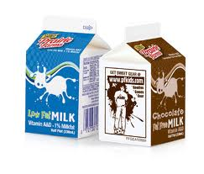
Fluid Milk Component
A variety of at least two types of pasteurized fluid milk must be offered at breakfast and lunch
The minimum portion size is 8 ounces
Allowable milk types are:
  Low-fat (1%) unflavored milk
  Fat-free unflavored and flavored milk
  SFAs may offer low-fat (unflavored) or fat-free (flavored or unflavored) lactose-free or lactose-reduced fluid milk or a nutritionally similar substitute
Refer to Accommodating Children with Special Dietary Needs manual
Notes:
A variety of at least two types of pasteurized fluid milk must be offered at breakfast and lunch within the allowable milk types: unflavored low-fat (1%) and fat-free (unflavored or flavored). The minimum portion size for fluid milk is 8 ounces.
Schools may offer a variety of milk options such as fat-free (unflavored or flavored), low-fat (unflavored only), and fat-free or low-fat (lactose-reduced or lactose-free). Note that if flavored reduced-lactose or lactose-free milk is offered, it also must be fat-free. Schools are not allowed to offer 2% or whole milk.
The allowable milk types established by this final rule also applies to meals for children in the 3-4 year-old age group. The USDA notified schools of this requirement for all school meals through implementation memorandum SP-29-2011.
There is no change to the requirements for the nutritional content of optional non-dairy beverages offered to students with special dietary needs in place of milk at the request of parents. Please refer to the Accommodating Children with Special Dietary Needs manual.

Slide 14
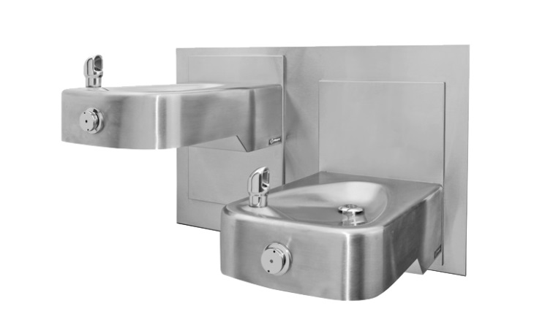
Water Availability
Free potable water must be available where breakfast and lunch meals are served
Water is in addition to milk and any other beverage being offered to students
SFAs cannot charge for potable water
Drinking fountain outside café may be used as long as students have unrestricted access during meal times
Notes:
Water must be made available to all students with breakfast and lunch meals.
Water availability is in addition to milk and any other beverages being served.
The SFA cannot charge for water (but may for bottled) and is not required to serve bottled water. Potable tap water is adequate to fulfill this requirement.
A drinking fountain located right outside of the cafeteria can be used to fulfill this mandate if students have free access to the fountain. Access is the key.

Slide 15
Part 2—Crediting
Notes:
Part 2--Crediting

Slide 16

Crediting Fruits and Vegetables
All fruits and vegetables are credited based on their volume as served
Some common exceptions include:
  Soups
    1 c commercially prepared tomato soup = ¼ c vegetable
  Leafy greens
    1 c leafy green = ½ c vegetable
  Fruit smoothies
The minimum creditable amount of fruit or vegetable is 1/8 cup
Notes:
All fruits and vegetables are credited based on their volume as served.
Some common exceptions include:
Soups (without a CN label or product formulation statement)
1 cup commercially prepared tomato soup equals ¼ cup vegetable
1 cup canned bean soup equals ½ cup vegetable
Raw leafy greens
1 cup equals ½ cup vegetable
Fruit smoothies
Homemade fruit smoothies made with milk or yogurt may credit toward both the fruit and milk or M/MA components, according to the quantities of each component listed in the standardized recipe.
Commercially prepared smoothies, however, may only credit towards the fruit component.
The minimum creditable amount of fruit or vegetable is 1/8 cup.

Slide 17
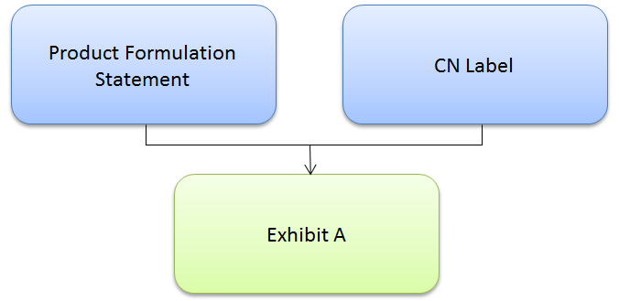
Crediting Grains
There are three ways to determine how many grain ounce equivalents (oz eq) are in a grain product
Refer to Exhibit A if you do not have a Product Formulation Statement or a CN Label for your product
Notes:
The amount of grain ounce equivalents in a grain product can be determined through a Product Formulation Statement from a manufacturer or a CN label from the product packaging. If you do not have a Product Formulation Statement or a CN Label, you must refer to Exhibit A to determine the quantity of grain oz. equivalents in a grain product.
Crediting grains correctly is a very important part of menu planning and can also be useful when completing production records, which will be discussed in an upcoming webinar.

Slide 18
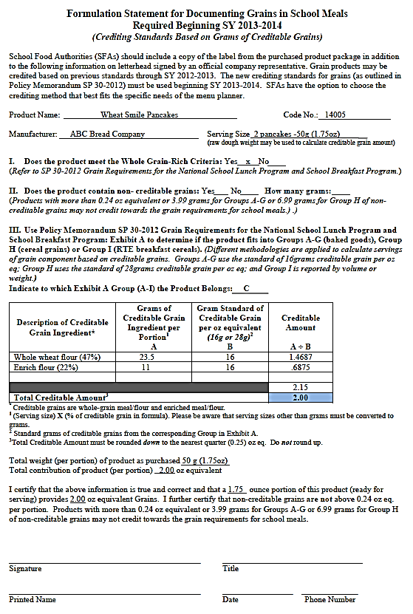
Product Formulation Statements
Notes:
We strongly encourage SFAs to have a completed, signed and dated, Product Formulation Statement from the manufacturer for accurate crediting purposes when purchasing a processed product without a CN label.
A Product Formulation Statement will provide specific information about how the product credits to meet CN meal patterns.
The Food Buying Guide can be used to credit foods in their natural state (cooked or un-cooked) that do not have added ingredients, such as a bone-in chicken breast with no additives .
Blank Prototype Product Formulation Statements are available for meat/meat alternates and grain products which may be sent to the manufacturer to be completed for your SFA.
We are aware that many districts have experienced issues with vendors’ nutrition and bid specifications stating that their products credit as certain ounce equivalents; however, they are not accurate in all instances. We strongly encourage you to ask your vendors for Product Formulation Statements for the products they are providing to you. Also, be mindful that product formulation statements often change, so be sure to check with your vendors periodically to make sure the one you are using is still current.
A product formulation statement template is included in the resource download.

Slide 19


Sample CN Label
Chicken Stir-Fry Bowl
Ingredient Statement:
Chicken, brown rice, broccoli, red peppers, carrots, onions, water, olive oil, soy sauce, spices.
CN
099135
Each 4.5 oz. Chicken Stir-Fry Bowl provides 1.5 oz. equivalent meat, 1.0 oz eq grains, ¼ cup dark green vegetable, ¼ cup red/orange vegetable,
and ⅛ cup other vegetable for Child Nutrition Meal Pattern Requirements. (Use of this logo and statement authorized by the Food and Nutrition Service, USDA XX/XX).
CN
CN
CN
Net Wt.: 18 pounds
Chicken Wok Company
1234 Kluck Street Poultry, PA 12345
Notes:
How to credit products, specifically grain products, has been a common issue this past year and we strongly recommend that you purchase products with CN labels whenever possible.
A CN label statement clearly identifies the contribution of a product toward the meal pattern requirements and protects a school from exaggerated claims about a product. It also provides a warranty against audit claims, if used according to the manufacturer's directions.
Manufacturers may apply for a Child Nutrition (CN) Label for qualifying products to indicate the number of grain oz. equivalents that meet the whole grain-rich criteria.
Products must contain at least 1/4 grain oz. equivalent per serving in order to include grains crediting on the CN Label.
The term, “oz eq grains” (which is highlighted in red text on the slide) on the CN Label indicates the product meets the current program requirements.
The terms “bread” and “bread alternate” on the CN label indicates the product meets previous program requirements for grains/breads, but may not meet current requirements.
We understand that many products you serve do not contain CN labels, especially grain items served at breakfast, such as pop tarts, mini pancakes and waffles, breakfast bars, etc. Many manufacturers print a statement on the product claiming it is a certain ounce equivalent. If the statement does not look like the one on this slide, it is not acceptable to use for crediting grains. You will either need to get a Product Formulation Statement from the manufacturer or use Exhibit A.

Slide 20
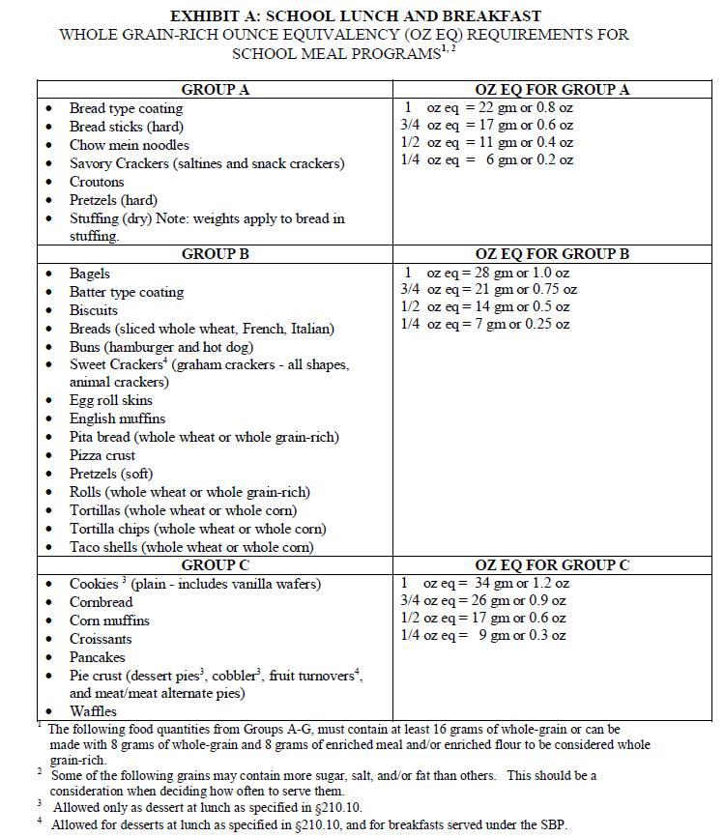
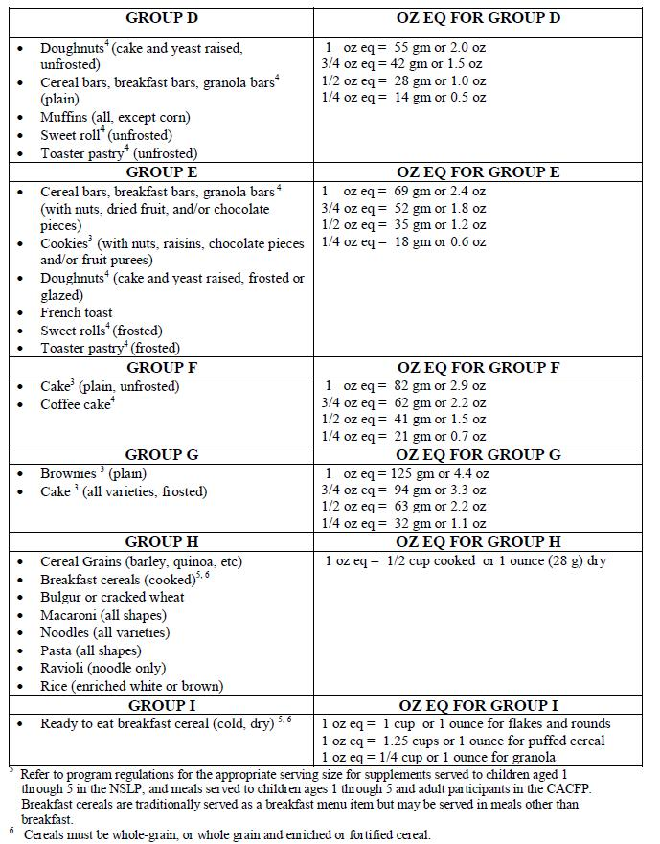
Crediting Grains Using Exhibit A
Notes:
This is Exhibit A, which is also included in the resource download. Refer to Exhibit A when crediting grains if a CN label or Product Formulation Statement is not available for that grain product. The minimum grain contribution per item is 0.25 oz eq.

Slide 21
How to Calculate Grain oz eq Using Exhibit A
Step 1
Ensure grain product is whole grain-rich
Step 2
Determine which group your product is listed under on Exhibit A
Step 3
Using the product’s nutrition facts label, determine how many grams are in the product
Step 4
Divide the total number of grams in the product by the number of grams equal to 1 oz eq grain
Step 5
Round down to the nearest 0.25 oz eq
Notes:
Now we will go over how to calculate grain oz equivalents if you do not have a CN label or PFS.
Step 1—Ensure grain product is whole grain-rich
Step 2—Determine which group your product is listed under on Exhibit A
Step 3—Using the product’s nutrition facts label, determine how many grams are in the product. (Be mindful of your serving size)
Step 4 – Divide the total number of grams in the product by the number of grams equal to 1 oz eq g
Step 5 – Round down to the nearest ¼ oz eq

Slide 22
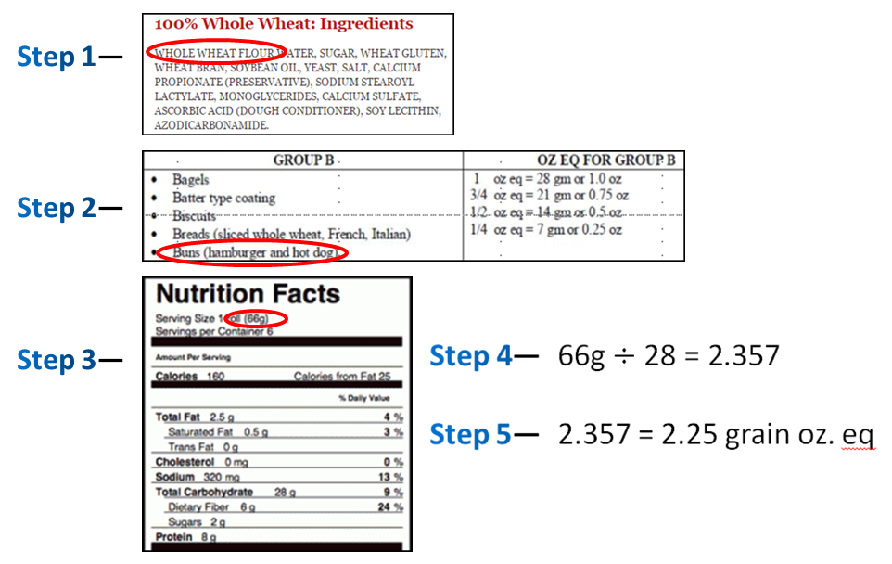
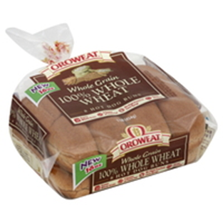
Calculating Grain oz eq
66g ÷ 28 = 2.357
2.357 = 2.25 oz eq grain
Notes:
Here is an example of how to calculate grains using Exhibit A
In step 1 we have identified the product as whole grain-rich.
For step 2 we have located the product in Group B in Exhibit A.
Next, we have determined that there are 66 grams in 1 serving of the hotdog bun.
For step 4, we divide 66g by 28, which equals 2.357.
In step 5, we round down to the nearest quarter ounce, which equals 2.25 grain oz. equivalents.
A lot of hamburger rolls, hot dog buns and breads did not meet the 2 grain oz. equivalents for the 9-12 grade level during last year’s cycle of Administrative Reviews. Make sure you are correctly calculating grain oz equivalents for all of your grain products.

Slide 23

Crediting Grain Items at Breakfast
Component | Ounce Equivalents | Items
 | 1.0-1.99 | 1 item
 | 2.0-2.99 | 1 or 2 items
Notes:
When crediting a grain item at breakfast, you will first need to determine its ounce equivalency. As stated on the previous slide, you must always round down to the nearest ¼ oz.; therefore, if an item is 1.88 oz eq, it would only credit as 1.75 grain oz. equivalents once it has been rounded down.
If an item is between 1.0 to 1.99 grain oz. eq, the item credits as 1 item
If an item is between 2.0-2.99 grain oz. eq, it credits as 1 or 2 items depending on what the menu planner decides. The menu planner must document the number of items that a larger grain product is being credited for, for Administrative Review purposes.

Slide 24

Crediting Meat/Meat Alternate
M/MA may be credited using a Product Formulation Statement or a CN Label
1 ounce cooked, skinless, unbreaded meat equals
1 oz eq M/MA
Crediting meat alternates:
  Nuts and Seeds: ¼ cup = 1 M/MA
    Can be used to meet up to 50% of the M/MA component daily
  Nut Butters: 2 tbsp = 1 M/MA
  Yogurt: 4 oz or ½ cup = 1 M/MA
  Cottage Cheese: ¼ c = 1 M/MA
  Tofu and Soy Products: ¼ cup = 1 M/MA
  Beans/Peas (Legumes): ½ cup = 2 M/MA
  Eggs: 1 large egg = 2 M/MA
  Cheese: 1 oz = 1 M/MA
Notes:
Crediting Meat and Meat Alternates
Meat and Meat Alternates may be credited using a Product Formulation Statement or a CN Label. Generally, 1 ounce of cooked, skinless, unbreaded meat equals 1 oz eq Meat and Meat Alternate.
Some common meat alternates are: Cheese: 1 oz = 1 M/MA, Eggs: 1 large egg = 2 M/MA and Yogurt: 4 oz or ½ cup = 1 M/MA

Slide 25
Part 3—Breakfast Requirements
Notes:
Part 3—Breakfast Requirements

Slide 26
SY 2015-2016 SBP Requirements
Breakfast Meal Components (3)
  Fruits/Vegetables
  Grains
    All grains must be 100% WGR
    Meat/Meat Alternates (optional)
  Milk
Must offer one cup fruit/vegetable
  Student must select at least ½ cup fruit/vegetable for meal reimbursement
Sodium targets per meal on average
  K-5 ≤ 540 mg
  6-8 ≤ 600 mg
  9-12 ≤ 640 mg
  K-8 ≤ 540 mg
Dietary Specifications (4)
  Min-max calorie range
  Saturated fat maximum
  Trans fat restriction
  Sodium
Notes:
Here are the requirements for breakfast for the 2015-2016 school year.
There are three breakfast meal components, which are grains (with optional meat/meat alternate); fruits/vegetables; and milk.
A minimum of 1 full cup of fruit must be offered at breakfast for all age/grade groups. Students must select at least ½ c for it to be a reimbursable meal.
Sodium targets per meal on average over the course of a week are listed for each age/grade group.
In addition to complying with the meal pattern requirements, meals served at breakfast must meet a few dietary specifications, including a minimum and maximum calorie range, a maximum for saturated fat, a daily restriction for trans fat, and a sodium target. The standards for calories, sodium and saturated fat are to be met on average over the week. This means that the levels of any of these in any one meal could exceed the standard as long as the average number for the week meets the standard.

Slide 27
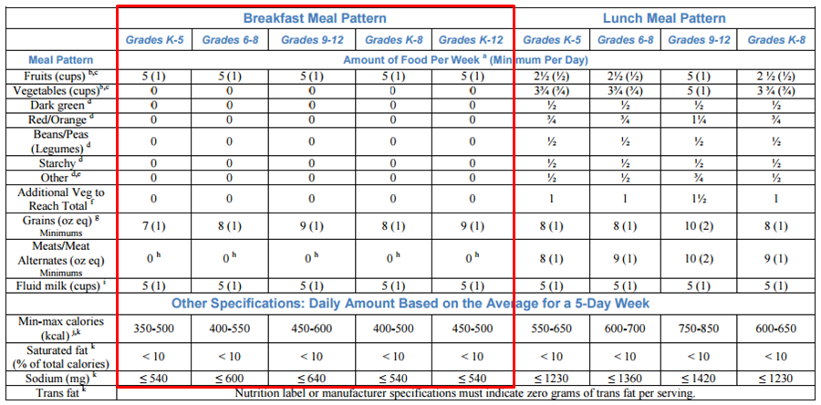
Breakfast (SBP) Meal Pattern for
SY 2015-2016
Notes:
This is the meal pattern chart for the breakfast program.

Slide 28
SBP Fruit and Vegetable Requirements
Must offer at least 1 full cup fruit or vegetable for all age/grade groups
Vegetables may be substituted for fruit
  At least 2 cups of the red/orange, dark green, legumes, or “other” vegetable subgroups must be offered during the week before a starchy vegetable can be considered. The sequence in which the subgroups are offered is not significant.
No more than half of the fruit or vegetable offerings over the course of the week may be in the form of juice
All juice must be 100% fruit or vegetable juice
SY 2015-2016 Breakfast Meal Pattern
Meal Pattern | Grades K-5 | Grades 6-8 | Grades K-8 | Grades 9-12 | Grades K-12
 | Amount of Food Per Week (Minimum Per Day)
Fruits or Vegetables (cups) | 5 (1) | 5 (1) | 5 (1) | 5 (1) | 5 (1)
Notes:
This slide shows fruit and vegetable requirements for the breakfast program.
For breakfast:
Schools must offer at least 1 full cup fruit or vegetable for all age/grade groups
If a school chooses to offer vegetables in place of fruits, it must plan to incorporate the under-consumed vegetables in the weekly menu before the starchy vegetables are considered. Provided at least 2 cups of the red/orange, dark green, legumes, or “other” vegetable subgroups are offered over the course of the week, it does not matter what day of the week the starchy vegetables are included in the menu. The sequence of offering the under-consumed vegetables or the starchy vegetables is not significant.
No more than half of the fruit or vegetable offerings over the course of the week may be in the form of juice; all juice must be 100% fruit or vegetable juice

Slide 29
SBP Grain Requirements
A minimum of 1 oz eq grain must be offered to each age/grade group daily
Schools may substitute M/MA for grains after the daily grain requirement is met
  1 ounce equivalent of M/MA is equivalent to 1 ounce equivalent of grains
  A school may offer a M/MA as an additional food and not credit it as a component
All grains offered at breakfast must be whole grain-rich
SY 2015-2016 Breakfast Meal Pattern
Meal Pattern | Grades K-5 | Grades 6-8 | Grades K-8 | Grades 9-12 | Grades K-12
 | Amount of Food Per Week (Minimum Per Day)
Grains (oz eq) | 7(1) | 8(1) | 8(1) | 9(1) | 9(1)
Notes:
The minimum daily grain requirement for breakfast is 1 oz eq for all age/grade groups. The minimum weekly grain requirement, however, varies for each age/grade group. The weekly requirement for grain ounce equivalents for students in the K-5 age/grade group is 7, 8 for students in the 6-8 and K-8 age/grade groups, and 9 for students in the 9-12 and K-12 age/grade groups.
Schools may substitute a meat or meat alternate as an alternative grain option after the 1 oz. grain requirement is met.
The background behind counting a meat or meat alternate as a grain is that the proposed regulations intended to require that a meat or meat alternate be offered at breakfast; however, based on comments that it was going to be a financial burden for many schools to meet this expectation, USDA made it optional. Therefore, a menu planner has discretion in deciding if, how, and when a meat or meat alternate is offered to students at breakfast.
If a meat or meat alternate is offered as an additional food that does not count towards the daily or weekly grain component requirements, it must still be counted towards the weekly dietary specifications for calories and saturated fat. Additional foods or “extras” cannot be credited as food items for the purpose of Offer versus Serve. Therefore, 4 food items must still be offered in addition to the meat or meat alternate.
As a best practice it is recommended that menu planners remain consistent when deciding to count a meat or meat alternate toward the grain component or not. Remember, in both situations, you still have to count it toward the weekly dietary specifications for calories, saturated fat and eventually sodium.
As a reminder, all grains offered must be whole grain-rich.

Slide 30
SBP Milk Requirements
SY 2015-2016 Breakfast Meal Pattern
Meal Pattern | Grades K-5 | Grades 6-8 | Grades K-8 | Grades 9-12 | Grades K-12
 | Amount of Food Per Week (Minimum Per Day)
Fluid milk (cups) | 5(1) | 5(1) | 5(1) | 5(1) | 5(1)
Must offer at least two choices at breakfast
Allowable milk types are low-fat (1% unflavored) or fat-free (flavored or unflavored)
Notes:
This slide shows the fluid milk component for breakfast. As you can see, there is a minimum requirement of 1 cup of fluid milk daily, totaling 5 cups over the course of a week. Schools must offer at least two types of milk to students at each meal. Allowable milk choices are fat-free (unflavored or flavored) and unflavored low-fat milk.

Slide 31
Dietary Specifications:
SBP Requirements
Breakfast Meal Pattern | K-5 | 6-8 | K-8 | 9-12 | K-12
Min-max calories (kcal) | (350-500) | (400-550) | (400-500) | (450-600) | (450-500)
Saturated fat (% of total calories) | < 10 | < 10 | < 10 | < 10 | < 10
Sodium (mg) Target 1 | ≤540 | ≤600 | ≤540 | ≤640 | ≤540
Trans fat | Nutrition label or manufacturer specifications must indicate zero grams of trans fat per serving.
Notes:
This chart shows the calorie ranges, sodium, saturated and trans fat requirements for each grade group for breakfast. Schools are required to meet the calorie, sodium, saturated fat and trans fat requirements as a per meal average over the course of the week.
A single breakfast menu plan could be written that would meet the requirement for all of the grade groups.
It is important to be mindful of calories when overlapping grade groups as there is a very small window. For example, if you are offering a K-12 breakfast meal pattern, the weighted average for calories over the course of the week is 450-500 calories per meal.

Slide 32
Part 4—Lunch Requirements
Notes:
Part 4—Lunch Requirements

Slide 33
NSLP Requirements
Lunch Meal Components
  Fruits
  Vegetables
    Dark green
    Red/orange
    Beans/legumes
    Starchy
    Other
  Grains
  Meats/Meat Alternates
  Fluid Milk
Sodium targets per meal on average
  K-5 ≤ 1230 mg
  6-8 ≤ 1360 mg
  9-12 ≤ 1420 mg
  K-8 ≤ 1230 mg
Dietary Specifications (4)
  Min-max calorie range
  Saturated fat maximum
  Trans fat daily requirement restriction
  Sodium
Notes:
There are 5 meal components for lunch. Lunch meal components are: fruits, vegetables (including requirements for vegetable subgroups), grains, meats/meat alternates and milk. Unlike breakfast, fruits and vegetables are separate components as are grains and meat and meat alternates.
In addition to complying with the meal pattern requirements, lunches must also meet a few dietary specifications, including a minimum and maximum calorie range, a maximum for saturated fat, a daily restriction for trans fat, and a sodium target. The standards for calories, sodium and saturated fat are to be met on average over the week. This means that the levels of any of these in any one meal could exceed the standard as long as the average number for the week meets the standard.

Slide 34
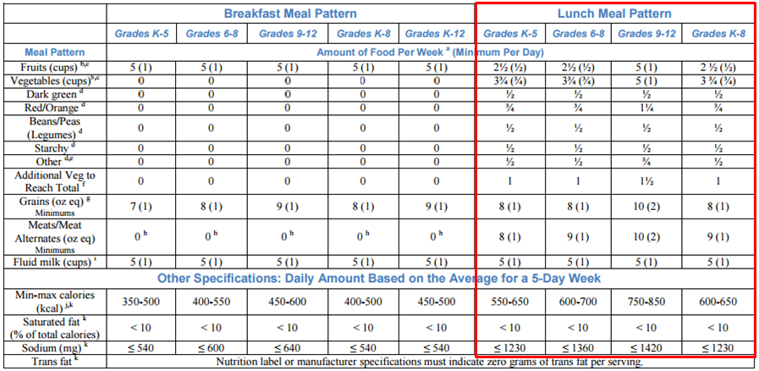
Lunch (NSLP) Meal Pattern for
SY 2015-2016
Notes:
This is the lunch meal pattern chart which is included in the resource download. We will now break down each requirement in greater detail.

Slide 35
NSLP Fruit Requirements
SY 2015-2016 Lunch Meal Pattern
Meal Pattern | Grades K-5 | Grades 6-8 | Grades K-8 | Grades 9-12
 | Amount of Food Per Week (Minimum Per Day)
Fruits (cups) | 2 ½ (½) | 2 ½ (½) | 2 ½ (½) | 5 (1)
At least ½ cup of fruit must be offered daily for grades K-5, 6-8, and K-8
At least 1 full cup fruit must be offered daily for grades 9-12
100% fruit juice may be used to meet no more than one-half of the fruits component
Notes:
This slide shows fruit requirements for lunch.
At least ½ cup of fruit must be offered daily for grades K-5, 6-8, and K-8, while at least 1 full cup fruit must be offered daily for grades 9-12
100% fruit juice may be used to meet no more than one-half of the daily fruits component

Slide 36
NSLP Vegetable Requirements
Daily and Weekly Vegetable Requirements
Weekly Vegetable Subgroup Requirements
Grades K-5
¾ cup daily
3 ¾ cups weekly
Grades 6-8
¾ cup daily
3 ¾ cups weekly
Grades K-8
¾ cup daily
3 ¾ cups weekly
Grades 9-12
1 cup daily
5 cups weekly
SY 2015-2016 Lunch Meal Pattern
Meal Pattern | Grades K-5 | Grades 6-8 | Grades K-8 | Grades 9-12
 | Amount of Food Per Week
Dark green | ½ | ½ | ½ | ½
Red/Orange | ¾ | ¾ | ¾ | 1 ¼
Beans/Peas (Legumes) | ½ | ½ | ½ | ½
Starchy | ½ | ½ | ½ | ½
Other | ½ | ½ | ½ | ¾
Additional Veg to Reach Total | 1 | 1 | 1 | 1 ½
Notes:
This slide shows lunch requirements for the vegetable component on the left and vegetable subgroup requirements on the right for each age/grade group.
There are weekly minimums for the vegetable subgroups, which means that over the course of the week, the required amount of each subgroup must be met, but that on any given day there are no specific subgroup quantity requirements.
The subgroups required each week consist of: dark green, red/orange, beans/peas (legumes), starchy, and other.
The “other” vegetable subgroup is a distinct grouping of food items, as classified by the 2010 Dietary Guidelines. Schools can substitute vegetables from the dark green, red/orange, or beans/peas for “other” vegetables if they desire, but they may NOT substitute starchy vegetables for the “other” vegetable subgroup.
Additionally, there is a catch-all category added for additional vegetables that can come from any subgroup to help meet the weekly total
100% veg juice may be used to meet no more than one-half of the veg component
Cooked dry beans or peas (legumes) may be counted as either a vegetable or as a meat alternate, but not as both in the same meal
There is a dark green vegetable exemption to adhere to Jewish Dietary Law. In order to receive this exemption, you must submit a request for NYSED approval. In lieu of dark green vegetables, red/orange or beans/peas (legumes) must be offered to meet quantity requirements.

Slide 37
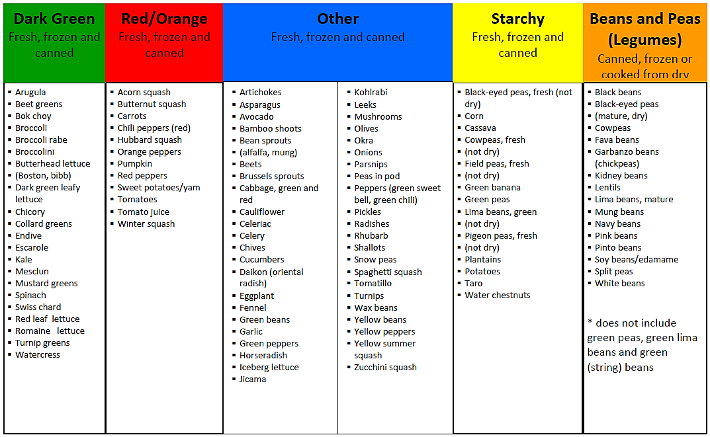
Examples of Vegetable Subgroups
Notes:
This vegetable subgroup handout has been included in the resource download and should be used when planning lunch menus to ensure that vegetables from each required subgroup are included.

Slide 38
NSLP Grain Requirements
SY 2015-2016 Lunch Meal Pattern
Meal Pattern | Grades K-5 | Grades 6-8 | Grades K-8 | Grades 9-12
 | Amount of Food Per Week (Minimum Per Day)
Grains (oz eq) | 8(1) | 8(1) | 8(1) | 10(2)
Daily alternative menu entrees that contain only 1 oz eq grain would not meet weekly grain requirements
  Example: Chef Salad with 1 grain oz eq grain roll
Grain-based desserts may account for up to 2 oz eq per week towards meeting the grain requirement
    Graham crackers are grain-based dessert at lunch
All grains offered at lunch must be WGR
Notes:
This slide shows the grain component for lunch. The numbers in parentheses refer to the minimum amount to be offered daily: for grades K-5, 6-8, K-8 a minimum of 1 grain ounce equivalent must be offered. For students in the 9-12 age/grade group, the minimum quantity is 2 grain oz. equivalents.
For K-5, 6-8 and K-8, daily alternative menu entrees that contain only 1 oz eq grain will not meet weekly grain requirements. For example, a Chef Salad offered with a 1 oz eq roll will only contribute a total of 5 oz eq over the course of the week, which does not meet the required 8 ounces equivalents.
Grain-based desserts may only contribute up to 2 grain oz. equivalents towards meeting the grain requirement. As a reminder, graham crackers are considered a grain-based dessert when served at lunch.
All grains must be whole grain-rich.

Slide 39
NSLP Meat/Meat Alternate Requirements
SY 2015-2016 Lunch Meal Pattern
Meal Pattern | Grades K-5 | Grades 6-8 | Grades K-8 | Grades 9-12
 | Amount of Food Per Week (Minimum Per Day)
M/MA (oz eq) | 8(1) | 9(1) | 9(1) | 10(2)
Daily alternative menu entrees that contain only 1 M/MA would not meet weekly M/MA requirements
  Example: Peanut Butter and Jelly Sandwich with 2 Tbsp. peanut butter
Schools offering only one choice of M/MA should not serve the same form of meat (ground, diced, pieces) more than three times in the same week
Beans/peas (legumes) cannot count as both a M/MA and a vegetable in the same meal
Notes:
These are the requirements for the meat or meat alternate component at lunch. Again, the numbers in parentheses refer to the minimum amount to be offered daily: for grades K-5, 6-8, K-8 the requirement is 1 oz eq and for grades 9-12, the minimum requirement is 2 oz eq.
Similar to requirements for grains, daily alternative menu entrees that contain only 1 oz of meat or meat alternate will not meet weekly meat or meat alternate requirements for the K-5, 6-8 and K-8 age/grade groups. For example, a Peanut Butter and Jelly Sandwich prepared with 2 Tbsp, or 1 ounce eq, of peanut butter will only contribute 5 oz. of meat or meat alternate over the course of the week, which does not meet the required 8 or 9 oz. eq. This was a very common finding during last year’s Administrative Reviews.
Schools that offer only one choice of meat or meat alternate during lunch cannot serve the same form of meat (such as ground, diced or pieces) more than three times in the same week, so it is important to vary the form of meat and meat alternates served whenever possible.
If beans/peas (legumes) are served as a meat alternate, they cannot also count toward the vegetable component in the same meal.

Slide 40
NSLP Milk Requirements
SY 2015-2016 Lunch Meal Pattern
Meal Pattern | Grades K-5 | Grades 6-8 | Grades K-8 | Grades 9-12
 | Amount of Food Per Week (Minimum Per Day)
Fluid milk (cups) | 5(1) | 5(1) | 5(1) | 5(1)
Must offer at least two choices at breakfast
Allowable milk types are low-fat (1% unflavored) or fat-free (flavored or unflavored)
Notes:
Consistent with milk requirements for breakfast a minimum of 1 cup of fluid milk each day and 5 cups per week must be offered to students at lunch. Schools must offer at least two milk choices from the allowable milk types. Allowable milk types include fat-free (unflavored or flavored) and unflavored low-fat milk.

Slide 41
Dietary Specifications:
NSLP Requirements
Lunch Meal Pattern | K-5 | 6-8 | K-8 | 9-12
Min-max calories (kcal) | (550-650) | (600-700) | (600-650) | (750-850)
Saturated fat (% of total calories) | < 10 | < 10 | < 10 | < 10
Sodium (mg) Target 1 | ≤1230 | ≤1360 | ≤1230 | ≤1420
Trans fat | Nutrition label or manufacturer specifications must indicate zero grams of trans fat per serving.
Notes:
This chart shows the calories, sodium, saturated fat and trans fat requirements for each grade group. Schools are required to meet the calorie, sodium, saturated fat and trans fat requirements as a per meal average over the course of the week.
It is very important to be mindful of dietary specifications requirements when planning meals for overlapping age/grade groups. For example, the K-8 menu plan has a very small window of calories where the K-5 and 6-8 requirements overlap. The calorie range for lunch for the K-8 menu is between 600-650 calories per meal and the sodium limit (less than 1,230mg) is consistent with the lower (K-5) age/grade group.

Slide 42
Part 5—Offer Versus Serve
Notes:
Part 5—Offer Versus Serve

Slide 43

Offer Versus Serve (OVS) at Breakfast
OVS is optional for all age/grade groups
Schools must offer all three required components in at least the minimum required amounts
Schools must offer at least 4 food items from the three required components
Students must select at least 3 food items, with one of the food items being at least ½ cup of fruit or vegetable
Notes:
Offer Versus Serve is optional at breakfast for all age/grade groups.
If you are going to participate in Offer Versus Serve, you must offer at least 4 food items from the three required breakfast components. Students must then select 3 of the items, with one being a ½ cup of fruit or vegetable.

Slide 44

Offer Versus Serve (OVS) at Lunch
OVS is only required for students in the 9-12 age/grade group,; it is optional for all other age/grade groups
Schools must offer all five required components in at least the minimum required amounts
Students are allowed to decline two of the five required food components
Students must take a minimum of a ½ cup of fruit or vegetable
If a student chooses ½ cup of fruit or vegetable, the other two components selected must be in the minimum required quantities to be considered reimbursable
  A student in the K-5 age/grade group selects ½ cup carrots, and a hamburger (2 oz. M/MA) on a whole wheat bun (1.5 oz eq grain)
  √ Reimbursable!
  A student in the 9-12 age/grade group selects ½ cup carrots, and a hamburger (2 oz. M/MA) on a whole wheat bun (1.5 oz eq grain)
   Not Reimbursable!
Notes:
Offer Versus Serve is required for the 9-12 age/grade group and is optional for all other age/grade groups at lunch.
If you are going to participate in OVS, you must offer all 5 lunch components in at least the minimum required amounts for each age/grade group. Students must then select 3 of the components, with one being a ½ cup of fruit or vegetable.
When selecting the 3 components, the student must have 2 full components along with at least ½ cup of fruit or vegetable in order to be considered a reimbursable meal.
If a student chooses ½ cup of fruit or vegetable, the other two components selected must be in the minimum required quantities to be considered reimbursable
For example:
A student in the K-5 age/grade group selects ½ cup carrots and a 2 oz. hamburger on a 1 and a half oz. whole wheat bun. This would be considered reimbursable.
A student in the 9-12 age/grade group selects ½ cup carrots and a 2 oz. hamburger on a 1 and a half oz. whole wheat bun. This would not be considered reimbursable.

Slide 45
Multiple Serving Lines
All components of the reimbursable meal must be available on all service lines in at least the minimum reimbursable portions
  Ensure all vegetable subgroups are available on all serving lines throughout the week
All reimbursable salad bars must include the grain, meat/meat alternate, fruit, vegetable and milk components
  Pre-portioned meats and grains are strongly recommended to guarantee that students select components in the required quantities
Notes:
If you have more than 1 serving line in a building, you must ensure that all serving lines contain all five components of the meal pattern, in at least the minimum portions.
If a salad bar is a stand alone reimbursable line it must include all components; including the grain, meat/meat alternate, fruit, vegetables and milk. Pre-portioned meats and grains are strongly recommended to guarantee that students select components in the required quantities to be considered reimbursable.
Make sure that all vegetable subgroups are made available on all serving lines . For example, if the main entrée includes a dark green leafy vegetable, ensure that the alternate lines include a dark green leafy vegetable on the same service day or on another day during the week.

Slide 46
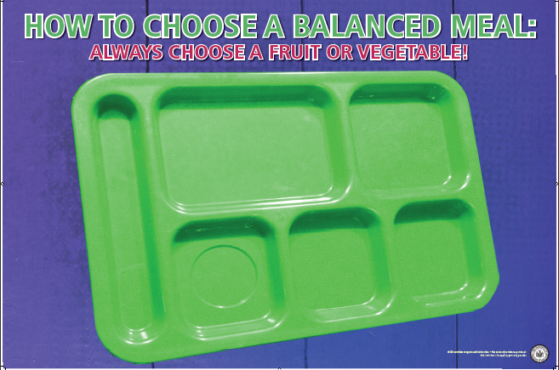
Signage
Must display at or near the beginning of each breakfast and lunch line!
Write the breakfast and lunch meal components and items daily!
Laminate this poster to use as a dry erase board!
Order Free Posters on the SED Child Nutrition Knowledge Center website!
Notes:
Signage is required at or near the beginning of each breakfast and lunch line. A menu with all components and items listed must be displayed to guarantee that students are aware of the meal offerings.
If Offer Versus Serve is implemented, the signage must also show that 3 of the 5 components are required for a reimbursable meal and that one of those 3 components must be a ½ cup of fruit or vegetable.
Signage is not required for field trips and other venues where signage may be problematic. However, if choices are offered, other methods should be used to inform students what to select.
Free posters and other resources are available from our office. The order form is available on the Child Nutrition Knowledge Center, under the resource tab.

Slide 47
Example of Appropriate Signage
Choose one:
Spaghetti & Meatball
Turkey Sandwich
Choose one:
Skim Chocolate
1% White
Please select at least 3 components (including a ½ cup of fruit or
vegetable)
Made w/ Meat & Whole Grains!
Drink Milk!
Must choose at least ½ cup of Fruit or Vegetable:
Fresh Pear ● Steamed Broccoli
Diced Peaches ● Romaine Salad
Notes:
This is an example of appropriate signage. As you can see, the menu offerings are listed by component to inform students what constitutes a reimbursable meal. The signage also informs students to select at least three components, including a ½ cup of fruit of vegetable.

Slide 48

Child Nutrition Program Administration
89 Washington Avenue, Room 375 EBA
Albany, NY 12234
(518) 473-8781
www.nysed.gov/cn/cnms.htm
The U.S. Department of Agriculture prohibits discrimination against its customers, employees, and applicants for employment on the bases of race, color, national origin, age, disability, sex, gender identity, religion, reprisal, and where applicable, political beliefs, marital status, familial or parental status, sexual orientation, or all or part of an individual's income is derived from any public assistance program, or protected genetic information in employment or in any program or activity conducted or funded by the Department. (Not all prohibited bases will apply to all programs and/or employment activities.)
If you wish to file a Civil Rights program complaint of discrimination, complete the USDA Program Discrimination Form, found online at http://www.ascr.usda.gov/complaint_filing_cust.html, or at any USDA office, or call (866) 632-9992 to request a form. You may also write a letter containing all of the information requested in the form. Send your completed complaint form or letter to us by mail at U.S. Department of Agriculture, Director, Office of Adjudication, 1400 Independence Avenue, S.W., Washington, D.C. 20250-9410, by fax (202) 690-7442 or email at program.intake@usda.gov.
Individuals who are deaf, hard of hearing or have speech disabilities, may contact USDA through the Federal Relay Service at (800) 877-8339; or (800) 845-6136 (Spanish).
USDA is an equal opportunity provider and employer.
Notes:
You have completed view the Meal Pattern webinar and may now close out of your browser by selecting the “X” on the right side of the webinar window.
You will then be directed to complete a brief five question assessment of the content covered in the webinar.
You must complete the assessment to receive credit for viewing this webinar.

