Slide 1

Nutrition Standards in the School Breakfast Program for 2013-14

Slide 2
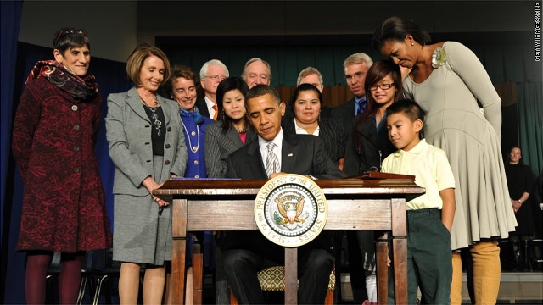
Healthy Hunger Free Kids Act (HHFKA)-2010
Nutrition Standards in the NSLP and SBP Programs
Historic legislation updating the nutrition standards in the NSLP & SBP for the first time in 15 years

Slide 3

The New Meal Patterns
Designed to improve nutrient density by:
Limiting calories
Serving more fruits, vegetables, legumes and whole grains
Serving lean meats
Limiting sodium & saturated fat
Requiring trans fat to be zero grams (<0.5 g)
*Serving only low fat (unflavored) and fat free milk (*required in both SBP & NSLP in 2012)

Slide 4
The Meal Patterns
Daily & Weekly Requirements
 | Breakfast Meal Pattern |  |  | Lunch Meal Pattern
 | Grades K-5ª | Grades 6-8ª | Grades 9-12ª | Grades K-5 | Grades 6-8 | Grades 9-12
Meal Pattern | Amount of Food^{b} Per Week (Minimum Per Day)
Fruits (cups)^{c,d} | 5 (1) ^{e} | 5 (1) ^{e} | 5 (1) ^{e} | 2.5 (0.5) | 2.5 (0.5) | 5 (1)
Vegetables (cups)^{c,d} | 0 | 0 | 0 | 3.75 (0.75) | 3.75 (0.75) | 5 (1)
Dark green ^{f} | 0 | 0 | 0 | 0.5 | 0.5 | 0.5
Red/Orange ^{f} | 0 | 0 | 0 | 0.75 | 0.75 | 1.25
Beans/Peas (Legumes) ^{f} | 0 | 0 | 0 | 0.5 | 0.5 | 0.5
Starchy^{f} | 0 | 0 | 0 | 0.5 | 0.5 | 0.5
Other ^{f,g} | 0 | 0 | 0 | 0.5 | 0.5 | 0.75
Additional Veg to Reach Total^{h} | 0 | 0 | 0 | 1 | 1 | 1.5
Grains (oz eq) ^{i} | 7-10 (1) ^{j} | 8-10 (1) ^{j} | 9-10 (1) ^{j} | 8-9 (1) | 8-10 (1) | 10-12 (2)
Meats/Meat Alternates (oz eq) | 0 ^{k} | 0 ^{k} | 0 ^{k} | 8-10 (1) | 9-10 (1) | 10-12 (2)
Fluid milk (cups) ^{l} | 5 (1) | 5 (1) | 5 (1) | 5 (1) | 5 (1) | 5 (1)
Other Specifications: Daily Amount Based on the Average for a 5-Day Week
Min-max calories (kcal)^{m,n,o} | 350-500 | 400-550 | 450-600 | 550-650 | 600-700 | 750-850
Saturated fat (% of total calories)^{n,o} | < 10 | < 10 | < 10 | < 10 | < 10 | < 10
Sodium (mg)^{n, p} | < 430 | < 470 | < 500 | < 640 | < 710 | < 740
Trans fat^{n,o} | Nutrition label or manufacturer specifications must indicate zero grams of trans fat per serving.

Slide 5
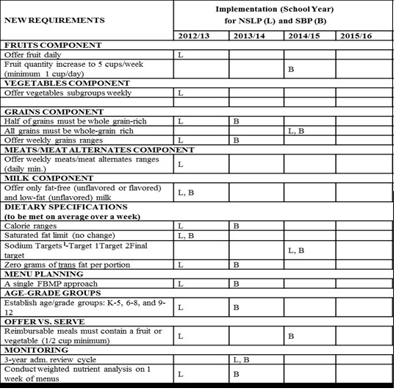
Implementation Time Line

Slide 6

Summary of Changes for SBP Meal Patterns
A single food based menu planning system for the SBP
Majority of changes begin for the SBP in 2013-14
Three grade groups (K-5), (6-8), (9-12)
Calorie ranges must be met over the week
Trans fats must be zero

Slide 7
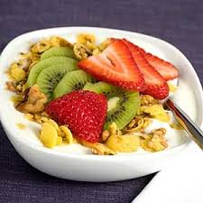
Breakfast Requirements 2013-14
Components
Breakfast consists of 3 components from three food groups
  Fruit/vegetables
  Grains
    meat/meat alternate (optional)
  Milk

Slide 8

Breakfast Requirements 2013-14
Food Items
A food item is a specific food offered within the 3 food components
For Offer vs. Serve (OVS) a school must offer at least 4 food items
(from the 3 food components)
A student must select at least 3 food items

Slide 9
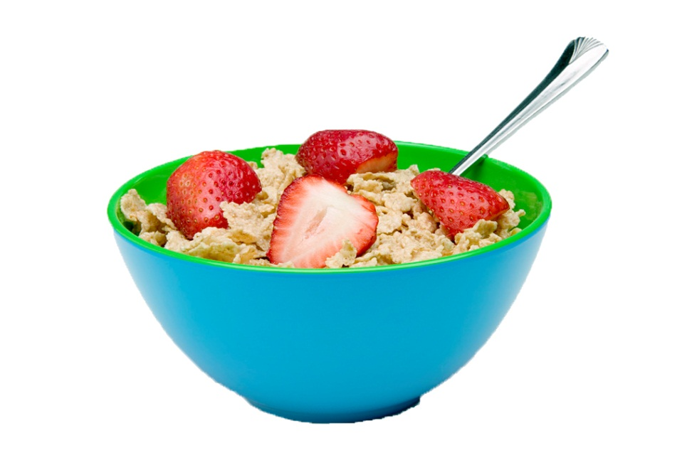
Breakfast Grains
All school programs must offer grains in ounce equivalents (oz eq) in 2013-14
A minimum of 1 oz eq of grains must be offered to each grade group daily
The minimum weekly offerings of grains vary by grade group

Slide 10
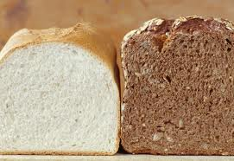
Whole Grain Rich Foods (WGR) at Breakfast
50% of grains offered must be whole grain rich beginning;
  2013-14 for the SBP
  a whole grain rich item does not need to be offered daily provided ½ of all grains for the week are whole grains
100% of grains offered must be whole grain rich for the SBP & NSLP in 2014-15

Slide 11
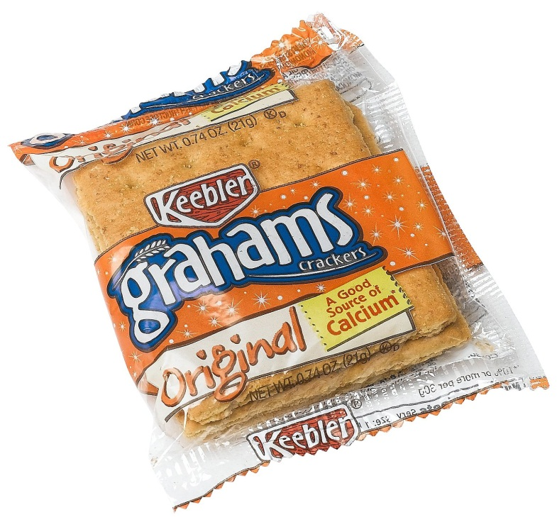
Grain-based Desserts
No grain-based dessert limit at breakfast
Sugar in grain items is allowed
  Some grain products can only be served as desserts in lunch/not allowable in breakfast (brownies, cookies)

Slide 12
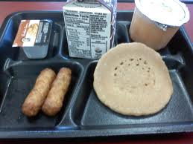
Optional Meat/Meat Alternate
No separate requirement to offer meat/meat alternate (m/ma) in the new SBP meal pattern
Schools may offer a m/ma in place of part of the grains component after the minimum 1 oz eq daily grain requirement is offered

Slide 13
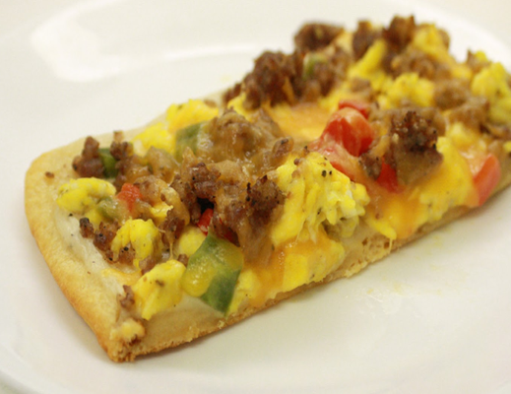
Optional Meat/Meat Alternate
A serving of 1 oz eq of m/ma may credit toward a 1 oz eq of grains
Alternately a school may offer a m/ma as an additional food and not credit it toward any component

Slide 14
Offering a M/MA as an additional Item
(not credited)
If a m/ma is offered as an additional food,
  it does not count towards the daily or weekly grain component requirements
  it must be counted towards the weekly dietary specifications for calories and saturated fat.
  it cannot be credited as food items for purposes of OVS.

Slide 15
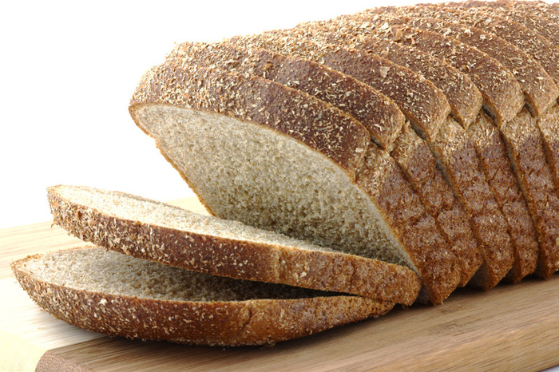
Flexibility in the M/MA & Grain Maximums Extended for 2013-14
Menus must meet daily & weekly minimums
No maximums
Calorie and saturated fat requirements

Slide 16

Breakfast Fruit/Juice/Vegetable Requirements 2013-14
No change to the existing fruit/juice/vegetable component
Offer at least ½ c of fruits and/or vegetables daily
No limitations for juice

Slide 17

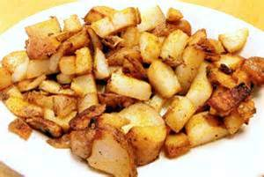
Breakfast Fruit/Juice/Vegetable Requirements 2013-14
Students are not required to take fruit under OVS in SY 2013-14 at breakfast
Fruits and vegetables may be offered interchangeably

Slide 18
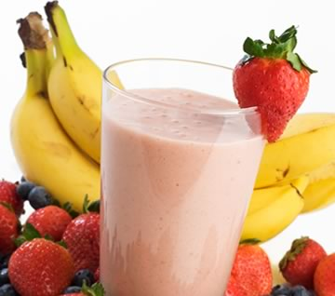
Fruits- Smoothies
Fruit smoothies prepared in-house may credit toward both the fruit and milk components
Commercial products may only credit toward fruit component
All meal components must be offered in the required minimum amounts
  Must still offer variety of fluid milk choices
  Additional fruit offerings encouraged
Refer to memo SP 36-2012, released 7/11/12

Slide 19
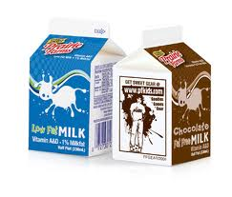
Breakfast Milk Requirements 2013-14
Only low-fat (1%) unflavored and fat-free flavored or unflavored milk
  must have a variety of at least two or more types
  required in both the SBP & the NSLP
  serving size must be at least 8 ounces

Slide 20
Weekly Grain & Calorie
 | K-5 | 6-8 | K-8 | 9-12 | K-12
Grains (oz eq) | 7-10 (1) | 8-10 (1) | 8-10 (1) | 9-10 (1) | 9-10 (1)
Calories | (350-500) | (400-550) | (400-500) | (450-600) | (450-500)

Slide 21
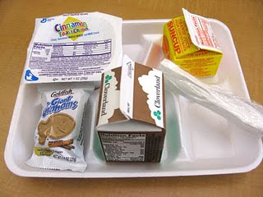
Reimbursable Breakfasts & Offer VS Serve (OVS)
Optional for all grade levels
4 food items must be offered daily
Must select at least 3 food items

Slide 22
SBP Menu Variety and Items
Choose 1 (each selection counts as 2 items) | Choose 1 | Choose 1
Breakfast Pizza OR | ½ cup Peaches | 1 % Milk
Mini Waffles OR | Fresh Banana | Fat Free Milk
Cereal Graham Crackers | ½ cup 100% Fruit Juice

Slide 23
SBP Menu Variety and Items
Choose 1 OR Choose Up To Any 2 (each selection (can be duplicate) counts as 2 items) items) |  | Choose 1 | Choose 1
Breakfast Sandwich | Cereal | 1/2 cup Peaches | 1% Milk
Bagel | toast | Fresh Apple | Fat Free Milk
Mini Pancakes | Graham Crackers | ½ cup 100% Fruit Juice

Slide 24
Sample Menu with 4 Items
Component | Crediting | Food items
Whole Wheat Bagel | 2 oz eq grain | 2 grain items
Fresh Orange | ½ c fruit | 1 fruit/veg item
Variety of Milk | 1 cup | 1 milk item

Slide 25



MEAL OR NO MEAL?

Slide 26
MEAL-3 of 4 items selected (fruit is not required in 2013-14)

Slide 27


MEAL OR NO MEAL?

Slide 28
MEAL
3 of 4 items selected- bagel is 2 oz eq

Slide 29
Sample Menu with 5 Items
Components | Crediting | Food items
Blueberry Muffin | 2 oz eq grain | 2 grain items
Cereal | 1 oz eq grain | 1 grain item
Kiwi Slices | ½ c fruit | 1 fruit/veg item
Variety of Milk | 1 cup | 1 milk item

Slide 30

MEAL OR NO MEAL?

Slide 31
MEAL
4 of 5 items selected-muffin is 2 oz eq

Slide 32
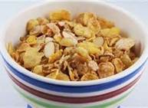
MEAL OR NO MEAL?

Slide 33
MEAL- 3 of 5 items selected

Slide 34
Sample Menu with 4 Items and a M/MA is Credited as a Grain Item
Components | Crediting | Food items
Yogurt | 1 oz eq grain | 1 grain item
Whole Grain Cereal | 1 oz eq grain | 1 grain item
Granny Smith Apple | ½ c fruit | 1 fruit/veg item
Variety of Milk | 1 cup | 1 milk item

Slide 35
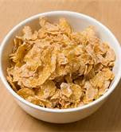
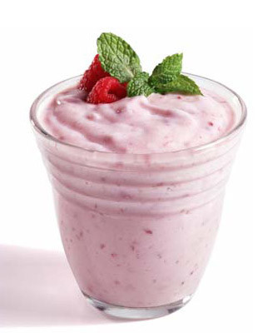
MEAL OR NO MEAL?

Slide 36
MEAL-3 of 4 items selected (fruit is not required in 2013-14)

Slide 37

MEAL OR NO MEAL?

Slide 38
MEAL- 3 of 4 items selected the yogurt is counting toward the grain eq

Slide 39
MEAL OR NO MEAL?

Slide 40
MEAL-*if the menu planner allows more than 1 selection of each item

Slide 41
Sample Menu with 4 Items and a M/MA is offered as an Additional Item (not credited)
Components | Crediting | Food Items
Yogurt |  | Not a food item
Whole Grain Toast | 1 oz eq grain | 1 grain item
Graham Crackers | 1 oz eq grain | 1 grain item
Orange Juice | ½ c fruit | 1 fruit/veg item
Variety of milk | 1 cup | 1 milk item

Slide 42
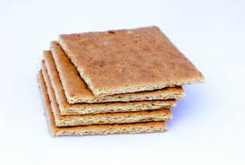
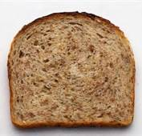
MEAL OR NO MEAL?

Slide 43
MEAL-3 OF THE 4 ITEMS SELECTED

Slide 44
MEAL OR NO MEAL?

Slide 45
NO MEAL
Only 2 items selected the yogurt is additional

Slide 46
Sample Menu with 4 Items and a M/MA is offered as an Additional Item in a Combination Item (not credited)
Components | Crediting | Food Items
Egg Sandwich on an English Muffin | 2 oz eq grain from bread, egg = extra | 2 grain food items; egg is not a food item
apple | ½ c fruit | 1 fruit/veg item
milk variety | 1 cup | 1 milk item

Slide 47

MEAL OR NO MEAL?

Slide 48
MEAL-3 of 4 items selected (fruit is not required in 2013-14)

Slide 49
SBP Menus
Menus for SBP must be posted daily listing items for selection
Menu planners determine how menu items credit based on offerings
There is a difference between variety and the number of items that can be selected

Slide 50
Suggestions for SBP Menu Planning
Start with simple menus-consider a cycle menu
Keep the crediting consistent (m/ma as a grain or an extra)
Gradually introduce more whole grains to move from 50 to 100%
Use more fruit than juice

Slide 51
Pre-plating/Bundling
Remember – OVS is not required at breakfast
Pre-plating/bundling is allowed
Encouraged to offer choices to the extent possible

Slide 52


Sample CN Label
Chicken Stir-Fry Bowl
Ingredient Statement:
Chicken, brown rice, broccoli, red peppers, carrots, onions, water, olive oil, soy sauce, spices.
CN
099135
Each 4.5 oz. Chicken Stir-Fry Bowl provides 1.5 oz. equivalent meat, 1.0 oz eq Grains, ¼ cup dark green vegetable, ¼ cup red/orange vegetable, and ⅛ cup other vegetable for Child Nutrition Meal Pattern Requirements. (Use of this logo and statement authorized by the Food and Nutrition Service, USDA XX/XX).
CN
CN
CN
Net Wt.: 18 pounds
Chicken Wok Company
1234 Kluck Street Poultry, PA 12345

Slide 53
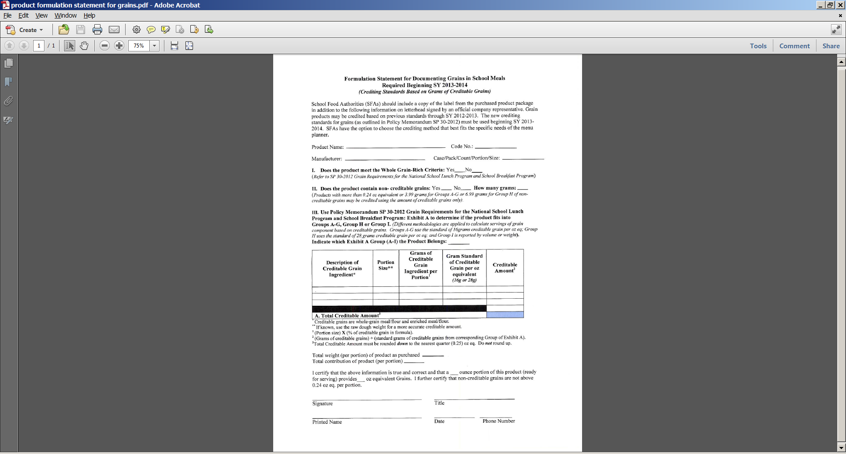
Product Formulation Statements
A Product Formulation Statement (PFS) will provide specific information about how the product credits to meet CN meal patterns

Slide 54
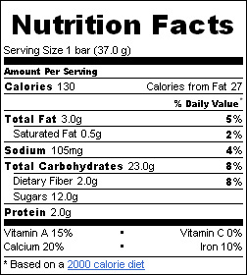
Calculating Grain Ounce Equivalents using Exhibit A
This is a label from a popular cereal bar containing fruit.
On the label it states:
Child Nutrition Program: 1 bread equivalent
Is this an acceptable CN label?
NO!! If we don’t have a CN label or a product formulation statement, we will have to use Exhibit A to calculate the ounce equivalents based on the weight of the whole product.
Which category on Exhibit A would we use?
Group E- cereal bar containing fruit
How many grams is equal to a one ounce equivalent in Group E?
69 grams
How many grams does the cereal bar weigh?
37 grams
How do we calculate the ounce equivalents?

Slide 55
Calculating Grain Ounce Equivalents using Exhibit A
Calculation:
37 grams ÷ 69 grams = 0.53623
Always round down to the nearest quarter
0.53623 = .50
This cereal bar is actually .5 of an ounce equivalent.
You would have to serve two cereal bars to equal the required one ounce equivalent of grain for the school breakfast program.

Slide 56
National School Lunch Program
Grain and Meat/Meat Alternate flexibility continues through 2013-14
Half of grain products Whole Grain Rich (WGR)
  Must contain at least 50% Whole Grain
Production Records for All meals

Slide 57
Required Elements of a Production Record
*required for all meals
All food items on the reimbursable menu
-including condiments and toppings
Quantity Prepared
Portion Sizes for each grade/age group
Number of reimbursable portions served
Number of a la carte/non reimbursable portions served (milk and second meals)
Number of leftover portions

Slide 58
Six Cent Certification
Can receive $.06 in 2013-14 and beyond
If you have not completed $.06 certification, why not?
www.nymenureview.com

Slide 59
New Administrative Review
Future meetings
Three Year Cycle
Breakfast review in 50% of NSLP reviewed sites
Off-Site and On-Site Review Components
Nutrient Analysis of both B and L
Resource Management Component

Slide 60
Verification
New Verification Form
  Read detailed instructions
  Based on eligible students as of October 1
  Do not include carryovers

Slide 61
Paid Lunch Equity (PLE)
Must conduct evaluation of PLE Annually
  Can use USDA Tool or Alternative Method
  Must keep backup documentation for method used
New flexibility to be exempt from PLE if excess fund balance exceeds three months operating
  Must get exemption approval from NYSED
Announcement on CNMS

Slide 62
Community Eligibility Option
Based on Directly Certified Students
  Must be at least 40% by building, group or LEA
  Receive reimbursement based on % DC X multiplier
  Must provide all meals to all students at no charge
Based on April 1 enrollment in year prior to implementation
Updated OTDA Direct Certification Data for April posted to CNMS
Must submit CEO documents by June 30, 2013 for 2013-14 participation – Watch for memo on CNMS

Slide 63
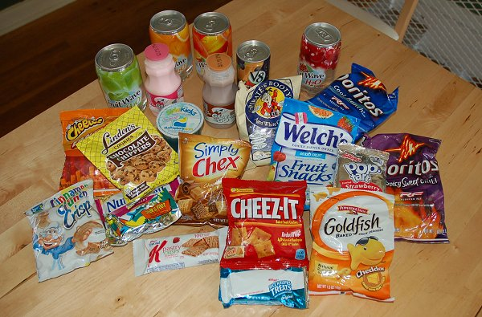
Competitive Foods
Proposed Rule comments closed 4/9/2013
Implementation of Final Rule
  One full school year after Final Rule Publication
    School year 2014-15 or 2015-16
No changes to Competitive Foods in 2013-14

Slide 64
SFSP and SBP Promotion
Schools must actively promote the Summer Food Service Program and the School Breakfast Program
Promotion can include websites, flyers, etc.
Contact NYSED to find SFSP sites near you
  Even if you’re not implementing SFSP in your district, you must still actively promote available programs in your communities

Slide 65
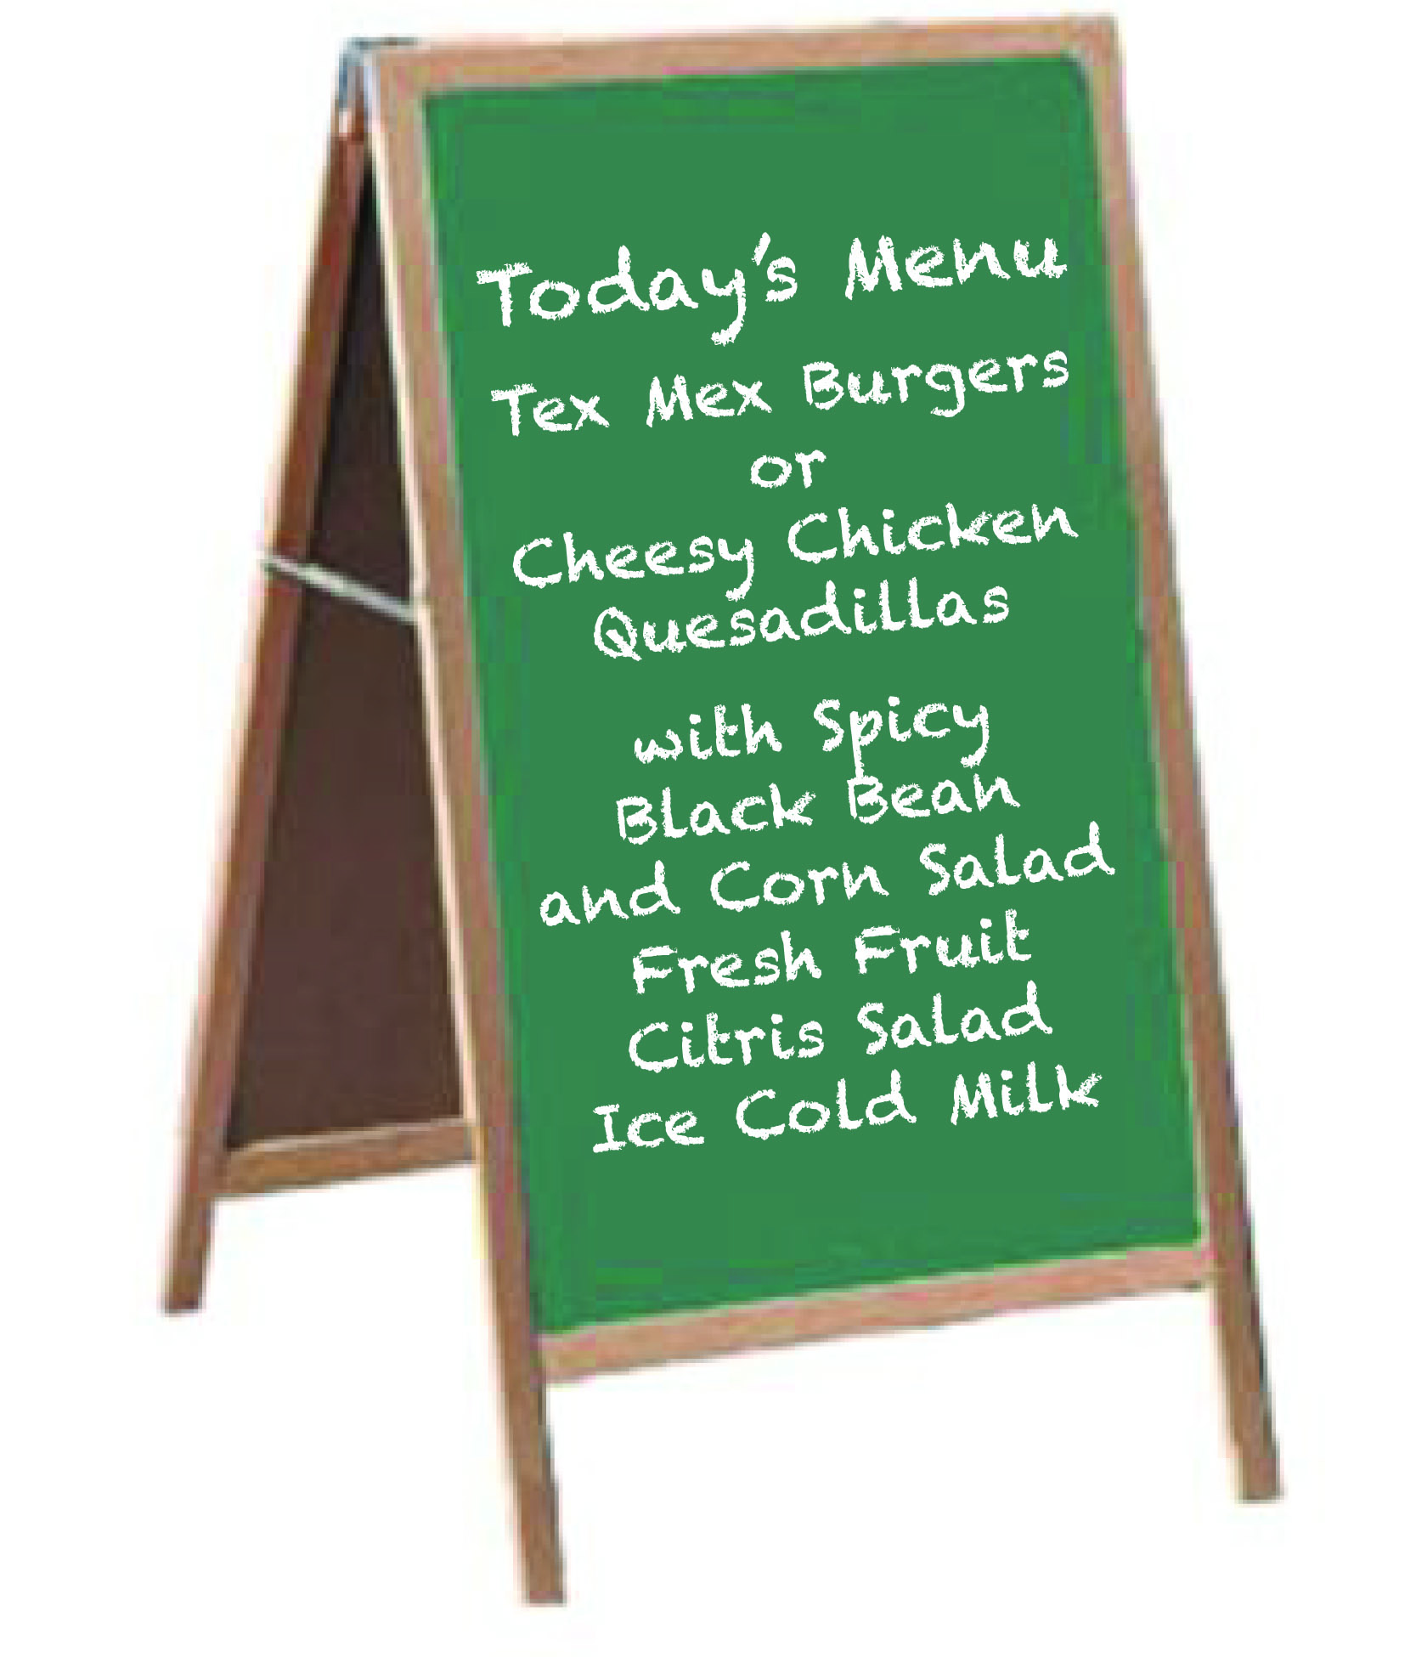
MEAL PROMOTION
Must advertise at the beginning of the line the meal offerings for Breakfast and Lunch each day
NYSED posters – Free!
  laminate and write-on each day
Contact Child Nutrition for
additional posters

Slide 66
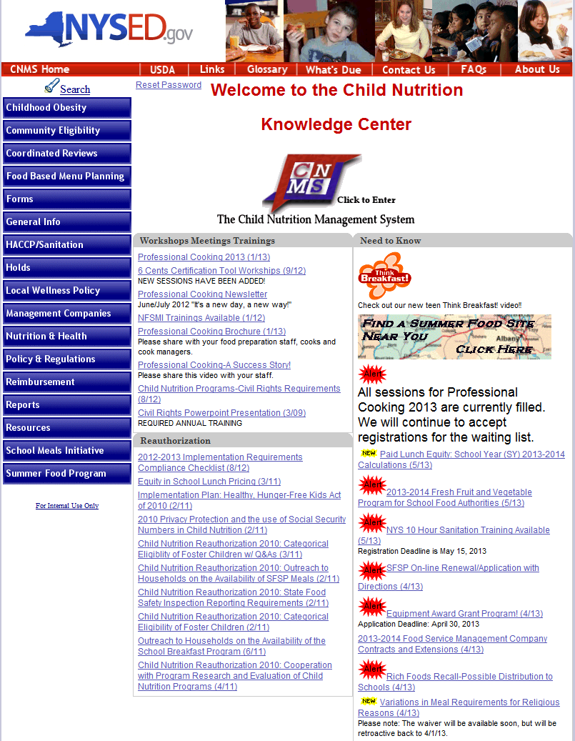

Slide 67
Child Nutrition Program Administration
99 Washington Avenue, Room 1623 OCP
Albany, NY 12234
(518) 473-8781
portal.nysed.gov

