Slide 1
WELCOME
NYSED Child Nutrition Program Administration
2016-2017 Food Service Management Company (FSMC) Contract and Extension Training

Slide 2
Professional Standards for State and Local Nutrition Program Personnel (Final Rule)
Effective July 1, 2015
This webinar will contribute up to 1.5 Training Hour toward the Professional Standards training requirements
Required to track the number of training hours earned each year and maintain documentation of the trainings attended
SED prototype tracking excel document for School Nutrition Directors
More information will be provided in upcoming SED webinars
USDA Learning Topic Code: 2460

Slide 3
Today’s Discussions
Overview of the Child Nutrition Programs
Regulatory Requirements
Pre-bid Process
Bidding Requirements
Administering FSMC Contracts
FSMC Extensions

Slide 4
Terminology
CPI-U—Consumer Price Index for Urban Consumers
FSMC—Food Service Management Company
HHKFA—Healthy Hunger Free Kids Act
IFB—Invitation for Bid
NYSED—New York State Education Department
RA—Recipient Agency
SFA—School Food Authority
USDA—United States Department of Agriculture

Slide 5
SFA Options to Operate Child Nutrition Programs
Becoming a Recipient Agency (RA)
BOCES Service
Food Service Management Company
Self Operated
Shared Manager
Vended Meals

Slide 6
Food Service Management Company
A commercial enterprise, public or nonprofit organization or individual that enters into a contract with a school food authority to run any aspect of the food service operation, whole or in part.

Slide 7
FSMC Operations in NYS
186 SFAs operate with FSMC
16% of NYS total SFAs
24% of Public SFAs

Slide 8
Breakfast Statistics
Breakfast 2013-2014
Breakfast 2014-2015
616,501 are served daily in NYS
2.6 million students with access to the program
23% Participation
79% are eligible for free
7% are eligible for reduced
14% are paid
624,884 are served daily in NYS
2.7 million students with access to the program
23% Participation
81% are eligible for free
6% are eligible for reduced
13% are paid

Slide 9
Lunch Statistics
Lunch 2013-2014
Lunch 2014-2015
1.6 million lunches are served daily in NY
3 million students have access to the program
54% Participation
66% are eligible for free
7% are eligible for reduced
27% are paid
1.6 million lunches are served daily in NY
3 million students have access to the program
52% Participation
66% are eligible for free
9% are eligible for reduced
25% are paid

Slide 10
Regulatory Authority
New York State General Municipal §Law 103
Advertisements
New York State Education Law §305.14a
Contract Terms
NYS Education Commissioner’s Regulations Part 114.2
Solicitation of Contracts
Federal regulations 7CFR Part 210.16
Regulation pertaining to operating with a FSMC

Slide 11
Invitation For Bid (IFB)
NYS regulations require IFB
IFB is the type of solicitation document used in competitive sealed bidding
Awarded to lowest responsive and responsible bidder
Formal method of procurement resulting in a fixed price contract
NYS no longer utilizes a maximum allowable cost contract

Slide 12
Fixed Price Contract
The price is fixed at the inception of the contract and is guaranteed for a specific period of time
Price is adjusted annually with the CPI-U
FSMC bills the SFA meals plus meal equivalent multiplied by contract price

Slide 13
Contract Duration
The contract is a one year contract with the option of 4 yearly extensions
The contract price has potential to increase based on the CPI-U

Slide 14
Memo/Prototype
Memo and Prototype Contracts available at www.nysed.gov/cn/cnms.htm
Prototype Contracts – required
Type II – Public and Non Public schools offering breakfast, lunch and/or snack (Per Meal Contract)
Type III – A La Carte or Special Milk Programs Only (annual or per meal management fee)
Type IV – Jails or RCCIs (per person per day or per person per meal)

Slide 15
Pre-Bid Development
Federal Regulation 7 CFR Part 210.16 requires that any amendments made by the SFA to the prototype contract must be approved by the State Agency prior to bidding

Slide 16
Pre-Bid Development
Provide bidders with enough information to submit an accurate and reasonable bid
Protect the financial and nutritional integrity of the SFA
Legal advice
Create a fair and equitable bidding process

Slide 17
Pre-Bid Development
SFA has the flexibility to set a quality bid specification
Set food and beverage procurements standards
Staffing requirements
Staffing levels by building
Experience
Education
Retain current staff
Develop 21 day menu that must be adhered to for the first 21 operating days
Foundation for future menus

Slide 18
Developing a 21 Day Menu
Information on meal pattern requirements can be found on Child Nutrition Knowledge Center
www.nysed.gov/cn/cnms.htm
NYSED staff can offer technical assistance in menu development
Regulations allow for the SFA to request the FSMC to submit 21 day menu with the Bid
Pros and Cons

Slide 19
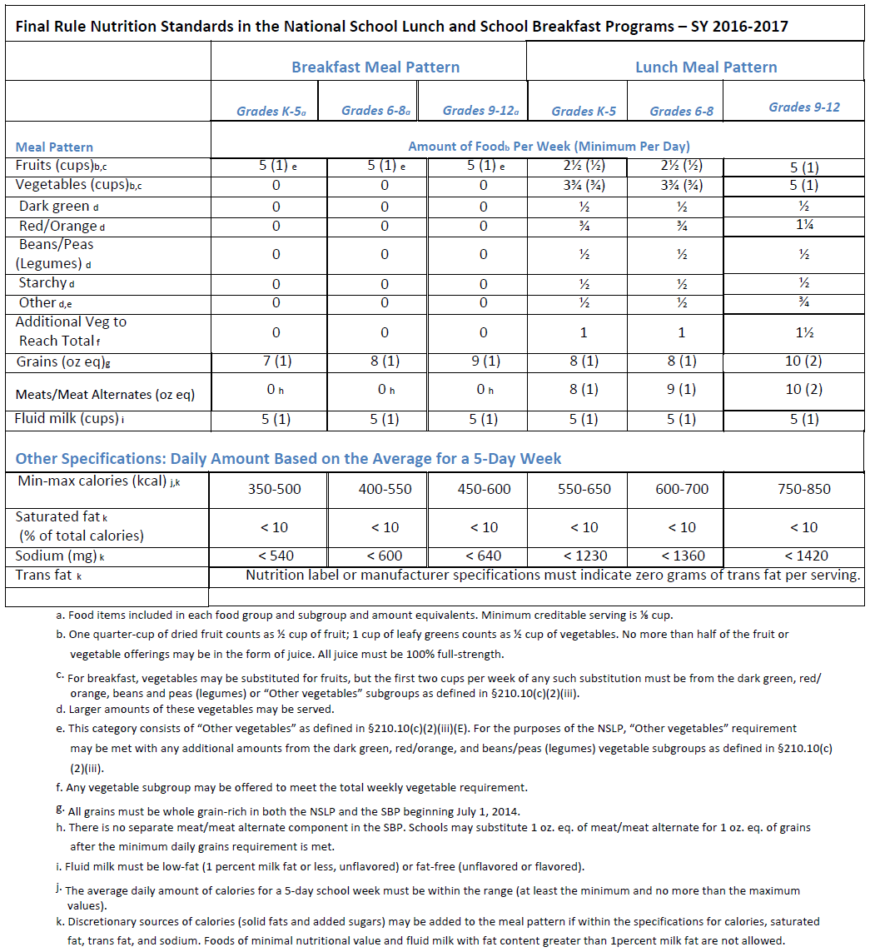

Slide 20
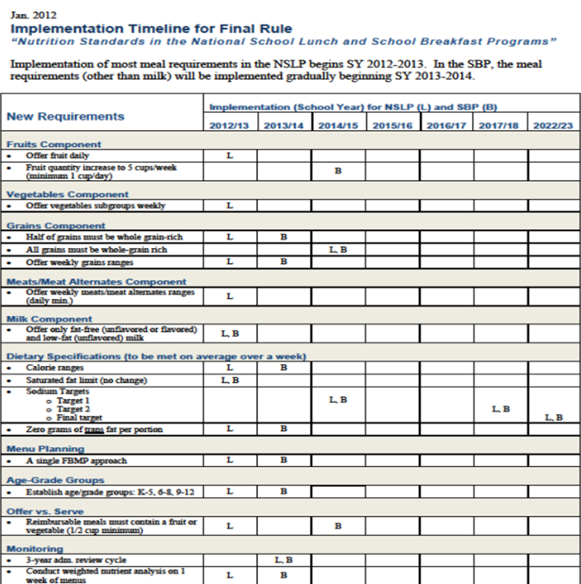

Slide 21
Pre-Bid Process
SFA completes the following information in the bid specification:
School Participation
Prices – by meal service, adults and a la carte
Insurance requirements
Performance security

Slide 22
Pre-Bid Process
Option 1 or 2
Bid option 1 – 1 bid price for breakfast and lunch
Bid option 2 – separate bid price for breakfast, lunch and snack
Options A, B or C
Option A – Guaranteed return to the SFA
Option B – Break Even
Option C – General Fund Subsidy

Slide 23
Schedules
Schedule A – Menus and related materials
Schedule B – Food, Beverage and Smallware Product Specifications
Schedule C – Local Wellness Policy
Schedule D – Cost Responsibility Detail Sheet
Schedule E – Itemized Inventory List
Schedule F – HACCP Based Food Safety Plan
Schedule G – Staffing Schedules and Related Information
Schedule H – Direct Diversion Receipt and/or WBSCM Requisition status report
Schedule I – Additional Schedules (calendar, map, forms)

Slide 24
Pre-Bid Process
Email completed pre-bid document to CN@nysed.gov
Include – updated prototype, all schedules, all amendments and all changes
Send in 30 days prior to letting bids
SFA will be notified via email once the pre-bid has been approved or if additional information or changes are needed

Slide 25
Questions?

Slide 26
Bidding Process
Advertise Bid
Must include time and place where bids will be received and publicly opened and read
At least 5 days shall elapse between first publication of advertisement and the date for opening and read
Sealed Bid
All bids submitted to the SFA must be sealed and cannot be opened until the specified time

Slide 27
Bidding Process
Awarded to the lowest responsive and responsible bidder
Board minutes must be submitted if the lowest bidder was not awarded
SFA must be able to demonstrate why they were not responsive or responsible

Slide 28
Type II Contract – Bid Option 2
To be completed by FSMC To Be completed To Be completed
by SFA by FSMC
Program | Management Fee | + | Direct Cost | = | Total per Meal | x | SFA Estimate of Meals & Equivalent Meals | = | Total SFA Cost
Breakfast |  | + |  | = |  | x |  | =
Lunch |  | + |  | = |  | x |  | =
Snack |  | + |  | = |  | x |  | =
GRAND TOTAL = ____________*
*Transfer this amount to either Option A, B or C selected by the SFA

Slide 29
Bid Approval
Once SFA awards the bid and receives board approval, the bid must be submitted to NYSED for final approval
Submit two copies of the completed bid package to NYSED
SFA will be contacted if information is missing
Mail the bid package to our office:
89 Washington Avenue
Room 375 EBA
Albany, NY 12234

Slide 30
Zero or Low Bid Amounts
Consistent with 7 CFR 210.16 (10) and NYS Education Law 305, the Commissioner is vested with the obligation of approving FSMC contracts that would thereby promote the best interest of the school district
Contracts containing a zero or extremely low management fee may not be in the best interest of the school district

Slide 31
Administering the Contract
SFA must provide oversight of the FSMC operations
Review and audit invoices
Ensure proper use of USDA Foods
Following established procurement standards
Staffing requirements are being met
Following the 21 day cycle menu – changes must be approved by SFA
All terms of the contract are adhered to

Slide 32
SFA Responsibilities
Establish an advisory board consisting of parents, students and staff to assist in menu planning
SFA retains control of the nonprofit school food service account
Conduct application, certification and verification procedures
Monthly claim for reimbursement
Conduct on-site visits
Establish internal controls

Slide 33
FSMC Responsibilities
Menus and meals served must meet program and bid specifications and requirements
Maintain accurate categorical point of service accountability counts/records
Train cashiers and staff
Submit monthly operating statement
Bill the SFA for number of meals plus equivalent meals multiplied by bid price

Slide 34
Conversion Factor
A la Carte Conversion
The manner in which the value a la carte food items sold is converted into meal equivalents
The meal equivalents are then billed to the SFA at current bid price
2016-2017 A la Carte Conversion Rate
$3.53
Changes annually

Slide 35
Federal Regulation 7 CFR Part 210.16
Make no payment for meals that:
Are spoiled or unwholesome at time of delivery
Do not meet meal pattern requirements
Do not otherwise meet the requirements of the contract

Slide 36
Record Retention
Invoices, bills and payroll records must be kept on file in the school district
All documentation to support meal service must be kept in the school district
Records must be kept for 3 years after the final payment has been made

Slide 37
Questions?

Slide 38
FSMC Contract Extension
Each contract can be extended annually for up to 4 years
Price may be increased up to the CPI-U percentage
Use the previous month before the ending month (Contract ends June 30th, use May CPI-U)

Slide 39
SFA Extension Objectives
The SFA is responsible for completing the extension
FSMC should not be completing the extension and just having the SFA sign it
The SFA must ensure the extension is complete and accurate before submitting to NYSED
NYSED is required to review and approve extensions

Slide 40
Extension Submission
Prototype Extension Form includes:
Checklist
Section 1 and 2 completed – pdf automatically calculates the increase based on CPI-U
Form 1 completed (HHFKA Amendment)
Debarment option A or B completed
Certificate of Lobbying

Slide 41
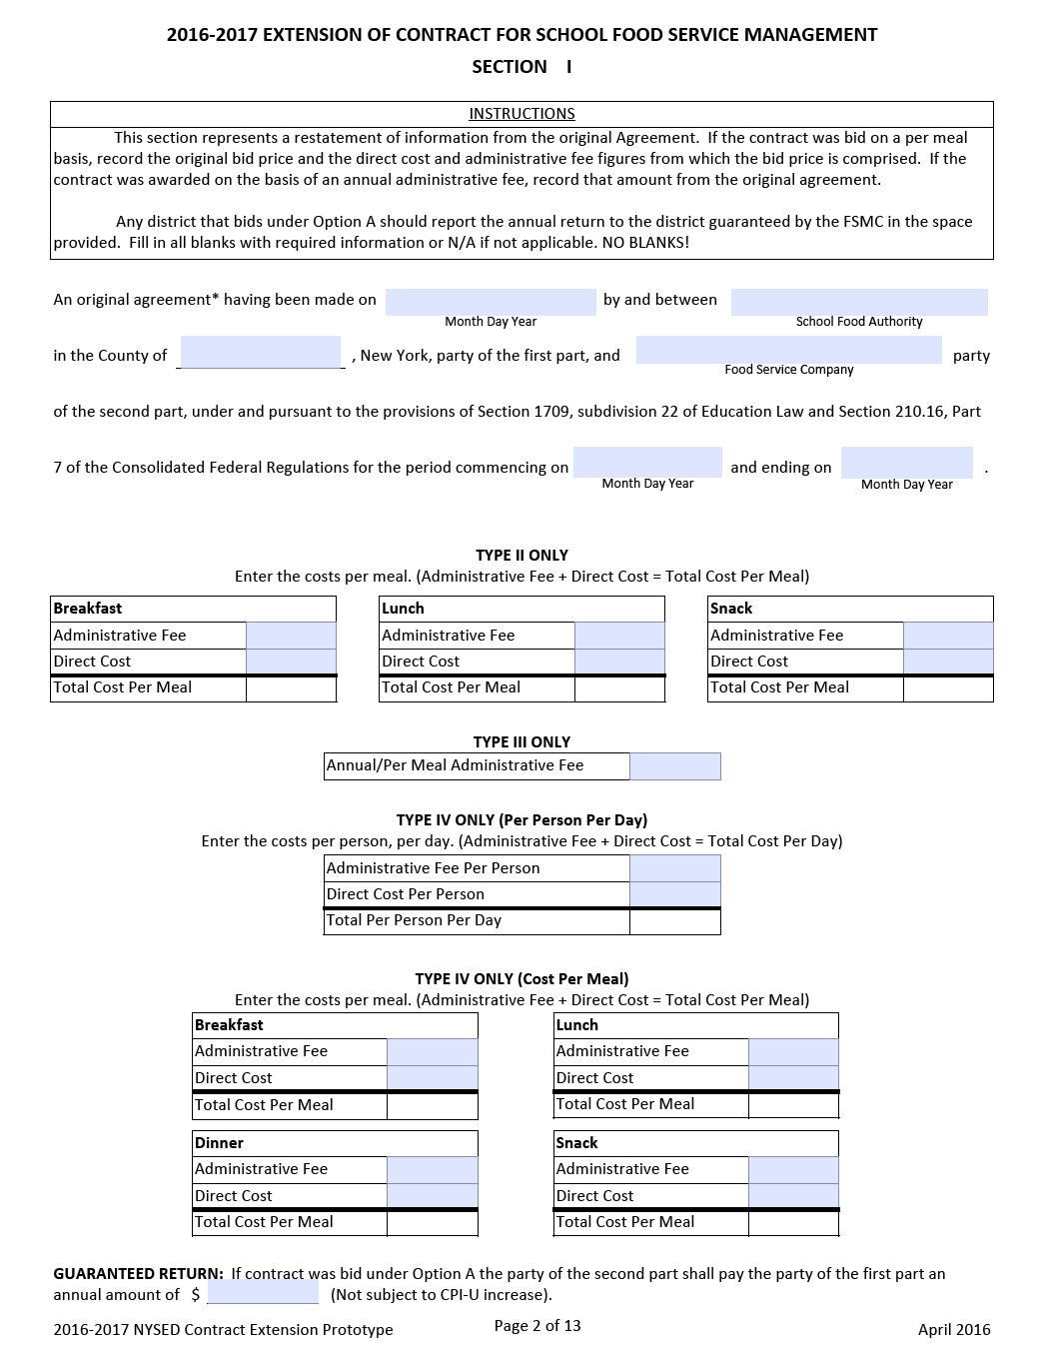

Slide 42
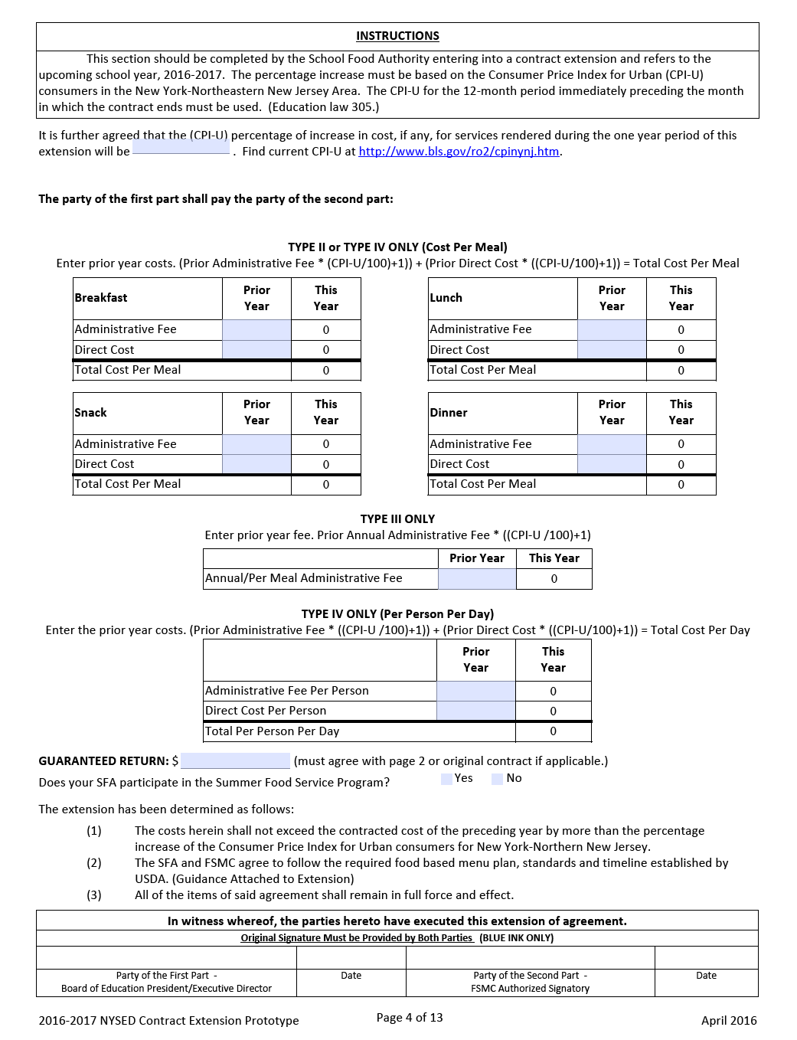

Slide 43
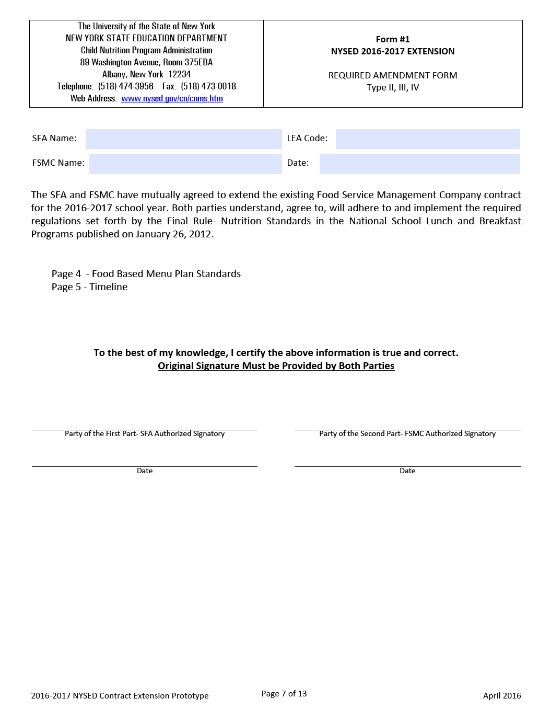

Slide 44
Questions
NYSED Child Nutrition Program Administration
(518) 473-8781
Jamie McMillian
Cheryl Nary

